Slide 1
Managing Sessions in PearsonAccess^{next}
For Computer-Based Testing
Notes:
Welcome to the Managing Sessions in PearsonAccess^{next} for Computer-Based Testing training slides.

Slide 2
How to use this PowerPoint
Additional information is included in the Notes section of most slides.
Some slides in this PowerPoint have videos. When this occurs, it will be mentioned in the Notes section.
When a video is available, please hover your cursor over the slide and select the Play button to view the video.
For slides with videos, please remember to read the Notes section for additional information.

Slide 3
Topics
Glossary
Session Resources
Prepare, Start, Unlock Sessions
Human Read-Aloud and Human Signer Sessions
Monitoring Student Testing Progress
Resuming Student Tests
Testing Out of Order
Mark a Test Complete
Resources
Notes:
In these training slides, we will provide an overview of the different tasks that a test coordinator or test administrator may need to perform when managing PearsonAccess^{next} Sessions for computer-based testing. These slides are not applicable for paper-based testing.

Slide 4
Glossary
PearsonAccess^{next}: The online management system used to register students, order test materials, and manage activities for computer-based testing.
Session: A group of students in PearsonAccess^{next} who will be testing at the same time (This is different from the actual “test session.”)
Student testing ticket: Contains the login details for students to access their assigned computer-based tests.
Student Test Status: shows the status of the students in the online testing process after testing has begun.

Slide 5
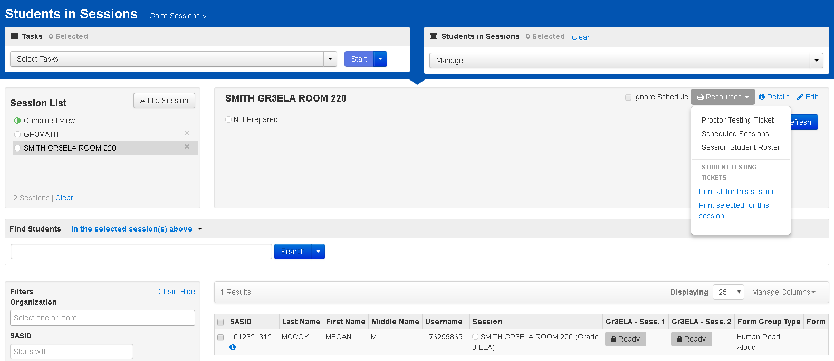
Session Resources
Notes:
A few days before testing, you should locate your Session Resources, including the student testing tickets and the Session Student Roster.
Select your Session(s) by going to Testing > Sessions and checking the box(es) next to the Session(s).
Click Go to Students in Sessions.
On this page, your resources can be found in the Resources dropdown, and can be accessed before or after the Session is prepared or started. When printing student testing tickets, you can print all tickets for the Session, or you can print only certain tickets by clicking the checkbox for the student(s) and selecting “Print selected for this session.”
If this is a Human Read-Aloud or Human Signer Session, the proctor testing ticket will be available in the Resources dropdown menu. The proctor testing ticket allows the test administrator to read or sign the test from their own device.

Slide 6
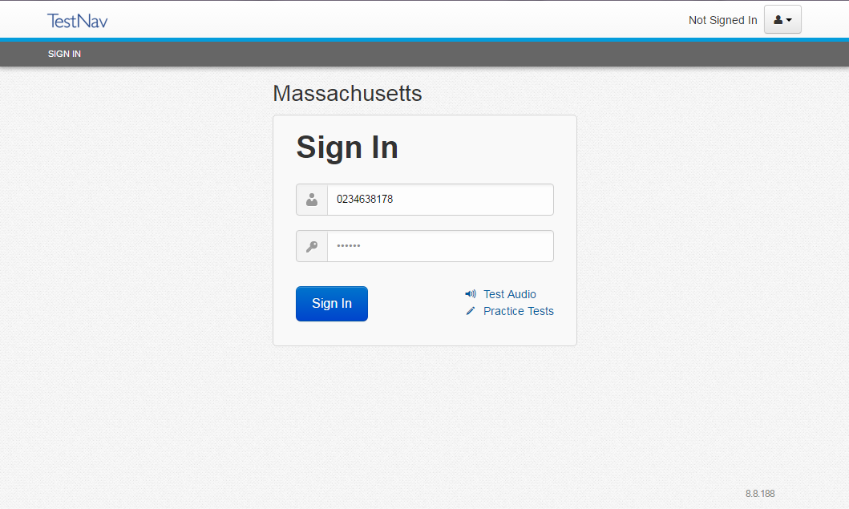
Session Resources
Notes:
The student testing ticket contains the information the student will need to log into TestNav and take the test. The testing ticket will be the same for the student for each test session in a content area test, unless the PearsonAccess^{next} (PAN) Session is changed.
In the same dropdown menu, PAN users can also access the Session Student Roster. The Session Student Roster lists all students in the Session as well as details that can be used for planning or tracking purposes, including usernames and passwords.

Slide 7
Prepare, Start, and Unlock Session
Prepare Session: Preparing the session will assign test forms.
Start Session: Start the session the day of testing.
Unlock Tests: Unlock the test so students may log into TestNav.
Notes:
To get a PearsonAccess^{next} Session ready, there are three steps that must be performed on the Students in Sessions page before students can begin testing.
Prepare Session: Preparing the Session will assign students the appropriate test forms that are listed in their Personal Needs Profiles. It is recommended to prepare the Session at least a day, but no more than two days, prior to testing, as it may take a few minutes for the system to assign the forms. Once the Session is prepared, any special forms such as text-to-speech, designated as TTS, will be displayed next to the student’s SASID.
Start PAN Session: Starting the Session should be done the day of testing. Once a Session is started, it cannot be stopped until all students are in Complete or Marked Complete status. If the Session was started early, the test will remain secure as long as the tests are locked and/or students do not have access to student testing tickets.
Unlock Session: Sessions should not be unlocked until just before testing. Once the Sessions are unlocked, students can log in if they have their student testing tickets. At the end of each test day, it is recommended that schools lock the test so that the tests remain secure. Tests can also be unlocked for individual students in the Session using the Student Test Status dropdown on the Students in Sessions page.

Slide 8
Human Read Aloud and Human Signer Sessions
Demonstration
Notes:
Please select the play button on the slide to view the video.
Students who are assigned the Human Read-Aloud or Human Signer test accommodations should have been placed in a separate PearsonAccess^{next} Session that is designated as either Human Read-Aloud or Human Signer. The Human Read Aloud or Human Signer Session ensures that all of the students in the group receive the same test form and that the test administrator will have a proctor testing ticket to read aloud or sign the test from their own device.
To verify the Human Read-Aloud or Human Signer Session was created, go to Testing and then Sessions. Select the appropriate Session(s) and then go to Select Tasks and click Create/Edit Sessions, and then click Start.
On the Create/Edit Sessions page, make sure the PearsonAccess^{next} Session is selected on the left-hand side of the screen. Ensure the Proctor Reads Aloud checkbox is checked and either the Human Read-Aloud or Human Signer is selected under the Form Group Type.

Slide 9
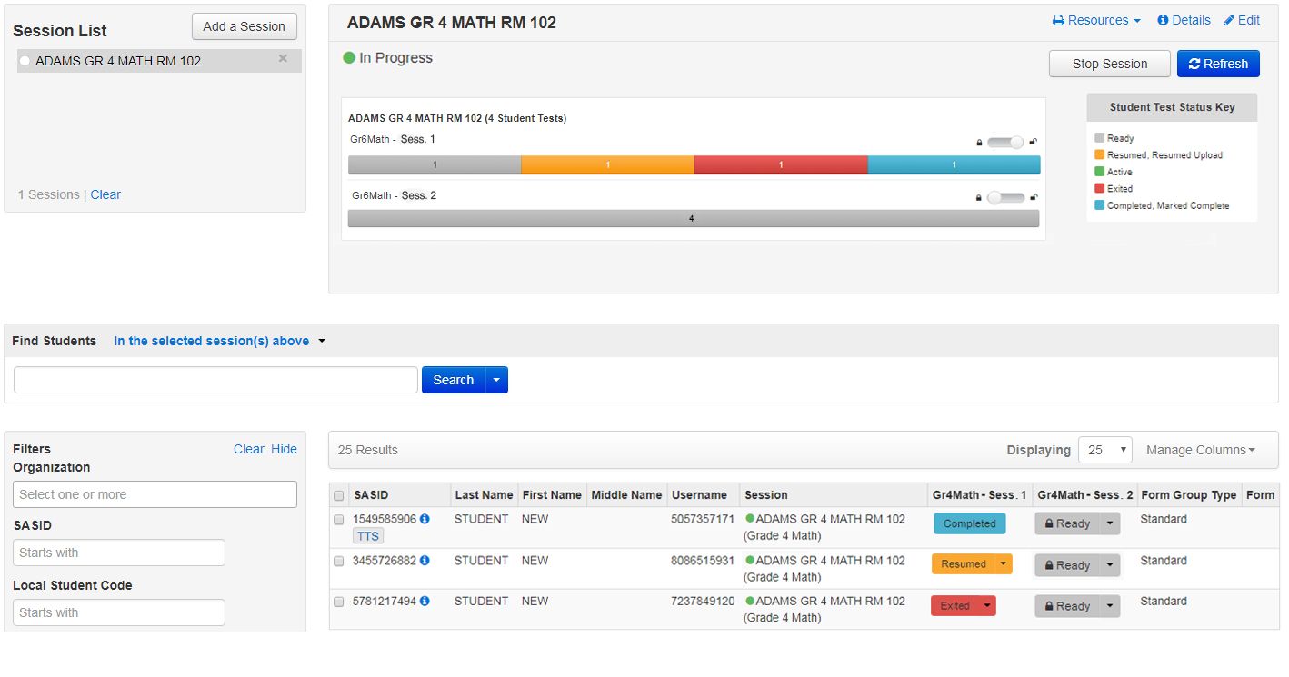
Monitor Student Testing Progress
https://support.assessment.pearson.com/x/JYDy
Notes:
Once students log into TestNav using their testing ticket, test coordinators and test administrators may monitor the progress of students. The Student Test Status will change individually for each student. The test status for each student is displayed in the Session window.
Ready (gray) status means that the student has not yet logged in.
Active (green) status means a student is logged into TestNav and actively testing.
Exited (red) status means the student is not currently testing and has not submitted final answers. Students could also be in exited status if they unintentionally exited during the test session. The test status will need to be changed to Resumed by the test administrator before the student can log back into the test and resume testing.
Resumed (yellow) status means the student had been authorized by the test administrator to resume the test but has not yet logged back into TestNav.
Resumed Upload (yellow) status means TestNav will attempt to locate a Student Response File (SRF). Resumed Upload status directs the user to browse for an SRF on the testing machine when the student signs back in to continue testing.
Completed (blue) status means the test session was submitted by the student through TestNav and the data has been processed.
Marked Complete (blue) status means the student is finished or otherwise will not continue the test session as scheduled. This status means that a test administrator marked the test session complete for the student since the student did not finish as expected.
For more information on each of these statuses, visit the PearsonAccess^{next} User Guide at the URL shown on your screen.

Slide 10
Mark Test Complete / Resume Test
Notes:
Please select the play button on the slide to view the video.
To mark a test complete, or to resume student tests, go to Testing > Students in Sessions. Be sure the Session name is selected in the Session List. At the bottom of the screen, check the box next to the name of each student. Then go to Select Tasks and select from the Student Test Statuses menu the action you would like to perform.
Note: Tests are completed when the student finishes a test session and submits their answers. Student tests are marked complete when a student has not finished the test session in the usual manner but will not return to finish the test. If students take Session 1 of a test but will not take Session 2 (or vice versa), Session 2 should be marked complete to indicate testing is complete for those students.
Also note that if students do not log out of TestNav properly as they complete each test session, or if there is a technical problem and the student is exited from TestNav, the test status will change to Exited. Before students can continue testing, the test administrator will need to Resume students using the Resume Student Tests task in the Student Test Statuses menu.

Slide 11
Testing Out of Sequence
Notes:
If a student needs to take Session 2 of a test before taking Session 1, the test can be set to start at Session 2 (note that Session 1 is the default). Testing out of sequence can be used if a student missed the first day of testing and will be taking Session 2 with the rest of the class, so that you can unlock the second test session for that student.
On the Students in Sessions page, locate the appropriate student(s) and unlock Session 2 of the test using the Student Test Status dropdown.
When finished, lock the test session the student already completed. When the student is ready to go back to Session 1, unlock Session 1 using the Student Test Status dropdown.

Slide 12
Resources
PearsonAccess^{next} User Guide: Retrieve Resources for an Online Test
PearsonAccess^{next} User Guide: Create a Session
PearsonAccess^{next} User Guide: Prepare a Session
PearsonAccess^{next} User Guide: Edit a Session
PearsonAccess^{next} User Guide: Add a Student to a Session
PearsonAccess^{next} User Guide: Move a Student Test Between Sessions
PearsonAccess^{next} User Guide: Unlock or Lock a Test
PearsonAccess^{next} User Guide: Monitor or Change Student Status
PearsonAccess^{next} User Role Matrix
Notes:
Here are the resources to help you with the process when you are managing PearsonAccess Next Sessions yourself.

Slide 13
Thank you.
Notes:
This concludes the Managing Sessions in PearsonAccess^{next} training slides. Thank you.

