Slide 1
Resolving Incorrect Accommodations During Testing
For Computer-Based Testing Only
Notes:
Welcome to the training slides for resolving an incorrect accommodation when the student is actively testing. These training slides describe the necessary steps to resolve an incorrect accommodation after a student has already begun testing.
These slides are not applicable for schools doing only paper-based testing.
This procedure applies only to the following accommodations that require a special accommodated CBT form:
Text-to-Speech
Human Read-Aloud or Human Signer (if a student is incorrectly assigned to a Human Read-Aloud/Human Signer PAN Session)
Assistive Technology
Screen Reader
American Sign Language
Spanish-English
For the Web Extension, Color Contrast, Alternate Cursor, Answer Masking, Calculator, and Spell-Checker accommodations and accessibility features; a student can log out of TestNav and the SR/PNP can be updated in the Manage Student Tests task by the test administrator. When the student logs back into TestNav, the accommodation or accessibility feature will be available.

Slide 2
How to use this PowerPoint
Additional information is included in the Notes section of most slides.
Some slides in this PowerPoint have videos. When this occurs, it will be mentioned in the Notes section.
  When a video is available, please hover your cursor over the slide and select the Play button to view the video.
  For slides with videos, please remember to read the Notes section for additional information.

Slide 3
Topics
Glossary
Overview
Mark Tests Complete
Void Tests
Resources
Notes:
We will cover the topics listed on this slide.
By the end of these slides, you will understand the steps needed to assign students the correct accommodation after they started testing. If students have not started testing yet, instead refer to the SR/PNP module for the steps to update a student’s SR/PNP.

Slide 4
Glossary
PearsonAccess^{next} (PAN): The online management system used to register students, order test materials, and manage activities for computer-based testing.
TestNav: The online testing platform that students use to take the computer-based MCAS assessments.
PAN Session: A group of students in PearsonAccess^{next} who will be testing at the same time. (This is different from the actual “test session.”)
Student Registration/Personal Needs Profile (SR/PNP): A collection of selected accessibility features and accommodations a student will need to take an MCAS test.

Slide 5
Overview
If one of the following incorrect accommodations is discovered after the student has started testing (text-to-speech, ASL, Spanish-English, screen reader, assistive technology, or if a student is incorrectly assigned to a Human Read-Aloud/Human Signer PAN Session), the test administrator should ask the student to exit the test using the User Icon on the top, right-hand side of the TestNav screen.
The test coordinator should Mark the Test Complete.
The test coordinator will need to void the test.
Once the test is marked void, the test coordinator can assign a new test to the student with the correct accommodation or feature selected on the Manage Student Tests Screen.
The test coordinator will create a new PearsonAccess Next Session and place the student in it.
The test administrator will prepare and start the new Session.
The student will log in to the test using a new testing ticket.
The principal or designee should follow instructions in the Principal’s Administration Manual on reporting the irregularity to the Department.
Notes:
If a student has begun testing and notifies the test administrator that they do not have the correct accommodation (for example, a student began testing without Text-to-Speech), these steps will need to be followed:
If one of the following incorrect accommodations (text-to-speech, ASL, Spanish-English, screen reader, assistive technology, or if a student is incorrectly assigned to a Human Read-Aloud/Human Signer PAN Session) is discovered after the student has started testing, the test administrator should ask the student to exit the test using the User Icon on the top, right-hand side of the TestNav screen.
The test coordinator should Mark the Test Complete.
The test coordinator will need to void the test.
Once the test is marked void, the test coordinator can assign a new test to the student with the correct accommodation or feature selected on the Manage Student Tests screen.
The test coordinator will create a new PearsonAccess Next Session and place the student in it.
The test administrator will prepare and start the new Session.
The student will log in to the test using a new testing ticket.
The principal or designee should follow instructions in the Principal’s Administration Manual on reporting the irregularity to the Department.

Slide 6
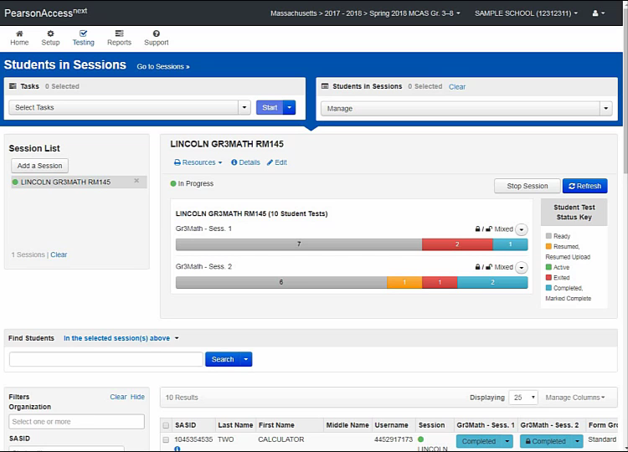
Mark Test Complete
Notes:
Please select the play button above to view the video.
The test coordinator will need to mark the first test complete (that is, the one with the incorrect accommodation). To mark the test complete, locate the student in the Students in Sessions screen and check the box next to the student’s SASID. Go to Select Tasks and check Mark Student Tests Complete. Check the box next to the student’s name. Provide the reason (i.e., student tested with incorrect accommodation), and then click Mark Complete. When finished, click Exit Tasks.

Slide 7
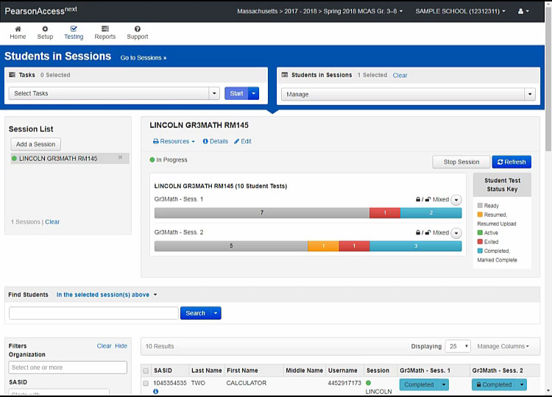
Void the Test
Notes:
Please select the play button above to view the video.
The test coordinator must then mark the first test for the student as void.
To void the test, stay on the Students in Sessions page. Check the box next to the student’s SASID if it is not already checked. Go to Select Tasks > Manage Student Tests and click Start.
Under the accommodations portion of this screen, there is a check box that says Void Test Score Code. Check that box and select the Wrong Accommodations option for the Void Test Score Reason in the dropdown menu below the checkbox. Click Save.

Slide 8
Resources
PearsonAccess^{next} User Guide: Mark Student Tests Complete
PearsonAccessnext User Guide: Manage Student Tests
Principal’s Administration Manual
  Select the Test Administration Manuals page for the appropriate administration
  Refer to Appendix A, Section C: Resolving Situations that Involve Accommodations

Slide 9
Thank you.
Thank you.
Notes:
This concludes the Resolving Incorrect Accommodations During Testing training slides. Thank you.

