Slide 1
Overview of the Next-Generation MCAS High School Biology and Introductory Physics Tests
The Office of Student Assessment Services November 4, 2019

Slide 2
Logistics for Webinar
Questions may be asked using the chat feature
  Questions will be answered aloud at the end of this presentation
  Questions with answers will also be emailed to participants
  Questions about a specific student should be sent to mcas@doe.mass.edu
This session is being recorded and will be available online in about one week at:
  MCAS Resource Center ― mcas.pearsonsupport.com/training
    In the section entitled “Training Sessions Previously Offered This School Year”

Slide 3
DESE Staff
Jodie Zalk, Test Administration Coordinator
Katie Bowler, Director of Test Development
Isadel Eddy, Science Test Coordinator/Physics Test Developer
Steve Long, Biology Test Developer
Erin Hashimoto-Martell, Director of STEM
Alicia Wedderburn, Science Content Support Specialist

Slide 4
1
Transition and Participation Requirements
2
Achievement Level Descriptors
3
New Test Design
CONTENTS
4
New Item Types
5
Resources and Questions

Slide 5
MCAS High School STE Tests June 2020
Next Generation Biology and Introductory Physics
First administration of Next-Gen test for Class of 2023 (Grade 9)
Based on 2016 standards
Computer-based with new test design, paper-based test as an accommodation
Standard setting in summer 2020; graduation requirement will be similar to legacy tests for 2 years (same as math and ELA)
Legacy Biology and Introductory Physics
Only for Grades 10+ (Class of 2022 and before)
Based on “overlapping” standards from 2006 and 2016 Frameworks (see link)
Paper-based only

Slide 6
MCAS High School STE Tests June 2020
Legacy Chemistry and Technology/Engineering
Offered to students in grades 9–12
Based on 2006 standards
Paper-based only
Continue to recommend phasing out of these 2 tests

Slide 7
MCAS High School STE Tests 2021 (Expected)
Biology and Introductory Physics
Next-Gen tests offered in February and June 2021
Legacy, paper-based test available for re-testers (Class of 2022 and prior)
Chemistry and Technology/Engineering
Legacy, paper-based tests
Based on 2006 standards
Offered only to re-testers (Class of 2022 and prior)

Slide 8
MCAS Next Generation Achievement Levels
Exceeding Expectations
A student who performed at this level exceeded grade-level expectations by demonstrating mastery of the subject matter.
Meeting Expectations
A student who performed at this level met grade-level expectations and is academically on track to succeed in the current grade in this subject.
Partially Meeting Expectations
A student who performed at this level partially met grade-level expectations in this subject. The school, in consultation with the student's parent/guardian, should consider whether the student needs additional academic assistance to succeed in this subject.
Not Meeting Expectations
A student who performed at this level did not meet grade-level expectations in this subject. The school, in consultation with the student's parent/guardian, should determine the coordinated academic assistance and/or additional instruction the student needs to succeed in this subject.

Slide 9
Next-Gen Reporting Categories
Biology Reporting Categories +/-5%
Molecules to Organisms | 35%
Heredity | 25%
Evolution | 20%
Ecology | 20%
Introductory Physics Reporting Categories +/-5%
Motion, Forces & Electromagnetism | 50%
Energy | 30%
Waves | 20%

Slide 10
Reporting on Science Practices in Next-Gen MCAS STE
At least 50% of items will be dual-coded to one of three practice groups:
Practices will be reported out, but as one category.
Investigations and Questioning
Mathematics and Data
Evidence, Reasoning, and Modeling
Notes:
Investigations & Questioning
Asking questions and defining problems
Planning and carrying out investigations
Mathematics & Data Analysis
Using mathematics and computational thinking
Analyzing and interpreting data
Evidence, Reasoning, & Modeling
Developing and using models
Constructing explanations and designing solutions
Engaging in argument from evidence
Obtaining, evaluating, and communicating information

Slide 11
Next-Gen MCAS High School Science Items
Item Type | Number of Items | Number of Points
Selected Response, 1 pt. | 26 | 26
Selected Response, 2 pts. | 3 | 6
Constructed Response, 4 pts. | 3 | 12
Module | 2 (3-5 SR-1 pt., 0-1 SR-2 pt., 1 CR-3 pt.) | 16
Total | 42-44 | 60
Similar timing and number of points to legacy tests

Slide 12
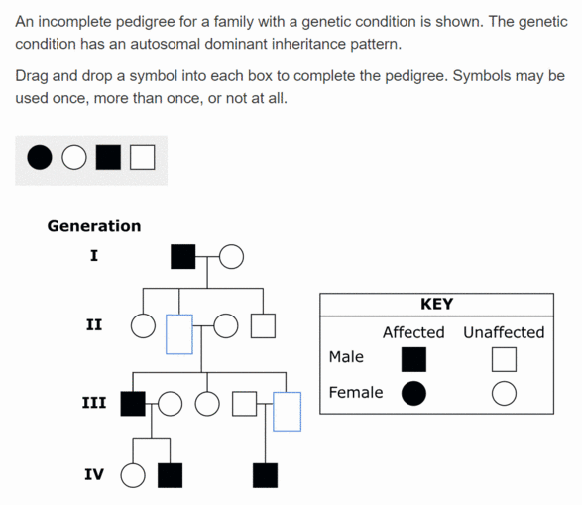
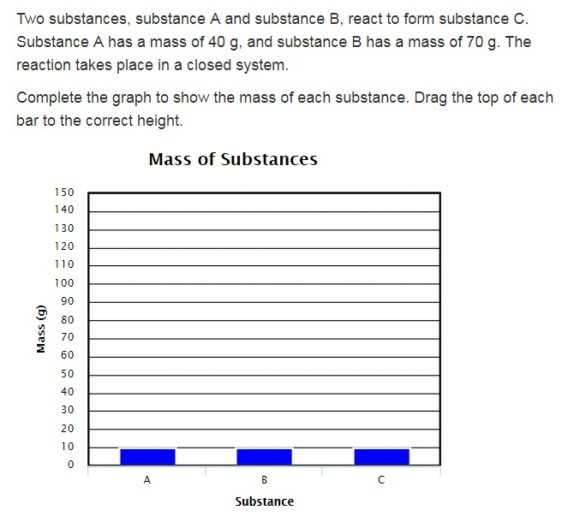
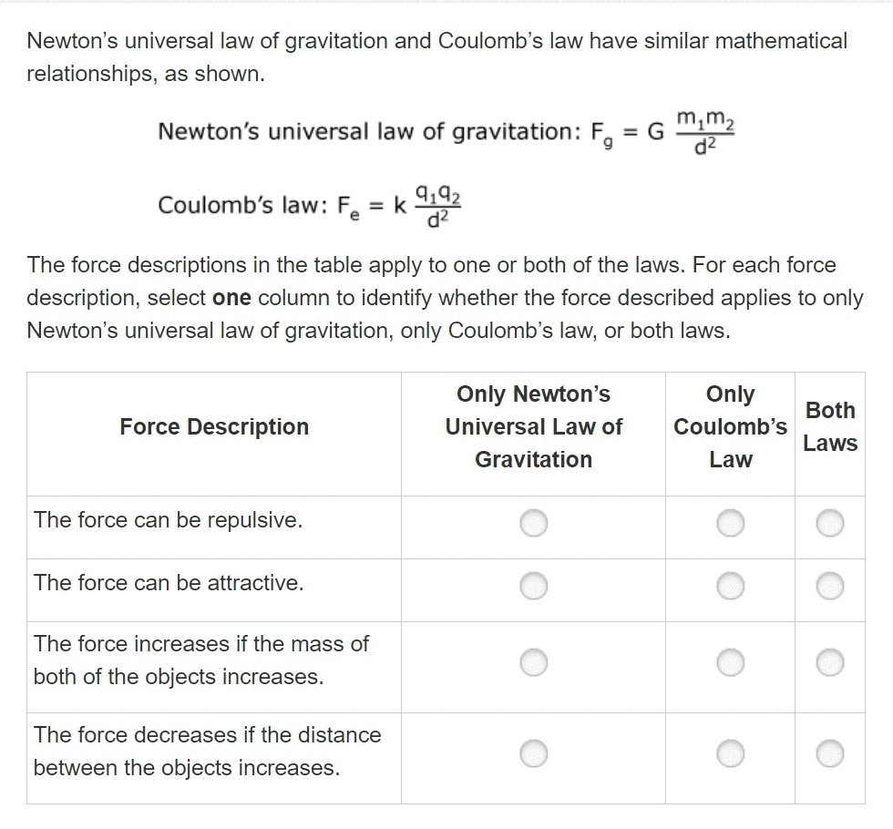
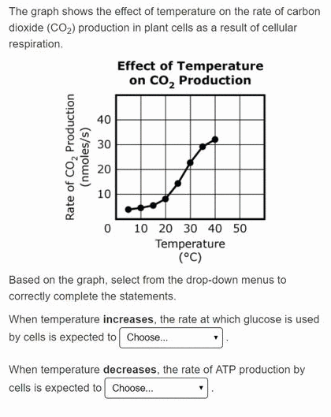
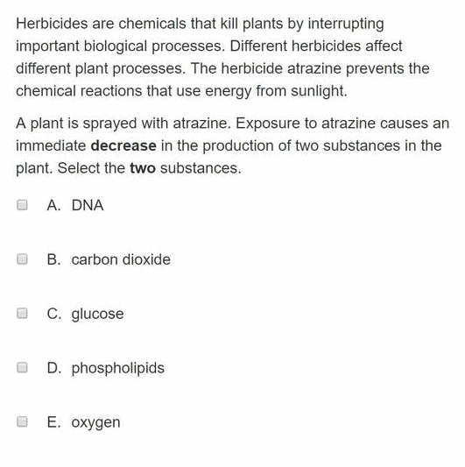
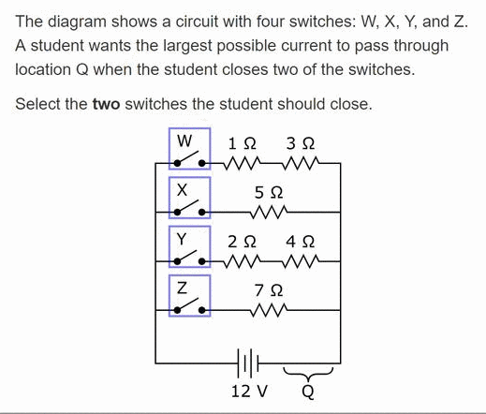
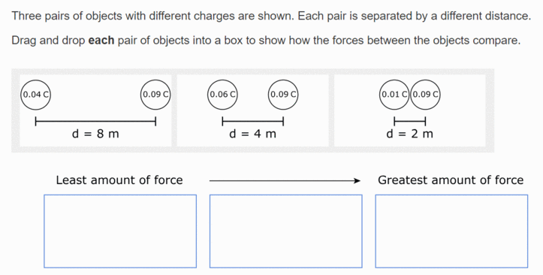
High School Technology-Enhanced Item Types
Drag and Drop
  Complete Models
  Rank Options
Hot Spots
Inline Choice
Multiple Select
Table
Graphs (5th Grade ex.)

Slide 13
2020 Standard Setting
High School Biology and Introductory Physics teachers needed
3–4 days mid-August 2020
Approximately 20 educators for each panel
Great professional development opportunity
Application will be posted to MCAS Headlines in spring 2020

Slide 14
High School STE MCAS Resources
Resources
Science Test Designs
Practice Tests and Blank Constructed-Response Boxes, including Equation Editor
STE MCAS Transition Information
Introductory Physics Reference Sheet (first used in 2019)
Released Items and Student Work

Slide 15
Additional Resources on the DESE MCAS website
Resource | Description
Home page | Access MCAS headlines and links to MCAS site (e.g., test schedule, test designs, training)
Student Assessment Updates | Biweekly email with important updates about the MCAS program Subscribe by emailing imailsrv@list1.doe.mass.edu with the following information in the body of the email: "subscribe SASUpdate Your_Name" (Example: subscribe SASUpdate John_Smith).
Participation Guidelines | Guidelines for MCAS participation
Training Resources | Recording of this session and online training modules
MCAS Trainings | Schedule of MCAS trainings and registration links
MCAS Accessibility | MCAS Accessibility and Accommodations Manual
Resources for Digital Learning | Resources on acquiring technology, digital citizenship, and online courses may be particularly helpful for schools new to CBT

Slide 16
Questions?
Please use the chat function to ask questions.
Questions with answers will be emailed to participants.
If you have follow up questions or comments, please email mcas@doe.mass.edu.

Slide 17
Email and Phone Support
MCAS Service Center
DESE Office of Student Assessment Services
All questions on logistics and technology (e.g., PearsonAccess Next, SR/PNP, TestNav)
  Web: mcas.pearsonsupport.com/
  Email: mcas@measuredprogress.org
  Phone: 800-737-5103
All policy questions (e.g., student participation, accommodations)
  Web: www.doe.mass.edu/mcas
  Email: mcas@doe.mass.edu
  Phone: 781-338-3625

