Slide 1
Resolving Incorrect
Form-Dependent
Accommodations During Testing
For Computer-Based Testing Only
Notes:
These training slides describe the necessary steps to resolve an incorrect accommodation after a student has already begun testing.
These slides are not applicable for schools doing only paper-based testing.
This procedure applies only to the following form-dependent accommodations that require a special accommodated computer-based testing (CBT) form:
Text-to-Speech
Human Read-Aloud or Human Signer (if a student is incorrectly assigned to a Human Read-Aloud/Human Signer PAN Session)
Compatible (External) Assistive Technology
Screen Reader
American Sign Language
Spanish/English
For the Web Extensions, Enlarged Cursor, Calculator, and Spell-Checker accommodations and accessibility features: a student can log out of TestNav and the SR/PNP can be updated in the Manage Student Tests task by the test administrator. When the student logs back in to TestNav, the accommodation or accessibility feature will be available.

Slide 2
How to use this PowerPoint
Additional information is included in the Notes section of most slides.
Some slides in this PowerPoint have videos. When this occurs, it will be mentioned in the Notes section.
  When a video is available, please hover your cursor over the slide and select the Play button to view the video.
  For slides with videos, please remember to read the Notes section for additional information.

Slide 3
Topics
Glossary
Overview
Mark Tests Complete
Void Tests
Resources
Notes:
We will cover the topics listed on this slide.
If you need to resolve incorrect accommodations for students who have not started testing yet, instead refer to the SR/PNP module for the steps to update a student’s SR/PNP. http://mcas.pearsonsupport.com/training/

Slide 4
Glossary
PearsonAccess^{next} (PAN): The online management system. All schools will use PAN to register students and order test materials. PAN is also used to manage testing activities for computer-based testing.
TestNav: The online testing platform that students use to take the computer-based MCAS assessments.
PAN Session: A group of students in PearsonAccess^{next} assigned the same subject and grade computer-based test who will take a test at the same time and in the same testing location.
Student Registration/Personal Needs Profile (SR/PNP): Student information needed to register a student for a test and assign selected accessibility features and accommodations a student needs to take a test.

Slide 5
Overview
If one of the following incorrect accommodations is discovered after the student has started testing (text-to-speech, ASL, Spanish-English, screen reader, compatible (external) assistive technology, or if a student is incorrectly assigned to a Human Read-Aloud/Human Signer PAN Session), follow these steps:
The test administrator should ask the student to exit the test using the User Icon on the top, right-hand side of the TestNav screen.
The test coordinator should Mark the Test Complete.
The test coordinator will need to void the test.(https://support.assessment.pearson.com/PAsup/setup/manage-students/update-pnp-settings) (URL:

Slide 6
Overview (cont’d)
Once the test is marked void, the test coordinator can assign a new test to the student with the correct accommodation or feature selected on the Manage Student Tests screen.
The test coordinator will create a new PAN Session and place the student in it.assessment.pearson.com/x/KoDy)
The test administrator will prepare and start the new Session.
The student will log in to the test using a new testing ticket.
The principal or designee should follow instructions in the Principal’s Administration Manual on reporting the irregularity to the Department.

Slide 7
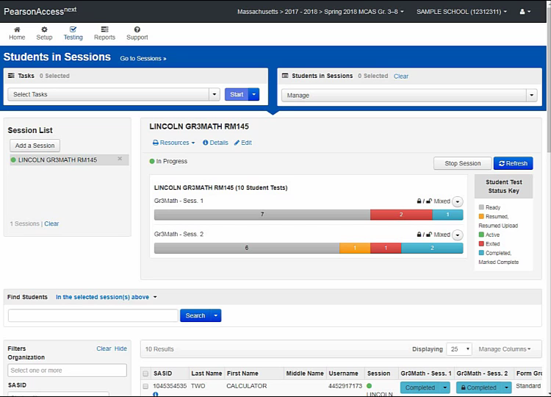
Mark Test Complete
Notes:
Please select the play button above to view the video.
The test coordinator will need to mark the first test complete (that is, the one with the incorrect accommodation). To mark the test complete, locate the student in the Students in Sessions screen and check the box next to the student’s SASID. Go to Select Tasks and check Mark Student Tests Complete. Check the box next to the student’s name. Provide the reason (i.e., student tested with incorrect accommodation), and then click Mark Complete. When finished, click Exit Tasks.

Slide 8
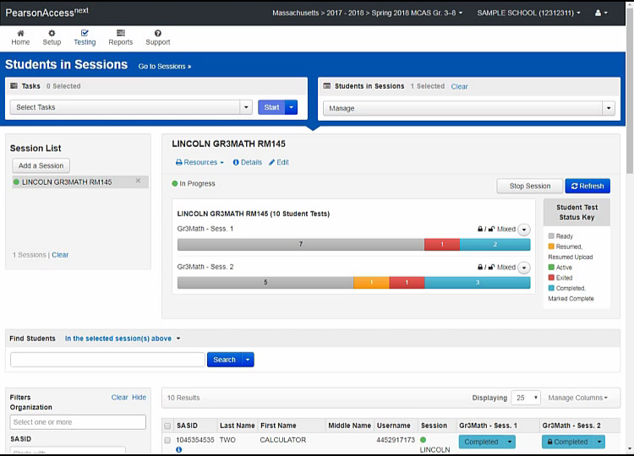
Void the Test
Notes:
Please select the play button above to view the video.
The test coordinator must then mark the first test for the student as void.
To void the test, stay on the Students in Sessions page. Check the box next to the student’s SASID if it is not already checked. Go to Select Tasks > Manage Student Tests and click Start.
Under the accommodations portion of this screen, there is a check box that says Void Test Score Code. Check that box and select the Wrong Accommodations option for the Void Test Score Reason in the drop-down menu below the checkbox. Click Save.

Slide 9
Resources
PearsonAccess^{next} User Guide: Mark Student Tests Complete (https://support.assessment.pearson.com/x/igQHAQ)
PearsonAccessnext User Guide: Manage Student Tests (https://support.assessment.pearson.com/PAsup/testing/manage-student-tests)
Principal’s Administration Manual (https://www.doe.mass.edu/mcas/admin.html)
  Select the Test Administration Manuals page for the appropriate administration
  Refer to Appendix A, Section D: Resolving Situations that Involve Accommodations
  Slide Resource URL Links:
  Mark Student Tests Complete:
    URL: https://support.assessment.pearson.com/x/igQHAQ
  Manage Student Tests:
    URL: https://support.assessment.pearson.com/PAsup/testing/manage-student-tests
  MCAS Test Administration Resources:
    URL: https://www.doe.mass.edu/mcas/admin.html

Slide 10
Thank you.
Thank you.
Notes:
This concludes the Resolving Incorrect Accommodations During Testing training slides. Thank you.

