Slide 1
MCAS Accessibility and Accommodations For New and Returning Staff
The Office of Student Assessment Services
February 1, 2024

Slide 2
Presenters
Robert Pelychaty, Manager of Inclusive Assessment
Shannon Cullen, Test Administration Coordinator
Holly Woodruff, Pearson Customer Support

Slide 3
Logistics for This Session
Use the Q&A feature to ask a question.
Some questions may be covered during the course of the presentation.
We will answer some questions at the end of this session.
After the session, we will email questions and answers to participants.
Email questions about individual records or specific questions about your school/district to mcas@doe.mass.edu instead of asking here.
Use the thumbs-up icon to “upvote” someone else’s question.
This session is being recorded and will be available in about a week in the MCAS Resource Center, along with the slides.
Slides were also emailed out beforehand and are being posted in the chat.
Click the “CC” to enable closed captioning (if needed).

Slide 4
Slides for This Session
Slides were emailed to participants before this session from MCASEvents@cognia.org.
Slides are now being posted in the chat.
If you cannot access the slides in the chat, ask in the Q&A.
After the session, we will send the slides again to participants, and they will be posted in the MCAS Resource Center along with the recording.

Slide 5
Today’s Agenda
Accessibility and Accommodations Overview
Participation Requirements and Guidelines
Accessibility Features and Accommodations
Accessibility and Accommodations Related to the Student Registration/Personal Needs Profile
Preparation for Testing
Resources, Support, and Next Steps

Slide 6
1. Accessibility and Accommodations Overview

Slide 7
Commonly Used Acronyms
CBT: Computer-based testing
PBT: Paper-based testing
PAN: PearsonAccess Next
SR/PNP: Student Registration/Personal Needs Profile
EL: English learner
ELA: English Language Arts
STE: Science and Technology/Engineering
SIMS: Student Information Management System

Slide 8
Commonly Used Acronyms related to Accommodations
ASL: American Sign Language
WebEx: Web Extension
STT: Speech-to-Text (electronic dictation)
TTS: Text-to-Speech (electronic read aloud)
AT: Compatible Assistive Technology
SR: Screen Reader

Slide 9
Poll Question
What is your role in providing or managing accessibility features or MCAS test accommodations in your school?
Principal or MCAS test coordinator
MCAS test administrator
Special education administrator or supervisor
Other role in my school or district

Slide 10
Poll Question 2
How many times have you provided or managed accessibility features or accommodations for MCAS testing?
Zero – I have never provided/managed MCAS accessibility features or accommodations
1–2 times
3–5 times
6+ times

Slide 11
New for 2023–24:
Color contrast and answer masking are no longer required in the SR/PNP.
All students will have access to these accessibility features in TestNav.
Review Appendix A: PAN Guidance for Form-Dependent Accommodations of the Guide to the SR/PNP Process before assigning accommodations.
Anyone who signs in to TestNav with a proctor testing ticket for a human read-aloud or human signer edition will see a prompt onscreen asking to verify whether they are a student or test administrator.
Designed to prevent students from entering responses with proctor testing ticket
Text-to-speech for Grade 8 Civics Field Test will appear differently than text-to-speech for other subjects (see Civics accommodated practice tests).

Slide 12
Resources for Accessibility and Accommodations on the DESE Website
www.doe.mass.edu/mcas/accessibility/
Forms and resources related to accommodations for
students with disabilities
ELs
Graphic Organizers, Checklists, and Supplemental Reference Sheets for Use by Students with Disabilities
Only for use by students with disabilities who have accommodation A9 listed in their IEP or 504 plan.

Slide 13
Accessibility and Accommodations Manual for the 2023–24 MCAS
Accessibility Features for All Students
MCAS Participation Requirements and Accommodations for Students with Disabilities and English Learners
(new) Appendix A: Decision-Making Tool for MCAS Participation by Students with Disabilities
Appendix B: Procedures for Scribing and Transcribing Student Responses
Appendix C: Procedures for Providing the Human Read-Aloud
(new) Appendix D: Guidelines for Using Assistive Technology as an MCAS Test Accommodation
(new) Appendix E: MCAS and ACCESS for ELLs Accessibility Features and Accommodations at a Glance

Slide 14
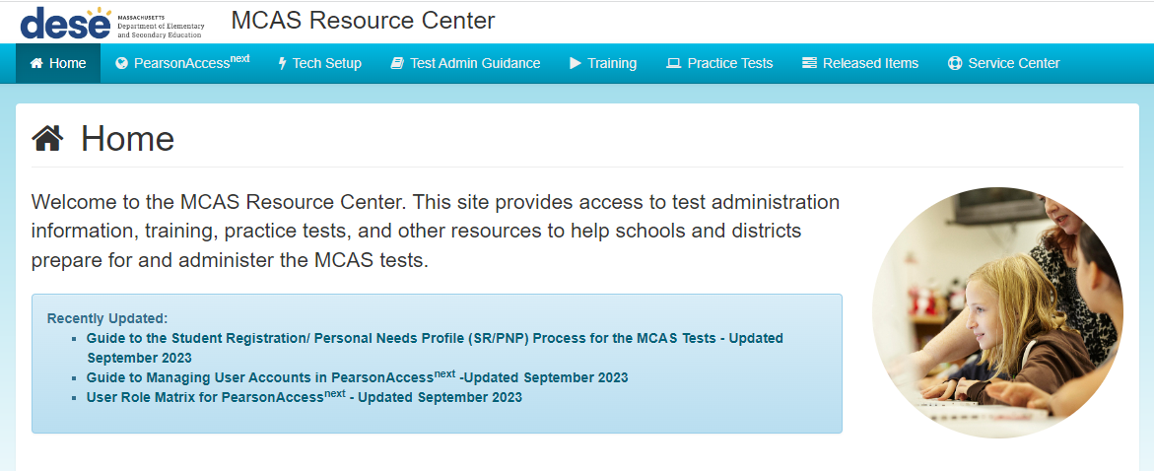
Resources for Accessibility and Accommodations on the MCAS Resource Center
http://mcas.pearsonsupport.com/
Training module on accessibility and accommodations
Recording of training session - PAN Tasks for Accessibility/Accommodations - March 3, 2023
Register for the 2024 PAN Tasks for Accessibility and Accommodations training –
February 29, 2024

Slide 15
2. Participation Requirements and Guidelines

Slide 16
MCAS Participation Requirements
All publicly-funded students must participate in MCAS tests required for their grade.
Includes students in public schools, charter schools, virtual schools, out-of-district placements, SEIS, DYS, and other students receiving instruction with public funds.
All eligible students and former students have the right to participate in high school tests and retests.

Slide 17
Participation Guidelines for Students with Disabilities
Option 1 | The student participates in standard MCAS testing under routine testing conditions with or without accessibility features.
Option 2 | The student participates in standard MCAS testing using necessary accessibility features and accommodations to demonstrate knowledge and skills. IEP teams determine accommodations and/or alternate assessments for students with disabilities. IEPs and 504 plans must list assessment decisions.
Option 3 | The student meets the definition of “students with the most significant cognitive disabilities” and participates in the MCAS-Alt.
Universal Accessibility Features (UFs): Tools and supports that are available to all students, either on the computer-based tests or their paper-based equivalents; some may need to be requested prior to testing via the SR/PNP.
Designated Accessibility Features (DFs): Flexible test administration procedures that may be used with any student at the discretion of the principal or test coordinator.
Accommodations (As): Specific supports available only to students with disabilities and ELs as detailed in a student’s IEP or 504 plan.
Special Access Accommodations (SAs): May be provided to students who meet certain guidelines and criteria.

Slide 18
IEP Team Decisions Needed Before Testing
Team members should review all accessibility and accommodations policies.
Important decisions required for each student with (and without) a disability taking spring test(s):
Which accessibility features and accommodations will be needed?
All students are eligible for accessibility features.
For students with disabilities:
Before testing and making decisions, give opportunity to take practice tests.
If read-aloud is needed, use text-to-speech (TTS) or human read-aloud. Schools may list “text-to-speech is preferable, but human reader is acceptable.”
Paper-based tests are available but must be listed as an accommodation in IEP or 504 plan for students unable to take computer-based tests.

Slide 19
Criteria for Providing Special Access Accommodations
Special access accommodations may be provided only to a limited number of students who:
Demonstrated significant deficits in reading, calculating, writing, or spelling; AND
receive ongoing intervention for these skills.
Special access accommodations may not be provided if student is simply performing “below grade level.”
Scores may be invalidated if ineligible students are provided special access accommodations .
Use of special access accommodations is reported with a notation on
Parent/Guardian Reports
School and District Rosters

Slide 20
Read-Aloud or Text-to-Speech for ELA Special Access Accommodation
This accommodation is intended for a small number of students with disabilities that severely limit or prevent them from reading, as documented in locally administered diagnostic evaluations. To receive the text-to-speech or human read-aloud accommodation for ELA tests, the student must meet all of the following criteria:
be virtually unable to read, even after varied and repeated attempts to teach the student to do so (i.e., the student is at the beginning stages of learning to read, and not simply reading below grade level), as determined by locally administered diagnostic evaluations (reading below the second grade-level)
receive ongoing intervention to learn the skill of reading
use this accommodation routinely (except during instruction in learning to read)

Slide 21
Participation Guidelines for English Learners
ELs are required to participate in all MCAS tests scheduled for their grade, with one exception:
First-year ELs are not required to take the spring MCAS ELA test but may participate at principal’s discretion.
EL accommodations: School staff familiar with the student should meet and
Review available accessibility features and accommodations for ELs;
Consider EL students’ language needs, learning characteristics, and preferences.
A sample form to document EL accommodations is provided on the DESE website.

Slide 22
3. Accessibility Features and Accommodations

Slide 23
How to View Accessibility Features and Accommodations
View the student practice tests and tutorial at http://mcas.pearsonsupport.com/student/
Descriptions of all accessibility features and accommodations in the Accessibility and Accommodations Manual
Accessibility features: pages 5–7
Standard accommodations for students with disabilities: pages 14–20
Special access accommodations for students with disabilities: pages 21–24
Accommodations for ELs: pages 27–28

Slide 24
Universal Accessibility Features (UF) for All Students
Computer | Paper
Highlighter tools | Highlighter tools
Color contrast | Colored overlays
Zoom in/out tool | Magnification tool/device
Enlarged cursor/mouse pointer (SR/PNP) | Enlarged Pencil/modified writing instrument
Line reader tool | Tracking device
Answer Eliminator | Use pencil to eliminate answer choices
Answer Masking | Mask text or answer(s) with blank card
Item flag/bookmark | Place marker
Notepad | Scratch paper

Slide 25
Universal Accessibility Features (UF) for All Students 2
Computer or Paper
Audio aids
Human read-aloud (or sign) selected words on Math or STE, as requested by student
Repeat/clarify test directions
Test admin redirects student’s attention to test

Slide 26
Designated Accessibility Features (DF) for Any Student, at Principal’s Discretion
Computer or Paper
Small group test administration (up to 10 students)
Individual (one-to-one) test administration
Frequent supervised breaks
Test in separate location
Seating in a specified area of room, including study carrel
Adaptive or specialized furniture or lighting
Noise buffer/noise-cancelling earmuffs/headphones (no music)
Familiar test administrator
Student reads test aloud to self
Specific time of day
“Stop Testing” policy: If student is not responding to test questions after 15−20 minutes, test administrator may ask if student is finished. If so, collect the student’s test materials. Student may sit quietly or be excused.

Slide 27
Accommodations for Students with Disabilities
Presentation Accommodations
Computer-Based | Paper-Based
Paper test, if unable to use computer (SR/PNP) | N/A
Text-to-speech/Human read-aloud for Math & STE (SR/PNP) | Human read-aloud for Math & STE (SR/PNP)
N/A | Large print test (SR/PNP)
Screen reader for student who is blind (SR/PNP) or Assistive Technology: Students who are not blind but use JAWS, NVDA, or ZoomText assistive technology programs (SR/PNP) | Braille test (SR/PNP)

Slide 28
Accommodations for Students with Disabilities (continued) 2
Presentation Accommodations
Computer-Based and Paper-Based
Human signer for Math, STE, and test questions only for ELA (SR/PNP)
Test administrator helps student track test items
*Note: Review A&A Manual for complete list of accommodations and descriptions

Slide 29
Accommodations for Students with Disabilities (continued) 3
Response Accommodations
Computer-Based and Paper-Based
Pre-approved ELA graphic organizer or Math/STE reference sheets (Customized reference sheet allowed, if approved by DESE, for STE tests) (SR/PNP)
Human scribe or external speech-to-text device for Math/STE (Dictation) (Note: 504 plan needed for injured writing arm/hand) (SR/PNP)
Responses recorded (audio or video), then transcribed by student during playback
Monitor placement of test responses
Braille writer, note-taker, or refreshable Braille display

Slide 30
Accommodations for Students with Disabilities (continued) 4
Response Accommodations
Computer-Based | Paper-Based
N/A | Answers recorded in test booklet or special paper
N/A | Typed responses (SR/PNP) (Transcription not needed)

Slide 31
Demonstrations
Text-to-Speech Tool*
Answer Masking and Color Contrast (available for all tests)
*On the Grade 8 Civics Field Test, text-to-speech will have a different appearance (see Civics accommodated practice tests).

Slide 32
Special Access Accommodations (SAs)
Computer and Paper
Text-to-speech/Human reader for ELA (SR/PNP)
Signing the ELA reading passages (SR/PNP)
Scribe responses or speech-to-text for ELA (SR/PNP)
Calculator or other mathematics tool, device, or manipulatives on non-calculator session of Math (SR/PNP)
Spell-checker for ELA (SR/PNP) (Note: available to all students for STE, but not Math)
Word prediction for ELA (SR/PNP)

Slide 33
Accommodations for English Learners (ELs)
Computer and Paper
Approved Bilingual Word-to-Word Dictionary or Glossary (Updated policy to allow certain electronic word-to-word dictionary apps)
Paper-based Test (SR/PNP)
Text-to-speech/human reader for Math and STE (in English) (SR/PNP)
Scribe for Math and STE (SR/PNP)
Spanish/English edition of the grade 10 Mathematics test or retest and June High School Science (if enrolled up to 3 years) (SR/PNP)
Read aloud/repeat/clarify test directions in student’s native language (if native language speaker is available)

Slide 34
Form-Dependent Accommodations
The following accommodations must be assigned correctly before testing.
If not assigned correctly, a student’s test will need to be stopped and a new test will need to be set up, and the student may need to retake a portion of the test.
Form-dependent accommodations for CBT:
Text-to-speech
Screen reader
ASL
Spanish/English
Compatible assistive technology
Human read-aloud
Human signer
Form-dependent accommodations for PBT:
Large-print
Braille
See the new Appendix A: PAN Guidance for Form-Dependent Accommodations in the Guide to the SR/PNP Process

Slide 35
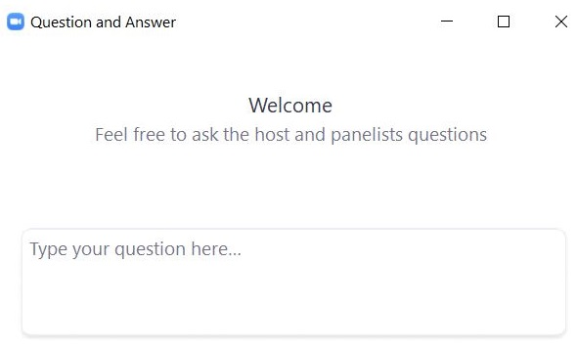
Questions and Answers
Use the “Q&A” feature to ask questions.

Slide 36
4. Accessibility and Accommodations Related to the Student Registration/Personal Needs Profile

Slide 37
What is the Student Registration/Personal Needs Profile (SR/PNP)?
Student Registration/Personal Needs Profile (SR/PNP) is a collection of student-level data, including
student demographic data
test registration information
information on selected accommodations that a student will use during testing
The SR/PNP process must be completed to determine the basis for the initial shipment of materials to schools, including
test administration manuals (CBT and PBT)
Student ID Labels for paper-based tests (PBT)
PBT test and answer booklets, including special test editions (e.g., large-print, Braille)
The SR/PNP determines initial test orders and provides a record of students tested and the accommodations they used.
For more information, view the recording of the Overview of the SR/PNP training session from January 18, 2024.

Slide 38
SR/PNP: Special Test Forms and Selected Accessibility Features and Accommodations
Special Test Forms - CBT
Text-to-Speech
Screen Reader Edition
American Sign Language Video (ASL edition)
Spanish/English Edition
Web Extension AT Form
Compatible Assistive Technology
Special Test Forms – PBT
Large Print Test Edition
Braille Test Edition
Selected Accommodations
Human Read-Aloud
Human Read-Aloud (Special Access - ELA)
Human Signer
Human Signer (Special Access - ELA)
Human Scribe
Human Scribe (Special Access - ELA)
Speech-to-Text (for Math and STE)
Speech-to-Text (Special Access - ELA)
Graphic Organizer/Reference Sheet
Typed Responses
Calculation Device on Noncalculator test session(s) (Math only)
Spell-Checker (Special Access - ELA)
Word Prediction (Special Access - ELA)
Other Accommodation Not Listed
Accessibility Features
Enlarged Cursor/Mouse

Slide 39
Guide to the SR/PNP Process
Field Definitions describes each accommodation.
Administrations lists availability on specific tests.
Field Notes indicates other accommodations that cannot be co-selected.
Expected Values indicates options for selecting the accommodation.

Slide 40
5. Preparation for Testing

Slide 41
Preparing for Test Administration
Provide training to test administrators who will provide accommodations.
Nondisclosure Acknowledgment Forms
Required for test administrators administering the following accommodations to sign prior to testing:
A2, A3.1, A3.2, A3.3, A5, A6.1, A8, A10.1, A10.2, A11, A12, A13, A14, A15, SA1.2, SA2, SA3.1, SA3.2, SA6, EL3.2, EL4.1, EL4.2
Provide students opportunities to view Student Tutorial and take online Practice tests using accommodated format, if appropriate.
http://mcas.pearsonsupport.com/student/

Slide 42
Pre-Administration Checklist for Administering Accommodations
Test Coordinators:
Verify that students with human read-aloud and human signer are assigned to separate PAN Sessions.
Verify that student accommodations have been assigned correctly by reviewing the PNP report in PAN.
Test Administrators:
Review Students in Sessions page to verify student accommodations.
Ensure that students with Human Read-Aloud or Human Signer are given the student testing ticket, not proctor testing ticket.

Slide 43
REMINDER: Provide to all students during testing
Untimed test sessions
Blank scratch paper (including blank, lined, or graph paper)
Assistance from test administrator, as needed, to navigate the computer-based testing platform

Slide 44
Reminders for Paper-Based Testing
Review and follow Special Instructions included with special test forms (e.g., braille, large-print) to ensure tests are scored properly.
Designate test administrators to transcribe large-print, braille, and other responses into standard booklet and include with original in Special Handling Envelope.
See Appendix A: Procedures for Scribing and Transcribing Student Responses in the Accessibility and Accommodations Manual.
Typed responses:
One item response per page
Each response must not exceed one page
Each page must include all parts of each item (e.g., a., b., c., d…)
Include student information in header/footer according to typed response appendix in each administration-specific Test Administrator’s Manual

Slide 45
Testing Irregularities – Use of Prohibited Materials
Report the use of any of the following to DESE as soon as possible after it occurs:
Cell phones or other unauthorized devices
Giving student an unauthorized accommodation, coaching, assisting, or guiding a student to get the answer, including telling a student to “go back and write more”
Dictionary or thesaurus on any MCAS test
Unapproved Math reference sheet or ELA graphic organizer, including
Adding text to an approved supplemental reference sheets/ELA organizer
Calculator on the noncalculator session of Mathematics test or human read-aloud/text-to-speech on ELA test, for a student who does not have this accommodation listed in an IEP or 504 plan

Slide 46
If a Student Refuses an Accommodation
Document student’s refusal in writing; keep in student’s file.
Sample refusal form — available in the Accessibility and Accommodations Manual at www.doe.mass.edu/mcas/accessibility/
Continue to make accommodation available, if needed, for remainder of test administration.
Do not make student sign waiver of their right to receive the accommodation.
Notify parent/guardian of student’s refusal.
Amend IEP/504 plan for future testing.
If appropriate, list accommodation in the IEP/504 plan “as requested by student,” or remove it.
Update the information in student’s SR/PNP if an accommodation was entered incorrectly or was not used.

Slide 47
Questions and Answers 2
Use the “Q&A” feature to ask questions.

Slide 48
Poll Question 3
Have any of the students in your school used speech-to-text and/or word prediction on MCAS computer-based tests?
Yes
No

Slide 49
Demonstrations 2
Web Extension Assignment Process
Described in Appendix A in the SR/PNP Guide
This process is not applicable for the Civics Field Test.

Slide 50
Web Extension Assistive Technology (AT) Form
Web AT form for the use of speech-to-text or word prediction special access accommodations
SR/PNP for student with a disability must designate Web Extension AT test form for the specific test. (Student will select either Co:Writer or Read&Write on TestNav screen.)
Web extensions are NOT available for Mathematics tests and Introductory Physics, due to conflicting use of the Equation Editor.
Do not assign the “Web Extension AT Form” to student who is unfamiliar with its use. Student should attempt a practice test with this feature prior to actual testing.
Review the Assistive Technology Guidelines for MCAS prior to selecting the Web Extension AT Form for students.

Slide 51
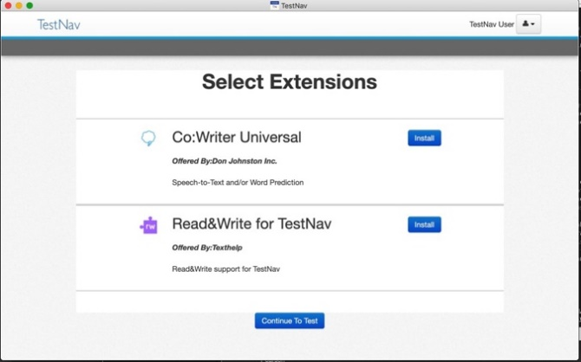
Web Extension Assistive Technology Form (SR/PNP)
Once designated in the SR/PNP, a student will see the “Select Extensions” screen in TestNav prior to starting test.
Select “Install” for the preferred
AT program, and
then select “Continue to Test.”

Slide 52
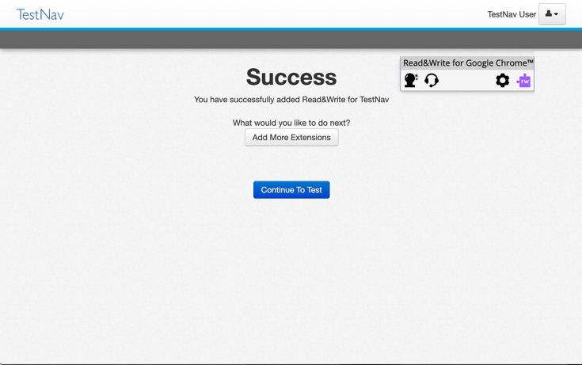
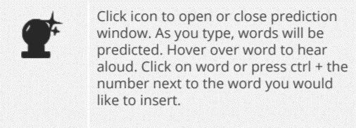
Read&Write Web Extension Tool Bar
When Speech-to-text and/or Word Prediction is enabled, tools above will automatically appear when student begins an open response section or text box.

Slide 53
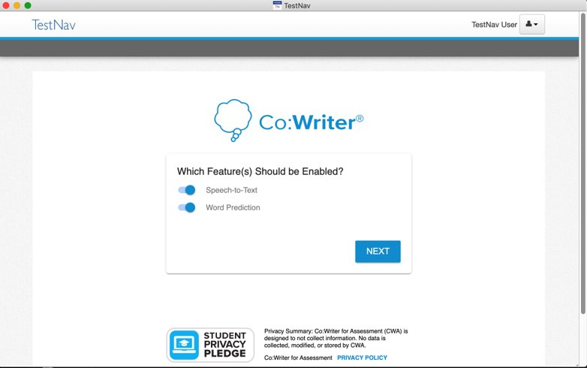
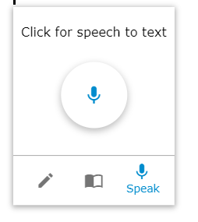
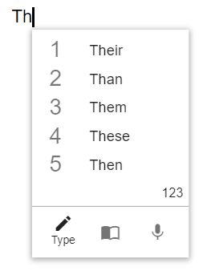
Co:Writer Web Extension Tool Bars
Speech-to-Text
Word Prediction
When Speech-to-text and/or Word Prediction is enabled, tools above will automatically appear when student begins an open response section or text box.

Slide 54
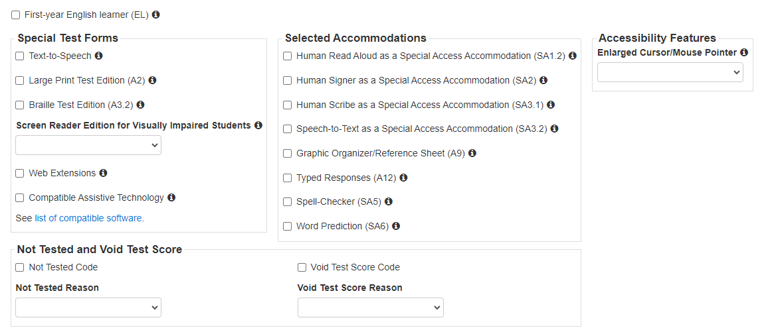
Web Extension Assistive Technology (AT) Form 2

Slide 55
Questions and Answers 3
Use the “Q&A” feature to ask questions.

Slide 56
6. Resources, Support, and Next Steps

Slide 57
Upcoming Training Sessions
Date | Session | Audience
Friday, February 2 | MCAS Test Security and Administration Protocols for New Staff | Principals, test coordinators, and test administration teams
Monday, February 5 | Pre-Administration Tasks for Technology Staff | Technology coordinators and technology staff
Registration for training sessions available now: www.doe.mass.edu/mcas/training.html
After each session is delivered, a recording of the session and the slides will be posted at mcas.pearsonsupport.com/training/ approximately one week later.

Slide 58
Future Training Sessions
Date | Session | Audience
Tuesday, February 27 | Tasks in PAN Before Testing | Principals and test coordinators
Thursday, February 29 | PAN Tasks for Accessibility and Accommodations | Principals, MCAS test coordinators, special education administrators and supervisors, and test administrators administering accessibility features for all students and accommodations for students with disabilities and EL students
Tuesday, March 12 | Tasks in PAN During Testing | Principals and test coordinators
Thursday, March 14 | Tasks in PAN After Testing | Principals and test coordinators
Registration for training sessions available now: www.doe.mass.edu/mcas/training.html
After each session is delivered, a recording of the session and the slides will be posted at mcas.pearsonsupport.com/training/ approximately one week later.

Slide 59
Additional Resources
Resource | Location
MCAS Resource Center | mcas.pearsonsupport.com
Modules and recordings of previous trainings | mcas.pearsonsupport.com/training
PAN user information | mcas.pearsonsupport.com/pearsonaccessnext
Student Assessment Updates (Biweekly email with important updates about the MCAS program) | www.doe.mass.edu/mcas/updates.html If you do not already receive this email, subscribe using this link: http://eepurl.com/ghSOhH
Released Items | mcas.pearsonsupport.com/released-items

Slide 60
Next Steps
Today: Complete the evaluation form.
Responses are associated with the name and email address used to log in.
Email your input to mcas@doe.mass.edu if you have problems accessing or completing the form.
Within one week:
Receive an email with the Q&A from this session
Recording will be available

Slide 61
Email and Phone Support
MCAS Service Center
DESE Student Assessment Services
Questions on logistics and technology (e.g., PearsonAccess Next, SR/PNP, TestNav)
Web: mcas.pearsonsupport.com
Email: mcas@cognia.org
Phone: 800-737-5103
Schedule Technology Support Call.
Policy questions (e.g., student participation, accommodations, “I have a student who…”)
Web: www.doe.mass.edu/mcas
Email: mcas@doe.mass.edu
Phone: 781-338-3625

Slide 62
Poll Question 4
Which demonstrations would you like to see again?
Text-to-Speech Tool
Answer Masking and Color Contrast
Web Extension Assignment Process

Slide 63
THANK YOU
The Office of Student Assessment Services
781-338-3625
mcas@doe.mass.edu
www.doe.mass.edu/mcas
135 Santilli Highway, Everett, MA 02149

