Slide 1
Overview of the Student Registration/ Personal Needs Profile (SR/PNP) Process for New Staff
For schools participating in the Grades 5 and 8 STE Pilot:
there will be a training tomorrow, January 19; registration is available. If you are unsure whether your school is participating in the pilot, please see the list posted on the DESE website. Questions can be directed to iada_dese@mass.gov
The Office of Student Assessment Services
January 18, 2024

Slide 2
Presenters
Shannon Cullen, MCAS and ACCESS Assessment Specialist
Scott Kelley, Data and Reporting Specialist
Jodie Zalk, Manager of Test Administration and Publications
Gloria Hernandez, Pearson Customer Support Specialist

Slide 3
Logistics for This Session
Use the Q&A feature to ask a question.
We will answer some questions aloud at specified times during this training session, and we will email the Q&A afterwards.
Type your questions anytime, but we may not answer them in real time as some questions may be covered during the presentation.
Use the thumbs-up icon to “upvote” someone else’s question.
Email student-specific questions to mcas@doe.mass.edu instead of asking here.
This session is being recorded and will be available in about a week in the MCAS Resource Center, along with the slides.
Slides were also emailed out beforehand, and are being posted in the chat.
Closed captioning has been enabled for participants who need it.
This session is being interpreted into ASL. Our interpreting team will be onscreen with the presenters.

Slide 4
Slides for This Session
Slides were emailed to participants before this session from MCASEvents@cognia.org.
Slides are now being posted in the chat.
If you cannot access the slides in the chat, ask in the Q&A.
After the session, we will send the slides again to participants, and they will be posted in the MCAS Resource Center along with the recording.

Slide 5
Today’s Agenda
SR/PNP Overview
Steps for Preparing the Initial File for Import
Steps for Completing the Initial Import
Steps after the Initial Import
Resources, Support, and Next Steps
Live “Sandbox Time”

Slide 6
1. SR/PNP Overview

Slide 7
Poll Question
How many times have you submitted the SR/PNP for MCAS for your organization?
Zero – I have never submitted an SR/PNP
1–2 times
3–5 times
6+ times

Slide 8
Commonly Used Acronyms
CBT: Computer-based testing
PBT: Paper-based testing
PAN: PearsonAccess Next
SR/PNP: Student Registration/Personal Needs Profile
EL: English learner
ELA: English Language Arts
STE: Science and Technology/Engineering
SASID: State-Assigned Student ID

Slide 9
What is the SR/PNP?
Student Registration/Personal Needs Profile (SR/PNP) is a collection of student-level data, including
student demographic data
test registration information
information on selected accommodations that a student will use during testing
The SR/PNP process must be completed to determine the basis for the initial shipment of materials to schools, including
test administration manuals (CBT and PBT)
Student ID Labels for paper-based tests (PBT)
PBT test and answer booklets, including special test editions
The SR/PNP determines initial test orders and provides a record of students tested and the accommodations they used.
Note: New principals may want to view the recording of the Intro to CBT training (Training from 1/17/24 will be posted in the next week).

Slide 10
What’s New for 2024?
Answer masking and color contrast accessibility features are no longer part of the SR/PNP file.
All students will have access to these accessibility features in TestNav.
Appendix A of the Guide to the SR/PNP Process: PAN Guidance for Form-Dependent Accommodations
Highlights important information regarding certain accommodations that require additional steps to assign in the SR/PNP
Text-to-speech
Web extensions (speech-to-text and word prediction)
Spanish/English edition
Screen reader edition
Compatible assistive technology
ASL edition
Human reader/human signer

Slide 11
Overview of Steps to Complete the SR/PNP Process
Download the .CSV file prepared by DESE from Dropbox Central in the DESE Security Portal (available on the first day of each SR/PNP window).
Delete students from the file who are no longer enrolled in your school, and add rows for students who were not included in the file and will be testing.
Verify and update students’ accessibility features and accommodations.
Save as a .CSV file and import file into PAN.
Resolve any errors that occur.
Update student information as needed, through file export/import process or through the user interface.

Slide 12
Sample SR/PNP .CSV File

Slide 13
SR/PNP Deadlines for 2024
Administration | Initial SR/PNP Window Important for receiving manuals on time and Student ID Labels for PBT
March Retests | January 22–February 2
Grades 3–8 | January 22–February 2
Grade 10 ELA and Mathematics | January 29–February 9
Grade 8 Civics Field Test | March 25–April 5
June High School Science | April 12–30
See the Statewide Testing Schedule for the following:
Extended deadlines for CBT
Deadlines for updating SR/PNP information (as needed) after administration
For the high school science administration, if a high school will not have any students participating, the school needs to email mcas@cognia.org to let them know by the deadline listed above.
For the grades 5 and 8 STE pilot administration, SR/PNP dates are the same as those for the grades 3-8 administration listed above.

Slide 14
For what reasons and when should we update the SR/PNP?
1. Initial SR/PNP Window
2. Extended SR/PNP Window for CBT
3. Test Administration Window
4. Deadline for Updating SR/PNP
Add students
Remove students/test assignments
Edit accommodations
Edit demographic info
Same as 1, but additional steps are required for some accommodations (see slide 15)
Same as 1, but may need to order paper-based tests for new PBT accommodations
Remove students/ test assignments
Edit accommodations that were not used
Edit demographic info

Slide 15
MCAS Accessibility and Accommodations
All accommodations with the “SR/PNP” designation in the Accessibility and Accommodations Manual must be selected prior to testing.
Some accommodations cannot be changed after a student signs in to the test. If the correct accommodations are not selected before a student signs in, additional steps during testing will be required.
Review Accessibility and Accommodations Manual
(New for 2023–24) Appendix E of the A&A Manual contains a list of accessibility features and accommodations and the corresponding column numbers in the SR/PNP.
Review module and previous trainings
Register for one of the upcoming Accessibility and Accommodations training sessions (January 30 and February 1)
Remember to assign accessibility features and accommodations appropriately:
Accessibility features available to all students
Accommodations available only for students with disabilities and ELs

Slide 16
Form-Dependent Accommodations
The following accommodations must be assigned correctly before testing. If not assigned correctly, a student’s test will need to be stopped and a new test will need to be set up, and the student may need to retake a portion of the test.
Form-dependent accommodations for CBT:
Text-to-speech
Screen reader
ASL
Spanish/English
Compatible assistive technology
Human read-aloud
Human signer
Form-dependent accommodations for PBT:
Large-print
Braille
See the new Appendix A: PAN Guidance for Form-Dependent Accommodations in the Guide to the SR/PNP Process

Slide 17
Accessibility Features and Accommodations That Must Be Included in the SR/PNP Prior to Testing
Accommodation # | Description
UF4 | Alternate Cursor/Mouse Pointer tool
A1 or EL1 | Paper test, if unable to use computer
A2 | Large-print edition
A3.1 or A3.2 | Screen reader or Braille edition for a student who is blind or visually impaired
A4 or EL3.1 | Text-to-speech (TTS) for Mathematics or STE tests
A5 or EL3.2 | Human read-aloud for Mathematics or STE tests
A6.1 or A6.2 | Human signer for Math, STE, or ELA test questions only (or ASL video for spring grade 10 Math and high school Biology and Introductory Physics–CBT only)
A9 | Supplemental graphic organizer or reference sheet
A10.1 or A10.2 EL4.1 or EL4.2 | Human scribe or external speech-to-text device for Math and/or STE
A12 | Typed responses for PBT only
Refer to Appendix A of the Guide to the SR/PNP Process for additional instructions for these accommodations.

Slide 18
Special Access Accommodations That Must Be Included in the SR/PNP Prior to Testing
Accommodation # | Description
SA1.1, SA1.2 or SA1.3 | Text-to-Speech or Human read-aloud (for ELA tests only)
SA2 | Human signer for ELA passages
SA3.1 or SA3.2 | Human scribe or speech-to-text device for ELA
SA4 | Calculation device or arithmetic table for noncalculator Math test session
SA5 | Spell-checker for ELA
SA6 | Word prediction for ELA
Refer to Appendix A of the Guide to the SR/PNP Process for additional instructions for these accommodations.

Slide 19
Guide to the SR/PNP Process
Includes:
Instructions for completing the initial process
Instructions for updating student information after the initial file upload
Field Definitions section:
Field Definitions describe each of the columns in the SR/PNP file.
Includes details on test codes (column J)
Field Notes and Validations describe eligibility to receive the accommodation and describe how to complete that field.
Expected Values indicate options for column input.
New for 2023-24: Appendix A: PAN Guidance for Form-Dependent Accommodations
Available on the MCAS Resource Center under “PearsonAccess Next Guidance.”

Slide 20
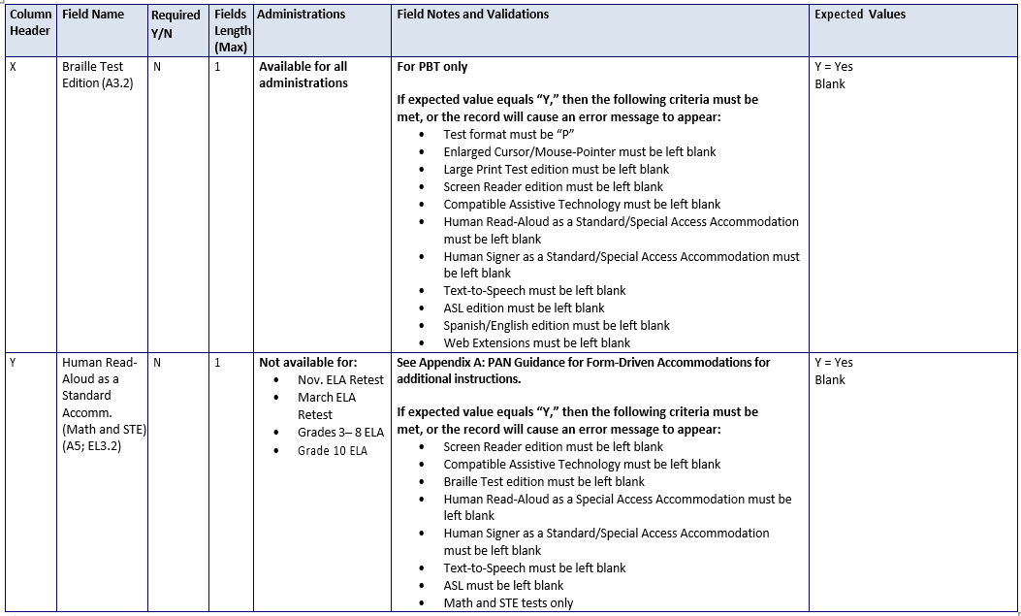
Field Definitions Portion of Guide to the SR/PNP Process

Slide 21
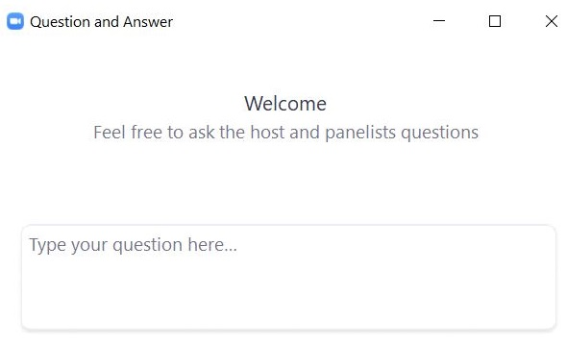
Questions and Answers
Use the “Q&A” feature to ask questions.

Slide 22
2. Steps for Preparing the Initial File for Import

Slide 23
Poll Question 2
What are the two websites you will need to use to complete the SR/PNP process?
PearsonAccess Next and TestNav
TestNav and DESE Website
MCAS Service Center Website and DESE Security Portal
DESE Security Portal and PearsonAccess Next

Slide 24
Overview of Steps to Complete the SR/PNP Process 2
Download the .CSV file prepared by DESE from Dropbox Central in the DESE Security Portal (available on the first day of each SR/PNP window).
Delete students from the file who are no longer enrolled in your school, and add rows for students who were not included in the file and will be testing.
Verify and update students’ accessibility features and accommodations.
Save as a .CSV file, and import file into PAN.
Resolve any errors that occur.
Update student information as needed, through file export/import process or through the user interface.

Slide 25
Secure Websites for this Process
DESE Security Portal: where to find the .CSV files that can be used as the basis for the SR/PNP
https://gateway.edu.state.ma.us/
If you cannot access the Security Portal, contact your Directory Administrator (www.doe.mass.edu/InfoServices/data/diradmin/list.aspx).
PearsonAccess Next (PAN): where to import the SR/PNP file
http://mcas.pearsonaccessnext.com
Also linked at http://mcas.pearsonsupport.com/pearsonaccessnext/
If you could access PAN before but no longer have access, try resetting your password in case the account expired.
If you do not have a PAN account, contact your school or district test coordinator.
Call MCAS Service Center (800-737-5103) if you cannot access your PAN account or for assistance with the SR/PNP import.

Slide 26
Frequently Asked Questions
What if I get an error message when logging in to PAN?
If your account has been disabled or deleted, contact your school or district test coordinator and they will be able to enable or restore your account.
What if I need to create more users for PAN?
Refer to resources (mcas.pearsonsupport.com/pearsonaccessnext):
Guide to Managing User Accounts in PearsonAccess Next
User Role Matrix for PearsonAccess Next
What if I’m unable to log in to the DESE Security Portal?
Contact your District Directory Administrator.

Slide 27
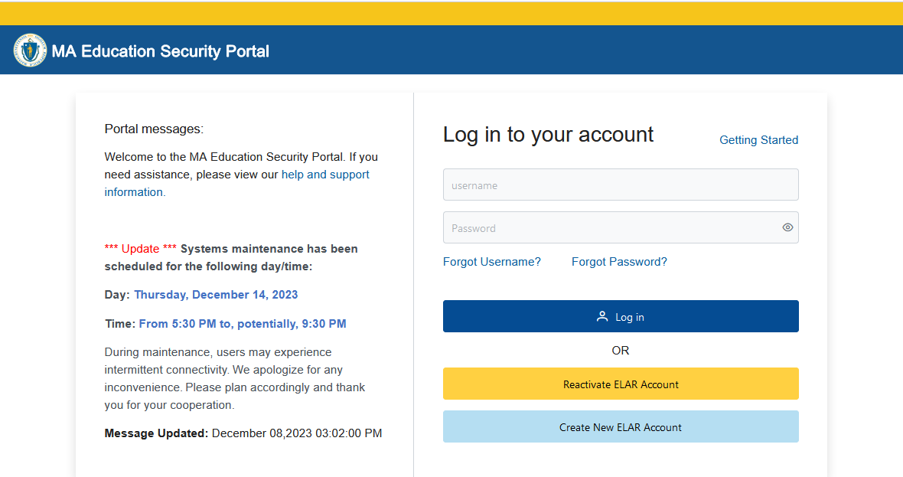
Logging in to the DESE Security Portal
Log in to the Security Portal at https://gateway.edu.state.ma.us/

Slide 28
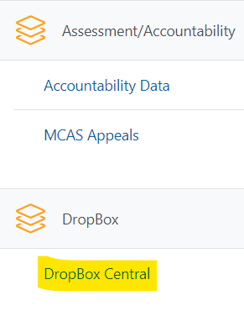
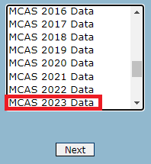
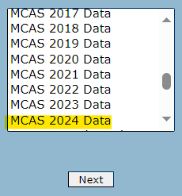
Accessing DropBox Central in the Security Portal
Enter your username and password.
You will then see an Application List.
Select DropBox Central.
Select MCAS 2024 Data.
Click Next.

Slide 29
The .CSV File for MCAS Test Administrations
DESE will post .CSV files to DropBoxes on the first day of the SR/PNP window of each administration.
Locate the .CSV file (e.g., “Spring2024…_SRPNP) and save it to your computer.
The .CSV files for the SR/PNP will be current as of approximately two weeks before the opening of each window.
Selected accommodations are prepopulated as follows.
Subject | Spring 2024 Grades | Source of Accommodations Data
ELA and Math | Grades 4–8 | Grades 3–7 Spring 2023 in those subjects
ELA and Math | Grade 10 | Grade 8 Spring 2022 in those subjects
STE for grades 5 and 8 | Grades 5 and 8 | Grades 4 and 7 Math Spring 2023
STE for high school | Grade 9 only | Grade 8 STE Spring 2023

Slide 30
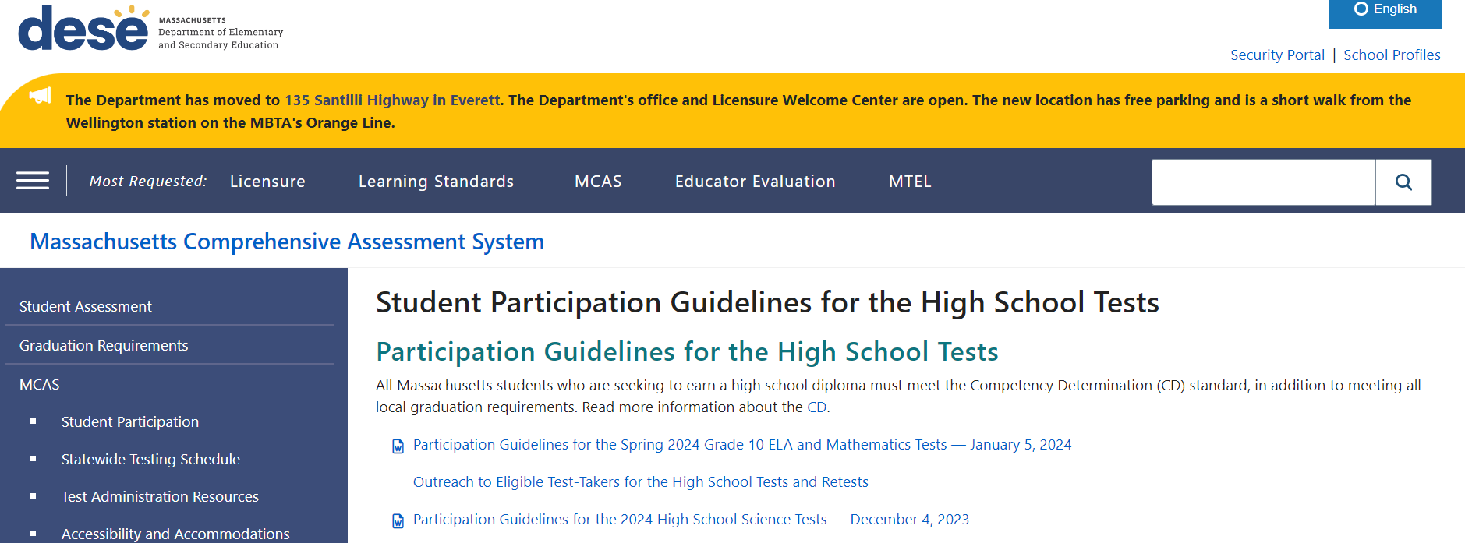
High School Participation Guidelines
Participation guidelines for the 2024 high school MCAS tests are available DESE website: www.doe.mass.edu/mcas/highschool.html
Email mcas@doe.mass.edu with questions.

Slide 31
Frequently Asked Questions
What if a student doesn’t have a SASID?
Search for claimed students in Edwin Analytics Student Profile Report (PR600).
If not found in PR600, call your district SIMS contact to create a new SASID, or locate the student’s existing SASID from the prior school, if applicable.
If you do not have a student’s SASID by the file import deadline, assign a “fake” 10-digit SASID starting with “88” (instead of “10”). Update the SASID in PAN as soon as you receive the actual SASID.
SASIDs cannot be newly assigned for students 22 years of age or older.
What if a student is listed in the .CSV file, but has already passed one of the tests?
Contact mcas@doe.mass.edu (please do not send SASIDs via email).

Slide 32
Frequently Asked Questions (cont’d)
What if I need a transfer student’s prior MCAS scores and/or CD status?
In most cases, students’ MCAS history is available in Edwin Analytics.
The Student Assessment History Summary report (PE613) and the Student CD Roster (PE618) have prior MCAS results and CD status.
Edwin Analytics is available on the Department's Security Portal.
See the October 31, 2023 Student Assessment Update for additional details.

Slide 33
Demonstrations: Tasks before Importing the File
Locating the Guide to the SR/PNP Process
Opening the .CSV file downloaded from DropBox Central
Adding/removing rows for a student who transfers in/out
Optional: using column L to remove first-year ELs who will not participate in the ELA test
Column L shows the student’s first-year EL status projected to March 1, 2024, based on historical SIMS.
Note that first-year ELs must participate in spring Mathematics and STE.
Updating a student’s accommodations
Saving the .CSV file

Slide 34
SR/PNP Initial Import – Step A: Prepare the File
Log in to the Security Portal (https://gateway.edu.state.ma.us/) to find the .CSV file posted in DropBox Central in the MCAS 2024 folder.
District and school files are available the same day that the SR/PNP window opens.
Delete rows of students who will not participate; add rows for new students who will participate.
(Spring ELA only) Optional: Use first-year EL flag in column L to find and remove the ELA row (only) for students who will not take the ELA test
Update any accommodations, as needed.
(High School Science Only) Add test codes for the high school science subject test.
Save the updated file as a .CSV file.

Slide 35
Questions and Answers 2
Use the “Q&A” feature to ask questions.

Slide 36
3. Steps for Completing the Initial Import

Slide 37
Overview of Steps to Complete the SR/PNP Process 3
Download the .CSV file prepared by DESE from Dropbox Central in the DESE Security Portal (available on the first day of each SR/PNP window).
Delete students from the file who are no longer enrolled in your school, and add rows for students who were not included in the file and will be testing.
Verify and update students’ accessibility features and accommodations.
Save as a .CSV file, and import file into PAN.
Resolve any errors that occur.
Update student information as needed, through file export/import process or through the user interface.

Slide 38
Demonstrations: Importing the File
Accessing PearsonAccess Next
Importing the .CSV file
Enrollment Transfer Work Requests

Slide 39
SR/PNP Initial Import – Step B: Import the File
Log in to PearsonAccess Next (PAN) (https://mcas.pearsonaccessnext.com/).
Select the appropriate test administration in the top right.
Note: PAN will default to the last administration you were working in.
On the Setup menu, select “Import/Export Data.”
In the Select Tasks drop-down, select “Import/Export Data.” Click “Start.”

Slide 40
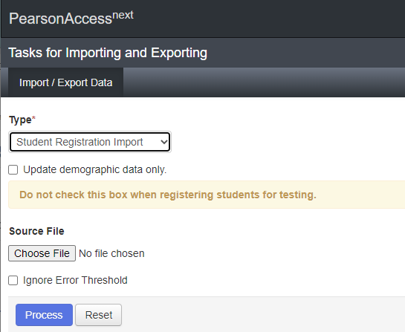
SR/PNP Initial Import – Step B: Import the File (cont’d)
In the Type drop-down, select “Student Registration Import.”
Ignore the option “Update demographic data only.”
Choose the .CSV file you had previously saved, and select “Process.”
Click refresh and when the file has completed processing, a green box with the message “Complete” will appear on the screen.
Confirm that all records have been successfully imported.

Slide 41
SR/PNP Import Errors
You may receive errors when importing the file into PAN.
See Part IV of the Guide to the SR/PNP Process for a list of common errors that may occur and how to resolve them.
Error: Incorrect number of fields found on line 2, expected: 11 actual: 53
Be sure to select the Student Registration Import from the drop-down, not the User Import
Error: The student can only be enrolled in 1 organization(s).
This occurs when a student is already enrolled in another school or district in PAN.

Slide 42
Enrollment Transfer Work Request
If you receive the error message, “The student can only be enrolled in 1 organization(s)”, you will need to complete an enrollment transfer work request to receive access to enroll/register this student.

Slide 43
Creating an Enrollment Transfer Work Request

Slide 44
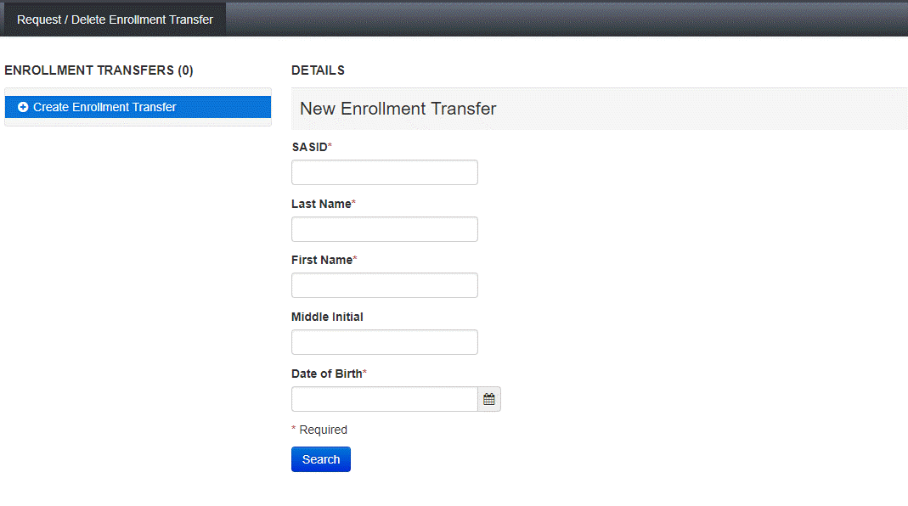
Creating an Enrollment Transfer Work Request (cont’d)

Slide 45
Enrollment Transfer Work Request 2
Additional steps are required once the student work request has been approved.
The MCAS Service Center will approve any outstanding Enrollment Transfer Work Requests 24 hours after being submitted.
For more information, including information about how to approve Enrollment Transfer Work Requests that are sent to your school, refer to the “Enrollment Transfer Guide” (mcas.pearsonsupport.com/manuals/ in the “PearsonAccess Next Guidance” section).

Slide 46
Important Reminders
Confirm that the correct administration name (e.g., Spring 2024 MCAS Gr. 3–8) is shown at the top of the screen in PAN.
Confirm you are in the blue live site of PAN, not the brown training site.
Only school or district test coordinators can import an SR/PNP file.
Test administrators do not have permission to do so.
If columns are hidden or frozen, be sure to unhide and unfreeze them prior to import.
Do not make changes to the format of the file.
Do not add a title to the file using row 1 of the spreadsheet – this will cause an error during upload.
The SR/PNP file import must be done by the initial deadlines for schools to receive an initial order of manuals and PBT tests and Student ID Labels.
Schools can update the SR/PNP (e.g., accommodations) but must also place an additional order for materials if needed.

Slide 47
Poll Question
When does DESE recommend assigning students to PAN Sessions using a student registration import?
During the initial SR/PNP process
About a week after the initial SR/PNP import
About two weeks prior to test administration
About two days prior to test administration

Slide 48
Important Reminders (cont’d)
PAN Sessions can only be assigned once using the SR/PNP import (column M).
DESE recommends leaving column M blank during the initial SR/PNP import.
Then, schools can create PAN Sessions approximately two weeks before test administration to minimize changes needed.
If students need to be moved between Sessions after they have been assigned, it must be done manually in the PAN User Interface.
If you have a large group of students to be moved between Sessions, contact the MCAS Service Center.
Students taking PBT cannot be placed in a PAN Session.
Confirm that you are selecting the correct test codes, using the Guide to the SR/PNP Process for reference.
When importing the file, be sure you have selected the correct file type (Student Registration Import). If an incorrect file type is selected (e.g., User Import), you will receive an error message.

Slide 49
Questions and Answers 3
Use the “Q&A” feature to ask questions.

Slide 50
4. Steps after the Initial Import

Slide 51
Overview of Steps to Complete the SR/PNP Process 3
Download the .CSV file prepared by DESE from Dropbox Central in the DESE Security Portal (available on the first day of each SR/PNP window).
Delete students from the file who are no longer enrolled in your school, and add rows for students who were not included in the file and will be testing.
Verify and update students’ accessibility features and accommodations.
Save as a .CSV file, and import file into PAN.
Resolve any errors that occur.
Update student information as needed, through the file export/import process or through the user interface.

Slide 52
Update SIMS Data
If you update any student demographic data in PAN (SASID, spelling of student’s name, grade, DOB), you must also update student information in SIMS.
Contact the district’s SIMS contact.
To find the contact for your district, go to https://profiles.doe.mass.edu/search/search.aspx?leftNavId=11239 Select “SIMS Contact” from the Function menu, and click “Get Results.”

Slide 53
Demonstrations: Updating the SR/PNP in PAN after the Initial .CSV File Import
Adding a student record
Updating an existing student record, including updating accommodations

Slide 54
Adding a New Student Record
Log in to PAN. Then select the test administration in the top right corner.
On the Setup menu, select “Students.”
In the Select Tasks drop-down, select “Create/Edit Students” and “Registration.” Click “Start.”
Tabs will appear at the top of the screen for each task that will be done sequentially.
Add details to Create/Edit Students. Enter all required fields (indicated by a red asterisk). Click “Create.”

Slide 55
Adding a New Student Record (cont’d)
Click “Register Students” at the top of the screen.
Click the “Registered” checkbox.
Click the “Student Grade” drop-down, indicate the student’s grade.
Click “Save.”
Click “Manage Student Tests” at the top of the screen.
Select the student from the drop-down, assign a test to the student, and select the organization.
Leave the group name blank.
Select the test format, and then select the checkbox next to each accessibility feature and/or accommodation the student will use.
Click “Create.”

Slide 56
Updating an Existing Student Record
Log in to PAN.
On the Setup menu, select “Students.”
Search for the student record by the last name or SASID.
Click the checkbox next to the student’s name.
From the Select Tasks drop-down, select “Create/Edit Students” and/or “Manage Student Tests” (depending on what needs to be updated). Click “Start.”
Update the student information as needed.
Click “Save.”

Slide 57
Updating PBT Student Tests
If you need to add a student taking PBT, or if you need to update a student’s PBT test accommodations after the initial SR/PNP window, you may need to place an additional materials order through the MCAS Service Center.
See Appendix B of the PAM: Procedures for Paper-Based Testing for information.

Slide 58
Updating an Existing Student Record – PBT for High Schools
Follow the steps on the previous slides to access the Manage Student Tests page in PAN.
Each test session must be edited separately.
Schools making a change to one test session will need to make that same change to the other session.
This is particularly relevant for accommodations.

Slide 59
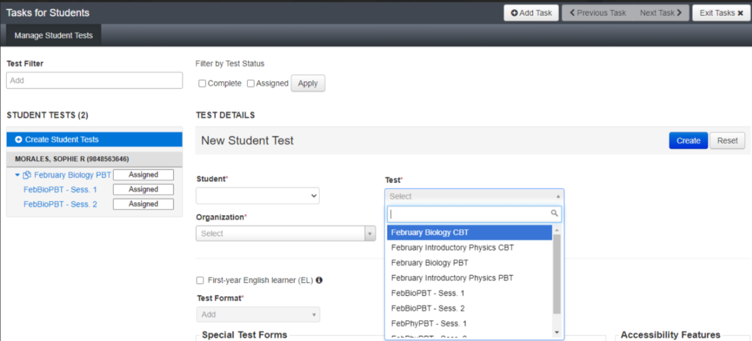
Updating an Existing Student Record – PBT for High Schools (cont’d)

Slide 60
Questions and Answers 4
Use the “Q&A” feature to ask questions.

Slide 61
5. Resources, Support, and Next Steps

Slide 62
Available Resources
Resource | Location Online
Guide to the SR/PNP Process (includes common error codes) | mcas.pearsonsupport.com/manuals/ (Click on “PearsonAccess Next Guidance”)
User Role Matrix | mcas.pearsonsupport.com/manuals/ (Click on “PearsonAccess Next Guidance”)
Guide to Managing User Accounts in PearsonAccess Next | mcas.pearsonsupport.com/manuals/ (Click on “PearsonAccess Next Guidance”)
File layouts: SR/PNP Template (file layout) PAN User Export file layout | mcas.pearsonaccessnext.com/ Support > Documentation
Training resources Recording of this session Online training modules on the SR/PNP and accessibility and accommodations | mcas.pearsonsupport.com/training
Upcoming training opportunities | www.doe.mass.edu/mcas/training.html
Accessibility and Accommodations Manual | www.doe.mass.edu/mcas/accessibility/
Crosswalk of Accessibility Features and Accommodations & SR/PNP Columns – Appendix E of the Accessibility and Accommodations Manual | https://www.doe.mass.edu/mcas/accessibility/manual-appx-e.docx

Slide 63
Additional Resources on the DESE MCAS Website
Resource | Description
Home page | Access MCAS headlines and links to MCAS site (e.g., test schedule, test designs, training)
Student Assessment Updates | Biweekly email with important updates about the MCAS program If you do not already receive this email, subscribe at this link: http://eepurl.com/ghSOhH
MCAS Pre-Administration Guide | Instructions and roles/responsibilities for principals/test coordinators, new staff, and technology coordinators for tasks to complete prior to MCAS test administration, supplementing test administration manuals

Slide 64
Upcoming Training Sessions
Date | Session | Audience
Tuesday, January 23 | Infrastructure Trials for Principals and Test Coordinators – Returning | Principals and test coordinators
Wednesday, January 24 | Infrastructure Trials for Technology Coordinators | Technology coordinators and technology staff
Thursday, January 25 | Infrastructure Trials for Principals and Test Coordinators – New Staff Part I | New principals and test coordinators
Friday, January 26 | Infrastructure Trials for Principals and Test Coordinators – New Staff Part II | New principals and test coordinators
Registration for training sessions available now: www.doe.mass.edu/mcas/training.html
After each session is delivered, a recording of the session and the slides will be posted at mcas.pearsonsupport.com/training/ approximately one week later.

Slide 65
Upcoming Training Sessions (continued)
Date | Session | Audience
Tuesday, January 30 Thursday, February 1 | MCAS Accessibility and Accommodations | Principals, test coordinators, special education administrators and supervisors, test administrators
Wednesday, January 31 | MCAS Test Security and Administration Protocols for Returning Staff | Principals, test coordinators, and test administration teams
Friday, February 2 | MCAS Test Security and Administration Protocols for New Staff | Principals, test coordinators, and test administration teams
Monday, February 5 | Pre-Administration Tasks for Technology Staff | Technology coordinators and technology staff
Registration for training sessions available now: www.doe.mass.edu/mcas/training.html
After each session is delivered, a recording of the session and the slides will be posted at mcas.pearsonsupport.com/training/ approximately one week later.

Slide 66
Future Training Sessions
Date | Session | Audience
Tuesday, February 27 | Tasks in PAN Before Testing | Principals and test coordinators
Thursday, February 29 | PAN Tasks for Accessibility and Accommodations | Principals, MCAS test coordinators, special education administrators and supervisors, and test administrators administering accessibility features for all students and accommodations for students with disabilities and EL students
Tuesday, March 12 | Tasks in PAN During Testing | Principals and test coordinators
Thursday, March 14 | Tasks in PAN After Testing | Principals and test coordinators
Registration for training sessions available now: www.doe.mass.edu/mcas/training.html
After each session is delivered, a recording of the session and the slides will be posted at mcas.pearsonsupport.com/training/ approximately one week later.

Slide 67
Next Steps
Today: Complete the evaluation form.
Responses are associated with the name and email address used to log in.
Email your input to mcas@doe.mass.edu if you have problems accessing or completing the form.
Within one week:
Receive an email with the Q&A from this session
Recording will be available

Slide 68
Email and Phone Support
MCAS Service Center
DESE Student Assessment Services
Questions on logistics and technology (e.g., PearsonAccess Next, SR/PNP, TestNav)
Web: mcas.pearsonsupport.com
Email: mcas@cognia.org
Phone: 800-737-5103
Policy questions (e.g., student participation, accommodations, “I have a student who…”)
Web: www.doe.mass.edu/mcas
Email: mcas@doe.mass.edu
Phone: 781-338-3625

Slide 69
For Schools Participating in the Grades 5 and 8 STE Pilot
DESE is hosting a webinar training tomorrow, January 19; registration is available.
If you are unsure whether your school is participating in the pilot, please see the list posted on the DESE website.
Questions can be directed to iada_dese@mass.gov

Slide 70
6. Live “Sandbox Time”

Slide 71
Poll Question—
Which demonstrations would you like to see again?
Adding/removing rows for a student who transfers in/out
Updating a student’s accommodations in the initial .CSV file
Accessing PearsonAccess Next
Importing the .CSV file
Enrollment transfer work request
Adding a student after the initial file import
Updating an existing student record after the initial file import
Updating a large number of student records via Student Registration Export/Import

Slide 72
THANK YOU
The Office of Student Assessment Services
781-338-3625
mcas@doe.mass.edu
www.doe.mass.edu/mcas
135 Santilli Highway, Everett, MA 02149

