Slide 1
Overview of Infrastructure Trials for Technology Coordinators
The Office of Student Assessment Services
January 24, 2024

Slide 2
Presenters
Shannon Cullen, Test Administration Coordinator
Joseph Henkelman, Pearson Technical Support

Slide 3
Logistics for This Session
Use the Q&A feature to ask a question.
We will answer some questions aloud at specified times during this training session, and we will email the Q&A afterwards.
Type your questions anytime, but we may not answer them in real time as some questions may be covered during the presentation.
Use the thumbs-up icon to “upvote” someone else’s question.
Email student-specific questions to mcas@doe.mass.edu instead of asking here.
This session is being recorded and will be available in about a week in the MCAS Resource Center, along with the slides.
Slides were also emailed out beforehand, and are being posted in the chat.
Closed captioning has been enabled for participants who need it.

Slide 4
Slides for This Session
Slides were emailed to participants before this session from MCASEvents@cognia.org.
Slides are now being posted in the chat.
If you cannot access the slides in the chat, ask in the Q&A.
After the session, we will send the slides again to participants, and they will be posted in the MCAS Resource Center along with the recording.

Slide 5
Today’s Agenda
Determining Whether to Run an Infrastructure Trial
Introduction to Infrastructure Trials
Tasks for Technology Staff
Administration and Next Steps
Resources, Support, and Next Steps
Live “Sandbox Time”

Slide 6
1. Determining Whether to Run an Infrastructure Trial

Slide 7
Poll Question
How many times have you conducted an Infrastructure Trial for MCAS computer-based testing?
0 times
1-2 times
3-5 times
6+ times

Slide 8
Computer-Based Testing (CBT) Components
PearsonAccess Next (PAN)
Online test management system for principals, test coordinators, and technology coordinators to manage user accounts, student registration, and computer-based test sessions.
TestNav8 (TN8)
Online testing platform used by students to take the computer-based MCAS assessments
ProctorCache
Software that allows for precaching of test content on a designated precaching machine located at the school and can reduce bandwidth requirements.
Recommendation on whether to use ProctorCache is based on school’s bandwidth.
For more information, view the recording of the “Introduction to MCAS CBT for New Staff” training session.

Slide 9
Recommended Windows to Conduct Preliminary System Tests/Infrastructure Trials
Grades | Recommended Windows
March Retests | January 29 – February 23
Grades 3–8 | January 29 – March 15
Grade 10 ELA | February 5 – March 18
June High School Science | April 22 – May 24
Note that there is no recommended Infrastructure Trial window for grade 10 Mathematics. If a school successfully completes grade 10 ELA CBT testing, and their technology does not change, they may not need to conduct additional Infrastructure Trials.
Note that there is no recommended Infrastructure Trial window for the Grade 8 Civics Field Test. Test administrators who wish to practice completing tasks in PAN may use the Spring 2024 MCAS Gr. 3–8 administration in the PAN training site
Schools may choose to complete an Infrastructure Trial for high school Science if they have students and staff who have not yet participated in CBT.

Slide 10
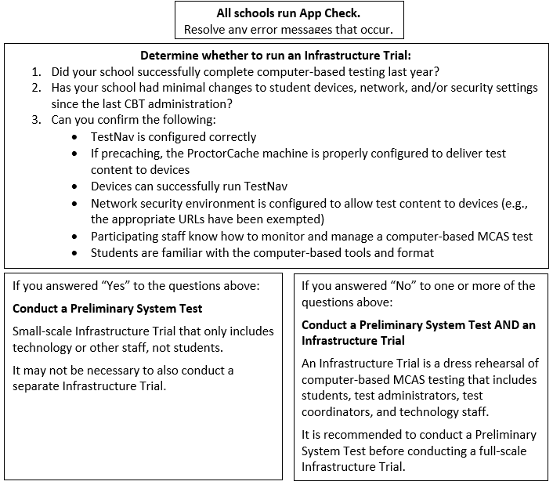
Determine Whether to Run an Infrastructure Trial

Slide 11
Testing Your Network and Devices
App Check: A test run in TestNav by school staff to check connectivity to Pearson servers, the ability of the device to enter “kiosk” mode, and the TestNav configuration (if a configuration identifier is used).
Preliminary System Test: A small-scale Infrastructure Trial during which school staff log in to and click through practice tests instead of students.
Infrastructure Trial: Simulated testing experience during which one or more practice test sessions are administered.

Slide 12
Testing Your Network and Devices 2
Task | What is it? | Should my school complete this task? | Who participates? | Confirms that:
App Check | App Check is completed in TestNav after configuring the network and downloading TestNav on student devices. | Yes, all schools should complete App Check. | Technology staff | Devices can successfully run TestNav TestNav is configured correctly
Preliminary System Test | Small-scale Infrastructure Trial completed by technology or other school staff, during which staff log in to TestNav on student devices and click through practice tests. | Strongly recommended for schools not conducting Infrastructure Trial. Recommended for schools conducting Infrastructure Trial. | Technology or other school staff | Devices can successfully run TestNav TestNav is configured correctly Network security environment is configured to allow test content to devices (e.g., the appropriate URLs have been exempted)
Infrastructure Trial | Simulated testing experience during which one or more practice test sessions are administered. | Guidance on whether to conduct an Infrastructure Trial is outlined on slide 10. | Students, teachers, technology staff, test coordinators | Devices can successfully run TestNav TestNav is configured correctly Network security environment is configured to allow test content to devices (e.g., the appropriate URLs have been exempted) If precaching, the ProctorCache machine is properly configured to deliver test content to devices Participating staff know how to monitor and manage a computer-based MCAS test Students are familiar with the computer-based tools and format.

Slide 13
Steps for Completing App Check
Typically completed by technology staff on a sample of student devices.
To run App Check:
Open the TestNav app and navigate to the Massachusetts sign in page.
Click the user icon in the top right and choose App Check from the menu.
Enter a Configuration Identifier if one will be used. Then select Run App Check.
A “Success” message should appear. If you encounter an error message, refer to the Set Up TestNav and App Check Error Messages webpages for further information.
See page 8, step 4 of the Infrastructure Trial Guide.

Slide 14
Demonstrations
MCAS Resource Center
Infrastructure Trial Readiness Guide
App Check
Instructions can be found in the TestNav8 User Guide

Slide 15
Steps for Conducting a Preliminary System Test
Technology staff follows all steps to prepare for Infrastructure Trial, including the following:
Download the TestNav app; confirm that the OS of student devices is supported by TestNav; configure internet firewalls, content filters, and spam filters to exempt the test delivery URLs from filtering and inspection; and download ProctorCache and precache tests, if applicable
Test coordinator creates a small number of sample student records and tests in the PAN training site and puts them into PAN Sessions. Test coordinators prepare and start PAN Sessions.
Technology or other staff logs in to TestNav with student credentials and clicks through practice tests to confirm they can access test content without issues.
For full instructions on how to complete a Preliminary System Test, refer to the Infrastructure Trial Guide.

Slide 16
2. Introduction to Infrastructure Trials

Slide 17
Main Steps for the Infrastructure Trial
Technology Coordinators:
Set up and configure ProctorCache and/or Secondary Save locations in PAN.
Set up and configure network to make sure the appropriate URLs are exempted.
Ensure that the current version of TestNav is installed on testing devices and that device OS versions are supported by TestNav.
Test Coordinators: Generate sample students, create PAN Sessions, and assign students to Sessions in the PAN training site.
Test Coordinators: Assign any accommodations that students may need to try out in the Trial.
Test Administrators: Administer practice tests to students using TestNav and manage those sessions in PAN during testing.
MCAS Testing Team: Conduct follow-up activities and review lessons learned with the test administration team based on your school’s circumstances.

Slide 18
Practice Tests
 | Infrastructure Trial | TestNav App | MCAS Resource Center
How to Access | Set up through PAN, students will use specific log-ins for TestNav. | Accessed through the “Practice Tests” button in the app. | Links to the CBT practice tests (URLs) and PDFs of the paper-based testing (PBT) practice tests are located under “Practice Tests” on the MCAS Resource Center
Tests included | Same practice tests in the TestNav app as well as Screen Reader (Grade 3 Math) and Compatible Assistive Technology (Grade 3 ELA) practice tests | Same as CBT practice tests on the MCAS Resource Center. | - CBT and PBT practice tests (all grades/subjects) - TTS (all grades/subjects) - ASL (Grade 10 Math, Biology, and Intro Physics) - Spanish/English (Grade 10 Math, Biology, and Intro Physics)
Used for | Used as a “dress rehearsal” for test day and should mimic as close as possible test day circumstances (e.g., time of day, number of students, staff involved). | Students can use to practice TestNav functionality and similar content. These can be done at any time. | Students can use to practice TestNav functionality and similar content. Not every TestNav feature is accessible through these practice tests (e.g., Zoom feature). These can be done at any time.

Slide 19
Number of Test Sessions in the Practice Tests
 | Infrastructure Trial contains additional test session(s) that students will not take | MCAS Resource Center | TestNav App
ELA | All grades: 2 test sessions (only the first contains test content) | 1 session | Same as CBT practice tests on the MCAS Resource Center
Math | Grades 3, 5–8: two test sessions (students DO take both sessions) Grades 4 & 10: three sessions (the first TWO contain test content). | 2 sessions | Same as CBT practice tests on the MCAS Resource Center
STE | Grades 5 & 8: three test sessions (only the first contains test content) Biology & Intro Physics: two test sessions (only the first contains test content) | 1 session | Same as CBT practice tests on the MCAS Resource Center

Slide 20
Training Site and User Accounts for PearsonAccess Next
Infrastructure Trials are done through the PAN training site: trng-mcas.pearsonaccessnext.com/customer/index.action
Users with accounts from last year may need to reset their passwords to enable their accounts by clicking “Forgot Password” on the login page.
User accounts need to be set up for each site individually (live and training) in order to gain access.
Usernames and passwords are always the same between the live and the training sites. If you reset a password on one site, passwords will be reset on both sites.
If you need access to PAN (either the training or live site), please reach out to your District Test Coordinator.
Discuss with your team who will be responsible for setting up PAN user accounts – both test coordinators and technology coordinators have this ability in PAN.
See the Guide to Managing User Accounts in PAN for information on setting up accounts in each site.

Slide 21
Demonstration
PearsonAccess Next
Live site
Training site

Slide 22
3. Tasks for Technology Staff

Slide 23
Steps for Technology Coordinators
View online training modules and attend training sessions
Infrastructure Trial for Technology Coordinators module
Pre-Administration Tasks for Technology Staff training session: February 5
Review the technology specifications
Identify any gaps in technology capacity
Prepare devices (install TestNav and run App Check)
Prepare and test any peripherals that will be used for testing such as input devices and displays (e.g., keyboards, mice, screens)
Determine bandwidth via Network Check

Slide 24
Steps for Technology Coordinators (continued)
Configure or disable ProctorCache (if applicable)
Precache test content (if applicable)
Set up the Secondary Save location in PAN (recommended)
Ensure that Pearson test delivery URLs are exempted from filtering and inspection in all network security appliances or tools such as Content Filters, Firewalls, and Antivirus software.
Purge precached content after testing (if applicable)

Slide 25
Getting Started
Review technology specifications for student devices and ProctorCache machines
Before updating a device’s operating system, schools should confirm it is listed on the TN8 requirements page.
It is strongly recommended that schools do not make changes to their infrastructure in the time between conducting a successful trial and the end of the CBT window.
Note: If ChromeOS devices are used for testing, it is recommended to use the LTS channel for OS updates rather than the Stable channel. (Beta channels should never be used)
Review network requirements and ensure the network and security settings are configured correctly.
Configure internet firewalls, content filters, and spam filters to exempt the test delivery URLs from filtering and inspection

Slide 26
Getting Started (continued)
Resources for the Technology Coordinator
Infrastructure Trial Readiness Guide on the MCAS Resource Center
Review ProctorCache recommendation to determine if ProctorCache is needed
Information for setting up ProctorCache configurations and precache by test
Attend Pre-Administration Tasks for Technology Staff training on February 5
Technology set-up page
System Requirements for ProctorCache and ProctorCache download

Slide 27
Poll Question 2
Do you anticipate that your school will use ProctorCache to precache test content for MCAS computer-based testing?
Yes
No
I’m not sure

Slide 28
Demonstration 2
Network Check in TestNav app

Slide 29
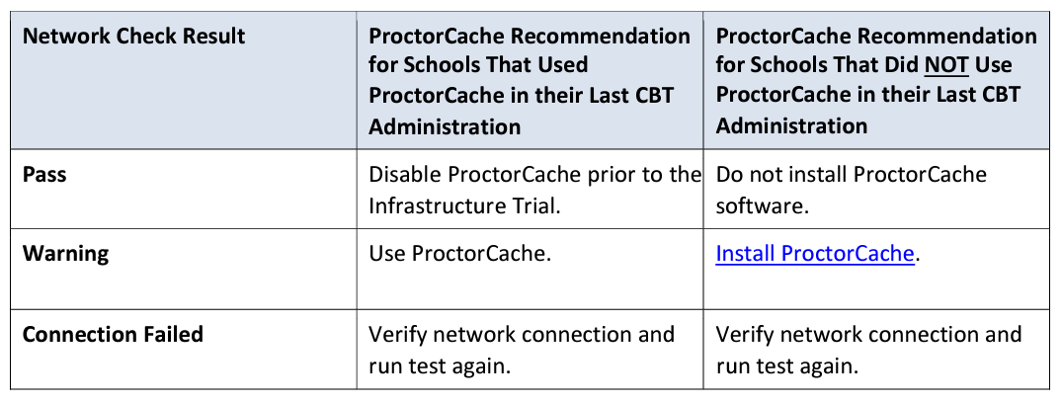
ProctorCache Recommendation
Use the Network Check feature in TestNav to check your organization’s network.
Click App Check in the upper right corner.
Click on Run Network Check.
Enter the number of devices which will be used under your network during testing.
Receive a message indicating whether ProctorCache is recommended.
Refer to the ProctorCache Recommendation on the Resource Center for additional information.

Slide 30
What is a Saved Response File (SRF)
A saved response file (SRF) is an encrypted file that includes a student’s response to a test question.
Student responses are uploaded directly to Pearson Servers
SRFs are never saved to the ProctorCache machine.
SRFs are only created when TestNav is unable to send the response to Pearson Servers.

Slide 31
Saved Response File (SRF) on Mac and Windows Machines
On the TestNav Configuration page, the default primary saved response file location is set to the student device.
Recommended to keep primary save location as is.
DESE strongly recommends using a secondary save location to ensure all devices have a backup save location.
For Mac and Windows machines, the secondary location can be a network drive location or an SFTP address.
Steps and instructions to find SRF and log files:
https://support.assessment.pearson.com/x/DAACAQ

Slide 32
Saved Response File (SRF) on iPads and Chromebooks
The primary saved response file location is on the student device and cannot be changed.
DESE strongly recommends a secondary save location using an SFTP address to ensure all devices have a backup save location.
Steps and instructions to find SRF and log files:
https://support.assessment.pearson.com/x/DAACAQ

Slide 33
Recommended before Conducting the Trial
Schedule one-on-one technology support from Pearson's support specialists.
Available for technology support prior to test administration

Slide 34
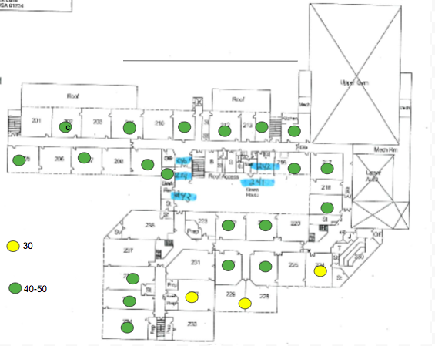
Network Planning
Consider creating coverage maps of network access points to identify potential areas of weakness before testing.
Example from Swampscott Public Schools
www.doe.mass.edu/mcas/ testadmin/schoolsamples/

Slide 35
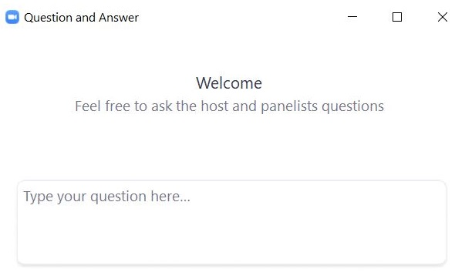
Questions and Answers
Use the “Q&A” feature to ask questions.

Slide 36
4. Administration and Next Steps

Slide 37
Conducting the Trial
Technology coordinators will be responsible for:
Ensuring ProctorCache software is running, if being used
Monitoring network performance for slowdowns or ISP bandwidth usage
Responding to technology/device issues that may arise
Test coordinators will be responsible for:
Directing test administrators and students to testing locations
Distributing testing tickets
Monitoring administration
Infrastructure Trials should take approximately 60 minutes to administer.

Slide 38
Student Status Dashboard and Error Codes
The Students in Sessions page has an additional feature to monitor students’ testing status.
A link will appear next to the status bar for each test session.
The feature is not available if there are more than 100 students in a session.

Slide 39
Student Status Dashboard and Error Codes 2
A dashboard will open in a separate tab in the browser.
This dashboard will allow users to see all students in that test session and their activity/testing status and any error codes on a student's device, as well as the battery level of each testing device.
Error Codes: https://support.assessment.pearson.com/x/DwACAQ

Slide 40
Steps to Resolve Error Codes
If possible, do not power the device off until the student has exited TestNav.
If a student powers off the device without logging out first, they will remain in Active status in PearsonAccess Next and the student will need to be resumed before signing back in to their test.
Troubleshoot the error according to the instructions on the Troubleshooting Error Codes webpage.

Slide 41
Steps to Resolve Error Codes (continued)
When resuming a test after an error has exited the student from TestNav, the original testing device should be used first.
This is so that any unsent responses on the original device can be sent to Pearson.
TestNav will always look in the primary and secondary save locations for a Student Response File when the student logs in to the test regardless of whether the student is in “Resume” or “Resume Upload” status.
If the original testing device cannot be used or if the original error is still occurring, then another device should be attempted. Many issues are resolved by trying a different device if one is available.
Review steps in the following documents:
Principal’s Administration Manual Appendix A
SRF and Log Files

Slide 42
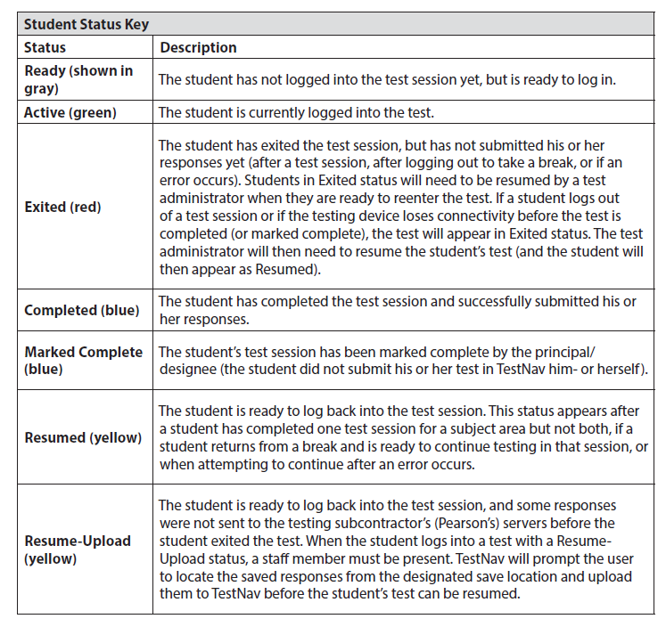
Key to Student Statuses for Students in PAN Sessions (Appendix B of the CBT TAM)
If a student needs to be resumed but shows as “Active” in PAN, then “Resume Upload” rather than “Resume” will be available. “Resume” will be available once “Resume Upload” is selected. Since any unsent responses will be loaded upon login in either status, “Resume” is recommended unless directed otherwise by Pearson support staff.

Slide 43
Resuming Student Tests
Sometimes a student will be exited from TestNav after they begin testing and will need to log back in.
Examples: user error, technology issues
Students must be in a “Ready”, “Resumed”, or “Resumed Upload” status in order to log in to TestNav.
If a student is in “Exited” status, and needs to get back in to TestNav, they will need to be Resumed by the Test Administrator.
Refer to the Resuming Student Tests video on the MCAS Resource Center for a demonstration of resuming student tests.

Slide 44
Resume-Upload
If a student is being resumed from an “Active” status in PAN, “Resume Upload” will be the only available option. This is to alert test administrators that there has been an abnormal exit such as the device being powered off.
Select “Resume Upload” in PAN
Select “Resume” in PAN
The student can also log in when in “Resume Upload”, but a message will appear on the student’s screen that gives the option of navigating to a Saved Response File. You can select “Skip Upload” on this message.
If you encounter any issues, call the MCAS Service Center.

Slide 45
Demonstration 3
Resume vs. Resume Upload

Slide 46
After The Infrastructure Trial
Meet/debrief with test coordinators and test administrators. Share any notes regarding technical issues and need for support with the District Test Coordinator/School Test Coordinator.
If any issues come up:
Report any issues that cannot be resolved with assistance to the MCAS Service Center.
Technology coordinators should schedule a technology support call. (URL: https://calendly.com/mcas-field-services-engineering)
Purge test content from your precaching machine (if ProctorCache was used).

Slide 47
Import/Export TestNav Configurations
Once you have fixed any issues you may have encountered during the Infrastructure Trial, export the TestNav configuration and import it into an operational test administration.
For more information on how to import and export TestNav Configurations, see the PearsonAccess^{next} User Guide.

Slide 48
Questions and Answers 2
Use the “Q&A” feature to ask questions.

Slide 49
5. Resources, Support, and Next Steps

Slide 50
Resources in the MCAS Service Center
Resource | Location
Infrastructure Trial Readiness Guide, including Best Practices for CBT Set-Up, Administration, and Troubleshooting | mcas.pearsonsupport.com/manuals (“PearsonAccess Next Guidance” drop-down)
Infrastructure Trial training modules | mcas.pearsonsupport.com/training
TestNav8 and PearsonAccess^{next} User Guides | mcas.pearsonsupport.com/technology-setup (“User Guides” drop-down)
Technology specifications | mcas.pearsonsupport.com/technology-setup (“Technology Guidelines” drop-down)
Accessibility and accommodations guidance and modules | mcas.pearsonsupport.com/manuals (“Accessibility and Accommodations Guidance” drop-down)

Slide 51
Additional Resources on the DESE MCAS Website
Resource | Description
Home page | Access MCAS headlines and links to MCAS site (e.g., test schedule, test designs, training)
Student Assessment Updates | Biweekly email with important updates about the MCAS program If you do not already receive this email, subscribe at this link: http://eepurl.com/ghSOhH
Sample materials from schools | Review materials developed by Swampscott Public Schools and other schools that can be helpful in preparing for an Infrastructure Trial.
Cybersecurity Information | Guidance on cybersecurity

Slide 52
Upcoming Training Sessions
Date | Session | Audience
Thursday, January 25, 9:30 – 11:00 a.m. | Infrastructure Trials for Principals and Test Coordinators – New Staff Part I | Principals and test coordinators
Friday, January 26, 9:30 – 11:00 a.m. | Infrastructure Trials for Principals and Test Coordinators – New Staff Part II | Principals and test coordinators
Tuesday, January 30 and Thursday, February 1, 9:30 – 11:00 a.m. | MCAS Accessibility and Accommodations | Principals, test coordinators, special education administrators and supervisors, test administrators
Wednesday, January 31, 9:30 – 11:15 a.m. | MCAS Test Security and Administration Protocols – Returning Staff | Principals, test coordinators, and test administration teams
Friday, February 2, 9:30 – 11:30 a.m. | MCAS Test Security and Administration Protocols – New Staff | Principals, test coordinators, and test administration teams
Monday, February 5, 9:30 – 11:00 a.m. | Pre-Administration Tasks for Technology Staff | Technology coordinators
Registration for training sessions available now: www.doe.mass.edu/mcas/training.html
After each session is delivered, a recording of the session and the slides will be posted at mcas.pearsonsupport.com/training/ approximately one week later.

Slide 53
Upcoming Training Sessions 2
Date | Session | Audience
Tuesday, February 27, 9:30 – 11:00 a.m. | Tasks in PearsonAccess Next Before Testing | Principals and test coordinators
Thursday, February 29, 9:30 – 11:00 a.m. | PAN Tasks for Accessibility Features and Accommodations | Principals, MCAS test coordinators, special education administrators and supervisors, and test administrators administering accessibility features and accommodations
Tuesday, March 12, 9:30 – 11:00 a.m. | Tasks in PAN During Testing | Principals and test coordinators
Thursday, March 14, 9:30 – 10:45 a.m. | Tasks in PAN After Testing | Principals and test coordinators
Registration for training sessions available now: www.doe.mass.edu/mcas/training.html
After each session is delivered, a recording of the session and the slides will be posted at mcas.pearsonsupport.com/training/ approximately one week later.

Slide 54
Next Steps
Today: Complete the evaluation form.
Responses are associated with the name and email address used to log in.
Email your input to mcas@doe.mass.edu if you have problems accessing or completing the form.
Within one week:
Receive an email with the Q&A from this session
Recording will be available

Slide 55
Email and Phone Support
MCAS Service Center
DESE Student Assessment Services
Questions on logistics and technology (e.g., PearsonAccess Next, SR/PNP, TestNav)
Web: mcas.pearsonsupport.com
Email: mcas@cognia.org
Phone: 800-737-5103
Schedule Technology Support Call.
Policy questions (e.g., student participation, accommodations, “I have a student who…”)
Web: www.doe.mass.edu/mcas
Email: mcas@doe.mass.edu
Phone: 781-338-3625

Slide 56
6. Live “Sandbox Time”

Slide 57
Poll Question—
Which demonstrations would you like to see again?
Accessing the Infrastructure Trial Guide
App Check
PAN live site vs. PAN training site
Network Check
Resume vs. resume upload

Slide 58
THANK YOU
The Office of Student Assessment Services
781-338-3625
mcas@doe.mass.edu
www.doe.mass.edu/mcas
135 Santilli Highway, Everett, MA 02149

