Slide 1
MCAS Performance Appeals
The Office of Student Assessment Services
October 5, 2023

Slide 2
Presenters
Robert Pelychaty, Manager of Inclusive Assessment
Kevin Froton, Cognia Program Manager

Slide 3
Logistics for This Session
Use the Q&A feature to ask a question.
We will answer some questions aloud at specified times during this training session, and we will email the Q&A afterwards.
Type your questions anytime, but we may not answer them in real time as some questions may be covered during the presentation.
Use the thumbs-up icon to “upvote” someone else’s question.
Email student-specific questions to mcas@doe.mass.edu instead of asking here.
This session is being recorded and will be available in about a week in the MCAS Resource Center, along with the slides.
Slides were also emailed out beforehand, and are being posted in the chat.
Closed captioning has been enabled for participants who need it.
This session is being interpreted into ASL. Our interpreting team will be onscreen with the presenters.

Slide 4
Today’s Agenda
The MCAS Performance Appeals Process
How to Submit MCAS Performance Appeals
View and Develop Customized Reports

Slide 5
1.The MCAS Performance Appeals Process

Slide 6
MCAS Performance Appeals is…
An alternative pathway to meeting CD requirement: “The MCAS Performance Appeals process was established in 2002 to provide eligible high school students who have been unable to pass the required MCAS tests with an additional opportunity to demonstrate through their course work that they meet or exceed the state's Competency Determination (CD) standard in order to earn a diploma.” www.doe.mass.edu/mcasappeals/

Slide 7
Appeals Options (*plus one option for students in military families)
MCAS cohort appeal - Comparison of student’s (appellant’s) GPA to all other students in the school (at least 6) who took the same courses at the same time as student, but who passed the test in that subject
MCAS portfolio appeal - A “competency portfolio” of work samples is submitted documenting achievement of specific learning standards in each subject.
MCAS transcript appeal – For students who transfer to a publicly funded Massachusetts high school in mid-March or later of their senior year
*Valor Act – If a high school student in an active military family moves from another state and enrolls in a Massachusetts high school in grade 11 or later, the district may, in lieu of having the student participate in MCAS retests, submit to the Department alternative evidence.

Slide 8
Who may file an MCAS Performance Appeal?
Only a student’s home school district, collaborative, or approved private school can file an appeal on behalf of a student. All appeal applications require the signature (i.e., sign-off) of the superintendent or designee.
If an appeal is requested by a student with a disability (age 18 or over) or the student’s parent/guardian, the district MUST file an appeal as described in 603 CMR 35.05(2)(C).

Slide 9
Eligibility Requirements
An appeal can be submitted for any student or former student who meets these eligibility requirements:
Testing Requirement for Cohort or Portfolio Appeal
Has taken high school ELA or Math test at least 3 times (or MCAS-Alt twice) without meeting the CD score; or
Has taken a Science test or MCAS-Alt once and is currently enrolled in a science course (If not currently enrolled in high school, the student is not required to be currently enrolled in a course.)
Attendance Requirement
Maintained 95% attendance in the year of and prior to the appeal (Written waiver requests will be considered for hardship reasons.)
Tutoring Requirement
Participates or participated in school-sponsored academic support and remediation in the subject of the appeal

Slide 10
Exceptions to Eligibility Requirements
Districts may request a waiver of any of the eligibility requirements under the following conditions:
Testing Requirement
Depending on date of transfer or absence
Attendance Requirement
If absences are due to hardship or disability
Tutoring Requirement
If student is not currently enrolled in a high school and not participating in any academic support

Slide 11
Preparing Cohort Appeals
Steps to Submit Cohort Appeals
Cohort Worksheet example
School completes a worksheet listing GPA(s) in required courses and test scores of appellant in the subject being appealed, plus GPAs of all other students in their cohort (at least 6)
School completes an online MCAS Performance Appeal application and uploads completed cohort worksheet and written course description(s)
Reviewed monthly during the school year (October through June) and must be submitted by the first Friday of the month in which the appeal is to be reviewed

Slide 12
Cohort Worksheet Analysis
Appeal is granted if Appellant’s GPA is higher than the Median GPA of the Cohort.
Appeal is also granted if Appellant’s GPA is higher than the Mean GPA of Cohort at 2 Standard Errors (S.E.) below the Mean AND the S.E. of the Mean is below .25

Slide 13
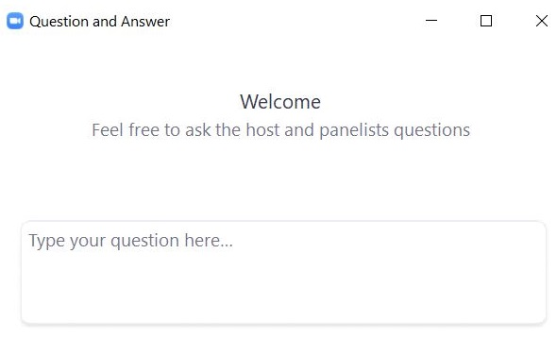
Questions & Answers
Use the “Q&A” feature to ask questions.

Slide 14
Portfolio Appeals
Educators may collect specific work samples to demonstrate competency in one or more subject areas for students that unable to have a granted cohort or transcript appeal
Portfolios may be collected during more than one school year.
Must be collected under the supervision of a school’s educator(s) and considered authentic.
Portfolios are cumulative.
Detailed feedback is returned to schools after each review.
If a portfolio appeal is not granted, it can be resubmitted with additional work samples.
Portfolios are reviewed in November, April, and June (see specific submission dates).
Specific portfolio requirements are described in the Guide to the MCAS Performance Appeals Process.

Slide 15
Portfolio Requirements for ELA and Mathematics
Requirements for ELA and Mathematics competency portfolios are based on the 2017 Curriculum Frameworks:
ELA—produce four (4) essays, plus two (2) short responses, based on grade 10 texts (multiple essays and short responses cannot be based on the same text):
Each essay and short response must include multiple drafts that are written entirely by the student (not rewritten by the teacher) and indicate a progression of the student’s thinking in each successive draft.
Responses should not consist of plot summaries, multiple-choice worksheets, short-answer tests, or quizzes.
Mathematics—work samples documenting all aspects of 15 standards (or clusters of standards) from all five conceptual categories.

Slide 16
Science Portfolio Requirements
Portfolio requirements for Introductory Physics and Biology are based on the 2016 STE Curriculum Framework:
Biology—A total of 8 standards (5 required and 3 discretionary) selected across the core ideas
Introductory Physics—A total of 7 standards (5 required and 2 discretionary) selected across the core ideas
Work samples must…
demonstrate all aspects of standards selected for the discipline;
not be corrected by the teacher and submitted as the student’s own work;
demonstrate the student’s thinking and problem-solving indicating the process used to solve each problem (i.e., show all student work); and
Not include simple multiple-choice, matching, or fill-in-the-blank worksheets.

Slide 17
Transcript Appeals
Only for students who transfer to a publicly funded Massachusetts high school in mid-March or later during their senior year
Schools must submit: Transcripts, GPAs, and if available, standardized test scores, college acceptance letters, and any other relevant academic evidence
If first enrolled in the high school between September–March of senior year, student must participate at least once in MCAS retests or MCAS high school Science test before an appeal will be considered.
Reviewed monthly during the school year (October–June) and must be submitted by the first Friday of the month in which the appeal is to be reviewed
Detailed information at www.doe.mass.edu/mcasappeals

Slide 18
Valor Act – Appeal for High School Students in a Military Family
The Valor Act only applies to high school students in an active military family.
Student must move from another state and enroll in a Massachusetts high school in grade 11 or later.
District submits alternative evidence that demonstrates that the student has met the Massachusetts CD graduation standard.
Schools must submit a completed Transcript Summary for a High School Student in a Military Family; and,
Transcripts, GPAs, another state’s exit exams, and if available, standardized test scores, college acceptance letters, and any other relevant academic evidence
Like cohort appeals, these will be reviewed monthly during the school year (October–June) and must be submitted by the first Friday of the month in which the appeal is to be reviewed.

Slide 19
2. How to Submit MCAS Performance Appeals

Slide 20
Online MCAS Appeals Application Process
How To:
Log in to the DESE Security Portal.
Create a new MCAS Performance Appeal Application.
Enter SASID and student demographic information.
Select appeal type.
Review eligibility requirements.
Attach supporting documents.
Review supporting documents.
Sign off and submit appeal.
Complete a partially completed appeal that was created earlier.

Slide 21
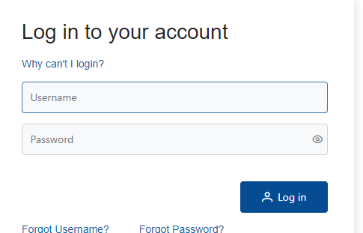
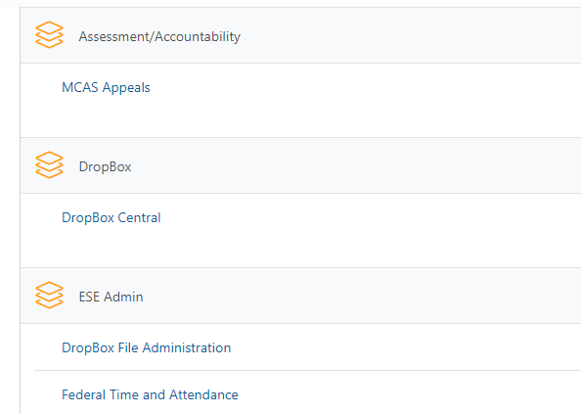
Step 1: Log in to the Security Portal and Select the MCAS Appeals Application
District MCAS Appeals user will log in to Security Portal using their User Name and Password.
Contact the district’s Directory Administrator for assistance, if user cannot access Security Portal.
Then, find Applications List and click MCAS Appeals application to begin entering an appeal.
Notes:
Notes: The user must be assigned the MCAS Appeals Role by their Directory Administrator. The User’s Name and Password are case sensitive.

Slide 22
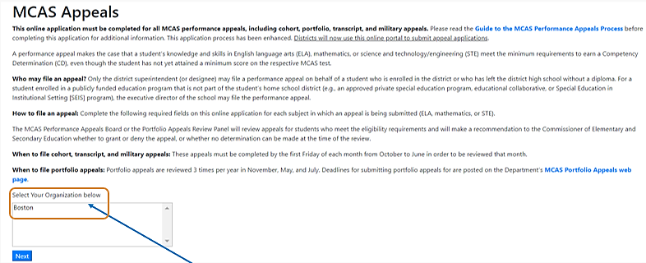
Step 2: Select Your Organization
Select an organization in the “Select Your Organization below” box then select “Next” to proceed.
Notes:
Note: Some users will see more than one organization depending on their role.

Slide 23
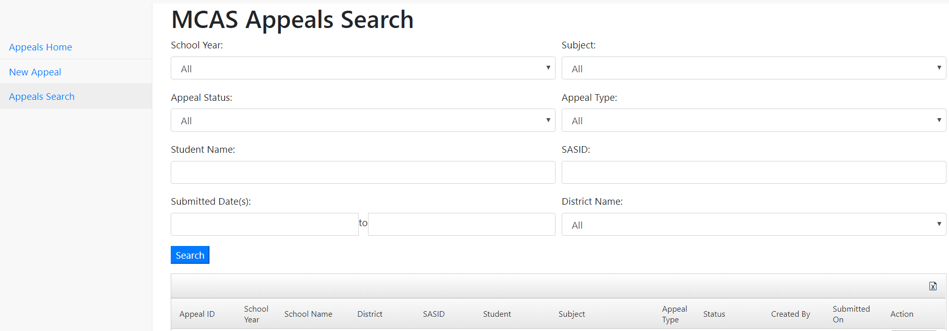
Step 3: Create a “New Appeal”
At the MCAS Appeals Search page, select the “New Appeal” link to begin a new appeal for a student.
Notes:
Note: For MCAS Appeals that have already been created, select the unique “Appeal ID” to review an appeal application for a student.

Slide 24
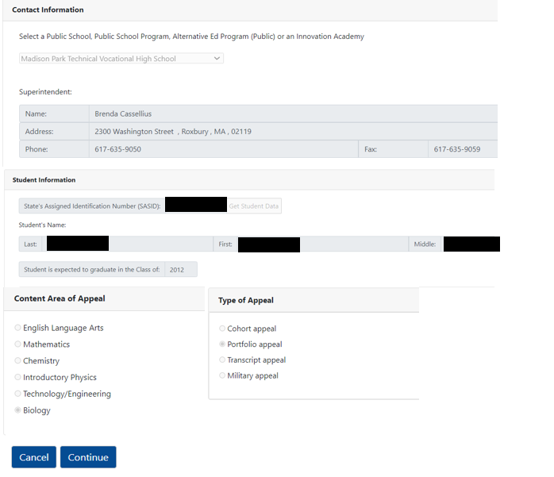
Step 4: Begin an appeals application for a specific student:
Complete all required fields.
Then select “Continue”
The first section of the appeal application will be automatically saved.
Notes:
Note: The correct superintendent and principal should be pre-populated based on the school that is selected. If incorrect, the user should update the information in school profiles.
If the student’s SASID is incorrect, you will not be able to enter the appeal. If the SASID is correct, but the student left school more than 5 years ago contact mcasappeals@doe.mass.edu for assistance.

Slide 25
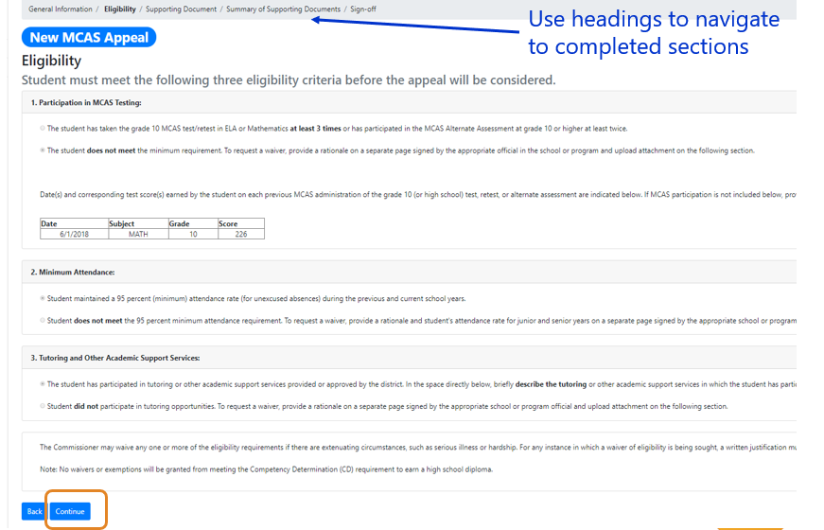
Step 5: Complete the required Eligibility section.
Each type of appeal has specific eligibility requirements.
Answer each eligibility question.
Then select “Continue” to proceed and save the second section of the appeal application.
Notes:
Note: When a student does not meet one or more the eligibility requirements, such as the MCAS participation requirement, it will be required to upload one or more “Eligibility Waiver Request” documents.

Slide 26
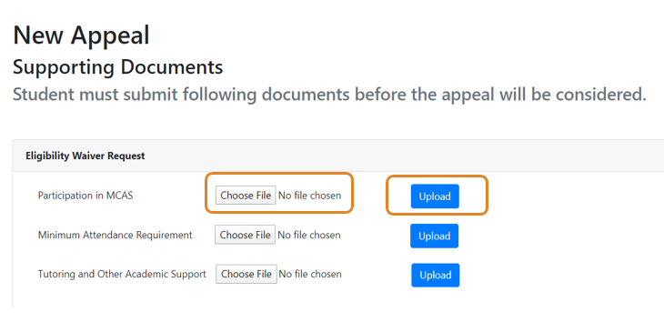
Step 6: Upload Supporting Documents
Upload Eligibility Waiver Request(s), if required.
Select “Choose File.”
Locate the file saved on your computer or drive and select the file to be uploaded.
Then select “Upload.”
Notes:
Note: Each type of appeal will require the upload of supporting documents (e.g., cohort worksheets, course descriptions, transcripts, etc.). If an eligibility wavier is necessary, the waiver request must be uploaded at this “Supporting Document” section.

Slide 27
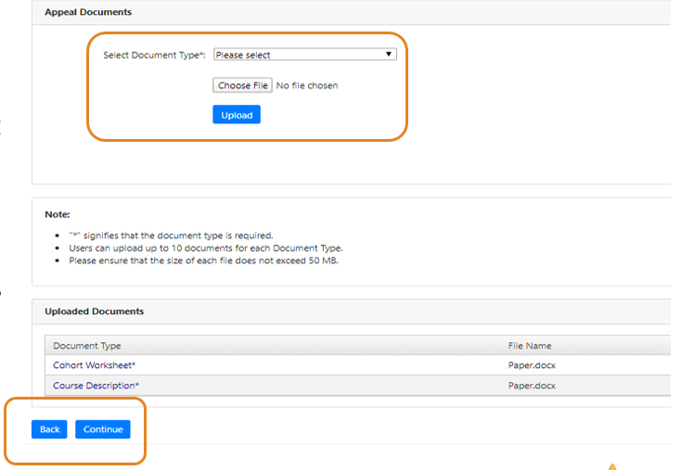
Step 6: Upload Other Supporting Documents (Continued)
Upload Supporting “Appeals Documents”
Use the “Select Document type” drop-down and select the correct document.
Select “Choose File” and then locate the correct file on your computer or drive and select the file to be uploaded.
Then, select Upload.
Select “Continue” to proceed and save.
Notes:
Notes: An asterisk (*) indicates that the specific document type is required. All successfully uploaded documents will appear in the “Uploaded Documents” section. Uploaded documents may be deleted.

Slide 28
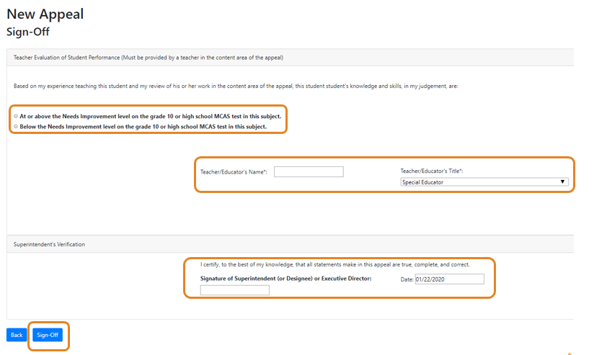
Step 7: Complete Sign-Off Section and Submit Appeal Application
Before submitting appeal, complete the Teacher’s Evaluation section and Superintendent’s Verification.
Complete the required fields, then select “Sign-Off” to submit the appeal.
Notes:
Note: Once the completed appeal is reviewed and a decision has been made, the information and documents that are submitted cannot be changed. If the student’s appeal is not granted, the school may easily resubmit another appeal for the student with additional information.

Slide 29
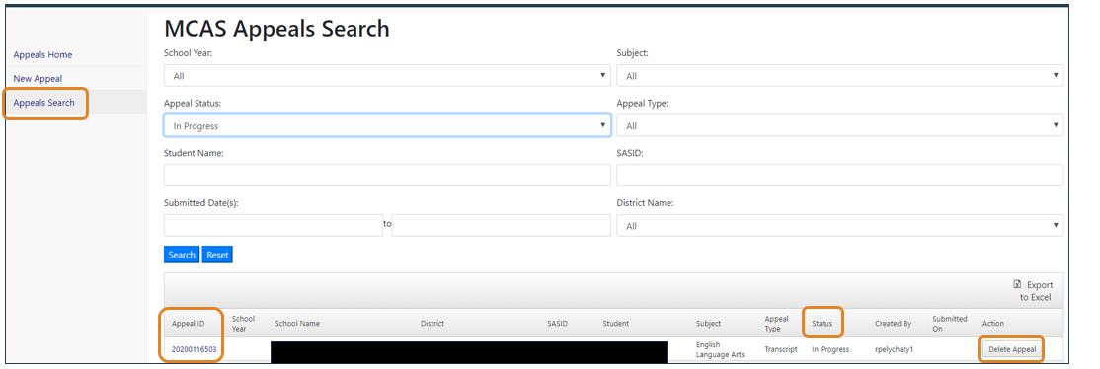
Complete an Appeal Started on an Earlier Date
Steps:
Log-in to MCAS Appeals application and select “Appeals Search”
Select appeal “Status” to search for “In Progress” appeals (not yet submitted).
Select “Appeal ID” to edit the application; or select “Delete Appeal” to remove “In Progress” application.
Notes:
Notes: Once the General Information section of the application is completed, the student’s appeal application will be automatically saved. Each appeal will be in an “In Progress” status until it is submitted. The student’s appeal can be completed at future date, and each “In Progress” appeal may also be deleted if the district does not want to submit the appeal or creates an appeal by error.

Slide 30
Questions & Answers 2
Use the “Q&A” feature to ask questions.

Slide 31
3. View and Develop Customized Reports

Slide 32
Viewing Results and Additional Features
View appeal status, decisions, search, print, resubmit, and create reports.
MCAS Appeals Search
District user can sort, filter, and review all appeals entered by the district.
Appeals Search status is available in real time.
Download and Print Decisions
Users will download decisions that must be shared with the student and/or parent (e.g., Parent Letter and Record of Performance).
Resubmit an Appeal
Appeals with a No-Determination or Denied decision can be resubmitted with additional information.

Slide 33
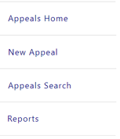
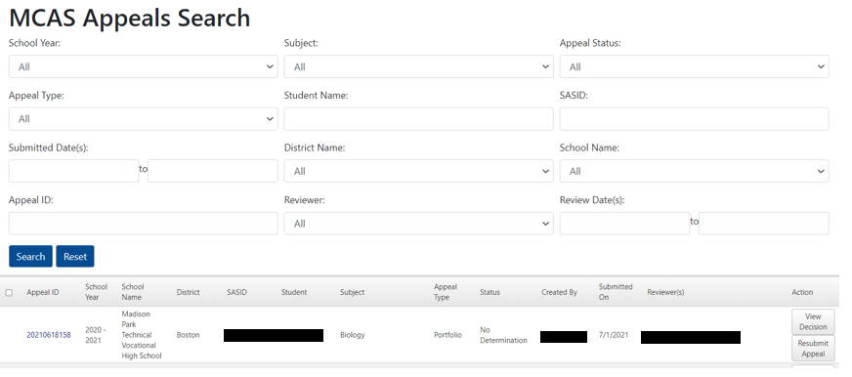
Review Appeals Status Using MCAS Appeals Search
Steps:
Log in and select “Appeals Search.”
Use following fields to search for appeals for specific students:
Subject, Status, Appeal Type, Student Name, SASID
View results in real time by viewing appeal “Status”
Click on “View Decision” to see results.

Slide 34
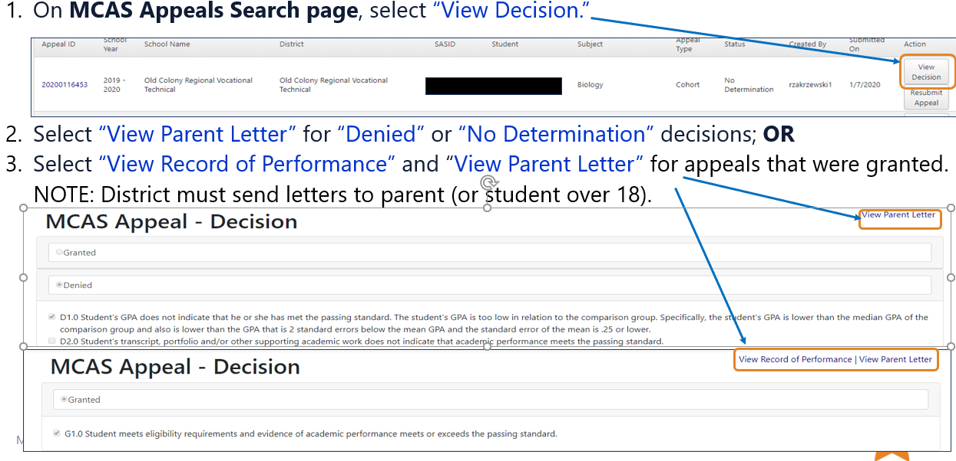
Download and Print Decisions and Parent Letters
Notes:
Note: All letters can be printed using the web browser print function.

Slide 35
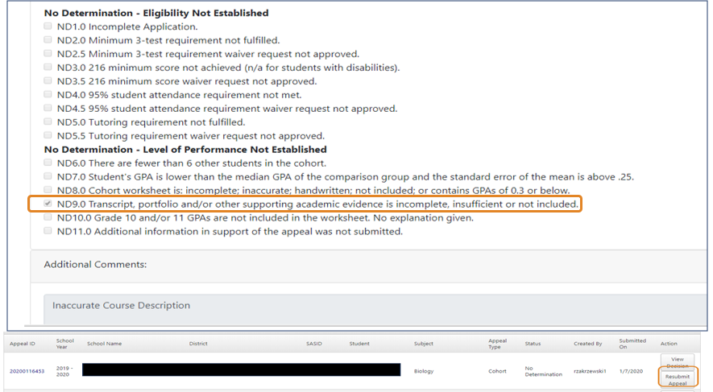
Resubmit an Appeal with a “No Determination” or “Denied” Status
Steps to resubmit an appeal:
On MCAS Appeals Search page, view decision and why appeal was either Denied or No Determination.
Select “Resubmit Appeal”
Add missing or new information.
District must complete sign-off section again.
NOTE:
All previously entered information will be saved.

Slide 36
Districts Can Create Customized Searches
Sample Customized Search – View all current Mathematics cohort appeals in the district for which a finding of No Determination was made.
Steps:
At MCAS Appeals Search, select the “No Determination,” “Mathematics,” and “Cohort” search fields.
Then, select “Search” to view all filtered results.

Slide 37
Exporting and Using Customized Search Results
Once filtered results appear, they can be exported to an Excel file.
Select “Export to Excel.”
Can be used to review appeals that need to be resubmitted.

Slide 38
Options for Generating Specialized Reports
Four report options:
Decisions by School/District
displays specific decision codes provided for all appeals
Number of Appeals by Student Status, Content Area, and Review Month/Year
a numerical tabulation of appeals granted and denied and organized by student status (SWD or Non-SWD) and content area of appeal
Records of Performance by Date
provides verification letter indicating students whose appeals were granted (a copy should be mailed to student/parent when the decision was made)
Appeals by Subgroup
results disaggregated by student status, gender, and race/ethnicity
For each report option, district user can further disaggregate the results using the search filter tools. All reports can be printed.

Slide 39
Select Type of Report
Select a specific type of report:
Decisions by School/District
Number of Appeals
Records of Performance by Date
Appeals by Subgroup

Slide 40
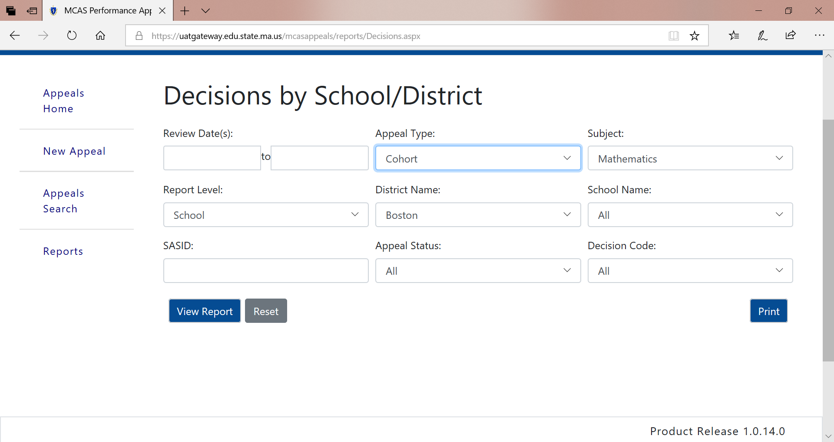
Report Option: Decisions by School/District
If desired, use filters to disaggregate results by Review Date, Appeal Type, School (some districts may have more than once high school), SASID, Appeal Status, and Decision Code. Then select “View Report.” (See sample report on next slide.)

Slide 41
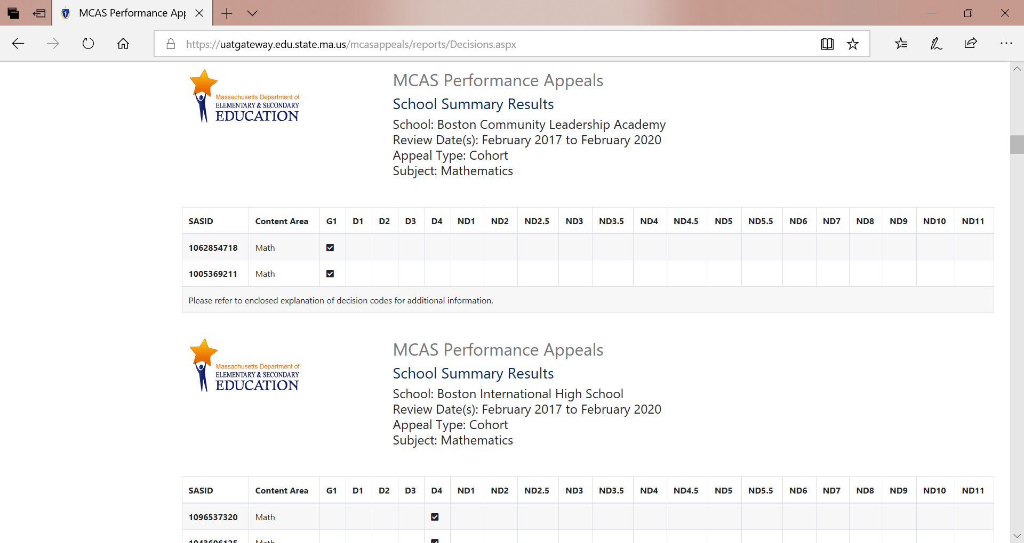
Sample Report for Decisions by School/District

Slide 42
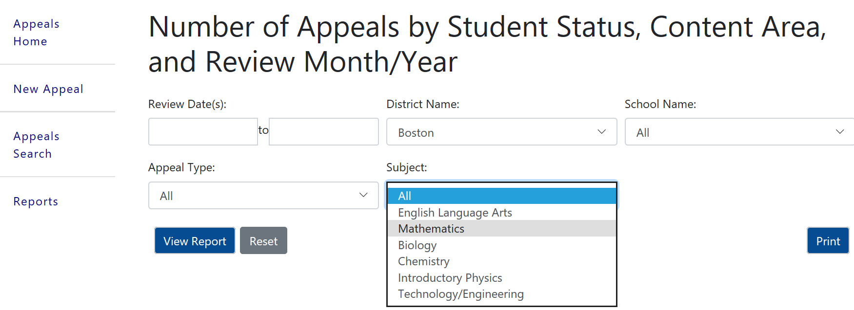
Report Option: Number of Appeals by Student Status, Content Area, and Review Month/Year
If desired, use filters to disaggregate results by Review Date, Appeal Type, School, and Subject (see sample report on next slide). Then select “View Report.”

Slide 43
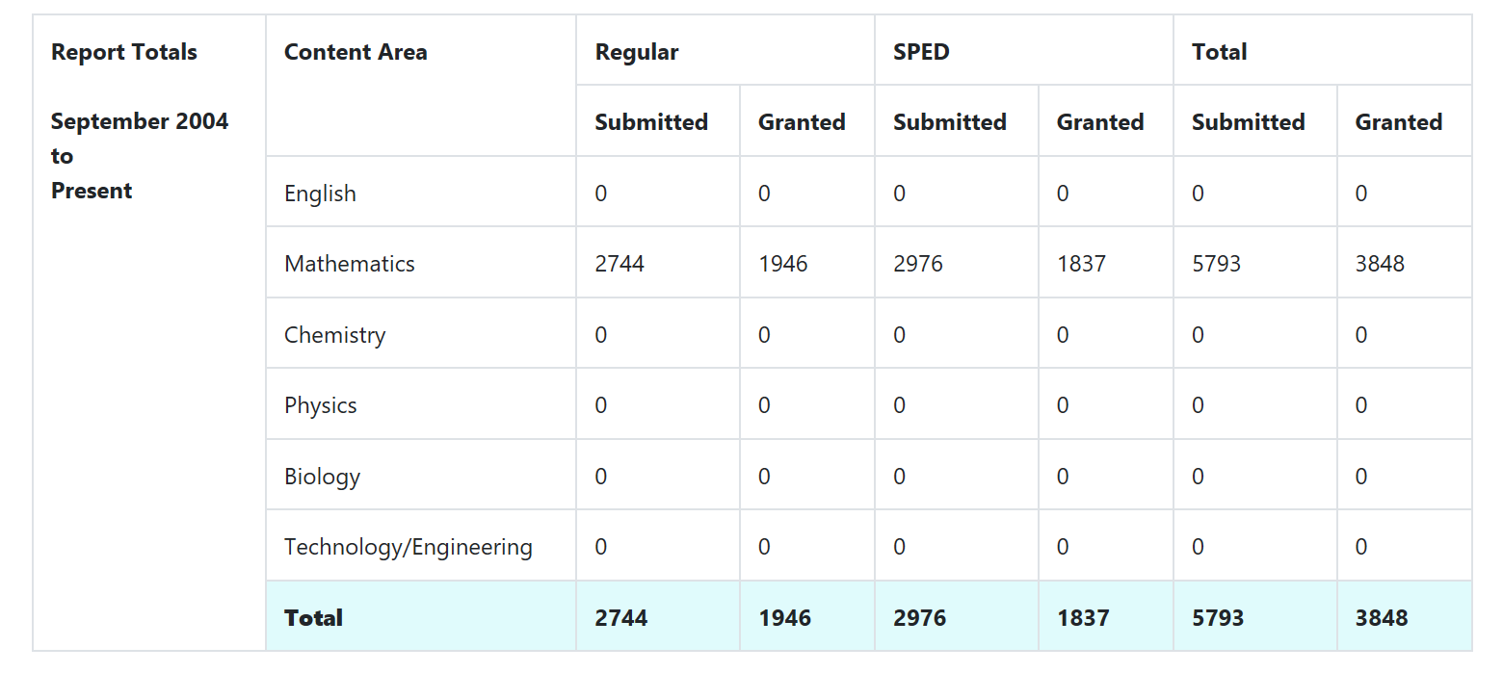
Sample Report for Number of Appeals
Note: Since Mathematics filter was selected, only Mathematics content area appeals are displayed.

Slide 44
Report Option: Records of Performance by Date
If desired, use filter results by Review Date, School (if district has more than one high school), and SASID. (See sample report on next slide.) Then select “View Report.”

Slide 45
Sample Report: Record of Performance by Date
District is required to keep one copy and give one copy to student for evidence that the student met the subject-specific CD requirement.
Note: Dates are only provided for appeals submitted after October 2019.

Slide 46
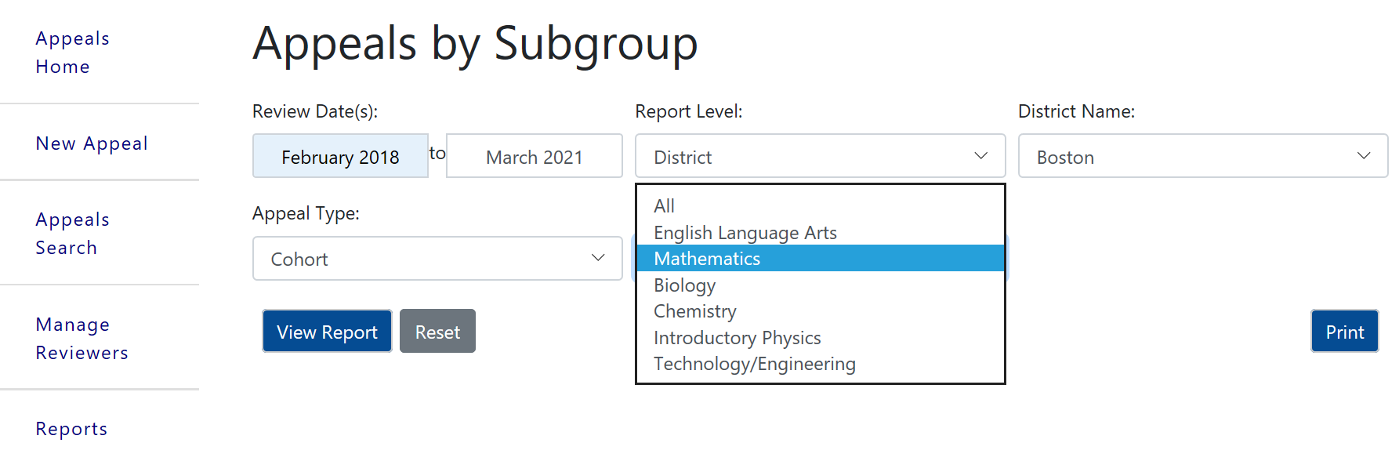
Report Option: Appeals by Subgroup
If desired, use filters to disaggregate results by Review Date, School, and Appeal Type and Subject. (See sample report on next slide.) Then, select “View Report.”

Slide 47
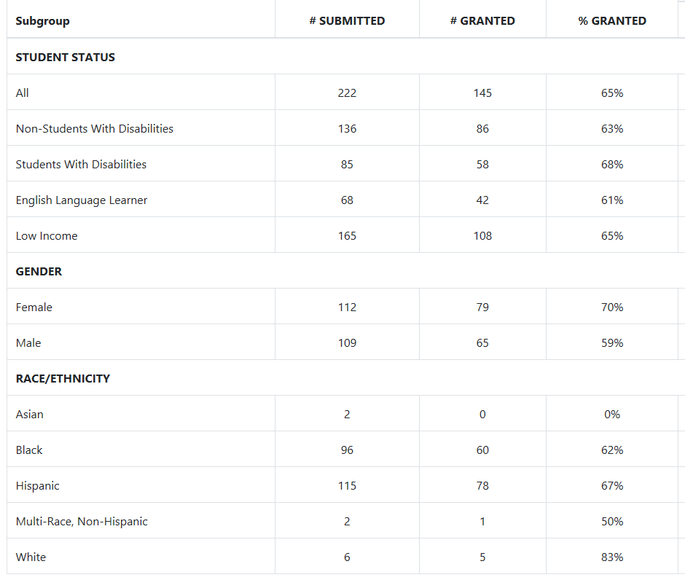
Sample Report: Appeals by Subgroup

Slide 48
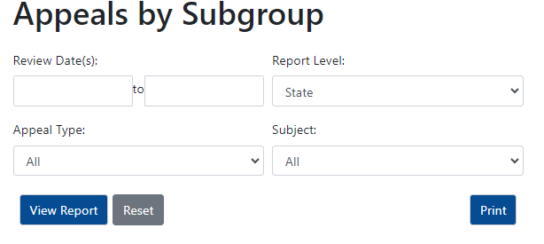
Print Feature
Once report is generated, select “Print” to use the web browser’s printing feature.

Slide 49
Overview of Statewide Results
About 16,500 total appeals were submitted between 2004 and 2023
~ 11,500 (70%) were granted.
~ 5,000 appeals were granted for students with disabilities (66%).
~870 of 2,200 portfolio appeals were granted (40%).
Portfolio appeals are often submitted multiple times before they are granted. Since portfolio appeals are cumulative, schools may submit incomplete portfolio appeals in order to receive feedback over the course of multiple years.

Slide 50
Questions & Answers 3
Use the “Q&A” feature to ask questions.

Slide 51
THANK YOU
The Office of Student Assessment Services
781-338-3625
mcas@doe.mass.edu
www.doe.mass.edu/mcas
75 Pleasant Street, Malden, MA 02148

