Slide 1
PAN Tasks for Accessibility and Accommodations
The Office of Student Assessment Services February 29, 2024

Slide 2
Presenters
Shannon Cullen, MCAS Test Administration Coordinator
Robert Pelychaty, Manager of Inclusive Assessment
Gloria Hernandez, Pearson Customer Support

Slide 3
Logistics for This Session
Use the Q&A feature to ask a question.
We will answer some questions aloud at specified times during this training session, and we will email the Q&A afterwards.
Type your questions anytime, but we may not answer them in real time as some questions may be covered during the presentation.
Use the thumbs-up icon to “upvote” someone else’s question.
Email student-specific questions to mcas@mass.gov instead of asking here.
This session is being recorded and will be available in about a week in the MCAS Resource Center, along with the slides.
Slides were also emailed out beforehand, and are being posted in the chat.
Closed captioning has been enabled for participants who need it.
This session is being interpreted into ASL. Our interpreting team will be onscreen with the presenters.

Slide 4
Slides for This Session
Slides were emailed to participants before this session from MCASEvents@cognia.org.
Slides are now being posted in the chat.
If you cannot access the slides in the chat, ask in the Q&A.
After the session, we will send the slides again to participants, and they will be posted in the MCAS Resource Center along with the recording.

Slide 5
Today’s Agenda
Overview of Accessibility and Accommodations Tasks in PAN
Tasks to Complete before Testing
Creating Human Read-Aloud/Human Signer Sessions
Verifying Accessibility Features and Accommodations
Updating Accommodations in PAN
Updating Form-Dependent Accommodations in PAN
Web Extensions
Resources, Support, and Next Steps
Live “Sandbox Time”

Slide 6
1. Overview of Accessibility and Accommodations Tasks in PAN

Slide 7
Poll Question
What is your role in MCAS test administration?
Principal or MCAS test coordinator
MCAS test administrator
Special education administrator or supervisor
Other role in my school or district

Slide 8
Poll Question 2
How many years have you coordinated or administered MCAS test accommodations at your school or district?
6 or more years
3 to 5 years
1 to 2 years
This is my first year.

Slide 9
New for 2023–24:
Color contrast and answer masking are no longer required in the SR/PNP.
All students will have access to these accessibility features in TestNav.
Review Appendix A: PAN Guidance for Form-Dependent Accommodations of the Guide to the SR/PNP Process before assigning accommodations.
Anyone who signs in to TestNav with a proctor testing ticket for a human read-aloud or human signer edition will see a prompt onscreen asking to verify whether they are a student or test administrator.
Designed to prevent responses entered into test administrator’s version (which does not save responses).

Slide 10
Computer-Based Testing (CBT) Components
PearsonAccess Next (PAN)
Online test management system for principals, test coordinators, and technology coordinators to manage user accounts, student registration, and computer-based test sessions.
PAN Session
A group of students in PAN who will be taking the same test together. Each PAN Session is grade and subject specific.
TestNav8 (TN8)
Online testing platform used by students to take the computer-based MCAS assessments
For more information, view the recording of the “Introduction to MCAS CBT for New Staff” training session from January 17, 2024.

Slide 11
Commonly Used Acronyms
CBT: Computer-based testing
PBT: Paper-based testing
PAN: PearsonAccess Next
SR/PNP: Student Registration/Personal Needs Profile
SIMS: Student Information Management System
EL: English learner
ELA: English Language Arts
STE: Science and Technology/Engineering
TTS: Text-to-speech
ASL: American Sign Language

Slide 12
Frequently Asked Questions from Prior Years
A student is supposed to have text-to-speech, but it’s not showing up on their test. What should I do?
(Answer on slide 48)
Web extensions were not assigned correctly. How do we correct this?
(Answer on slides 54–57)
Spring 2024 MCAS Test Administration FAQs
Page 7: FAQs on administering tests to students with disabilities
Page 8: FAQs on administering tests to ELs

Slide 13
Timeline of Tasks to Complete for Accessibility and Accommodations
Beginning in Fall 2023
2 weeks before testing
2 days before testing
1 day before testing
IEP teams make decisions.
Create PAN Sessions for students with Human Read Aloud and Human Signer accommodations.
Print testing tickets, including proctor testing tickets for students taking Human Read Aloud/Human Signer.
Test administrators verify accommodations using “Students in Sessions” page in PAN.
Complete the SR/PNP process and update as needed.
Train test administrators who will be providing accommodations. accurately.
Verify accommodations using PNP report.
Important for form-dependent accommodations
Students take practice tests and tutorial to become familiar with accommodations.

Slide 14
2. Tasks to Complete before Testing

Slide 15
Resources for Administering Accommodations for MCAS Testing
Recordings of previous training sessions:
MCAS Accessibility and Accommodations (note each session below contains the same content)
January 30, 2024
February 1, 2024
MCAS Test Administration and Security Protocols for New Staff – February 2, 2024
MCAS Test Administration and Security Protocols for Returning Staff – January 31, 2024
Accessibility and Accommodations Manual
Accessibility and Accommodations module
Resolving Incorrect Accommodations During Testing module
Additional resources on the DESE website

Slide 16
Pre-Administration Checklist for Administering Accommodations
Test Coordinators:
Verify that students with Human Read-Aloud and Human Signer are assigned to separate PAN Sessions.
Verify that student accommodations have been assigned correctly by reviewing the PNP report in PAN.
Test Administrators:
Review “Students in Sessions” page in PAN to verify student accommodations.
Ensure that students with Human Read-Aloud or Human Signer are given the student testing ticket, not the proctor testing ticket.

Slide 17
Test Admin Workgroup Input: “What are your school’s procedures for ensuring accuracy on the SR/PNP, particularly for accommodations?”
District 1:
School test coordinator sends list of students with IEPs to special education administrator.
Administrator reviews IEPs for changes and creates a spreadsheet of student accommodations.
Test coordinator then takes list of students and updates their SR/PNP spreadsheet with their accommodations.
Test coordinator reviews their list of students who have a 504 plan, and compiles spreadsheet of accommodations they use.
Test coordinator then assigns rooms for students, and contacts Student Support Services so that counselors can be these students’ test administrators.
The test coordinator sends list of EL students to their EL department chair.
They confirm which students are eligible for the Spanish/English edition for high school, and then assign testing rooms and Spanish-speaking test administrators.
District 2:
The district data analyst takes the DESE file and compares it against the district student information management system to confirm the accommodations match. Schools then go through and confirm accommodations.

Slide 18
Poll Question 3
Does your school use procedures similar to either of the districts on the previous slide?
Yes, District 1.
Yes, District 2.
No, we use different procedures.

Slide 19
Poll Question 4
If I select the Human Read-Aloud accommodation on the SR/PNP prior to import, will PAN automatically create the Human Read-Aloud Session?
Yes
No
I don’t know.

Slide 20
Creating Human Read-Aloud and Human Signer Sessions
Students with the Human Read-Aloud or Human Signer accommodation will need to be assigned to separate PAN Sessions with no more than 5 students (a proctor testing ticket will not be created without these steps).
Schools must use the PAN user interface to create these separate PAN Sessions. Follow the instructions in Appendix A of the Guide to the SR/PNP Process to create these Sessions using the PAN user interface.
NOTE: Any responses entered using the proctor testing ticket will not be saved. Test administrators need to make sure that students use their own (student) testing tickets.
Review the module for Creating Sessions on the MCAS Resource Center.

Slide 21
Demonstration
Creating Human Read-Aloud and Human Signer Sessions
Accessing Proctor Testing Tickets and Student Testing Tickets
Accessing the PNP report

Slide 22
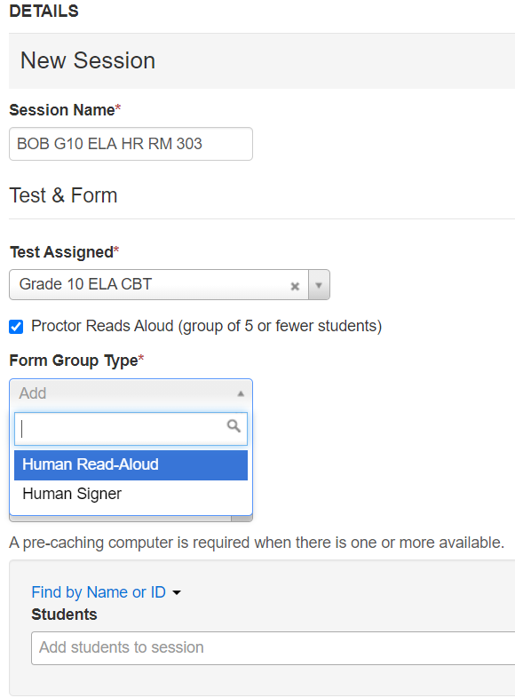
Creating Human Read-Aloud and Human Signer Sessions 2
Testing > Sessions > select your Session(s), then go to Select Tasks, Create/Edit Sessions > Start
Make sure your Session is selected on the left side of the screen, scroll down and check the Proctor Reads Aloud box, and then select either Human Read-Aloud or Human Signer in the Form Group Type drop-down. Click Save.

Slide 23
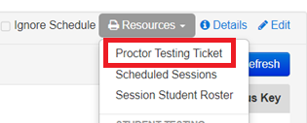
Accessing Proctor Testing Tickets
To access Proctor Testing Tickets for a Human Read-Aloud or Human Signer Session, go to Testing > Students in Sessions.
Select Add a Session and search for and select your Session.
Select Add Selected.
Under the Resources drop-down menu, select Proctor Testing Ticket.

Slide 24
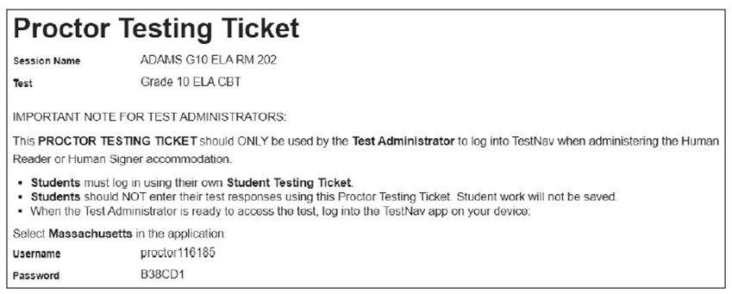
Proctor Testing Tickets
* We suggest printing this ticket out on different colored paper or highlighting the ticket to ensure only the test administrator uses this ticket (not the student).

Slide 25
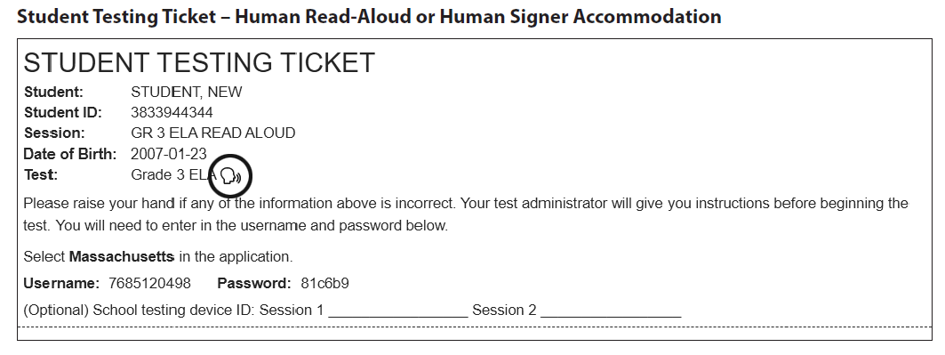
Student Testing Tickets for Human Read-Aloud, Human Signer, TTS

Slide 26
Verify Accessibility Features and Accommodations: Accessing the PNP Report
Before preparing PAN Sessions, verify students’ accommodations:
Go to Reports > Operational Reports > Students and Registrations > PNP Report
Preparing PAN Sessions is completed up to 2 days prior to testing.
District test coordinators, school test coordinators, and technology coordinators can access this report in PAN. Test administrators do not have access to the report.

Slide 27
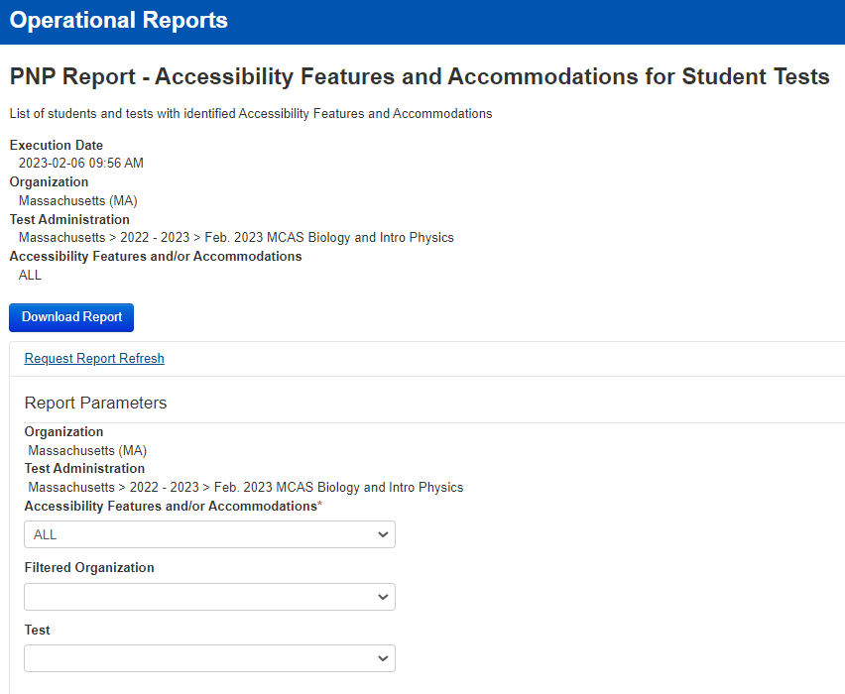
Accessing the PNP Report in PAN

Slide 28
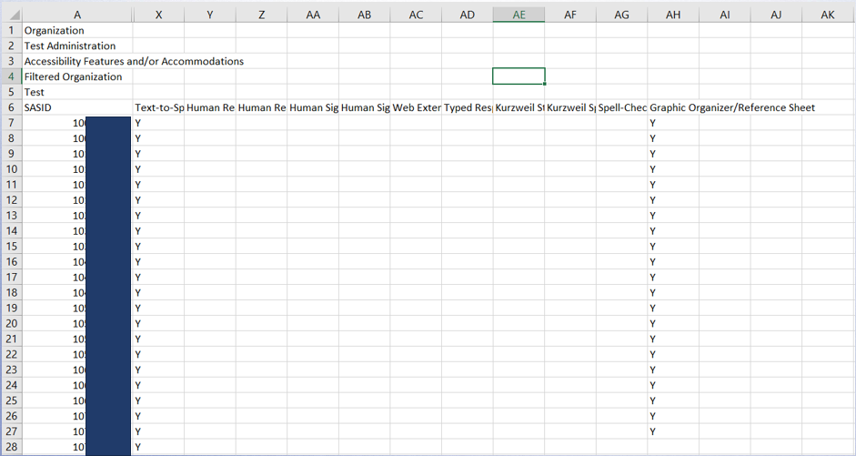
PNP Report

Slide 29
Verify Students’ Accommodated Forms Prior to Testing (After Sessions Are Prepared)
View the Students in Sessions page to see accommodated forms listed next to students’ names.
If an accommodated form is not listed (or if the wrong form is listed), see the following slides on updating accommodations.
Indicator | Description
TTS | Text-to-speech
SR | Screen Reader
AT | Compatible Assistive Technology
ASL | American Sign Language
S | Spanish/English
Calc | Calculation device on a non-calculator section
WebX | Web Extensions

Slide 30
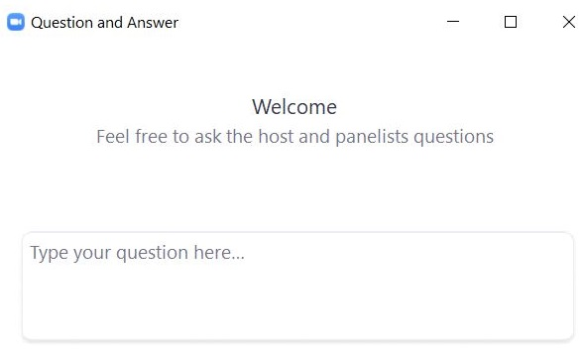
Questions and Answers
Use the “Q&A” feature to ask questions.

Slide 31
3. Updating Accommodations in PAN

Slide 32
Poll Question 5
When is it recommended to review and verify student accommodations using the PNP report?
The morning of testing
Before submitting the SR/PNP file
Before marking tests complete
Before preparing PAN Sessions

Slide 33
Updating Accommodations in PAN
After reviewing the PNP report, you may discover you need to update accessibility features or accommodations for certain students.
These updates should be made before preparing Sessions through the PAN user interface.
If you need to update accommodations for a large number of students, contact the MCAS Service Center.
Note: If an error is discovered after a student logs in, update the accommodations following steps beginning on slide 38, or slide 48 for form-dependent accommodations.

Slide 34
Demonstrations
Updating Accommodations in the User Interface

Slide 35
Step-by-Step Procedures to Update Accommodations in PAN
From the Setup drop-down, select Students.
Search by last name or SASID.
Click the checkbox next to the student’s name.
From the Select Tasks drop-down, select Manage Student Tests. Click Start. Click the content area test on the left side.
Add or remove the check from the box next to each accommodation as needed.
Click Save.

Slide 36
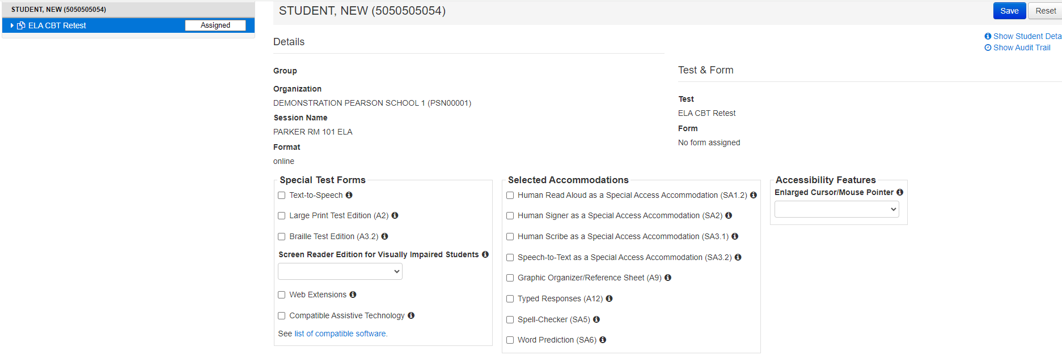
Steps to Update Accommodations in User Interface
Manage Student Tests Display Screen

Slide 37
High School PBT Tests in PAN
For the paper-based (PBT) editions of all high school tests, each test session has its own screen in PAN in Manage Student Tests. Each test session should be updated individually by clicking on each on the left side of the page.

Slide 38
What if a student starts testing with the incorrect accessibility feature/accommodation?
For the accessibility features and accommodations listed below, a new test is not needed.
Student should sign out of the test in TestNav, and the principal/test coordinator should follow the same steps listed on slide 35.
Go to Setup > Students > Select Student > Select Tasks > Manage Student Tests > Start
Update feature or Accommodation > Save
Student logs back in to test
Calculation Device Alternate Cursor/Mouse Pointer Human Scribe Graphic organizer | Web Extensions (Speech-to-text and Word Prediction) Spell-Check Typed Responses

Slide 39
Updating Accommodations After Testing for Students Who Did Not Use an Accommodation
Update accommodations in PAN for each content area test if a student refused or did not use an accommodation:
Setup > Students > Manage Student Tests
If form-dependent accommodations cannot be changed (i.e., TTS, ASL, Screen Reader, Spanish) in PAN and were incorrect during testing, accommodations can be updated during the discrepancy period.
More information about the 2024 discrepancy period will be shared in future Student Assessment Updates.

Slide 40
4. Updating Form-Dependent Accommodations

Slide 41
Form-Dependent Accommodations
The following accommodations must be assigned correctly before testing.
If not assigned correctly, a student’s test will need to be stopped and a new test will need to be set up, and the student may need to retake a portion of the test.
Form-dependent accommodations for CBT:
Text-to-speech
Screen reader
ASL
Spanish/English
Compatible assistive technology
Human read-aloud
Human signer
Form-dependent accommodations for PBT:
Large-print
Braille
See the new Appendix A: PAN Guidance for Form-Dependent Accommodations in the Guide to the SR/PNP Process

Slide 42
Updating a Human Read-Aloud/Human Signer Session
Human Read-Aloud and Human Signer Sessions must be designated in the Sessions > Create/Edit sessions task.
Refer to slide 22 for steps.
Note: If a Session has been prepared, a new Session will need to be created in order to update the Form Group Type.

Slide 43
Updating Form-Dependent Accommodations After a PAN Session is Prepared
Most accessibility features and accommodations can be updated after a PAN Session is prepared according to the steps on slide 35. The following form-dependent accommodations are exceptions:
Text-to-speech
Screen-reader
Compatible Assistive Technology
ASL
English/Spanish Edition
Human Read-Aloud/Human Signer Session

Slide 44
Demonstrations 2
Updating Form-Dependent Accommodations after a PAN Session is Prepared

Slide 45
Exceptions: Updating Form-Dependent Accommodations After a PAN Session Is Prepared
The student must be removed from the Session before changes can be made.
Students in Sessions > Click the checkbox next to student’s name > Select Tasks > Remove Students from Sessions > Start
Then, update the student on Manage Student Tests page.
Then, add the student back to the PAN session.

Slide 46
Poll Question 6
The wrong accommodation was assigned to a student in PAN, and the student has started their test. Do I need to assign the student a new test?
Yes
No
Only for certain accommodations

Slide 47
Demonstrations
Updating Form-Dependent Accommodations after a Student Signs in to a Test

Slide 48
What are the steps to take if a student started testing with the incorrect form-dependent accommodation?
For text-to-speech, screen reader, ASL, compatible AT, and Spanish edition, or human read-aloud/human signer (if a student was incorrectly assigned to a Human Read-Aloud/Human Signer PAN Session), follow these steps:
The student needs to exit the test.
The test coordinator marks the test complete. (Testing > Students in Sessions > Mark Student Tests Complete)
The test coordinator voids the test (e.g., Manage Students Tests screen > select the “Void Test Score Code” and the appropriate “Void Test Score Reason” from the drop-down).
Assign the student a new test with the correct accommodated test form.
The test administrator can create a new PAN Session for the student or place the student in a different PAN Session.
School personnel will contact the Department and may need to submit an irregularity report.
Review the training module Resolving Incorrect Accommodations During Testing for a step-by-step demonstration online at http://mcas.pearsonsupport.com/training/

Slide 49
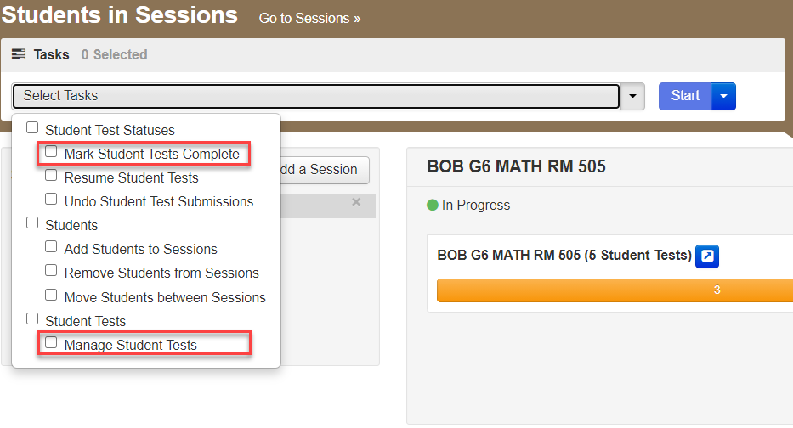
Step 1 After a Student Signs in to a Test
Select the student on the Students in Sessions page > Select Tasks > Mark Student Tests Complete > Manage Student Tests > Start

Slide 50
Step 2 After a Student Signs in to a Test: Void the Test
On the Manage Student Tests tab, check the box for Void Test, and select the reason – i.e., Wrong Accommodations.

Slide 51
Step 3 After a Student Signs in to a Test: Mark the Test Complete
On the Mark Student Tests Complete tab, check the boxes for all sessions that are not yet complete > describe reason (e.g., incorrect accommodation given) > Mark Complete

Slide 52
Step 4 After a Student Signs in to a Test: Create a New Test for the Student
On the Setup > Students page, select the student, go to Select Tasks > Manage Student Tests > Start
Create a new test for the student by filling in the required fields. Click Save.
The student will need to be added to a new PAN Session and a new testing ticket will need to be printed.
Call DESE to determine whether an irregularity report is necessary.

Slide 53
Questions and Answers 2
Use the “Q&A” feature to ask questions.

Slide 54
5. Web Extensions

Slide 55
Web Extensions
For students using speech-to-text and/or word prediction on ELA, grades 5 and 8 STE, and high school Biology (not applicable for Math and Introductory Physics), Web Extensions must also be selected in the SR/PNP. Assistive Technology Guidelines for MCAS
Note that web extensions will be assigned differently for the grade 8 Civics field test. More information will be shared at the Grade 8 Civics Test Administration training on March 21.

Slide 56
Web Extension Assistive Technology (AT) Form
Web AT form for the use of speech-to-text or word prediction accommodations
IEP must list “speech-to-text” or “word prediction” as an accommodation, and student must meet criteria to receive this accommodation.
SR/PNP for student with a disability must designate Web Extension AT test form for the specific test. (Student will select either Co:Writer or Read&Write on TestNav screen.)
Web extensions are NOT available for Mathematics and Introductory Physics, due to conflicting use of the Equation Editor.
Do not assign the “Web Extension AT Form” to student who is unfamiliar with its use. Student should attempt a practice test with this feature prior to actual testing.
Review Assistive Technology Guidelines for MCAS prior to selecting the Web Extension AT Form for students.

Slide 57
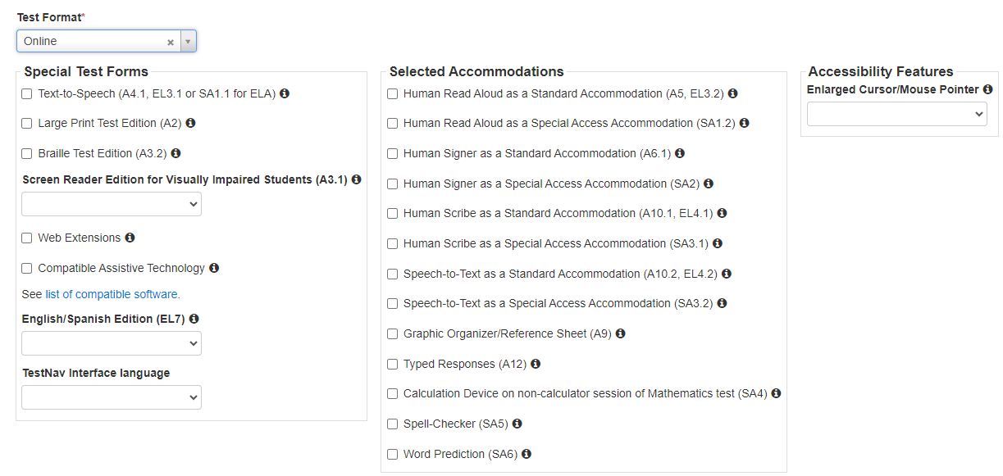
Web Extension Assistive Technology (AT) Form 2

Slide 58
Questions and Answers 3
Use the “Q&A” feature to ask questions.

Slide 59
6. Resources, Support, and Next Steps

Slide 60
Resources for PAN Tasks for Accessibility and Accommodations
Resource | Location
Guide to the SR/PNP Process | mcas.pearsonsupport.com/manuals (“PearsonAccess Next Guidance” drop-down)
Creating Sessions module | mcas.pearsonsupport.com/training
Verifying accommodations by viewing the PNP report | https://support.assessment.pearson.com/PAsup/reporting/operational-reports
Updating Accommodations in PAN Resolving Incorrect Accommodations During Testing module | mcas.pearsonsupport.com/training
Accessibility and accommodations guidance and modules | mcas.pearsonsupport.com/manuals (“Accessibility and Accommodations Guidance” drop-down)
Appendix B of the CBT TAM – Resolving Situations that Involve Accommodations | https://www.doe.mass.edu/mcas/admin.html
Accessibility and Accommodations Manual | https://www.doe.mass.edu/mcas/accessibility/default.html

Slide 61
Additional Resources on the DESE MCAS Website
Resource | Description
Home page | Access MCAS headlines and links to MCAS site (e.g., test schedule, test designs, training)
Student Assessment Updates | Biweekly email with important updates about the MCAS program If you do not already receive this email, subscribe at this link: http://eepurl.com/ghSOhH

Slide 62
Upcoming Training Sessions on PAN Tasks
Tasks in PAN During Testing
Tuesday, March 12 at 9:30–11:00 a.m.
Audience: Principals, test coordinators, and test administrators
Printing student testing tickets
Downloading the Session Student Roster
Starting PAN Sessions
Locking/Unlocking test sessions
Managing active student tests
Resuming student tests
Managing make-up testing
Moving students between PAN Sessions
Voiding student tests
Tasks in PAN After Testing
Thursday, March 14 at 9:30–10:45 a.m.
Audience: Principals and test coordinators
Filling in not tested codes
Removing students from PAN Sessions
Marking student tests complete
Stopping PAN Sessions
Registration for training sessions available now: www.doe.mass.edu/mcas/training.html
After each session is delivered, a recording of the session and the slides will be posted at mcas.pearsonsupport.com/training/ approximately one week later.

Slide 63
Next Steps
Today: Complete the evaluation form.
Responses are associated with the name and email address used to log in.
Email your input to mcas@mass.gov if you have problems accessing or completing the form.
Within one week:
Receive an email with the Q&A from this session
Recording will be available

Slide 64
Email and Phone Support
MCAS Service Center
DESE Student Assessment Services
Questions on logistics and technology (e.g., PearsonAccess Next, SR/PNP, TestNav)
Web: mcas.pearsonsupport.com
Email: mcas@cognia.org
Phone: 800-737-5103
Schedule Technology Support Call.
Policy questions (e.g., student participation, accommodations, “I have a student who…”)
Web: www.doe.mass.edu/mcas
Email: mcas@mass.gov
Phone: 781-338-3625

Slide 65
7. Live “Sandbox Time”

Slide 66
Poll Question 7
Which demonstration would you like to see again?
Creating Human Reader/Human Signer Sessions
Printing Student and Proctor Testing Tickets
Accessing the PNP Report to verify accommodations
Updating accommodations in the PAN User Interface
Updating form-dependent accommodations after preparing PAN Sessions
Updating form-dependent accommodations after a student signs in to a test

Slide 67
THANK YOU
The Office of Student Assessment Services
781-338-3625
mcas@mass.gov
www.doe.mass.edu/mcas
135 Santilli Highway, Everett, MA 02149

