Slide 1
Tasks in PearsonAccess Next After Testing
The Office of Student Assessment Services March 14, 2024

Slide 2
Presenters
Shannon Cullen, MCAS Test Administration Coordinator
Scott Kelley, Data and Reporting Specialist
Gloria Hernandez, Pearson Customer Support Specialist

Slide 3
Logistics for This Session
Use the Q&A feature to ask a question.
We will answer some questions aloud at specified times during this training session, and we will email the Q&A afterwards.
Type your questions anytime, but we may not answer them in real time as some questions may be covered during the presentation.
Use the thumbs-up icon to “upvote” someone else’s question.
Email student-specific questions to mcas@mass.gov instead of asking here.
This session is being recorded and will be available in about a week in the MCAS Resource Center, along with the slides.
Slides were also emailed out beforehand, and are being posted in the chat.
Closed captioning has been enabled for participants who need it.
This session is being interpreted into ASL. Our interpreting team will be onscreen with the presenters.

Slide 4
Slides for This Session
Slides were emailed to participants before this session from MCASEvents@cognia.org.
Slides are now being posted in the chat.
If you cannot access the slides in the chat, ask in the Q&A.
After the session, we will send the slides again to participants, and they will be posted in the MCAS Resource Center along with the recording.

Slide 5
Today’s Agenda
Timeline of Tasks in PearsonAccess Next (PAN)
Tasks After All Testing Has Been Completed
Resources, Support, and Next Steps
Live “Sandbox Time”

Slide 6
Poll Question
What is your role in MCAS test administration?
Principal or MCAS test coordinator
Technology coordinator
MCAS test administrator
Other role in my school or district

Slide 7
Poll Question 2
How many years have you participated in MCAS test administration at your school or district?
6 or more years
3 to 5 years
1 to 2 years
This is my first year.

Slide 8
Commonly Used Acronyms
CBT: Computer-based testing
PBT: Paper-based testing
PAN: PearsonAccess Next
SR/PNP: Student Registration/Personal Needs Profile
EL: English learner
ELA: English Language Arts
STE: Science and Technology/Engineering
SASID: State-Assigned Student ID

Slide 9
New for 2024
Answer masking and color contrast accessibility features are no longer part of the SR/PNP file.
All students will have access to these accessibility features in TestNav.
Appendix A of the Guide to the SR/PNP Process: PAN Guidance for Form-Dependent Accommodations
Highlights important information regarding certain accommodations that require additional steps to assign in the SR/PNP
Text-to-speech
Web extensions (speech-to-text and word prediction)
Spanish/English edition
Screen reader edition
Compatible assistive technology
ASL edition
Human reader/human signer

Slide 10
1. Timeline of Tasks in PearsonAccess Next

Slide 11
Timeline of Tasks in PAN to Complete Before Testing for Principals/Test Coordinators
2 weeks before testing
Create PAN Sessions and add students
Verify accommodations in PAN
Recommended to be completed by principals/test coordinators, but can also be done by
• District or School Test Coordinator
• Tech Coordinator
Up to 2 days before testing
Prepare PAN Sessions
Print testing tickets
Recommended to be completed by principals/ test coordinators, but all PAN users have access to do these tasks.
Now
Continue to update student info in PAN (SR/PNP)
Conduct Preliminary System Test/Infr. Trial
See recommended dates for Infrastructure Trial
Enrollment Transfer Work Requests (as needed)

Slide 12
Timeline of Tasks in PAN to Complete During Testing for Principals/Test Coordinators
Test Day
Unlock PAN Sessions
Distribute testing tickets to Test Administrators
Recommended: test administrators unlock PAN Sessions, but all PAN users have access to do this.
During Testing
Resolve incorrect accommodations
Manage makeup testing
Void tests as needed
These tasks should be completed by principals/test coordinators.
1 day before testing
Start PAN Sessions
Recommended: Principals/test coordinators, but all PAN users have access to do this.

Slide 13
Timeline of Tasks in PAN to Complete After Testing for Principals/Test Coordinators
After Testing
Mark tests complete
Fill in Not Tested codes
Void tests
Stop PAN Sessions
Recommended: principals/test coordinators stop PAN Sessions, but all PAN users have access to this. The other tasks should be completed by principals/test coordinators.

Slide 14
Timeline of Tasks in PAN to Complete Before and During Testing for Test Administrators
Up to 2 days before testing
1 day before testing
Start PAN Sessions
Recommended: Principals/test coordinators, but all PAN users have access to do this.
Test Day
Verify that students have the correct test forms, including accommodations
Note that this should be done after Sessions have been prepared.
Unlock PAN Sessions
Distribute testing tickets to students
Monitor students in PAN
Resume students who exit TestNav unexpectedly
Recommended: Test administrators unlock PAN Sessions, but all PAN users have access to do this.

Slide 15
For Additional Support on These Tasks
Most of the tasks on slides 11-14 were covered in the previous training sessions.
The recordings and slides will be available soon at mcas.pearsonsupport.com/training/
Schools may also refer to the Additional PAN Demonstrations for Infrastructure Trials (also on the same web page).
MCAS Resource Center & Logging into PearsonAccess^{next}
Resuming Students’ Tests
Marking Students’ Tests Complete
Updating Student Records & Adding Accommodations
PAN Sessions – Prepare, Start, Lock/Unlock, and Resources

Slide 16
2. Tasks after All Testing has been Completed

Slide 17
Updating Accommodations After Testing for Students Who Did Not Use an Accommodation
Update accommodations in PAN for each content area test if a student refused or did not use an accommodation:
Setup > Students > Manage Student Tests
If the following accommodations cannot be changed (i.e., TTS, ASL, Screen Reader, ASL, Spanish) in PAN and were incorrect during testing, accommodations can be updated during the discrepancy period.
More information about the 2024 discrepancy period will be shared in future Student Assessment Updates.
Important for accurate data collection

Slide 18
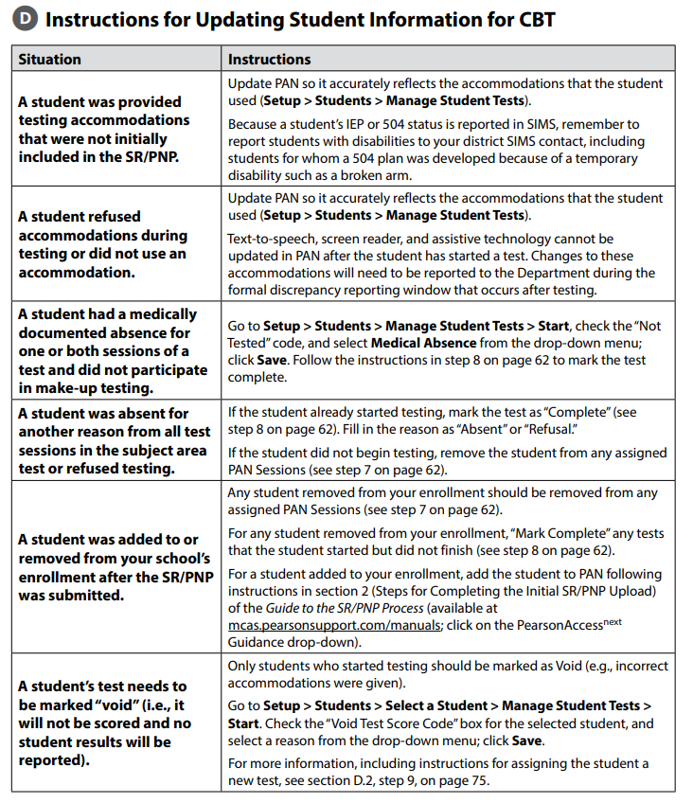
Confirm All Students Participated in Testing and Update Student Information
Check rosters and confirm that all students participated in testing.
Refer to table on page 136 of the PAM for instructions on updating student information.

Slide 19
Clean Up PAN Sessions
Enter Not Tested for Medical Reason for students who were absent for medical reasons and will not test.
On the Manage Student Tests page, check the box for Not Tested Code and enter Not Tested Reason.
If a student is absent for other reasons, no action is required.
Remove students in “ready” status from the PAN Session.
Students in “ready” status have not signed in to a test.
Mark tests complete.
Ensure all students are in a “complete” or “marked complete” status.
Stop PAN Sessions.

Slide 20
Demonstrations
Not Tested for Medical Reason
Remove Students from PAN Sessions
Mark Tests Complete
Stop PAN Sessions

Slide 21
Not Tested for Medical Reason
Go to Setup > Students, and check the box next to the student’s SASID.
Then, go to Select Tasks > Manage Student Tests > Start.
Check the Not Tested Code box and select Medical Absence from the appropriate drop-down menu; click Save.

Slide 22
Removing Students from PAN Sessions
If a student did not log in to test and is still in “Ready” status, they should be removed from the PAN Session.
Go to Testing > Sessions.
Select the name of the PAN Session the student is in and select Go to Students in Sessions.
Select the checkbox next to the student name and go to Select Tasks > Remove Students from Sessions.
Select the checkbox next to the student name and select Remove.
See guidance at https://support.assessment.pearson.com/display/PAsup/Remove+a+Student+from+a+Session

Slide 23
Make Sure Tests Are in Complete/Marked Complete Status
Make sure each student’s test sessions (not the PAN Session) are either in Complete or Marked Complete status.
Students’ tests need to be “marked complete” if they
did not complete testing and have a test session with a status of Exited, Resumed, or Resumed Upload
took only one test session
See guidance at https://support.assessment.pearson.com/display/PAsup/Mark+Student+Tests+Complete

Slide 24
Mark Student Tests Complete
On the Mark Student Tests Complete tab, check the boxes for all of the test sessions that are not complete > describe reason (e.g., unable to finish due to illness) > Mark Test Complete

Slide 25
Stop PAN Sessions after Testing is Completed
All PAN Sessions must be “stopped” after testing.
See page 63 of the PAM.
Before “stopping” PAN Sessions, all tests must be complete or marked complete.
Step-by-step procedures:
Go to Testing > Sessions and check the box next to each PAN Session that is still listed as “In Progress”.
You can use the Session Status filter on the left to find only the Sessions that are “In Progress.”
Click Go to Students in Sessions.
Click on Combined View on the left side, and then click Stop All Sessions.

Slide 26
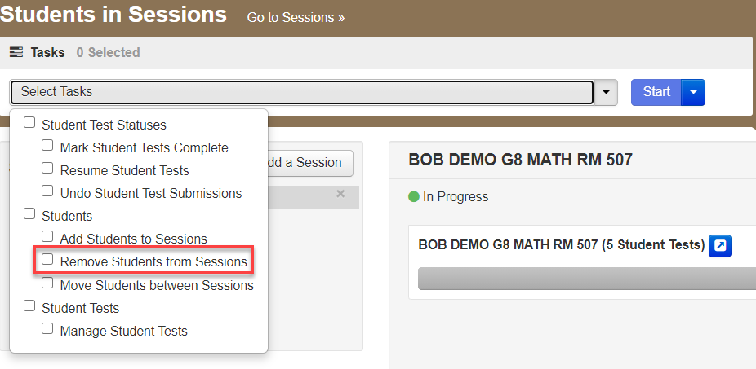
How to Handle Absent Students (Not MED)
Remove absent students in ready status from PAN Sessions.
There is no further action in PAN for students absent for a non-medical reason.
This includes students who transferred out of your school and did not test.
https://support.assessment.pearson.com/display/PAsup/Remove+a+Student+from+a+Session

Slide 27
How to Handle Students with a Medical Absence
Students who logged into a test:
Mark the student’s test complete
Students who did not log into a test:
Remove the student from the Session
Final Step
Select the “Medical Absence” Not Tested Reason in Manage Student Tests

Slide 28
Poll Question 3—3
Schools need to enter Not Tested Codes for which of the following students:
Students who were absent for any reason
Students who were absent for medical reasons only
Students who completed test session 1 but not test session 2
Students who were dismissed in the middle of a test session

Slide 29
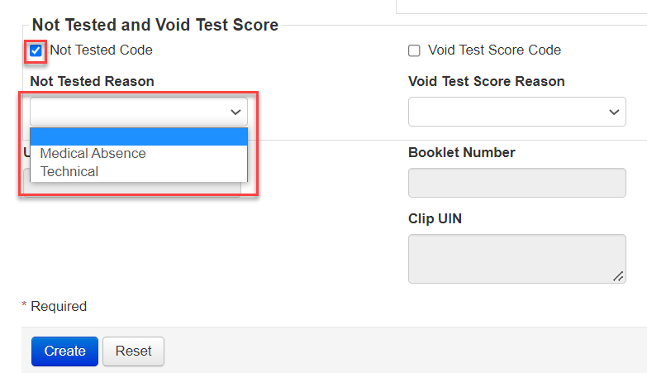
Not Tested Codes (Student Will Not Continue Testing)
Enter the Not Tested Code via PAN user interface or file only for students with a:
Medical Absence
Technical Failure
Call the MCAS Service Center before selecting this code (800-737-5103)
For schools with a large number of students with medical absences, schools can upload an updated SR/PNP file after testing to indicate medical absences in column N.

Slide 30
Additional Tasks after Test Administration
Follow the steps listed in the PAM for all the tasks to complete after test administration.
Checklist of tasks after test administration appears on page 48.
The steps/descriptions begin on page 60.
Steps for completing the Principal’s Certification of Proper Test Administration (PCPA) and updating the SR/PNP are provided in the PAM, and the deadline dates for completing these tasks are included in the Statewide Testing Schedule.

Slide 31
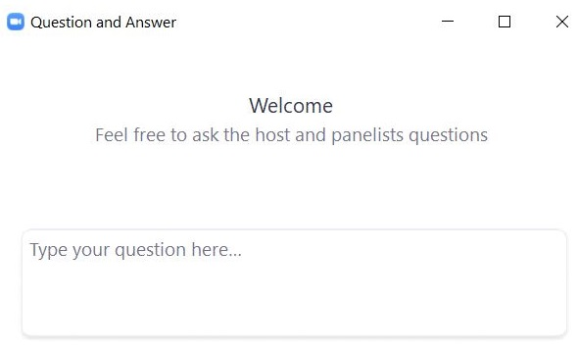
Questions and Answers
Use the “Q&A” feature to ask questions.

Slide 32
3. Resources, Support, and Next Steps

Slide 33
Additional Resources
Resource | Location
Guide to the SR/PNP Process | mcas.pearsonsupport.com/manuals (“PearsonAccess Next Guidance” drop-down)
Creating Sessions and Session Management online training modules | mcas.pearsonsupport.com/training
Accessibility and accommodations module and previously offered session on this topic | mcas.pearsonsupport.com/training
Accessibility and accommodations guidance | mcas.pearsonsupport.com/manuals (“Accessibility and Accommodations Guidance” drop-down)
Test administration manuals | www.doe.mass.edu/mcas/testadmin/manual/
Student Assessment Updates (Biweekly email with important updates about the MCAS program) | www.doe.mass.edu/mcas/updates.html If you do not already receive this email, subscribe using this link: http://eepurl.com/ghSOhH

Slide 34
Additional Resources from the PAN User Guide
Resource | Location
Stop a PAN Session | https://support.assessment.pearson.com/PAsup/testing/stop-a-session
Move a Student Test between PAN Sessions | https://support.assessment.pearson.com/PAsup/testing/move-a-student-test-between-sessions
Remove a Student Test from a PAN Session | https://support.assessment.pearson.com/PAsup/testing/remove-a-student-from-a-session
Mark Student Tests Complete | https://support.assessment.pearson.com/PAsup/testing/mark-student-tests-complete
Edit Student Test Details | https://support.assessment.pearson.com/PAsup/testing/edit-student-test-details

Slide 35
Next Steps
Today: Complete the evaluation form.
Responses are associated with the name and email address used to log in.
Email your input to mcas@mass.gov if you have problems accessing or completing the form.
Within one week:
Receive an email with the Q&A from this session
Recording will be available

Slide 36
Email and Phone Support
MCAS Service Center
DESE Student Assessment Services
Questions on logistics and technology (e.g., PearsonAccess Next, SR/PNP, TestNav)
Web: mcas.pearsonsupport.com
Email: mcas@cognia.org
Phone: 800-737-5103
Schedule Technology Support Call
Policy questions (e.g., student participation, accommodations, “I have a student who…”)
Web: www.doe.mass.edu/mcas
Email: mcas@mass.gov
Phone: 781-338-3625

Slide 37
4. Live “Sandbox Time”

Slide 38
Poll Question 4—3
Which demonstrations would you like to see again?
Not tested for medical reason
Remove student from PAN Session
Mark student’s test complete
Stop PAN Sessions

Slide 39
THANK YOU
The Office of Student Assessment Services
781-338-3625
mcas@mass.gov
www.doe.mass.edu/mcas
135 Santilli Highway, Everett, MA 02149

