Slide 1
Tasks in PearsonAccess Next During Testing
The Office of Student Assessment Services March 12, 2024

Slide 2
Presenters
Shannon Cullen, MCAS Test Administration Coordinator
Gloria Hernandez, Pearson Customer Support Specialist

Slide 3
Logistics for This Session
Use the Q&A feature to ask a question.
We will answer some questions aloud at specified times during this training session, and we will email the Q&A afterwards.
Type your questions anytime, but we may not answer them in real time as some questions may be covered during the presentation.
Use the thumbs-up icon to “upvote” someone else’s question.
Email student-specific questions to mcas@mass.gov instead of asking here.
This session is being recorded and will be available in about a week in the MCAS Resource Center, along with the slides.
Slides were also emailed out beforehand, and are being posted in the chat.
Closed captioning has been enabled for participants who need it.
This session is being interpreted into ASL. Our interpreting team will be onscreen with the presenters.

Slide 4
Slides for This Session
Slides were emailed to participants before this session from MCASEvents@cognia.org.
Slides are now being posted in the chat.
If you cannot access the slides in the chat, ask in the Q&A.
After the session, we will send the slides again to participants, and they will be posted in the MCAS Resource Center along with the recording.

Slide 5
Today’s Agenda
Timeline of Tasks in PearsonAccess Next (PAN)
Printing Testing Tickets
Managing and Monitoring Sessions
Make-Up Testing and Moving Student Tests
Additional Tasks during Testing
Resources, Support, and Next Steps
Live “Sandbox Time”

Slide 6
Poll Question
What is your role in MCAS test administration?
Principal or MCAS test coordinator
Technology coordinator
MCAS test administrator
Other role in my school or district

Slide 7
Poll Question 2
How many years have you participated in MCAS test administration at your school or district?
6 or more years
3 to 5 years
1 to 2 years
This is my first year.

Slide 8
Commonly Used Acronyms
CBT: Computer-based testing
PBT: Paper-based testing
PAN: PearsonAccess Next
SR/PNP: Student Registration/Personal Needs Profile
EL: English learner
ELA: English Language Arts
STE: Science and Technology/Engineering
SASID: State-Assigned Student ID

Slide 9
New for 2024
Answer masking and color contrast accessibility features are no longer part of the SR/PNP file.
All students will have access to these accessibility features in TestNav.
Appendix A of the Guide to the SR/PNP Process: PAN Guidance for Form-Dependent Accommodations
Highlights important information regarding certain accommodations that require additional steps to assign in the SR/PNP
Text-to-speech
Web extensions (speech-to-text and word prediction)
Spanish/English edition
Screen reader edition
Compatible assistive technology
ASL edition
Human reader/human signer

Slide 10
Resources for Tasks to Complete During Testing
PAN Overview Video
Recordings of previous training sessions:
Introduction to Computer-Based Testing – January 17, 2024
MCAS Test Administration and Security Protocols for New Staff – February 2, 2024
MCAS Test Administration and Security Protocols for Returning Staff – January 31, 2024
Moving Students Between Sessions module
Sessions Management module
PAN Dashboards module

Slide 11
1. Timeline of Tasks in PearsonAccess Next

Slide 12
Timeline of Tasks in PAN to Complete Before Testing for Principals/Test Coordinators
2 weeks before testing
Create PAN Sessions and add students
Verify accommodations in PAN
Recommended to be completed by principals/test coordinators, but can also be done by
• District or School Test Coordinator
• Tech Coordinator
Up to 2 days before testing
Prepare PAN Sessions
Print testing tickets
Recommended to be completed by principals/ test coordinators, but all PAN users have access to do these tasks.
Now
Conduct Preliminary System Test/Infr. Trial
Continue to update student info in PAN (SR/PNP)
Enrollment Transfer Work Requests (as needed)
See recommended dates for Infrastructure Trial

Slide 13
Timeline of Tasks in PAN to Complete During Testing for Principals/Test Coordinators
1 day before testing
Test Day
During Testing
Start PAN Sessions
Unlock PAN Sessions
Distribute testing tickets to Test Administrators
Resolve incorrect accommodations
Manage makeup testing
Void tests as needed
Recommended: Principals/test coordinators, but all PAN users have access to do this.
These tasks should be completed by principals/test coordinators.
Recommended: test administrators unlock PAN Sessions, but all PAN users have access to do this.

Slide 14
Timeline of Tasks for in PAN to Complete After Testing for Principals/Test Coordinators
After Testing
Mark tests complete
Fill in Not Tested codes
Void tests
Stop PAN Sessions
Recommended: principals/test coordinators stop PAN Sessions, but all PAN users have access to this. The other tasks should be completed by principals/test coordinators.

Slide 15
Timeline of Tasks in PAN to Complete Before and During Testing for Test Administrators
Up to 2 days before testing
1 day before testing
Test Day
Unlock PAN Sessions
Distribute testing tickets to students
Monitor students in PAN
Resume students who exit TestNav unexpectedly
Verify that students have the correct test forms, including accommodations
Start PAN Sessions
Recommended: Principals/test coordinators, but all PAN users have access to do this.
Note that this should be done after Sessions have been prepared.
Recommended: Test administrators unlock PAN Sessions, but all PAN users have access to do this.

Slide 16
2. Printing Testing Tickets

Slide 17
Demonstrations
Download testing tickets and Session Student Roster

Slide 18
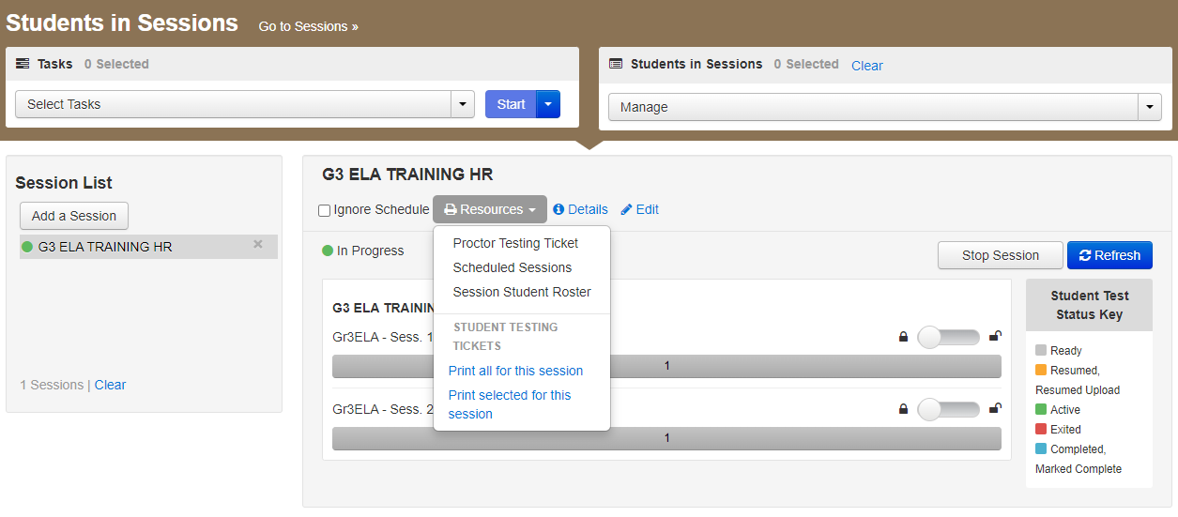
Download Testing Tickets and the Session Student Roster
Student testing tickets and proctor testing tickets (for human read-aloud/signer PAN Sessions) are located in the Resources drop-down in the Students in Sessions view, along with a Session Student Roster.

Slide 19
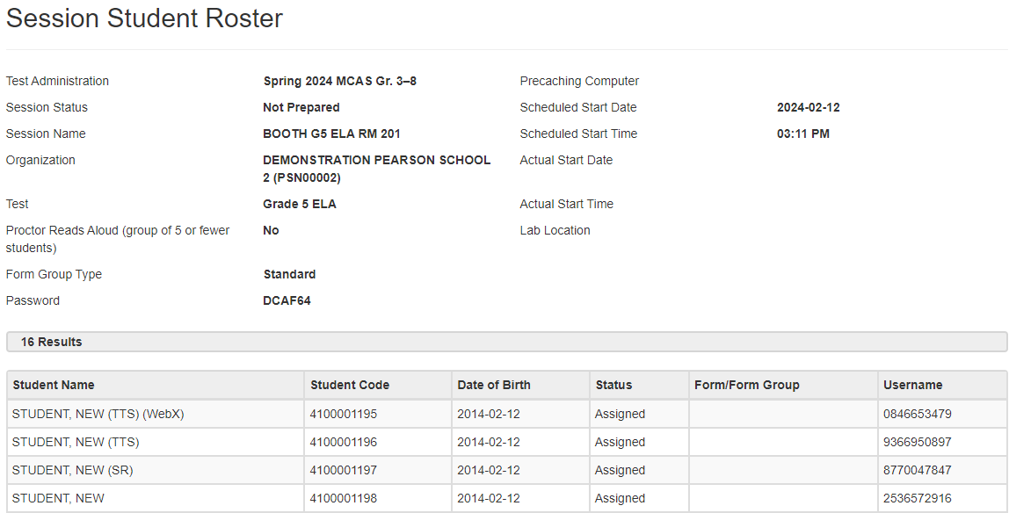
Sample Session Student Roster

Slide 20
Print Testing Tickets
Testing tickets contain the sign-in information that students need to type in to begin each test session.
Students use the same testing ticket for each subject area test (e.g., Jon Ward has one ticket for grade 4 ELA sessions 1 and 2, and a different ticket for grade 4 Mathematics).
Print testing tickets one or two days before testing, and distribute them to test administrators on the day of testing.
Testing tickets are considered secure and must be tracked.
Note: Proctor testing tickets are available for Human Read-Aloud and Human Signer Sessions only.
Responses are not saved when using a proctor testing ticket.

Slide 21
Testing Tickets
Advise your test administrators to check that each student has the correct testing ticket.
Students should verify their name and date of birth on the testing ticket.
Students can also verify their name in the top right corner of TestNav.

Slide 22
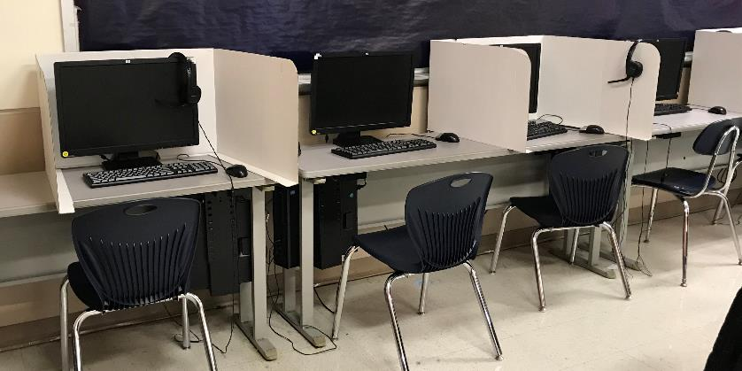
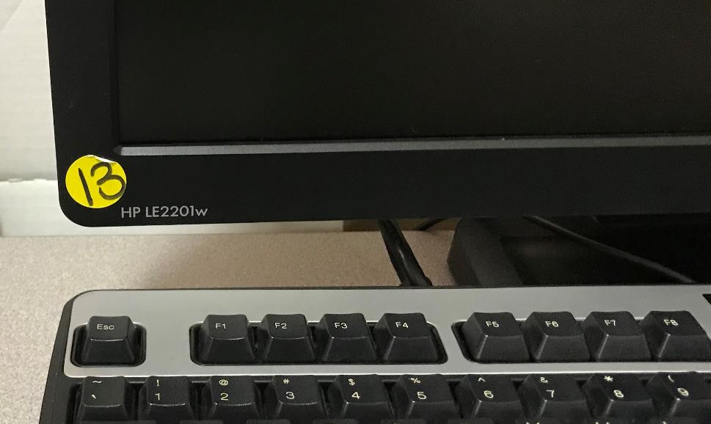
Example of a School Testing Device ID
Stickers with numbers on all the machines in the computer lab, each numbered sequentially
Thanks to E J Harrington School in Lynn

Slide 23
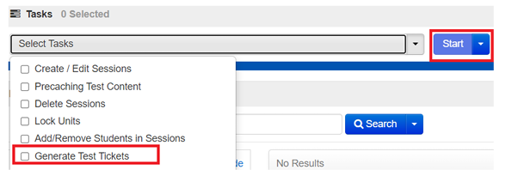
Batch Printing Testing Tickets
Test coordinators can print student testing tickets for multiple PAN Sessions at a time.
When tickets are printed, each PAN Session will be sorted by a leading header page labeled with the PAN Session name followed by tickets for that Session.
Note that batch printing is not available for proctor tickets – these are only available in the Resources drop-down menu on the Students in Sessions page.
Go to Testing > Sessions. Search for and select your PAN Sessions.
Under Select Tasks, select Generate Test Tickets.

Slide 24
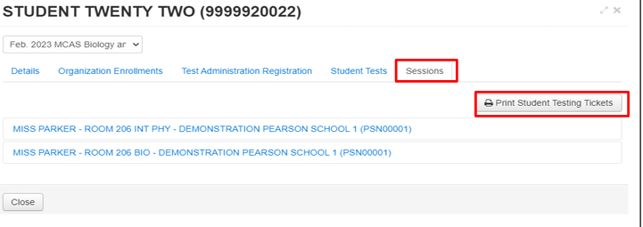
Printing All Testing Tickets for One Student
PAN users can print all of the testing tickets for the different subject area tests a student will take from one screen.
Go to Setup > Students. Search for the student.
Select the blue “i” information icon next to the student’s SASID.
Select the Sessions tab of the pop-up window.
Select Print Student Testing Tickets.

Slide 25
Poll Question 3
In your school, who is responsible for printing testing tickets?
Principal/MCAS test coordinator
Test administrators
Technology coordinator
Other

Slide 26
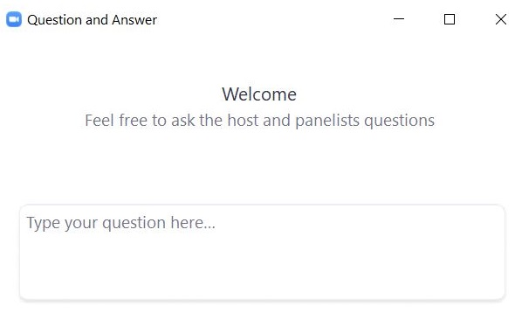
Questions and Answers
Use the “Q&A” feature to ask questions.

Slide 27
3. Managing and Monitoring Sessions

Slide 28
Demonstrations 2
Start a PAN Session
Lock/Unlock a Test Session

Slide 29
Start the Session
Testing > Sessions > select one or more Sessions > Show Students in Sessions > click Session name or Combined View > Start Session
PAN Sessions may be “prepared” up to two days prior to testing.
PAN Sessions cannot be “started” earlier than one day prior to testing. Principals should determine if they will “start” PAN Sessions or delegate this to test administrators.

Slide 30
Unlock the Test Session
Test sessions are locked by default; the test administrator should unlock the test session when ready for students to sign in to the test.
Only one test session per student can be unlocked at a time.
Test sessions can be unlocked for the entire class, or at the individual student level.
Unlocking at the student level is useful for make-up testing or when only a few tests in the session will be administered.
Recommended: Lock the test session at the end of the day to maintain test security.
See the CBT Test Administrator’s Manual (TAM) for maintaining security during restroom breaks and the mid-session break (instead of locking/unlocking a test).

Slide 31
Unlock the Test Session 2
Testing > Students in Sessions > select your PAN Session on the left side:
To unlock the test session for all the students: slide the padlock for the selected session to the unlocked position.
To unlock the test session for one student: select the lock icon to change it to an unlocked icon for the appropriate session.

Slide 32
Demonstrations 3
Manage Active Student Tests

Slide 33
Manage Active Student Tests
Test administrators should monitor student testing in PAN.
Reminder: PAN needs to be refreshed every 15 minutes, or else users will be logged out.
Testing > Sessions > select their PAN session, click Go to Students in Sessions
On the Students in Sessions screen, view the progress of the entire class and individual students.
A progress bar for the entire class shows at the top.
Click to refresh to see updates.
A status for each student also appears.
Click on the status bar to view individual student progress through the test session.

Slide 34
Student Status Dashboard
Testing > Sessions > select a session > Go to Students in Sessions > Monitor Test (above the student status bar)

Slide 35
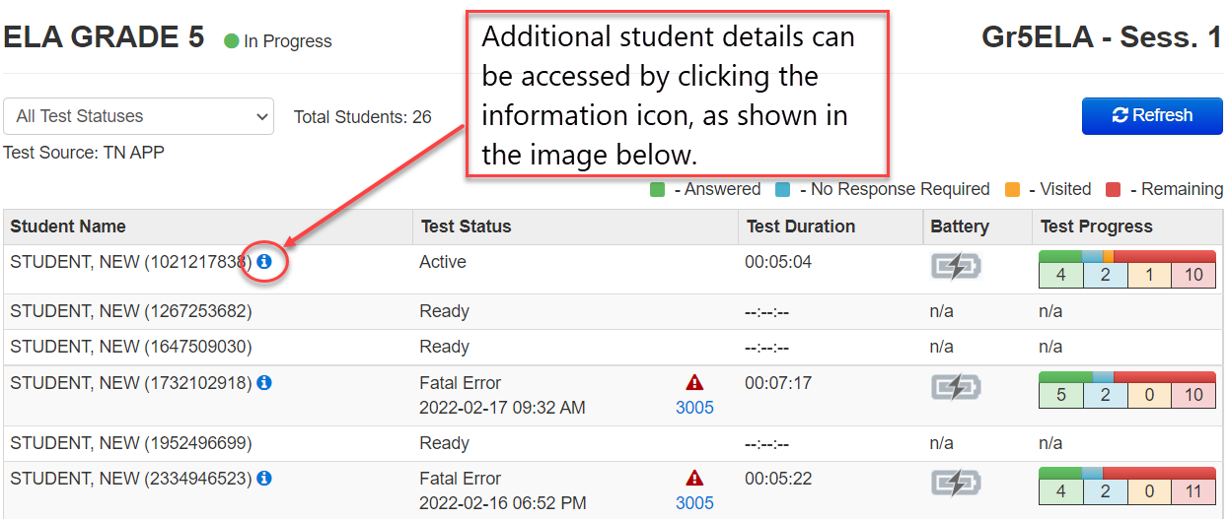
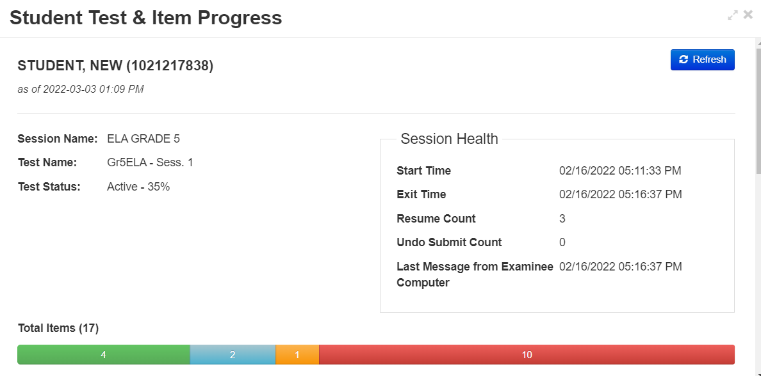
Student Status Dashboard (continued)

Slide 36
Manage Active Student Tests 2

Slide 37
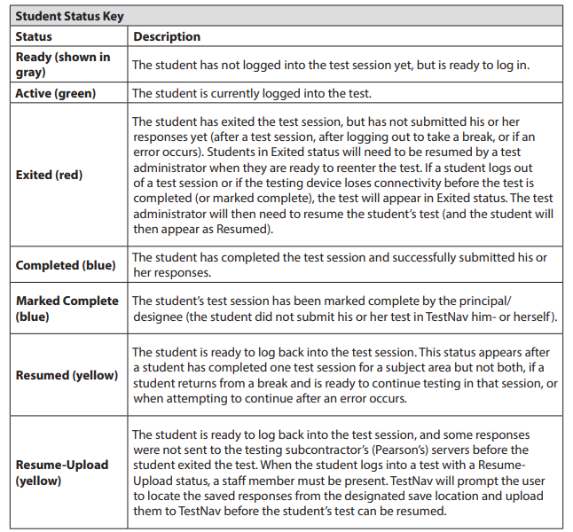
Student Status Key (Page 136 of the CBT TAM)

Slide 38
Resuming Student Tests
Sometimes a student will be exited from TestNav after they begin testing and will need to log back in.
Examples: user error, technology issues
Students must be in a “Ready”, “Resumed”, or “Resumed Upload” status in order to log in to TestNav.
If a student is in “Exited” status, and needs to get back in to TestNav, they will need to be Resumed by the Test Administrator.
Refer to the Resuming Student Tests video on the MCAS Resource Center for a demonstration of resuming student tests.

Slide 39
Resume-Upload
If a student is being resumed from an “Active” status in PAN, “Resume Upload” will be the only available option. This is to alert test administrators that there has been an abnormal exit such as the device being powered off.
Select “Resume Upload” in PAN
Select “Resume” in PAN
The student can also log in when in “Resume Upload”, but a message will appear on the student’s screen that gives the option of navigating to a Saved Response File. You can select “Skip Upload” on this message.
If you encounter any issues, call the MCAS Service Center.

Slide 40
Demonstrations 4
Resuming a Student’s Test

Slide 41
Resume Student Tests
To resume one student’s test: Testing > Students in Sessions > select Resume from the drop-drown next to the student’s name
To resume multiple students’ tests: Select the checkboxes next to the students’ tests to be resumed, select Resume Student Tests from the Select Tasks menu, and click Start. Select the students’ names again and then click Resume.

Slide 42
What if TestNav stops responding or exits a student from the test?
Attempt to identify the cause (e.g., security violation, loss of connectivity).
Test administrator resumes the student’s test.
When resuming a test after an error has exited the student from TestNav, the original testing device should be used first.
Contact your technology coordinator for assistance.
Additional CBT Instructions in CBT TAM (Appendix B)

Slide 43
Troubleshooting Tips
Contact your technology coordinator for repeated technical interruptions and to troubleshoot TestNav error codes. The following resources are available for technology coordinators:
Best Practices for MCAS CBT Set-Up, Administration, and Troubleshooting
TestNav Error Codes
TestNav System Requirements
Recording and slides from the Pre-Administration Tasks for Technology Staff training – February 5, 2024
SRF and Log Files (SRF: Saved Response Files)

Slide 44
Troubleshooting Tips 2
If possible, do not power the device off until the student has exited TestNav.
If the original testing device cannot be used or if the original error is still occurring, then another device should be attempted. Many issues are resolved by trying a different device if one is available.
Issues that cannot be resolved quickly should be immediately reported to the MCAS Service Center at 800-737-5103.
Large-scale technology failures (i.e., ones that affect one or more classrooms or in which the testing schedule is interrupted) should also be reported to the Department at 781-338-3625.
It is not necessary to report to the Department a loss in connectivity that can be quickly restored with minimal interruption to student testing.
Review steps in the following documents:
Principal’s Administration Manual Appendix A

Slide 45
Additional Guidance for Test Administrators
PAN Overview Video
Appendix B of the CBT TAM
A. Background and Overview (p. 134)
B. How to Use the “Students in Sessions” Screen (p. 135)
C. How to Resume Students’ Tests from Exited Status (p. 137)
D. Instructions for Make-Up Testing (p. 137)
E. Troubleshooting Situations that Can Occur in Test Sessions (p. 139)
F. Resolving Situations that Involve Accommodations (p. 141)
G. Error Codes and TestNav Issues (p. 144)

Slide 46
Questions and Answers 2
Use the “Q&A” feature to ask questions.

Slide 47
Poll Question
Which demonstration(s) would you like to see again?
Download student testing tickets
Download the session student roster
Start a PAN Session
Lock/unlock a test session
Manage active student tests
Resume a student’s test

Slide 48
4. Make-Up Testing and Moving Student Tests

Slide 49
Logistics for Make-up Testing
Students who are absent on the day of testing should be scheduled to make up the session.
All make-up testing must be completed within the windows listed in the Statewide Testing Schedule.
Students who are scheduled for make-up testing can either be left in their original PAN Session, or they can be moved to a new PAN Session. This is a local decision.

Slide 50
Poll Question 4
For makeup testing in your school, do you leave students in their original PAN Sessions or move them to new PAN Sessions?
Leave students in their original PAN Sessions
Move students to new PAN Sessions specifically for makeups
Sometimes A, sometimes B.

Slide 51
Poll Question 5
If a student is moved from one PAN Session to another, will the student need a new testing ticket?
Yes
No
I don’t know.

Slide 52
Moving Students between Sessions
Students who are moved to a new Session will need a new student testing ticket.
Student tests may not be moved to a new PAN Session:
if the student is in Active Status
if the status of the PAN Session is Stopped
Student tests may be moved to a new PAN Session if one session is Complete and the other is Ready (i.e., if a student was present for session 1 but has not yet taken session 2).
Only principals/test coordinators and technology coordinators are able to move students between PAN Sessions; test administrators do not have this permission in PAN.

Slide 53
Moving Students between Sessions (continued)
Reasons why you may want to move a student from one PAN Session to another include:
Correcting an error in the PAN Session to which the student was initially assigned
Updating a student’s PAN Session
Moving a newly enrolled student during the enrollment transfer process
(Optional) Moving a student who was absent during testing to be in a new PAN Session for make-up testing

Slide 54
Demonstration
Move a Student between PAN Sessions

Slide 55
Move a Student to a New PAN Session
In order to move a student to a new PAN Session, the test assigned to the Session must match the test assigned to the student (e.g., grade 3 ELA).
Navigate to Testing > Sessions.
Check the boxes next to the current PAN Session as well as the Session into which the student will be moved.
Then go to Testing > Students in Sessions. Click the current PAN Session on the left-hand side of the screen, scroll down, and check the box next to the student(s).
Click Select Tasks, then check Move Students between Sessions, and then click Start.

Slide 56
Move a Student to a New PAN Session (continued)
On this page, check the box under the name of the new PAN Session, then click Move.
See the Moving Students Between Sessions module for detailed instructions

Slide 57
Questions and Answers 3
Use the “Q&A” feature to ask questions.

Slide 58
5. Additional Tasks during Testing

Slide 59
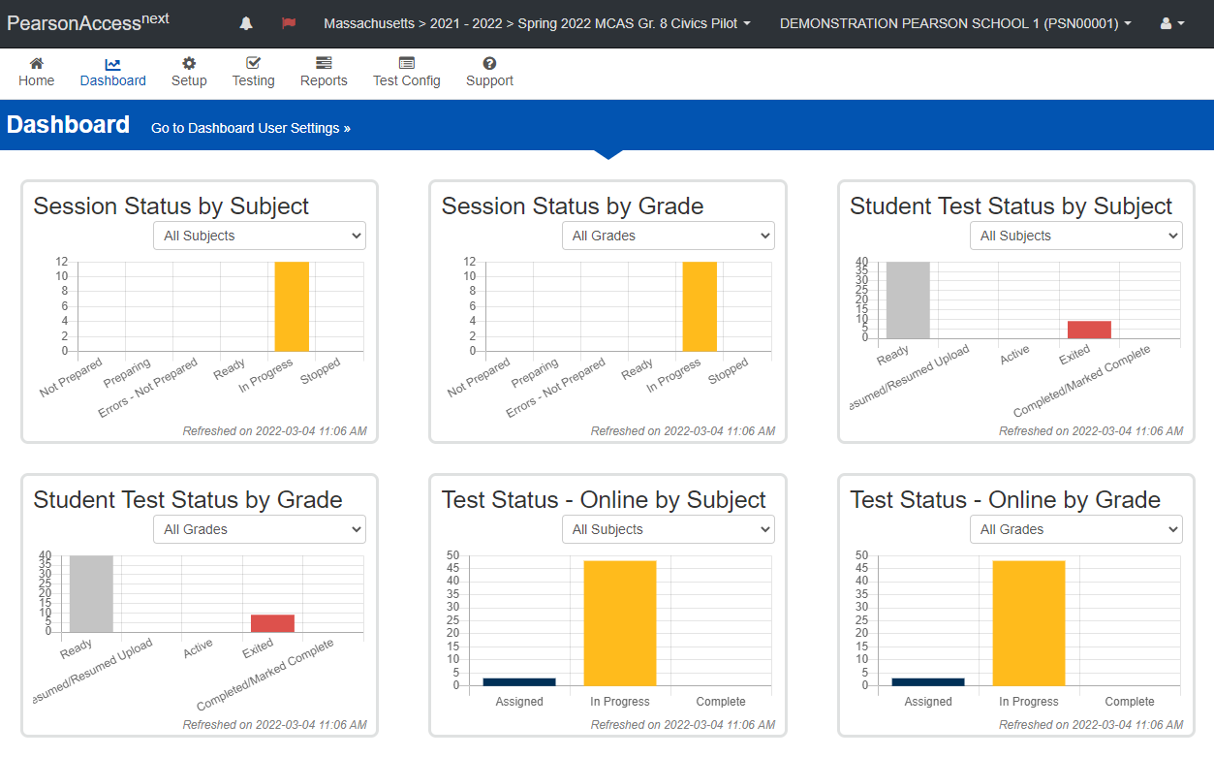
PAN Dashboards
Dashboards are available in PAN to users with district or school test coordinator and technology coordinator roles.
Using the dashboards is optional, and may be helpful during testing to understand how many students and sessions are in each status.
See the PAN Dashboards module and slides on the MCAS Resource Center for further information.

Slide 60
When should a test be marked as void?
If a student’s test should not be scored (see reasons below), the student will need to take a replacement test, and the initial test should be marked as void.
students who started the test with the wrong accommodation before being assigned a new test with the correct accommodations
students who did not complete testing due to a technical failure (and will take a replacement test)
other unspecified reason (call the Department)
Results from the initial test will not be reported.

Slide 61
Demonstration 4
Void student tests

Slide 62
Void Student Tests
Go to Setup > Students, and check the box next to the student’s SASID.
Then, go to Select Tasks > Manage Student Tests > Start.
Check the Void Test Score box and select the reason from the appropriate drop-down menu; click Save.

Slide 63
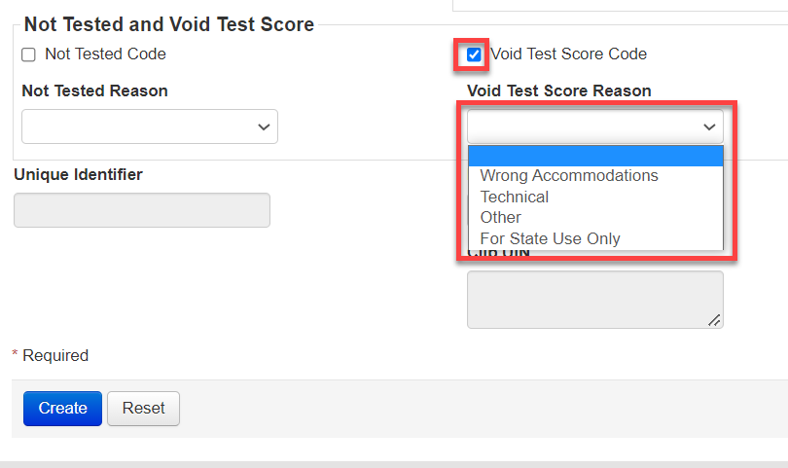
Voiding a Test (Student Will Continue Testing with a New Sign-in)
Enter Void Code
Wrong Accommodations
Technical Failure
Note: If a student cannot continue testing, contact the MCAS Service Center for guidance before entering this code.
Other
For State Use Only

Slide 64
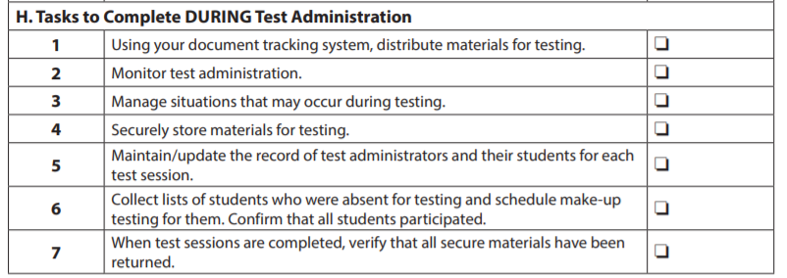
Additional Tasks During Test Administration
Follow the steps listed in the Principal’s Administration Manual for tasks to complete during test administration.
Checklist of tasks during test administration appears on page 47.
The steps/descriptions begin on page 58.

Slide 65
Questions and Answers 4
Use the “Q&A” feature to ask questions.

Slide 66
6. Resources, Support, and Next Steps

Slide 67
Additional Resources
Resource | Location
Guide to the SR/PNP Process | mcas.pearsonsupport.com/manuals (“PearsonAccess Next Guidance” drop-down)
Online training modules: Creating Sessions module Sessions Management module Moving Students Between Sessions module Overview of Infrastructure Trials for Principals and Test Coordinators (including additional PAN demonstrations) | mcas.pearsonsupport.com/training
Accessibility and accommodations guidance and link to modules and recording of a live session | mcas.pearsonsupport.com/manuals (“Accessibility and Accommodations Guidance” drop-down)
Enrollment Transfer Guide | http://mcas.pearsonsupport.com/manuals/ (“PearsonAccess Next Guidance” drop-down)

Slide 68
Additional Resources from the PAN User Guide
Resource | Location
Starting and unlocking Sessions | https://support.assessment.pearson.com/PAsup/testing/start-a-session-and-unlock-tests-sessions
Monitoring student tests | https://support.assessment.pearson.com/PAsup/testing/monitor-or-change-student-test-status
Resuming student tests | https://support.assessment.pearson.com/PAsup/testing/resume-a-test
Move a student between Sessions | https://support.assessment.pearson.com/PAsup/testing/move-a-student-test-between-sessions

Slide 69
Additional Resources on the DESE MCAS Website
Resource | Description
Home page | Access MCAS headlines and links to MCAS site (e.g., test schedule, test designs, training)
Student Assessment Updates | Biweekly email with important updates about the MCAS program If you do not already receive this email, subscribe at this link: http://eepurl.com/ghSOhH

Slide 70
Upcoming Training Session on PAN Tasks
Date | Session | Audience
Thursday, March 14 | Tasks in PAN After Testing Filling in not tested codes Removing students from PAN Sessions Marking student tests complete Stopping PAN Sessions | Principals and test coordinators
Registration available now: www.doe.mass.edu/mcas/training.html
After the session, a recording of the session and the slides will be posted at mcas.pearsonsupport.com/training/ approximately one week later.

Slide 71
Next Steps
Today: Complete the evaluation form.
Responses are associated with the name and email address used to log in.
Email your input to mcas@mass.gov if you have problems accessing or completing the form.
Within one week:
Receive an email with the Q&A from this session
Recording will be available

Slide 72
Email and Phone Support
MCAS Service Center
DESE Student Assessment Services
Questions on logistics and technology (e.g., PearsonAccess Next, SR/PNP, TestNav)
Web: mcas.pearsonsupport.com
Email: mcas@cognia.org
Phone: 800-737-5103
Schedule Technology Support Call
Policy questions (e.g., student participation, accommodations, “I have a student who…”)
Web: www.doe.mass.edu/mcas
Email: mcas@mass.gov
Phone: 781-338-3625

Slide 73
7. Live “Sandbox Time”

Slide 74
Poll Question 6
Which demonstration(s) would you like to see again?
Move a student between PAN Sessions
Void student tests
Batch printing testing tickets
Printing all testing tickets for one student

Slide 75
THANK YOU
The Office of Student Assessment Services
781-338-3625
mcas@mass.gov
www.doe.mass.edu/mcas
135 Santilli Highway, Everett, MA 02149

