Slide 1
Tasks in PearsonAccess Next Before Testing
The Office of Student Assessment Services February 27, 2024

Slide 2
Presenters
Shannon Cullen, MCAS Test Administration Coordinator
Gloria Hernandez, Pearson Customer Support

Slide 3
Logistics for This Session
Use the Q&A feature to ask a question.
We will answer some questions aloud at specified times during this training session, and we will email the Q&A afterwards.
Type your questions anytime, but we may not answer them in real time as some questions may be covered during the presentation.
Use the thumbs-up icon to “upvote” someone else’s question.
Email student-specific questions to mcas@mass.gov instead of asking here.
This session is being recorded and will be available in about a week in the MCAS Resource Center, along with the slides.
Slides were also emailed out beforehand, and are being posted in the chat.
Closed captioning has been enabled for participants who need it.
This session is being interpreted into ASL. Our interpreting team will be onscreen with the presenters.

Slide 4
Today’s Agenda
Timeline of Tasks in PearsonAccess Next (PAN)
Updates to Student Registration
Introduction to PAN Sessions
Creating PAN Sessions
Preparing PAN Sessions
Resources, Support, and Next Steps
Live “Sandbox Time”

Slide 5
Poll Question
What is your role in MCAS test administration?
Principal or MCAS test coordinator
Technology coordinator
MCAS test administrator
Other role in my school or district

Slide 6
Poll Question 2
How many years have you coordinated MCAS test administration at your school or district?
6 or more years
3 to 5 years
1 to 2 years
This is my first year.

Slide 7
New for 2024
Answer masking and color contrast accessibility features are no longer part of the SR/PNP file.
All students will have access to these accessibility features in TestNav.
Appendix A of the Guide to the SR/PNP Process: PAN Guidance for Form-Dependent Accommodations
Highlights important information regarding certain accommodations that require additional steps to assign in the SR/PNP
Text-to-speech
Web extensions (speech-to-text and word prediction)
Spanish/English edition
Screen reader edition
Compatible assistive technology
ASL edition
Human reader/human signer

Slide 8
Commonly Used Acronyms
CBT: Computer-based testing
PBT: Paper-based testing
PAN: PearsonAccess Next
SR/PNP: Student Registration/Personal Needs Profile
EL: English learner
ELA: English Language Arts
STE: Science and Technology/Engineering
SASID: State-Assigned Student ID

Slide 9
1. Timeline of Tasks in PearsonAccess Next

Slide 10
Timeline of Tasks in PAN to Complete Before Testing for Principals/Test Coordinators
2 weeks before testing
Create PAN Sessions and add students
Verify accommodations in PAN
Recommended to be completed by principals/test coordinators, but can also be done by
• District Test Coordinator
• Tech Coordinator
Up to 2 days before testing
Prepare PAN Sessions
Print testing tickets
Recommended to be completed by principals/ test coordinators, but all PAN users have access to do these tasks.
Now
Continue to update student info in PAN (SR/PNP)
Conduct Preliminary System Test/Infr. Trial
See recommended dates for Infrastructure Trial
Enrollment Transfer Work Requests (as needed)

Slide 11
Timeline of Tasks in PAN to Complete During Testing for Principals/Test Coordinators
Test Day
Unlock PAN Sessions
Distribute testing tickets to Test Administrators
Recommended: test administrators unlock PAN Sessions, but all PAN users have access to do this.
During Testing
Resolve incorrect accommodations
Manage makeup testing
Void tests as needed
These tasks should be completed by principals/test coordinators.
1 day before testing
Start PAN Sessions
Recommended: Principals/test coordinators, but all PAN users have access to do this.

Slide 12
Timeline of Tasks for in PAN to Complete After Testing for Principals/Test Coordinators
After Testing
Mark tests complete
Fill in Not Tested codes
Void tests
Stop PAN Sessions
Recommended: principals/test coordinators stop PAN Sessions, but all PAN users have access to this. The other tasks should be completed by principals/test coordinators.

Slide 13
Timeline of Tasks in PAN to Complete Before and During Testing for Test Administrators
Up to 2 days before testing
1 day before testing
Start PAN Sessions
Recommended: Principals/test coordinators, but all PAN users have access to do this.
Test Day
Verify that students have the correct test forms, including accommodations
Note that this should be done after Sessions have been prepared.
Unlock PAN Sessions
Distribute testing tickets to students
Monitor students in PAN
Resume students who exit TestNav unexpectedly
Recommended: Test administrators unlock PAN Sessions, but all PAN users have access to do this.

Slide 14
2. Updates to Student Registration

Slide 15
Poll Question 3
If a new student transfers to your school after submitting the initial SR/PNP but prior to MCAS testing, the first step you should take in PAN is to:
Assign the student to a PAN Session
Submit an enrollment transfer work request
Attempt to create the student record in PAN
Create a new PAN Session for the transfer student

Slide 16
Updates to Student Registration
If a new student transfers to your school after submitting the initial SR/PNP, the first step you should take is to attempt to create the student record in PAN.
This can be done via file export/import, or through the PAN User Interface.
Instructions for updating student information after the initial SR/PNP file import are located in the Guide to the SR/PNP Process.
Demonstrations can be viewed in the recording of the Overview of the SR/PNP training from January 18.

Slide 17
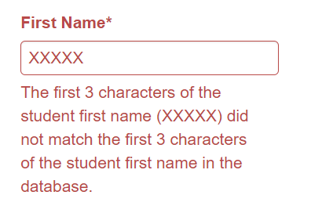
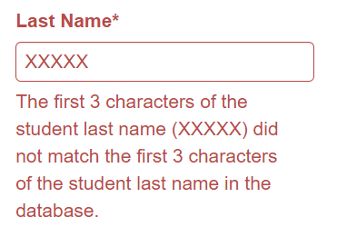
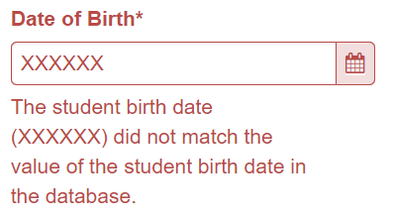
Updates to Student Registration: Demographic Errors
If a student’s demographic information (e.g., name, date of birth) has changed since the last MCAS administration, users may encounter an error when attempting to create the student record in PAN.
Possible demographic errors:
If you encounter these errors, you can try to find students by SASID, and then change the demographic information in PAN.
Any changes to student information should also be made in SIMS.

Slide 18
Updates to Student Registration: Demographic Errors (continued)
Search for the student by SASID:
Go to Setup > Students.
Enter the student SASID.
Select “by Ignoring…” in the drop-down menu next to Find Students.
Select Search.
Select the checkbox next to the student’s SASID.
Select Tasks > Create/Edit Students > Registration > Start.
Fill out the required fields to update the student information and register them for testing.

Slide 19
Updates to Student Registration: Enrollment Error
If the student is enrolled in another organization in PAN, you will see the following error when you attempt to create the student record:
Error: The student is currently enrolled to another organization. To enroll this student in your organization please create an Enrollment Transfer Request.
This error indicates that you must submit an Enrollment Transfer Request.
The enrollment transfer process allows the new school to “request” a transfer and the former school to “approve” the transfer.
When a student record is transferred in PAN, all student information and any PNP information that the former school entered will also transfer.

Slide 20
Demonstrations
Registering a Student for Testing
Creating Enrollment Transfer Work Requests
Approving Enrollment Transfer Work Requests

Slide 21
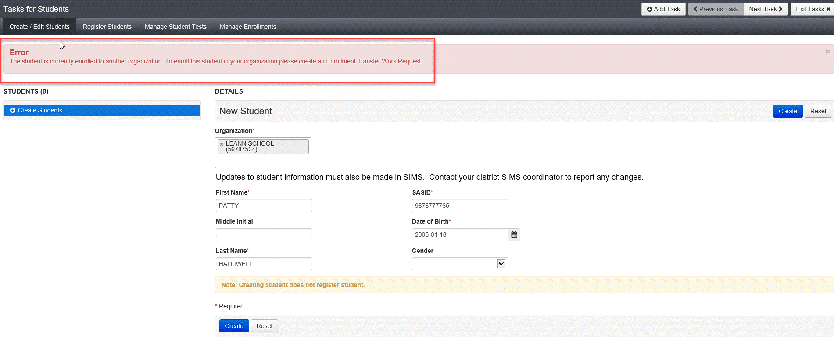
Registering a Student for Testing
If a student has moved to your organization, the first step is to attempt to create the student record in PAN.
To create a student record in PAN, go to Setup > Students > Select Tasks > Create/Edit Students > Start
If you receive an error message because the student is enrolled at another organization (in PAN), you will need to create a Work Request to transfer the student record.

Slide 22
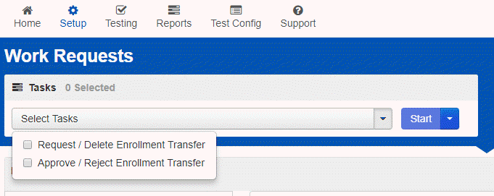
Creating a Work Request
To create a Work Request, go to Setup > Work Requests > Select Tasks > Request/Delete Enrollment Transfer > Start

Slide 23
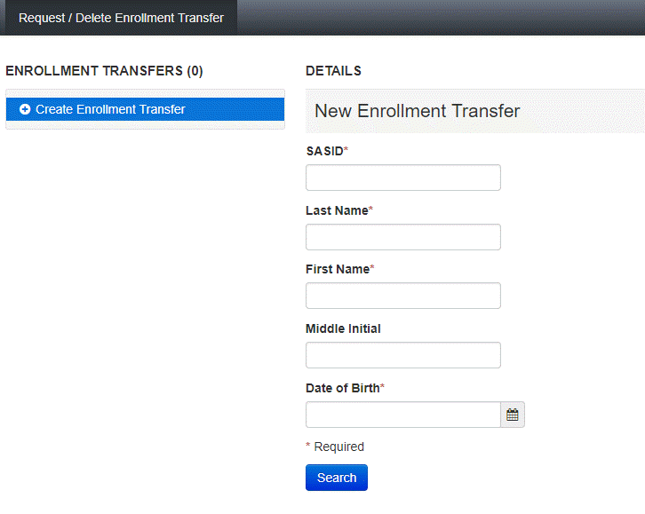
Creating a Work Request 2
Fill out the required information and click Search.

Slide 24
Approving a Work Request
After completing the request, an email is sent to the Transfer Coordinator at the previous district/school where the student is currently registered.
The previous school will need to approve the request.
To approve a work request, go to Setup > Work Request > Select Tasks > Approve/Reject Enrollment Transfer > Start. Then, click Approve (as long as the student has transferred out of your district/school).
If a request has not been approved within 24 hours, call the MCAS Service Center at 800-737-5103 for support.
Full instructions for creating and approving enrollment transfer requests, including steps for follow-up, are included in the Enrollment Transfer Guide.

Slide 25
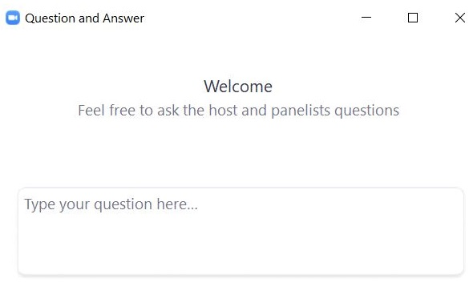
Questions and Answers
Use the “Q&A” feature to ask questions.

Slide 26
3. Introduction to PearsonAccess Next Sessions

Slide 27
What are PearsonAccess Next (PAN) Sessions?
A Session is a group of students in PearsonAccess Next (PAN) who will be taking the same test together.
Each PAN Session is grade and subject specific.
The Human Read-Aloud and Human Signer accommodations require students to be assigned to a separate Session that is specifically designated as Human Read-Aloud or Human Signer.
Note that PAN Sessions are different than the actual “test session.”
PAN Sessions can be created at any time prior to administration.
Recommended: Create PAN Sessions approximately two weeks before test administration
The timing can help to minimize changes needed (e.g., student transfers).

Slide 28
Poll Question 4
Do students who take paper-based tests need to be placed into a PAN Session?
Yes
No
I don’t know.

Slide 29
PAN Session Names
Users will be able to see all PAN Sessions in their organization.
Recommended: Use a naming convention for PAN Sessions that will help test administrators quickly and easily find the test they are administering, including the following items:
Test administrator name; testing location; grade; subject area test
Example: Smith.Rm202.G4.Math
A PAN Session name may contain up to 50 characters; commas (,) are not allowed.
Expected/allowed values:
A–Z
a – z
0 – 9
- (Hyphen)
. (Period)
‘ (Standard Apostrophe)
Embedded Spaces
See page 22, column M of the Guide to the SR/PNP Process for more information.

Slide 30
4. Creating PAN Sessions

Slide 31
Poll Question 5
Can I change my PAN Sessions after assigning them on the SR/PNP import?
Yes
No
I don’t know.

Slide 32
Two Ways to Create PAN Sessions
There are two ways to create PAN Sessions: SR/PNP file import and user interface.
SR/PNP File Import
Creating PAN Sessions via a file import can only be done one time. Additional changes would need to be made through the user interface.
Recommended: Use the file import to create Sessions for large numbers of students or when creating 5 or more PAN Sessions.
User Interface
Recommended: Use the user interface to create a small number of PAN Sessions.
Required: Use the user interface to create/edit Human Read-Aloud or Human Signer accommodated Sessions.

Slide 33
Demonstrations 2
Creating PAN Sessions via the SR/PNP Import
Creating PAN Sessions via the User Interface
Adding Students to PAN Sessions

Slide 34
Option 1: Creating PAN Sessions via SR/PNP File Import
Export your current SR/PNP data.
Add the PAN Session names to column M. Save the file.
Import the updated SR/PNP file to PAN.
Note that once PAN Sessions have been created, they cannot be changed via a file import.
If you need to make changes to a large number of PAN Sessions, call the MCAS Service Center.
Schools may choose to go through this process twice – once for ELA, and once for Math/STE.
High schools submit a separate SR/PNP file for STE.

Slide 35
Option 1: Creating Sessions via SR/PNP Import
Setup > Import/Export Data > Select Tasks, Import/Export Data > Student Registration Export > Process
Export the file and add the appropriate Session names for each student in column M. When completed, save the file as a .CSV.
Setup > Import/Export Data > in the Tasks drop-down, choose Import/Export Data > Student Registration Import > select the file you just saved > Process
Confirm that your Sessions have been created by going to Testing > Sessions > Show All Results

Slide 36
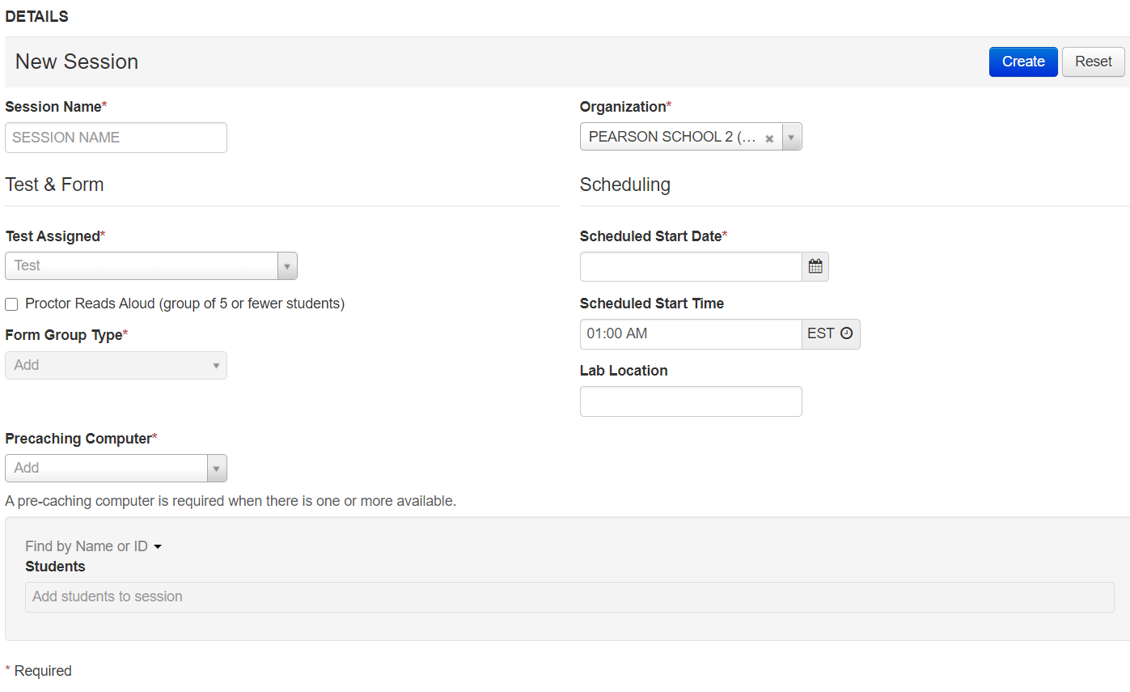
Option 2: Creating Sessions via PAN User Interface
Testing > Sessions > Select Tasks, Create/Edit Sessions > Start
Complete the required fields and click Create.

Slide 37
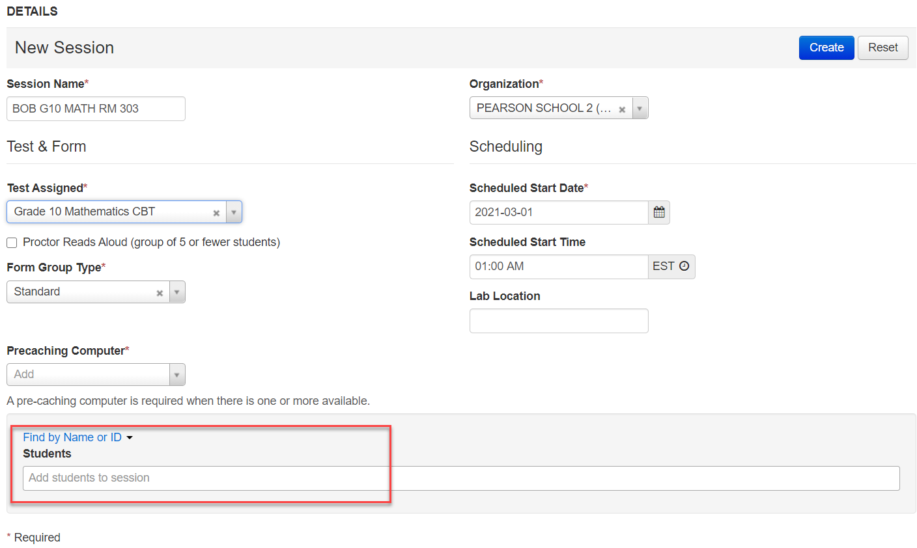
Adding Students to PAN Sessions
Go to Testing > Sessions > Create/Edit Sessions
Once required information is entered, students can be selected for the specific PAN Session at the bottom of the screen.

Slide 38
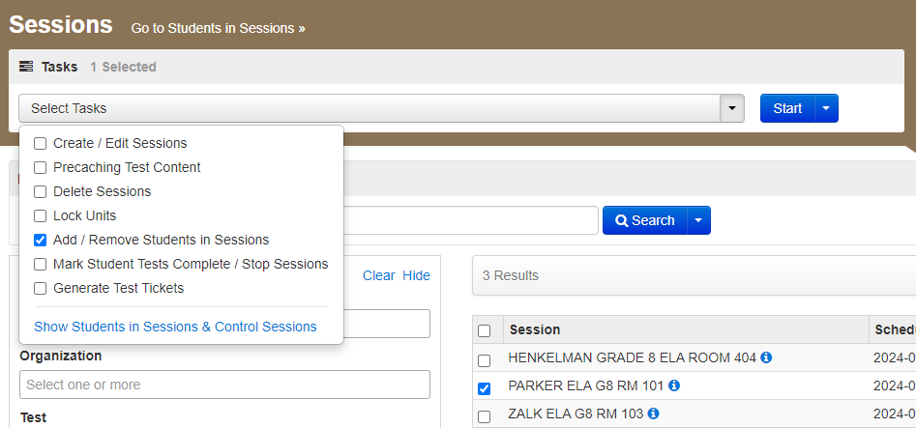
Adding Students to PAN Sessions (continued)
If you need to add students to a Session that has already been created, it can also be done by going to Testing > Sessions > Add/Remove Students in Sessions
Search for the names of the students.
Select the checkboxes next to the student names.
Select Save.

Slide 39
Why might a student record not be found when assigning that student to a PAN Session?
Student is already assigned to a PAN Session.
Student is assigned to paper-based testing (PBT).
Student would need to be assigned to computer-based testing (CBT).
Student is assigned to a different grade level.
Student would need to be assigned the appropriate grade level test.

Slide 40
Questions and Answers 2
Use the “Q&A” feature to ask questions.

Slide 41
5. Preparing PAN Sessions

Slide 42
Verify Accessibility Features and Accommodations: Accessing the PNP Report
Before preparing PAN Sessions, verify students’ accommodations:
Go to Reports > Operational Reports > Students and Registrations > PNP Report
District test coordinators, school test coordinators, and technology coordinators can access this report in PAN. Test administrators do not have access to the report.
Attend the PAN Tasks for Accessibility and Accommodations training session for further information (Thursday, February 29 at 9:30 a.m.)

Slide 43
Poll Question 6
When should I prepare my PAN Sessions?
Any time after submitting the SR/PNP
Two weeks prior to testing
Up to two days prior to testing
On test day

Slide 44
Demonstrations 3
Prepare PAN Sessions

Slide 45
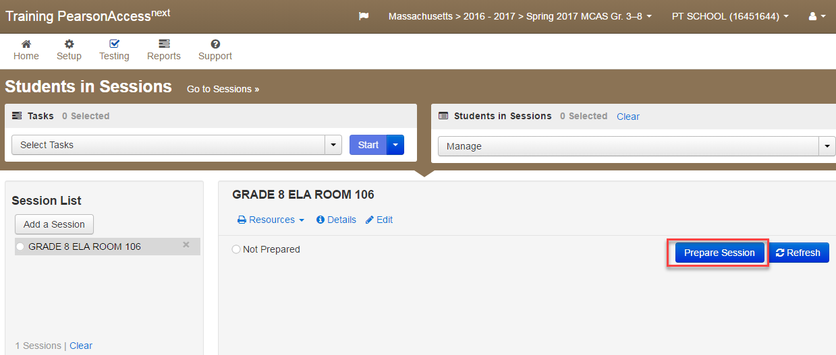
Prepare PAN Sessions
Sessions must be prepared by principals/test coordinators before they can be started. (Starting Sessions is covered in our March 12 training).
Preparing Sessions assigns the test forms to students.
Testing > Students in Sessions > Find the Session and select the checkbox to see the Session Details screen.
Click the blue Prepare Session button.

Slide 46
Questions and Answers 3
Use the “Q&A” feature to ask questions.

Slide 47
6. Resources, Support, and Next Steps

Slide 48
Additional Resources
Resource | Location
Guide to the SR/PNP Process | mcas.pearsonsupport.com/manuals (“PearsonAccess Next Guidance” drop-down)
Enrollment Transfer Guide | mcas.pearsonsupport.com/manuals (“PearsonAccess Next Guidance” drop-down)
Online training modules: Creating Sessions module Sessions Management module Overview of Infrastructure Trials for Principals and Test Coordinators (including additional PAN demonstrations) | mcas.pearsonsupport.com/training
Accessibility and accommodations guidance and link to modules and recording of a live session | mcas.pearsonsupport.com/manuals (“Accessibility and Accommodations Guidance” drop-down)

Slide 49
Additional Resources from the PAN User Guide
Resource | Location
Create a student record | https://support.assessment.pearson.com/PAsup/setup/manage-students/create-a-student-record
Edit a student record | https://support.assessment.pearson.com/PAsup/setup/manage-students/edit-a-student-record
Request Enrollment Transfer | https://support.assessment.pearson.com/PAsup/setup/manage-students/request-enrollment-transfer
Creating PAN Sessions | https://support.assessment.pearson.com/PAsup/testing/create-a-session
Adding Students to Sessions | https://support.assessment.pearson.com/PAsup/testing/add-a-student-to-a-session
Preparing Sessions | https://support.assessment.pearson.com/PAsup/testing/prepare-a-session

Slide 50
Additional Resources on the DESE MCAS Website
Resource | Description
Home page | Access MCAS headlines and links to MCAS site (e.g., test schedule, test designs, training)
Student Assessment Updates | Biweekly email with important updates about the MCAS program If you do not already receive this email, subscribe at this link: http://eepurl.com/ghSOhH
Manuals | Pre-Administration Guide and Spring 2024 Principal’s Administration Manual
SR/PNP Windows for the 2023-24 MCAS Tests and Retest | Find information about each SR/PNP window including dates and the .CSV file names

Slide 51
Upcoming Training Sessions on PAN Tasks
Date | Session | Audience
Thursday, February 29, 9:30 – 11:00 a.m. | PAN Tasks for Accessibility and Accommodations | Principals, MCAS test coordinators, special education administrators and supervisors, and test administrators administering accessibility features for all students and accommodations for students with disabilities and EL students
Tuesday, March 12, 9:30 – 11:00 a.m. | Tasks in PAN During Testing | Principal, test coordinators, and test administrators
Thursday, March 14, 9:30 – 10:45 a.m. | Tasks in PAN After Testing | Principals and test coordinators
Registration for training sessions available now: www.doe.mass.edu/mcas/training.html
After each session is delivered, a recording of the session and the slides will be posted at mcas.pearsonsupport.com/training/ approximately one week later.

Slide 52
Upcoming Training Sessions
PAN Tasks for Accessibility and Accommodations
Thursday, February 29
Creating Human Read-Aloud/Human Signer Sessions
Printing proctor testing tickets
Verifying accessibility features and accommodations
Updating accommodations in PAN
Updating form-dependent accommodations
Web extensions
Tasks in PAN During Testing
Tuesday, March 12
Printing student testing tickets
Downloading the Session Student Roster
Starting PAN Sessions
Locking/Unlocking test sessions
Managing active student tests
Resuming student tests
Managing make-up testing
Moving students between PAN Sessions
Voiding student tests
Tasks in PAN After Testing
Thursday, March 14
Filling in not tested codes
Removing students from PAN Sessions
Marking student tests complete
Stopping PAN Sessions

Slide 53
Next Steps
Today: Complete the evaluation form.
Responses are associated with the name and email address used to log in.
Email your input to mcas@mass.gov if you have problems accessing or completing the form.
Within one week:
Receive an email with the Q&A from this session
Recording will be available

Slide 54
Email and Phone Support
MCAS Service Center
DESE Student Assessment Services
Questions on logistics and technology (e.g., PearsonAccess Next, SR/PNP, TestNav)
Web: mcas.pearsonsupport.com
Email: mcas@cognia.org
Phone: 800-737-5103
Schedule Technology Support Call.
Policy questions (e.g., student participation, accommodations, “I have a student who…”)
Web: www.doe.mass.edu/mcas
Email: mcas@mass.gov
Phone: 781-338-3625

Slide 55
7. Live “Sandbox Time”

Slide 56
Poll Question 7
Which demonstration would you like to see again?
Registering a Student for Testing
Creating Enrollment Transfer Work Requests
Approving Enrollment Transfer Work Requests
Creating PAN Sessions via the SR/PNP import
Creating PAN Sessions via the user interface
Adding students to PAN Sessions
Preparing PAN Sessions

Slide 57
THANK YOU
The Office of Student Assessment Services
781-338-3625
mcas@mass.gov
www.doe.mass.edu/mcas
135 Santilli Highway, Everett, MA 02149

