Slide 1
Pre-Administration Tasks for Technology Staff
The Office of Student Assessment Services February 5, 2024

Slide 2
Presenters
Shannon Cullen, Test Administration Coordinator
Michael Reynolds, Pearson Field Service Engineer

Slide 3
Logistics for This Session
Use the Q&A feature to ask a question.
We will answer some questions aloud at specified times during this training session, and we will email the Q&A afterwards.
Type your questions anytime, but we may not answer them in real time as some questions may be covered during the presentation.
Use the thumbs-up icon to “upvote” someone else’s question.
Email student-specific questions to MCAS@mass.gov instead of asking here.
This session is being recorded and will be available in about a week in the MCAS Resource Center, along with the slides.
Slides were also emailed out beforehand, and are being posted in the chat.
Closed captioning has been enabled for participants who need it.
This session is being interpreted into ASL. Our interpreting team will be onscreen with the presenters.

Slide 4
Slides for This Session
Slides were emailed to participants before this session from MCASEvents@cognia.org.
Slides are now being posted in the chat.
If you cannot access the slides in the chat, ask in the Q&A.
After the session, we will send the slides again to participants, and they will be posted in the MCAS Resource Center along with the recording.

Slide 5
Today’s Agenda
Technology Staff Responsibilities
TestNav Installation
Testing Network and Devices
Disabling or Installing ProctorCache
Saved Response Files (SRFs)
Troubleshooting
Resources, Support, and Next Steps

Slide 6
New for 2023–24
TestNav app version 1.12 (updated in summer 2023)
Updated OS supported by TestNav
Technical bulletin for iPads

Slide 7
1. Technology Staff Responsibilities

Slide 8
Computer-Based Testing (CBT) Components
PearsonAccess Next (PAN)
Online test management system for principals, test coordinators, and technology coordinators to manage user accounts, student registration, and computer-based test sessions.
TestNav8 (TN8)
Online testing platform used by students to take the computer-based MCAS assessments
ProctorCache
Software that allows for precaching of test content on a designated precaching machine located at the school and can reduce bandwidth requirements.
Recommendation on whether to use ProctorCache is based on school’s bandwidth.
For more information, view the recording of the “Introduction to MCAS CBT for New Staff” training session.

Slide 9
Pre-Administration Checklist for Technology Staff
Review the technology coordinator responsibilities in the Pre-Administration Guide and in the Principal’s Administration Manual.
Establish communication plan with principal/test coordinators.
Verify access to PearsonAccess^{next} training and operational sites.
Verify all student and ProctorCache devices meet technology specifications, and ensure external hardware is available (e.g., headphones, chargers).
Configure devices and servers.
Add provided URLs to the exempt list in any applicable network appliance or software (e.g., content filters, firewalls, proxy servers, anti-virus solutions).

Slide 10
Pre-Administration Checklist for Technology Staff (continued)
Download and install TestNav on student devices and run App Check from TestNav.
Create a TestNav configuration in PAN.
Disable or install ProctorCache as applicable.
Precache test content, if using ProctorCache.
Conduct the Preliminary System Test and, if applicable, the Infrastructure Trial.
Schedule one-on-one support with technology specialists.

Slide 11
Bring Your Own Device (BYOD)
Schools that intend to use BYOD for MCAS should inform DESE by emailing MCAS@mass.gov. Further instructions will be provided.
Deadline was January 29 for spring administrations.
Recommendations
Use devices managed by the school/district.
Confirm that devices meet minimum system requirements.
Note that unmanaged Chromebooks cannot be used for BYOD.

Slide 12
2. TestNav Installation

Slide 13
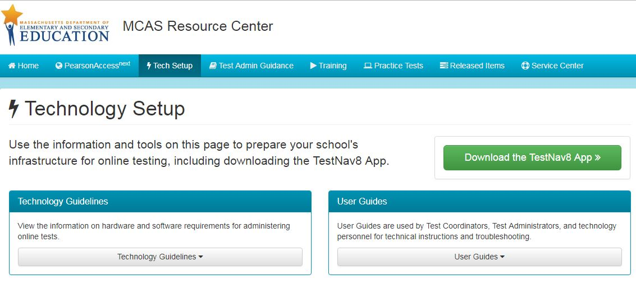
Getting Started
Review technology specifications for student devices.
Before updating a device’s operating system, confirm it is listed on the TN8 requirements page
Download TestNav: http://mcas.pearsonsupport.com/technology-setup/
Slide Resource Link URLs:
TestNav System Requirements: https://support.assessment.pearson.com/display/TN/TestNav+System+Requirements
TestNav8 App Download: http://mcas.pearsonsupport.com/technology-setup/

Slide 14
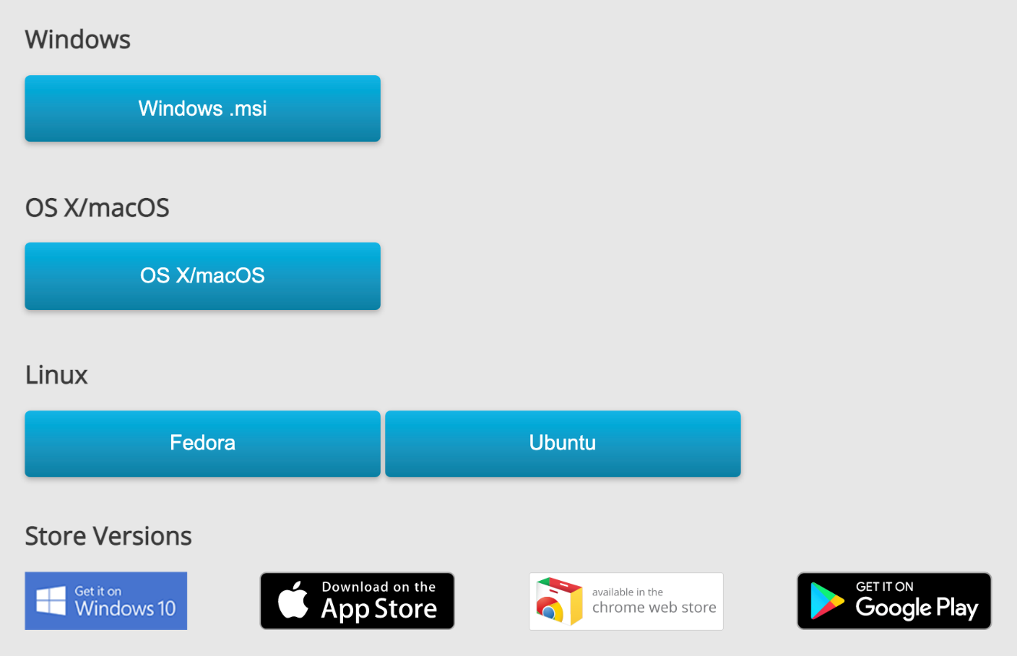
TestNav Download
Each available platform has its own TestNav app.
Confirm that you are downloading the correct app for your device.

Slide 15
Network Configuration
If your school is using any new security services or vendors that were introduced after your last MCAS computer-based test administration, it is especially important to check your network exempt list for TestNav URLs.
Firewalls, content filters, proxy servers, anti-virus software, and any other inspection or security tools should be set to exempt the following URLs from filtering or inspection (must include asterisk):
*.testnav.com: 80
*.testnav.com: 443
*.pearsontestcontent.com
*.thawte.com
*.usertrust.com
*.comodoca.com
*.google-analytics.com (optional)
*.cowriter.dev

Slide 16
Network Configuration (continued)
*.donjohnston.net
*cw-ws.qadji.com
*.speechstream.net
toolbar.speechstream.net
cache.speechstream.net
speech.speechstream.net
rwgoogle-webservices-7.texthelp.com
testnav-cognitive-auth.dev.texthelp.com
wss://eastus.stt.speech.microsoft.com/
Please see the Network Requirements and Guidelines page for additional information.

Slide 17
Windows, OS X, and Linux Requirements for TestNav App
Supported Operating Systems
Windows: Win10 (64-bit) – 21H2, 22H2.
Win11(64-bit)
(includes Windows Store app)
OS X: 12,13,14 (Intel Mac)
Linux: Fedora 37+ (64-bit)
Ubuntu 22.10+ (64-bit)
Requirements | Windows | OS X, macOS | Linux
Supported devices | Desktops Laptops Tablets | Desktops Laptops | Desktops Laptops
Processor | x64 - AMD, ARM, ARM64, or Intel-based | x64 - AMD, ARM, ARM64, or Intel-based | x64 - AMD, ARM, ARM64, or Intel-based
Memory | Recommended: 4GB RAM Minimum: 2GB RAM | Recommended: 4GB RAM Minimum: 2GB RAM | Recommended: 2GB RAM Minimum: 1GB RAM
Min. Screen Size | 9.5 in. | 9.5 in. | 9.5 in.
Min. Screen Resolution | 1024 x 768 | 1024 x 768 | 1024 x 768

Slide 18
Chromebook System Requirements for TestNav App
Chromebooks require Chrome OS 114-118 (Stable Channel) or 114+ (LTS Channel)
LTS Channel is suggested
Must use installable Chrome OS TestNav app
Ensure Chrome app is installed from Chrome Web Store and not Google Play Store.
2017 and newer Chrome OS devices must be managed in your Google Admin console in order to run TestNav and other applications in Kiosk mode.
Tablet mode is not supported for convertible Chromebooks
 | Chrome OS
Supported devices | Chromebooks Chromeboxes
Processor | Any
Memory | Recommended: 4GB RAM Minimum: 2GB RAM
Min. Screen Size | 9.5 in.
Min. Screen Resolution | 1024 x 768

Slide 19
iPad System Requirements for TestNav App
 | iOS
Supported devices | iPads
Processor | Any
Memory | Recommended: 2GB RAM Minimum: 1GB RAM
Min. Screen Size | 9.5 in.
Min. Screen Resolution | 1024 x 768
Supported iOS:
15.2-16.x, 17.3
Download:
From the App Store
iPadOS 17.3 Bulletin
Schools should not use iPadOS 17.0, 17.1, or 17.2 for testing

Slide 20
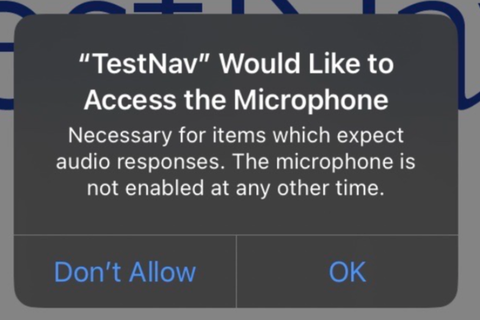
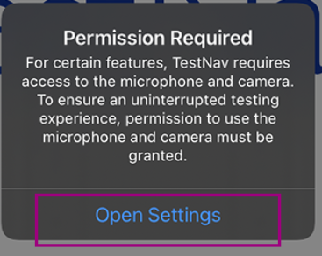
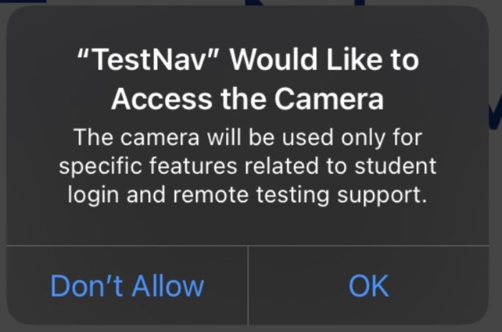
Additional Set Up Steps For TestNav on iPads
Enable Microphone and Camera
The first time TestNav is launched after installation, it asks for permission to access both the microphone and camera.
Tap/click OK for both prompts.
If No is selected on either, another prompt is displayed allowing the user to enter the device permissions settings.

Slide 21
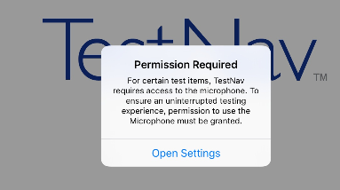
Additional Set-Up Steps For TestNav on iPads (continued)
Confirm App Self-Lock
TestNav will display this prompt each time a student begins a secure test and during App Check.
Students or staff should select Yes.
(It is recommended to launch TestNav on iPads after installation to both enable the microphone and camera and to familiarize yourself with the App Self-Lock prompt.)

Slide 22
Demonstrations: TestNav
TestNav download site
Logging in correctly (choosing a customer)

Slide 23
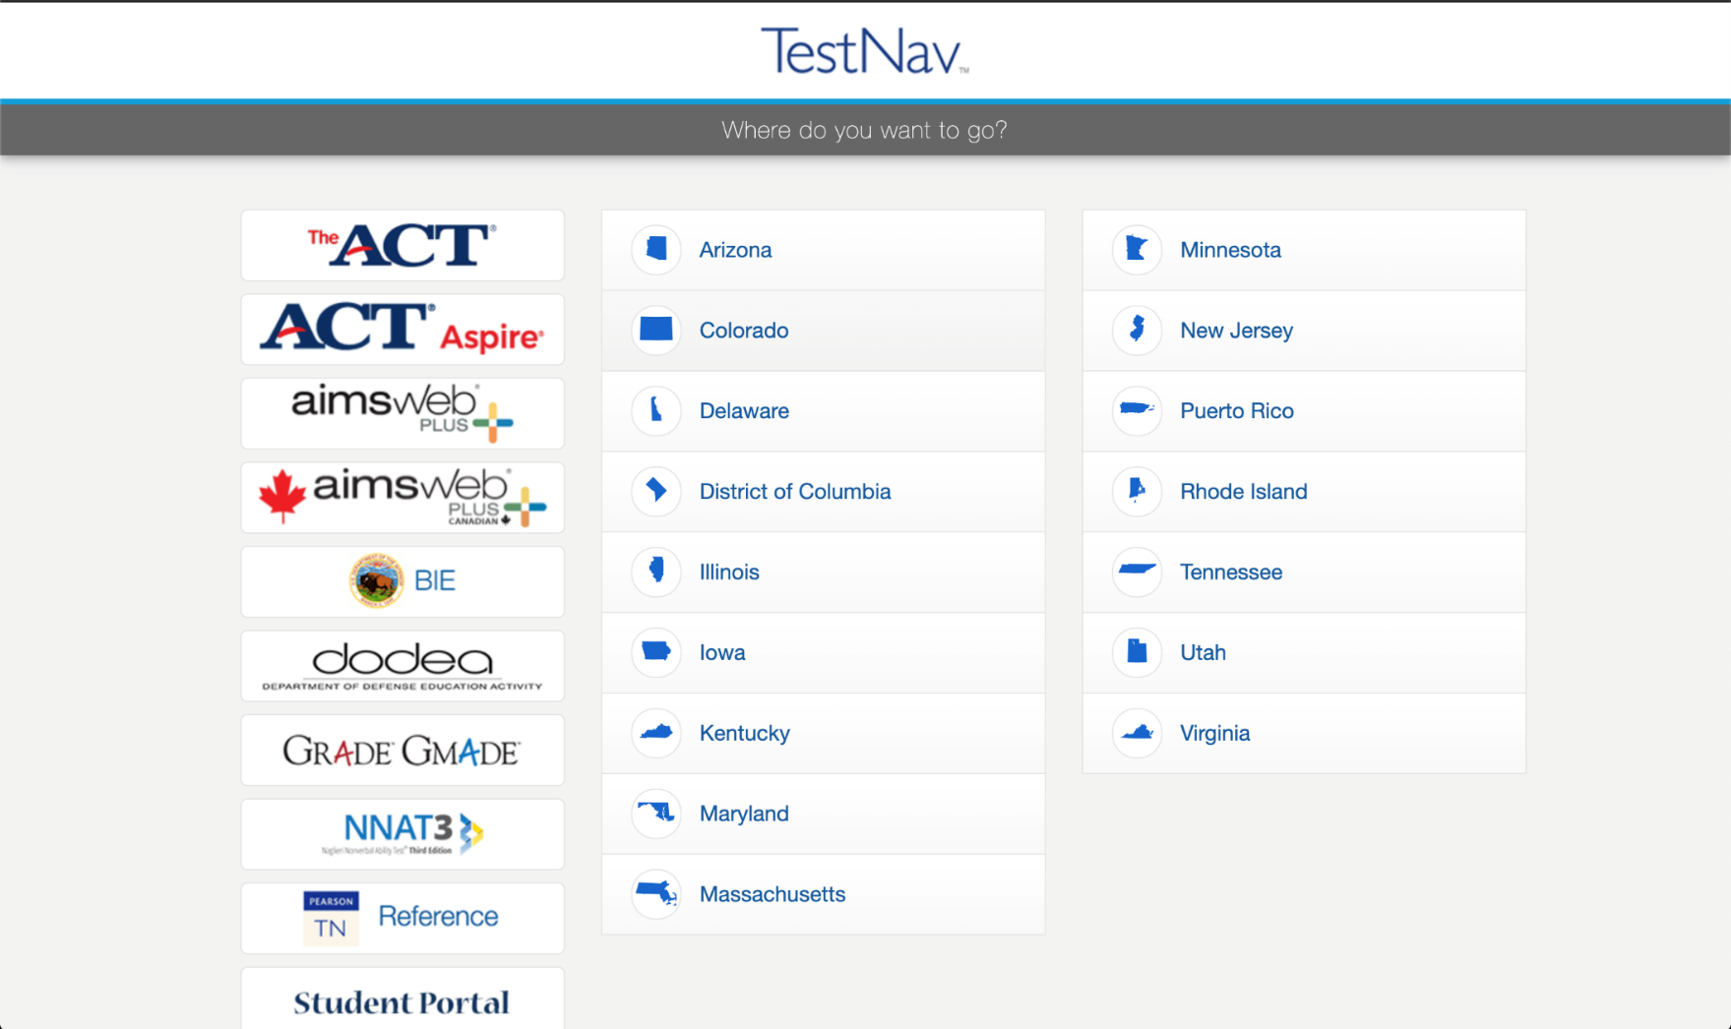
Logging in Correctly (Choosing a Customer)
After TestNav has been installed correctly, open TestNav and navigate to Massachusetts.

Slide 24
3. Testing Network and Devices

Slide 25
Testing Your Network and Devices
App Check: A test run in TestNav by school staff to check connectivity to Pearson servers, the ability of the device to enter “kiosk” mode, and the TestNav configuration (if a configuration identifier is used).
Preliminary System Test: A small-scale Infrastructure Trial during which school staff log in to and click through practice tests instead of students.
Infrastructure Trial: Simulated testing experience during which one or more practice test sessions are administered.

Slide 26
Poll Question
Which schools should run App Check?
Schools using iPads only
Schools using Chromebooks only
Schools who do not conduct an Infrastructure Trial
All schools

Slide 27
App Check
All schools should run App Check prior to testing.
App Check should be performed at least once for each device type and operating system.
App Check without the Configuration ID: will check full-screen capability as well as connectivity to TestNav servers.
App Check with Configuration ID: performs the same checks but also includes anything that is listed TestNav configuration area of PAN (ProctorCache and secondary save locations).

Slide 28
Preliminary System Tests
All schools should conduct a Preliminary System Test, especially schools that do not conduct a full-scale Infrastructure Trial.
A Preliminary System Test is a small-scale Infrastructure Trial during which a small number of staff log in to TestNav as students on student devices and click through practice tests.
A Preliminary System Test is an Infrastructure Trial conducted on a smaller scale without students.

Slide 29
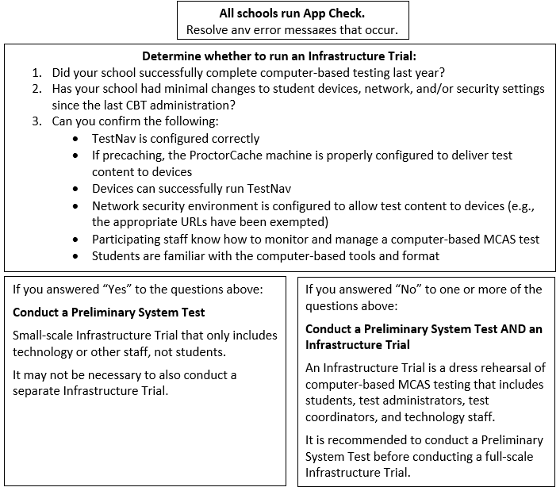
Determine Whether to Run an Infrastructure Trial

Slide 30
Resources for Infrastructure Trials
Infrastructure Trial Readiness Guide
http://mcas.pearsonsupport.com/manuals/ (Click on the “PearsonAccess Next Guidance” drop-down.)
Training modules
http://mcas.pearsonsupport.com/training/
“Overview of Infrastructure Trials” training from January 24:
http://mcas.pearsonsupport.com/training/
ProctorCache Recommendation for MCAS CBT Testing
http://mcas.pearsonsupport.com/manuals/

Slide 31
Network Check
Use the Network Check feature in TestNav to check your organization’s network to determine whether you need to use ProctorCache.
Schools are encouraged to run Network Check a few times in different scenarios such as on different access points or in different parts of the building.
If Network Check passes, schools are also encouraged to enter a larger number of expected students into the Network Check to determine how much overhead bandwidth is available.

Slide 32
Demonstrations
App Check
Network Check

Slide 33
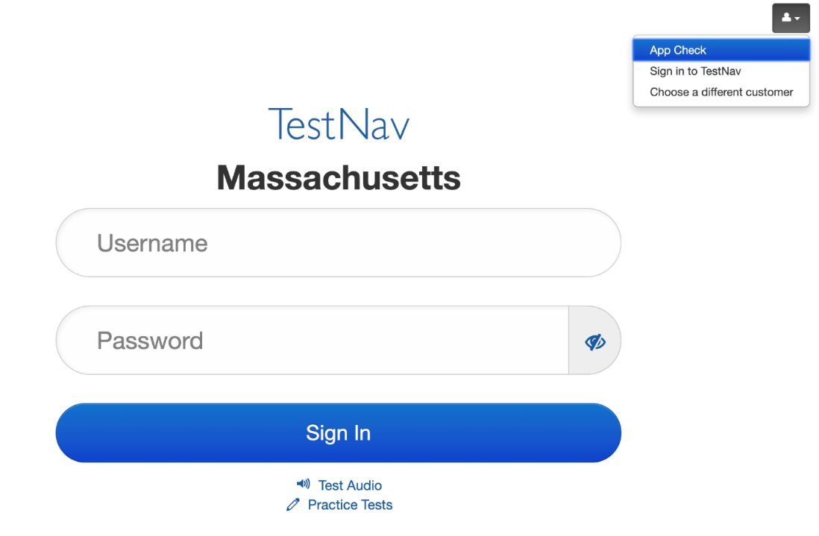
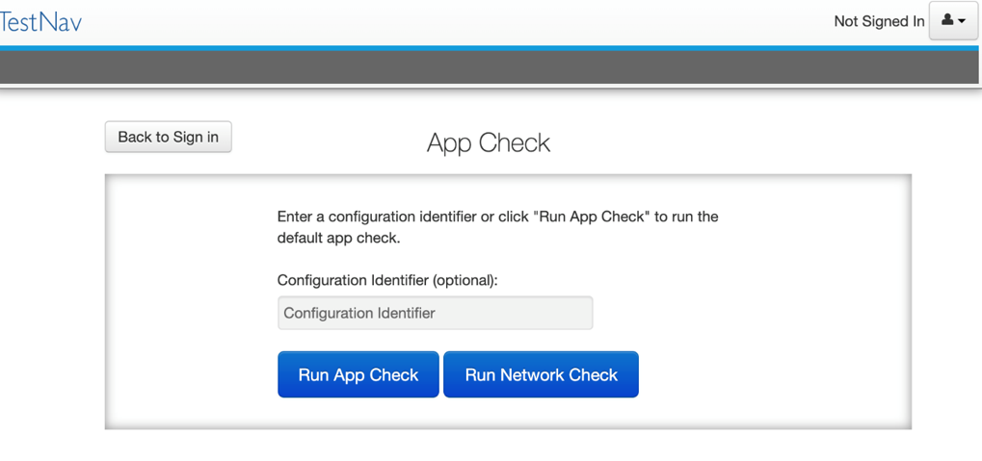
TestNav App Check
Select App Check from the drop-down menu in the upper right-hand corner in TestNav.
Then, select Run App Check.

Slide 34
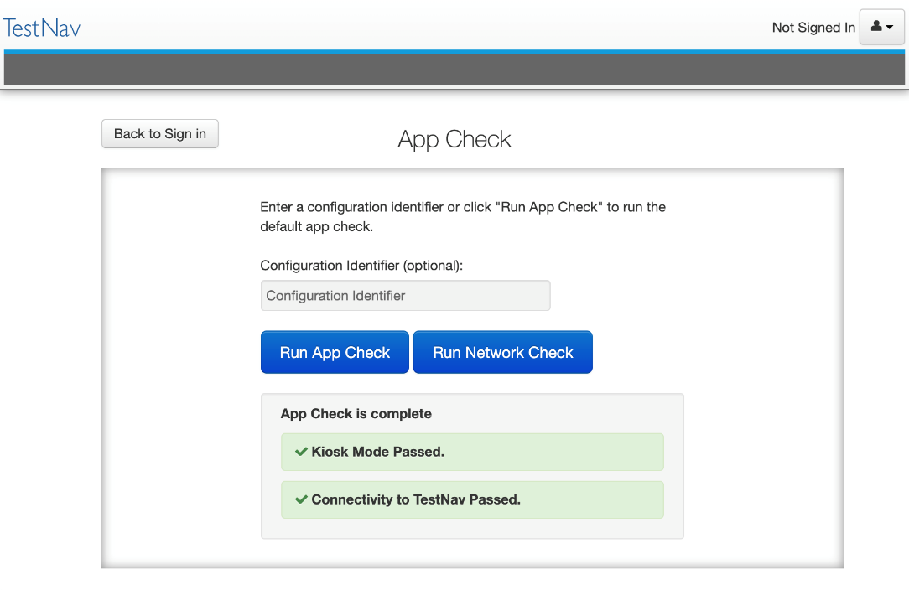
TestNav App Check (continued)
App Check will then provide messages indicating whether the device has passed or failed.
If a failed message is received, please visit the App Check Error Messages section on the Pearson Support website to troubleshoot.

Slide 35
TestNav Network Check
Select App Check from the drop-down menu in the upper right-hand corner in TestNav.
Then, select Run Network Check.

Slide 36
TestNav Network Check (continued)
Network Check will provide a “Pass” or “Warning” message, indicating whether ProctorCache is recommended.

Slide 37
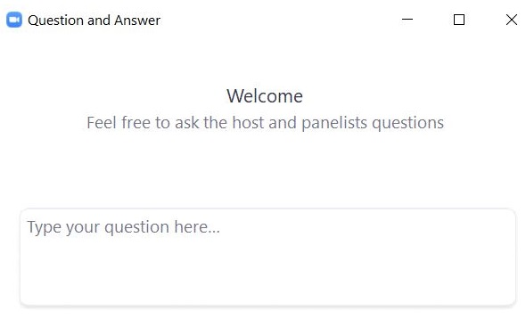
Questions and Answers
Use the “Q&A” feature to ask questions.

Slide 38
4. Disabling or Installing ProctorCache

Slide 39
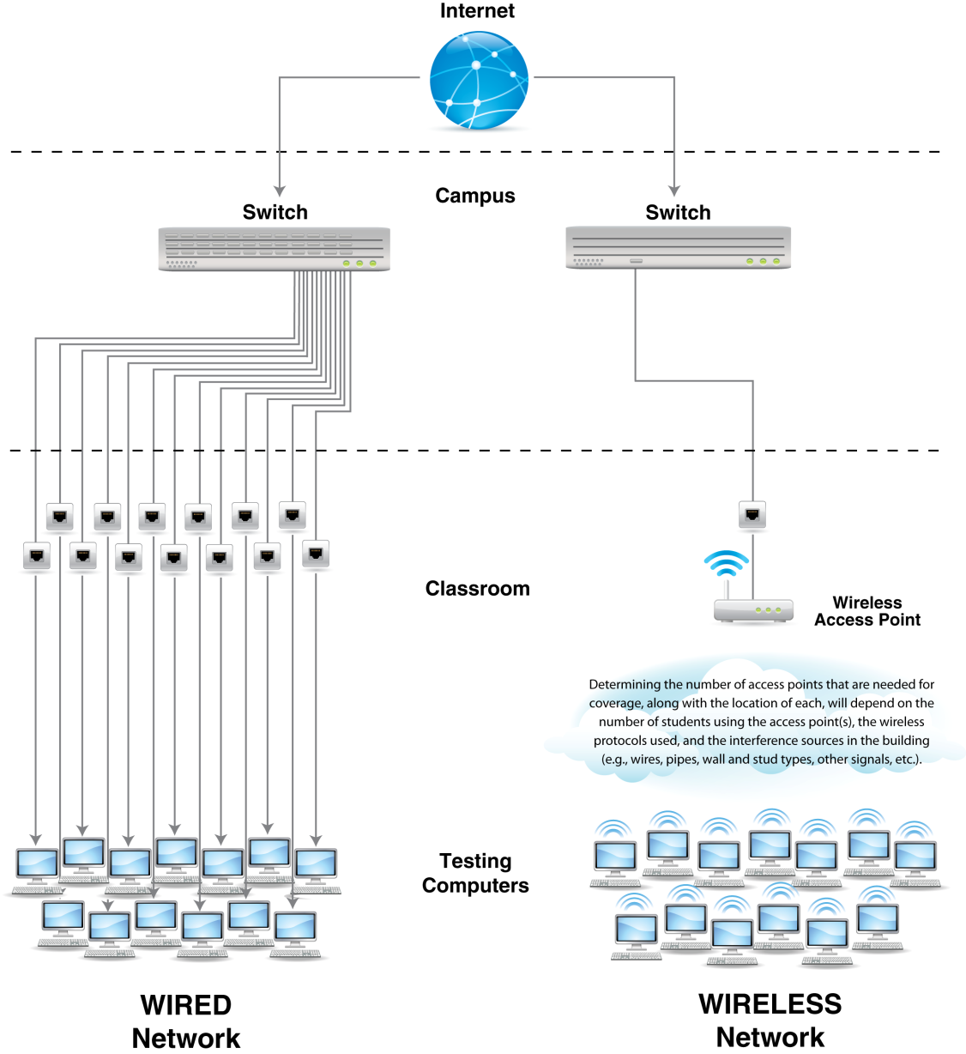
Internet Connectivity with ProctorCache

Slide 40
ProctorCache Recommendation
Network Check Result | ProctorCache Recommendation for Schools That Used ProctorCache in Their Last CBT Administration | ProctorCache Recommendation for Schools That Did NOT Use ProctorCache in Their Last CBT Administration
Pass | Disable ProctorCache prior to the Infrastructure Trial. | Do not install ProctorCache software
Warning | Use ProctorCache. | Install ProctorCache.
See the ProctorCache Recommendation for MCAS CBT Testing at http://mcas.pearsonsupport.com/manuals/ for detailed information.

Slide 41
ProctorCache System Requirements and Recommendations
ProctorCache runs on Windows and requires a static (fixed) internal IP address.
If your district requires ProctorCache but has no Windows machines to use for that purpose, contact the MCAS Service Center.
Does not require an underlying server-based operating system
TCP ports include 80/443 (communication with Pearson servers), and 4480/4481 (ProctorCache ports - LAN traffic only)
For setting up an upstream proxy, refer to the Windows “Set Up and Use ProctorCache” section in the TestNav 8 ProctorCache User Guide.
Organizations may set up multiple ProctorCache machines if applicable.

Slide 42
ProctorCache System Requirements and Recommendations (continued)
Whenever possible, minimize the physical distance between ProctorCache machines and student testing devices.
Set up ProctorCache machines locally (i.e., at schools) rather than centrally (at a district office).
The default password for the ProctorCache software is t35t1n6.
Recommended versions for spring 2024 testing:
For Windows: ProctorCache Version 2021.1.
If you have an older version of the ProctorCache software on your machine, it is recommended you uninstall the old version prior to installing the new version.

Slide 43
ProctorCache Setup – Download and Installation
Download Installer
Updated ProctorCache installers at download.testnav.com
Run installer and start service
Service is normally started by default
If the installer doesn’t start automatically, select the shortcut on your desktop.
Verify service is running; purge old cached content
Open ProctorCache Admin Page
Select and purge content from previous test administrations (ProctorCache password required to complete)

Slide 44
Demonstrations: ProctorCache
TestNav Configuration page
Check for ProctorCache version
PAN precache by test
Admin page “Test” tab
Admin page “Clients” tab

Slide 45
ProctorCache Setup – TestNav Configuration
TestNav configuration for ProctorCache is available:
For infrastructure trials, use the training site:
http://trng-mcas.pearsonaccessnext.com
For operational testing, use the operational site:
http://mcas.pearsonaccessnext.com
Configurations set up in the training site can be exported and then imported directly into the operational site.

Slide 46
TestNav Configuration
If ProctorCache is deemed necessary, add your ProctorCache IP Address and Port to your TestNav Configuration and ensure you are on a supported version of ProctorCache.
If ProctorCache is deemed unnecessary, ensure your IP Address and Port are deleted from your TestNav configuration and click Save.
You will add your response file backup locations here as well.
Notes:
Mention Secondary Save location

Slide 47
Precaching by Test
Precaching is available and can be found by selecting the Setup drop-down and selecting Precache by Test.
Precaching by Test needs to be done only once per test administration per caching server.

Slide 48
PAN Precache by Test
You can select up to 10 tests at a time to be cached to the precaching computer you configured.
Once you’ve selected your tests and precaching computer, click Precache.

Slide 49
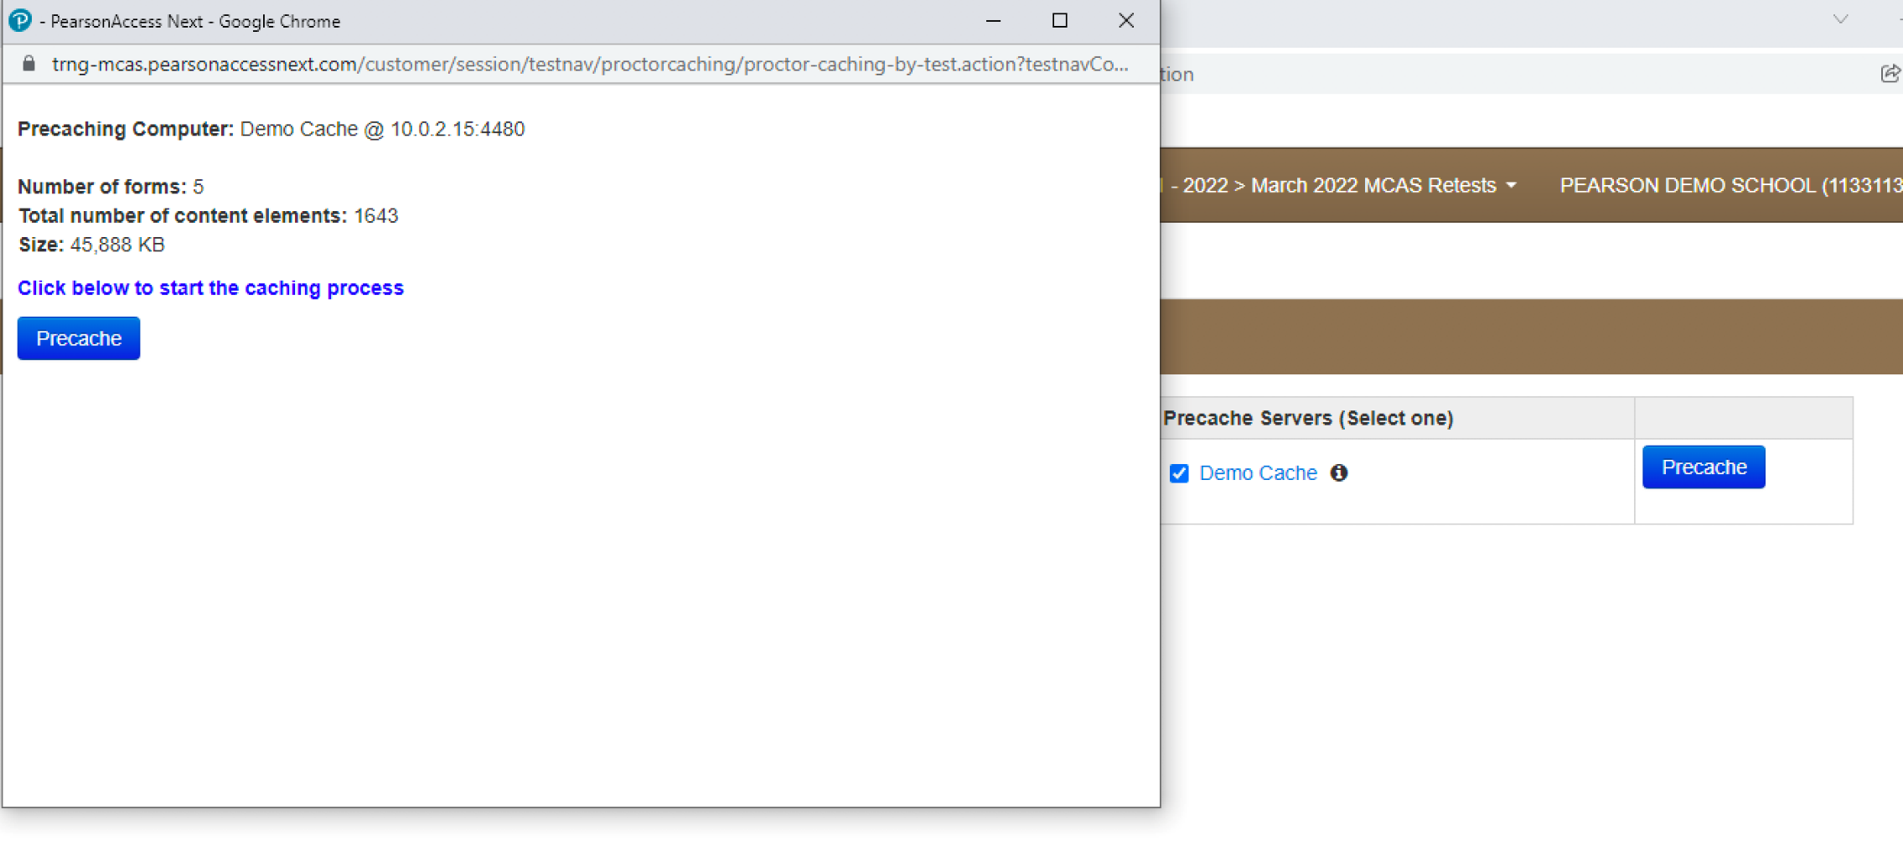
PAN Precache by Test (continued)
Once Precache is clicked, a popup window will appear that displays an overview of your precaching computer and specifications.
Click the Precache button to start the caching process.

Slide 50
ProctorCache Admin Page
The Tests Tab will show your cached tests and forms, along with their caching status, entries and the date they were cached.
The Clients Tab will show the student machine that is accessing the ProctorCache server at that point in time.

Slide 51
Poll Question 2
If using ProctorCache, when should you precache test content?
A. About a week prior to testing
B. About two weeks prior to testing
C. The day before testing
D. The morning of testing

Slide 52
Precache by Test Prior to Creating Student Tests
Precaching for the Infrastructure Trial can be done now for March retests and spring grades 3–8 and 10. Precaching for operational testing will be available approximately one week before each testing window.
For March retests: Operational test content available on February 26 (ELA) and February 29 (Math)
For grade 10 ELA: Operational test content available on March 19
For grades 3–8: Schools should not precache the operational tests until one week prior to the start of their testing window:
Operational test content available for ELA on or around March 18
See the Statewide Testing Schedule for a full list of dates

Slide 53
ProctorCache Setup – Precaching
TestNav configurations can be set up at the school level only by Technology Coordinators.
An organization can only have one configuration.
However, each configuration can have multiple precaching computers.

Slide 54
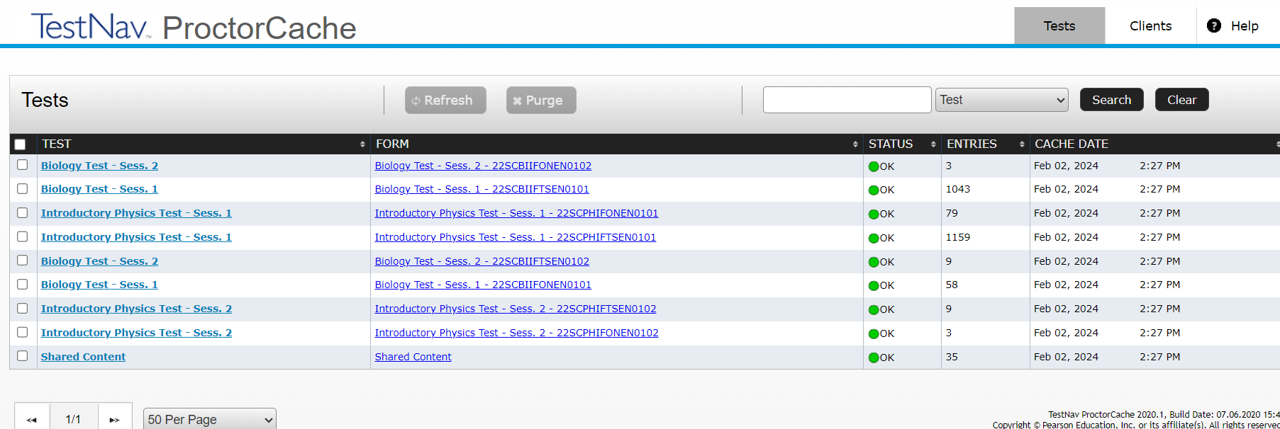
Frequently Asked Questions
How do I verify whether my content is cached?
To find out if ProctorCache is working as expected, you may enter the following URL to confirm whether forms have been correctly precached: http://[Caching Computer’s IP Address]:4480
(e.g., http://192.168.100.50:4480)

Slide 55
Frequently Asked Questions (continued)
How do I check whether the clients are connecting to the ProctorCache computer?
On the Sign In Screen on the TestNav app, there is a User Icon on the top, right-hand side of the screen with an App Check option.
Enter the Configuration Identifier found in PearsonAccess Next found at Setup > TestNav Configurations > select your configuration > Create/Edit Configurations. There will be a Configuration Identifier for each computer set up in that Configuration.

Slide 56
Frequently Asked Questions 2 (continued)
When should I purge test content?
Schools and districts that have old test content on their ProctorCache machines should purge previous test content and ensure they are using a recommended ProctorCache software version for spring 2024.
At the end of the spring 2024 testing window, it is expected that schools purge test content for security purposes (and to reduce the amount of data stored on the caching machine).

Slide 57
Questions and Answers 2
Use the “Q&A” feature to ask questions.

Slide 58
5. Saved Response Files (SRFs)

Slide 59
What is a Saved Response File (SRF)?
A saved response file (SRF) is an encrypted file that includes a student’s response to a test question.
Responses are uploaded directly to Pearson servers.
SRFs are never saved to the ProctorCache machine.
SRFs are only created when TestNav is unable to send the response to Pearson servers.

Slide 60
Saved Response File (SRF) on Mac and Windows Machines
On the TestNav Configuration page, the default primary saved response file location is set to the student device.
This location can be changed, but it is not recommended to do so.
Pearson strongly recommends using a secondary save location to ensure all devices have a backup save location.
For Mac and Windows machines, the secondary location can be a network drive location or an SFTP address.
Steps and instructions to find SRF and log files

Slide 61
Saved Response File (SRF) on iPads and Chromebooks
The primary saved response file location is on the student device and cannot be changed.
Pearson recommends a secondary save location using an SFTP address to ensure all devices have a backup save location.
Steps and instructions to find SRF and log files

Slide 62
SRF Secondary Save Location for Chromebooks and iPads
Chromebooks and iPads cannot write to a network drive, and an SFTP server must be configured (since they are mobile devices).
Select an SFTP solution that meets your network installation requirements that will work with TestNav.
For questions about the installation and configuration of SFTP solutions, contact the vendors/suppliers of the SFTP solution (not the MCAS Service Center).
For questions on whether the SFTP path matches the expected syntax in PAN or whether the SFTP configuration works with TestNav, schedule a call with Pearson’s Technology Support Specialists.

Slide 63
Demonstrations 2
Secondary Save Locations

Slide 64
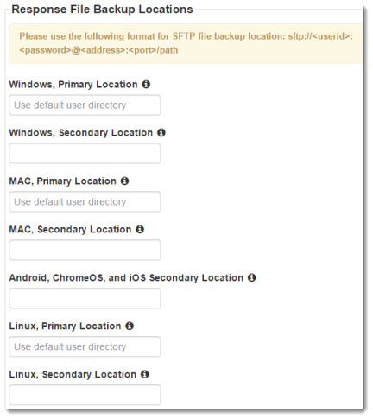
Secondary Save Locations
Student responses are sent to Pearson on every student navigation or every 2 minutes for open-ended responses.
Both the Primary and Secondary files are written to at the same time, if the response cannot be sent to Pearson.
Uploading of response data is continuous. If an upload fails, TestNav saves the SRF to the primary save location (student device) and the secondary save location, if configured, and the student will be exited from TestNav.

Slide 65
6. Troubleshooting

Slide 66
Expected Behaviors in TestNav
Not all problems have error messages, and not all problems are technical issues.
Users may encounter issues in TestNav that are different than anticipated or TestNav tools that do not appear to be working properly but are actually working as designed. For example:
The Notepad cannot be resized.
The Exhibits cannot be resized (e.g., reference sheets).
A question appears as Not Answered in the Review menu until all parts of the question have been answered.

Slide 67
Steps to Resolve Error Codes
If possible, do not power the device off until the student has exited TestNav.
If a student powers off the device without logging out first, they will remain in Active status in PearsonAccess Next and the student will need to be resumed before signing back in to their test.
Troubleshoot the error according to the instructions on the TestNav Error Codes webpage.

Slide 68
Steps to Resolve Error Codes (continued)
When resuming a test after an error has exited the student from TestNav, the original testing device should be used first.
This is so that any unsent responses on the original device can be sent to Pearson.
TestNav will always look in the primary and secondary save locations for a Student Response File when the student logs in to the test regardless of whether the student is in “Resume” or “Resume Upload” status.
If the original testing device cannot be used or if the original error is still occurring, then another device should be attempted. Many issues are resolved by trying a different device if one is available.
Review steps in the following documents:
Principal’s Administration Manual Appendix A
SRF and Log Files

Slide 69
Common TestNav Error Codes
Refer to the TestNav Error Codes webpage for a full list of error codes and instructions.
If your school is experiencing a high volume of error codes, contact the MCAS Service Center.
Error 1001: Your test has been saved. Please notify your test administrator.
This error is presented prior to EWS (Early Warning System) errors as a placeholder. Another error should present immediately after this one, which will give you more information about how to handle the issue. Test administrators should click the button in order to see the next error display.

Slide 70
Common TestNav Error Codes (continued)
Error 1005: No saved response file found.
The student’s status is set to Resumed-Upload, but no file was found in the designated response file. This is normal since an SRF is only created if the student’s response is unable to be uploaded to Pearson servers. Test administrators should click “Skip Upload”. Placing the student into the “Resume” status immediately after “Resume Upload” will prevent the “Skip Upload” prompt from appearing on student devices.
Call the MCAS Service Center if your school experiences a high number of error 1005.
Error 1009: Unable to download test content.
TestNav cannot download all necessary files for the test. The likely root cause of this issue is the content filter, network firewall, or another security product blocking or inspecting traffic from the test delivery URLs. Test delivery URLs should be exempted from filtering and inspection within the district’s security environment. See the Network Requirements and Guidelines for further information.

Slide 71
Common TestNav Error Codes 2 (continued)
Error 9026: This test must be resumed by the proctor to allow it to be taken again.
Confirm username and password, resume student in PAN.
Error 9058/9059: The username or password entered is incorrect.
Incorrect log in information is being used. The session has not been started.
Check that caps lock is off and student is signing into Massachusetts. Verify student is in the correct session and attempting to sign in with the correct testing ticket. Generate new testing tickets to ensure student has the correct and up to date credentials.

Slide 72
Common TestNav Error Codes 3 (continued)
Error 3005: TestNav has detected that another application attempted to become the active window.
Technology staff should review student testing profiles to prevent other application windows, pop-up notifications, system messages, etc. from launching during secure testing.
Error 8026: Unable to connect to the proctor caching computer.
Technology staff should be engaged and local network connection to ProctorCache device must be established. Error can be prevented by enabling Precaching Computer Override in TestNav Configurations in PAN, or bypassing/removing ProctorCache altogether.

Slide 73
Questions and Answers 3
Use the “Q&A” feature to ask questions.

Slide 74
7. Resources, Support, and Next Steps

Slide 75
Resources in the MCAS Resource Center
Resource | Location
Infrastructure Trial Readiness Guide, including Best Practices for CBT Set-Up, Administration, and Troubleshooting | mcas.pearsonsupport.com/manuals (“PearsonAccess Next Guidance” drop-down)
Infrastructure Trial training modules | mcas.pearsonsupport.com/training
TestNav8 and PearsonAccess^{next} User Guides | mcas.pearsonsupport.com/technology-setup (“User Guides” drop-down)
Technology specifications | mcas.pearsonsupport.com/technology-setup (“Technology Guidelines” drop-down)
Accessibility and accommodations guidance and modules | mcas.pearsonsupport.com/manuals (“Accessibility and Accommodations Guidance” drop-down)

Slide 76
Additional Resources on the DESE MCAS Website
Resource | Description
Home page | Access MCAS headlines and links to MCAS site (e.g., test schedule, test designs, training)
Student Assessment Updates | Biweekly email with important updates about the MCAS program If you do not already receive this email, subscribe at this link: http://eepurl.com/ghSOhH
Cybersecurity Information | Guidance on cybersecurity

Slide 77
February/March Training Sessions
Date | Session | Audience
Tuesday, February 27 | Tasks in PAN Before Testing | Principals and test coordinators
Thursday, February 29 | PAN Tasks for Accessibility and Accommodations | Principals, MCAS test coordinators, special education administrators and supervisors, and test administrators administering accessibility features for all students and accommodations for students with disabilities and EL students
Tuesday, March 12 | Tasks in PAN During Testing | Principals, test coordinators, and test administrators
Thursday, March 14 | Tasks in PAN After Testing | Principals and test coordinators
Registration for training sessions available now: www.doe.mass.edu/mcas/training.html
After each session is delivered, a recording of the session and the slides will be posted at mcas.pearsonsupport.com/training/ approximately one week later.

Slide 78
Next Steps
Today: Complete the evaluation form.
Responses are associated with the name and email address used to log in.
Email your input to MCAS@mass.gov if you have problems accessing or completing the form.
Within one week:
Receive an email with the Q&A from this session
Recording will be available

Slide 79
Email and Phone Support
MCAS Service Center
DESE Student Assessment Services
Questions on logistics and technology (e.g., PearsonAccess Next, SR/PNP, TestNav)
Web: mcas.pearsonsupport.com
Email: mcas@cognia.org
Phone: 800-737-5103
Schedule Technology Support Call
Policy questions (e.g., student participation, accommodations, “I have a student who…”)
Web: www.doe.mass.edu/mcas
Email: MCAS@mass.gov
Phone: 781-338-3625

Slide 80
THANK YOU
The Office of Student Assessment Services
781-338-3625
MCAS@mass.gov
www.doe.mass.edu/mcas
135 Santilli Highway, Everett, MA 02149

