Slide 1
Overview of Infrastructure Trials for New Test Coordinators –Part I
Note: This is a 2-part training, and if you have not yet registered for Part II (which will be held tomorrow, January 26), registration is still available at www.doe.mass.edu/mcas/training.html.
The Office of Student Assessment Services January 25, 2024

Slide 2
Presenters
Shannon Cullen, Test Administration Coordinator
Joseph Henkelman, Pearson Technical Support
Matthew Ingles, Pearson Customer Support

Slide 3
Logistics for This Session
Use the Q&A feature to ask a question.
We will answer some questions aloud at specified times during this training session, and we will email the Q&A afterwards.
Type your questions anytime, but we may not answer them in real time as some questions may be covered during the presentation.
Use the thumbs-up icon to “upvote” someone else’s question.
Email student-specific questions to mcas@doe.mass.edu instead of asking here.
This session is being recorded and will be available in about a week in the MCAS Resource Center, along with the slides.
Slides were also emailed out beforehand, and are being posted in the chat.
Closed captioning has been enabled for participants who need it.
This session is being interpreted into ASL. Our interpreting team will be onscreen with the presenters.

Slide 4
Slides for This Session
Slides were emailed to participants before this session from MCASEvents@cognia.org.
Slides are now being posted in the chat.
If you cannot access the slides in the chat, ask in the Q&A.
After the session, we will send the slides again to participants, and they will be posted in the MCAS Resource Center along with the recording.

Slide 5
Today’s Agenda
Determining Whether to Run an Infrastructure Trial
Introduction to Infrastructure Trials
Checklist of Steps: Tasks for Test Coordinators and Test Administrators
Resources, Support, and Next Steps
Live “Sandbox Time”

Slide 6
Tomorrow’s Agenda
Checklist of Steps: Tasks for Test Coordinators and Test Administrators
Administration and Next Steps
Resources, Support, and Next Steps
Live “Sandbox Time”

Slide 7
1. Determining Whether to Run an Infrastructure Trial

Slide 8
Poll Question
How many times have you conducted an Infrastructure Trial for MCAS computer-based testing?
0 times
1–2 times
3–5 times
6+ times

Slide 9
Computer-Based Testing (CBT) Components
PearsonAccess Next (PAN)
Online test management system for principals, test coordinators, and technology coordinators to manage user accounts, student registration, and computer-based test sessions.
TestNav8 (TN8)
Online testing platform used by students to take the computer-based MCAS assessments
ProctorCache
Software that allows for precaching of test content on a designated precaching machine located at the school and can reduce bandwidth requirements.
Recommendation on whether to use ProctorCache is based on school’s bandwidth.
For more information, view the recording of the “Introduction to MCAS CBT for New Staff” training session.

Slide 10
Recommended Windows to Conduct Preliminary System Tests/Infrastructure Trials
Grades | Recommended Windows
March Retests | January 29 – February 23
Grades 3–8 | January 29 – March 15
Grade 10 ELA | February 5 – March 18
June High School Science | April 22 – May 24
Note that there is no recommended Infrastructure Trial window for grade 10 Mathematics. If a school successfully completes grade 10 ELA CBT testing, and their technology does not change, they may not need to conduct additional Infrastructure Trials.
Note that there is no recommended Infrastructure Trial window for the Grade 8 Civics Field Test. Test administrators who wish to practice completing tasks in PAN may use the Spring 2024 MCAS Gr. 3–8 administration in the PAN training site
Schools may choose to complete an Infrastructure Trial for high school Science if they have students and staff who have not yet participated in CBT.

Slide 11
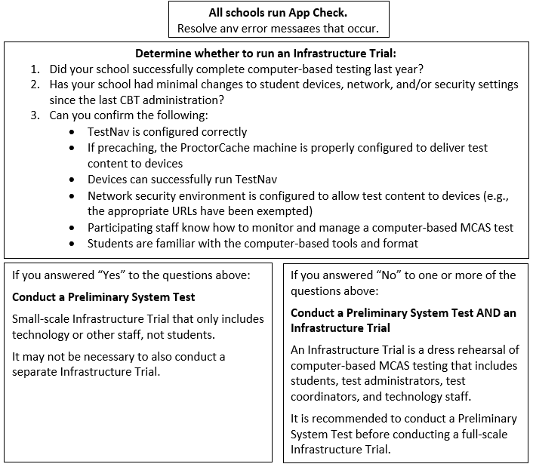
Determine Whether to Run an Infrastructure Trial

Slide 12
Testing Your Network and Devices
App Check: A test run in TestNav by school staff to check connectivity to Pearson servers, the ability of the device to enter “kiosk” mode, and the TestNav configuration (if a configuration identifier is used).
Preliminary System Test: A small-scale Infrastructure Trial during which school staff log in to and click through practice tests instead of students.
Infrastructure Trial: Simulated testing experience during which one or more practice test sessions are administered.

Slide 13
Testing Your Network and Devices 2
Task | What is it? | Should my school complete this task? | Who participates? | Confirms that:
App Check | App Check is completed in TestNav after configuring the network and downloading TestNav on student devices. | Yes, all schools should complete App Check. | Technology staff | Devices can successfully run TestNav TestNav is configured correctly
Preliminary System Test | Small-scale Infrastructure Trial completed by technology or other school staff, during which staff log in to TestNav on student devices and click through practice tests. | Strongly recommended for schools not conducting Infrastructure Trial. Recommended for schools conducting Infrastructure Trial. | Technology or other school staff | Devices can successfully run TestNav TestNav is configured correctly Network security environment is configured to allow test content to devices (e.g., the appropriate URLs have been exempted)
Infrastructure Trial | Simulated testing experience during which one or more practice test sessions are administered. | Guidance on whether to conduct an Infrastructure Trial is outlined on slide 11. | Students, teachers, technology staff, test coordinators | Devices can successfully run TestNav TestNav is configured correctly Network security environment is configured to allow test content to devices (e.g., the appropriate URLs have been exempted) If precaching, the ProctorCache machine is properly configured to deliver test content to devices Participating staff know how to monitor and manage a computer-based MCAS test Students are familiar with the computer-based tools and format.

Slide 14
Steps for Completing App Check
Typically completed by technology staff on a sample of student devices.
To run App Check:
Open the TestNav app and navigate to the Massachusetts sign in page.
Click the user icon in the top right and choose App Check from the menu.
Enter a Configuration Identifier if one will be used. Then select Run App Check.
A “Success” message should appear. If you encounter an error message, refer to the Set Up TestNav and App Check Error Messages webpages for further information.
See page 8, step 4 of the Infrastructure Trial Guide.

Slide 15
Steps for Conducting a Preliminary System Test
Technology staff follows all steps to prepare for Infrastructure Trial, including the following:
Download the TestNav app; confirm that the OS of student devices is supported by TestNav; configure internet firewalls, content filters, and spam filters to exempt the test delivery URLs from filtering and inspection; and download ProctorCache and precache tests, if applicable.
Test coordinator creates a small number of sample student records and tests in the PAN training site and puts them into PAN Sessions. Test coordinators prepare and start PAN Sessions.
Technology or other staff logs in to TestNav with student credentials and clicks through practice tests to confirm they can access test content without issues.
For full instructions on how to complete a Preliminary System Test, refer to the Infrastructure Trial Guide.

Slide 16
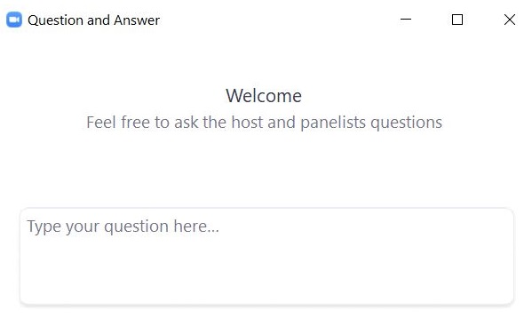
Questions and Answers
Use the “Q&A” feature to ask questions.

Slide 17
2. Introduction to Infrastructure Trials

Slide 18
Main Steps for the Infrastructure Trial
Technology Coordinators:
Set up and configure ProctorCache and/or Secondary Save locations in PAN.
Set up and configure network to make sure the appropriate URLs are exempted.
Ensure that the current version of TestNav is installed on testing devices and that device OS versions are supported by TestNav.
Test Coordinators: Generate sample students, create PAN Sessions, and assign students to Sessions in the PAN training site.
Test Coordinators: Assign any accommodations that students may need to try out in the Trial.
Test Administrators: Administer practice tests to students using TestNav and manage those sessions in PAN during testing.
MCAS Testing Team: Conduct follow-up activities and review lessons learned with the test administration team based on your school’s circumstances.

Slide 19
Practice Tests
 | Infrastructure Trial | TestNav App | MCAS Resource Center
How to Access | Set up through PAN, students will use specific log-ins for TestNav. | Accessed through the “Practice Tests” button in the app. | Links to the CBT practice tests (URLs) and PDFs of the paper-based testing (PBT) practice tests are located under “Practice Tests” on the MCAS Resource Center
Tests included | Same practice tests in the TestNav app as well as Screen Reader (Grade 3 Math) and Compatible Assistive Technology (Grade 3 ELA) practice tests | Same as CBT practice tests on the MCAS Resource Center. | - CBT and PBT practice tests (all grades/subjects) - TTS (all grades/subjects) - ASL (Grade 10 Math, Biology, and Intro Physics) - Spanish/English (Grade 10 Math, Biology, and Intro Physics)
Used for | Used as a “dress rehearsal” for test day and should mimic as close as possible test day circumstances (e.g., time of day, number of students, staff involved). | Students can use to practice TestNav functionality and similar content. These can be done at any time. | Students can use to practice TestNav functionality and similar content. Not every TestNav feature is accessible through these practice tests (e.g., Zoom In/Out tool). These can be done at any time.

Slide 20
Demonstration
Accessing the practice tests

Slide 21
Number of Test Sessions in the Practice Tests
 | Infrastructure Trial contains additional test session(s) that students will not take | MCAS Resource Center | TestNav App
ELA | All grades: 2 test sessions (only the first contains test content) | 1 session | Same as CBT practice tests on the MCAS Resource Center
Math | Grades 3, 5-8: two test sessions (students DO take both sessions) Grades 4 & 10: three sessions (the first TWO contain test content) | 2 sessions | Same as CBT practice tests on the MCAS Resource Center
STE | Grades 5 & 8: three test sessions (only the first contains test content) Biology & Intro Physics: two test sessions (only the first contains test content) | 1 session | Same as CBT practice tests on the MCAS Resource Center

Slide 22
Training Site and User Accounts for PearsonAccess Next
Infrastructure Trials are done through the PAN training site: trng-mcas.pearsonaccessnext.com/customer/index.action
Users with accounts from last year may need to reset their passwords to enable their accounts by clicking “Forgot Password” on the login page.
User accounts need to be set up for each site individually (live and training) in order to gain access.
Usernames and passwords are always the same between the live and the training sites. If you reset a password on one site, passwords will be reset on both sites.
If you need access to PAN (either the training or live site), please reach out to your district test coordinator.
Discuss with your team who will be responsible for setting up PAN user accounts for other users in your school – both test coordinators and technology coordinators have this ability in PAN.
See the Guide to Managing User Accounts in PAN for information on setting up accounts in each site.

Slide 23
Demonstrations
PearsonAccess Next
Live site
Training site

Slide 24
Questions and Answers 2
Use the “Q&A” feature to ask questions.

Slide 25
3. Checklist of Steps: Tasks for Test Coordinators and Test Administrators

Slide 26
Overview of Steps for Test Coordinators
View training modules (mcas.pearsonsupport.com/training/)
Assemble an Infrastructure Trial team to carry out all the required tasks.
Identify students who will participate.
It is recommended that schools select the maximum number of staff and students who will be using network resources at the same time, so that the trial approximates the maximum anticipated network load.
Train all staff involved in the Infrastructure Trial.
Designate appropriate testing schedule, locations, and devices.
Consult with the technology coordinator and confirm that all devices meet the technology specifications.

Slide 27
Overview of Steps for Test Coordinators (continued)
Covered during Part I (today)
Covered during Part II (tomorrow)
Generate sample students.
Edit student records (if needed).
Assign student tests.
Create/Edit PAN Sessions.
Prepare/Start PAN Sessions.
Print student testing tickets, and print proctor testing tickets for students in Human Read-Aloud and Human Signer PAN Sessions.
Mark tests complete.
Stop PAN Sessions.
Convene your team prior to operational testing to resolve any issues you encountered.

Slide 28
Overview of Steps for Test Administrators
View training modules (mcas.pearsonsupport.com/training/)
Confirm students have the correct test form assigned by using the Session Student Roster (recommended)
Start, Stop, and Resume student tests in PAN
Lock and Unlock PAN Sessions
Monitor student progress in the PAN Sessions
Close down testing devices
Covered during Part I (today)
Covered during Part II (tomorrow)

Slide 29
Demonstrations 2
Generating Sample Students
Creating PAN Sessions

Slide 30
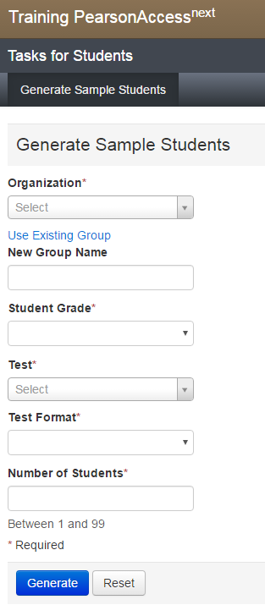
Generate Sample Students
Sample students are created for the Infrastructure Trial instead of using live student data.
Setup > Students > Generate Sample Students
Populate all the fields, including New Group Name, which will be used when adding students to PAN Sessions.
Once complete, click Generate. Repeat until all groups of sample students have been created (e.g., Grade 3 Math, Grade 4 Math)
Note: Groups are ONLY used in the Infrastructure Trial (not actual testing) to help schools assign a large number of sample students to PAN Sessions.
Group Names should include the following, for ease of finding them:
Test administrator name, testing location, grade, subject area test

Slide 31
DESE File of Sample Students
Upon request, DESE can place a pre-populated .CSV file of sample students in schools’ MCAS 2024 Data folder in DropBox Central.
Records are representative of students in each school.
Includes some pre-populated accommodations available in CBT practice tests in the Infrastructure Trial.
After accessing the .CSV file from DropBox, schools can assign appropriate PAN Session names and then import the file into the PAN Training Site prior to conducting an Infrastructure Trial.
Contact DESE to make this request at mcas@doe.mass.edu
Note that it is not recommended to use live student data from your SR/PNP file for Infrastructure Trials.

Slide 32
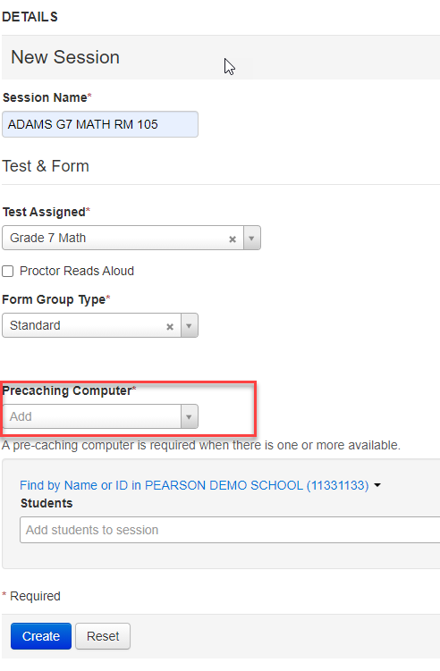
Create PAN Sessions
Sample students must be added to PAN Sessions by completing the following steps.
Testing > Sessions > Create/Edit Sessions
Complete all the required fields, including selecting a precaching computer if one has been configured for your school.
If no configurations have been set, this field will be blank; if one has been set, it will show in this field.
Under Students, change the drop-down to the Group option, select your group, and click Create.

Slide 33
Questions and Answers 3
Use the “Q&A” feature to ask questions.

Slide 34
Demonstrations
Updating a Student Record
Adding an Accommodation for a Student
Adding a Student Using an Accommodation to a PAN Session
Human Reader/Human Signer PAN Sessions

Slide 35
Add Accommodations to a Student Record
It is strongly recommended that students who will be using accessibility features and accommodations during operational testing be provided the opportunity to practice with these during the Infrastructure Trial.
To edit a student record and add accommodations: Setup > Students > select the checkbox next to the student name and choose Create/Edit Students and Manage Student Tests from the Tasks menu.
On the Create/Edit Students page, the sample student’s name can be updated to reflect accommodations (e.g., New Student TTS).
On the Manage Student Tests page, choose the test on the left side, select the accommodations, and click Save.

Slide 36
Form-Dependent Accommodations
The following form-dependent accommodations are especially important to verify before testing because they cannot be changed after a student signs in to the test.
Text-to-speech
ASL video edition of the grade 10 Mathematics test and June high school Science tests
Spanish/English edition of the grade 10 Mathematics test/retest and high school Science tests
Screen reader edition
Compatible assistive technology
DESE recommends practicing with these accommodations during the Infrastructure Trial to confirm that the school is ready to administer the accommodations during operational testing.

Slide 37
Add Accommodations to a Student Record 2

Slide 38
Add a Student Using an Accommodation to a PAN Session
Testing > Sessions
Select the Session you are adding a student to
Select Tasks > Add/Remove Students in Sessions > Start
Select the student and Save

Slide 39
Edit PAN Sessions – Human Reader/Human Signer
Students who are assigned a Human Reader or Human Signer accommodation must be placed in a PAN Session designated as Human Reader or Human Signer because these tests require a proctor testing ticket.
Testing > Sessions > find your PAN Session and select the checkbox > Create/Edit Sessions
Select the Proctor Reads Aloud option and choose the Human Read-Aloud or Human Signer option in the Form Group Type drop-down. Click Save.

Slide 40
Questions and Answers 4
Use the “Q&A” feature to ask questions.

Slide 41
4. Resources, Support, and Next Steps

Slide 42
Resources in the MCAS Resource Center
Resource | Location
Infrastructure Trial Readiness Guide, including Best Practices for CBT Set-Up, Administration, and Troubleshooting | mcas.pearsonsupport.com/manuals (“PearsonAccess Next Guidance” drop-down)
Infrastructure Trial training modules | mcas.pearsonsupport.com/training
Student tutorial and practice tests | mcas.pearsonsupport.com/student
TestNav8 and PearsonAccess^{next} User Guides | mcas.pearsonsupport.com/technology-setup (“User Guides” drop-down)
Guide to the SR/PNP Process | mcas.pearsonsupport.com/manuals (“PearsonAccess Next Guidance” drop-down)
Technology specifications | mcas.pearsonsupport.com/technology-setup (“Technology Guidelines” drop-down)
Accessibility and accommodations guidance and modules | mcas.pearsonsupport.com/manuals (“Accessibility and Accommodations Guidance” drop-down)

Slide 43
Additional Resources on the DESE MCAS Website
Resource | Description
Home page | Access MCAS headlines and links to MCAS site (e.g., test schedule, test designs, training)
Student Assessment Updates | Biweekly email with important updates about the MCAS program If you do not already receive this email, subscribe at this link: http://eepurl.com/ghSOhH
Sample materials from schools | Review materials developed by Swampscott Public Schools and other schools that can be helpful in preparing for an Infrastructure Trial.

Slide 44
Upcoming Training Sessions
Date | Session | Audience
Friday, January 26, 9:30–11:00 a.m. | Infrastructure Trials for Principals and Test Coordinators – New Staff Part II | Principals and test coordinators
Tuesday, January 30 and Thursday, February 1, 9:30–11:00 a.m. | MCAS Accessibility and Accommodations | Principals, test coordinators, special education administrators and supervisors, test administrators
Wednesday, January 31, 9:30–11:15 a.m. | MCAS Test Security and Administration Protocols – Returning Staff | Principals, test coordinators, and test administration teams
Friday, February 2, 9:30–11:30 a.m. | MCAS Test Security and Administration Protocols – New Staff | Principals, test coordinators, and test administration teams
Monday, February 5, 9:30–11:00 a.m. | Pre-Administration Tasks for Technology Staff | Technology coordinators
Registration for training sessions available now: www.doe.mass.edu/mcas/training.html
After each session is delivered, a recording of the session and the slides will be posted at mcas.pearsonsupport.com/training/ approximately one week later.

Slide 45
Infrastructure Trials for New Principals and Test Coordinators Part II
Agenda Topics
Tasks for Test Coordinators and Test Administrators – During and After the Infrastructure Trial
Prepare/Start/Stop PAN Sessions
Confirm students have the correct test form assigned by using the Session Student Roster (recommended)
Print student testing tickets, and print proctor testing tickets for students in Human Read-Aloud and Human Signer PAN Sessions
Lock and Unlock PAN Sessions
Monitoring PAN Sessions
Resume student tests in PAN
Mark tests complete
Administration and Next Steps

Slide 46
Upcoming Training Sessions 2
Date | Session | Audience
Tuesday, February 27, 9:30–11:00 a.m. | Tasks in PearsonAccess Next Before Testing | Principals and test coordinators
Thursday, February 29, 9:30–11:00 a.m. | PAN Tasks for Accessibility Features and Accommodations | Principals, MCAS test coordinators, special education administrators and supervisors, and test administrators administering accessibility features and accommodations
Tuesday, March 12, 9:30–11:00 a.m. | Tasks in PAN During Testing | Principals and test coordinators
Thursday, March 14, 9:30–10:45 a.m. | Tasks in PAN After Testing | Principals and test coordinators
Registration for training sessions available now: www.doe.mass.edu/mcas/training.html
After each session is delivered, a recording of the session and the slides will be posted at mcas.pearsonsupport.com/training/ approximately one week later.

Slide 47
Next Steps
Today: Complete the evaluation form.
Responses are associated with the name and email address used to log in.
Email your input to mcas@doe.mass.edu if you have problems accessing or completing the form.
Within one week:
Receive an email with the Q&A from this session
Recording will be available

Slide 48
Email and Phone Support
MCAS Service Center
DESE Student Assessment Services
Questions on logistics and technology (e.g., PearsonAccess Next, SR/PNP, TestNav)
Web: mcas.pearsonsupport.com
Email: mcas@cognia.org
Phone: 800-737-5103
Schedule Technology Support Call
Policy questions (e.g., student participation, accommodations, “I have a student who…”)
Web: www.doe.mass.edu/mcas
Email: mcas@doe.mass.edu
Phone: 781-338-3625

Slide 49
5. Live “Sandbox Time”

Slide 50
Poll Question 2
Which demonstrations would you like to see again?
Accessing the practice tests
PAN training site vs. live site
Generating sample students
Creating PAN Sessions
Updating a student record
Add an accommodation to a sample student
Add student to PAN Session
Human Reader/Human Signer Sessions

Slide 51
THANK YOU
The Office of Student Assessment Services
781-338-3625
mcas@doe.mass.edu
www.doe.mass.edu/mcas
135 Santilli Highway, Everett, MA 02149

