Slide 1
Overview of Infrastructure Trials for Returning Principals and Test Coordinators
The Office of Student Assessment Services January 23, 2024

Slide 2
Presenters
Shannon Cullen, Test Administration Coordinator
Jodie Zalk, Manager of Test Administration and Publications
Joseph Henkelman, Pearson Technical Support
Matthew Ingles, Pearson Customer Support

Slide 3
Logistics for This Session
Use the Q&A feature to ask a question.
We will answer some questions aloud at specified times during this training session, and we will email the Q&A afterwards.
Type your questions anytime, but we may not answer them in real time as some questions may be covered during the presentation.
Use the thumbs-up icon to “upvote” someone else’s question.
Email student-specific questions to mcas@doe.mass.edu instead of asking here.
This session is being recorded and will be available in about a week in the MCAS Resource Center, along with the slides.
Slides were also emailed out beforehand, and are being posted in the chat.
Closed captioning has been enabled for participants who need it.

Slide 4
Slides for This Session
Slides were emailed to participants before this session from MCASEvents@cognia.org.
Slides are now being posted in the chat.
If you cannot access the slides in the chat, ask in the Q&A.
After the session, we will send the slides again to participants, and they will be posted in the MCAS Resource Center along with the recording.

Slide 5
Today’s Agenda
Determining Whether to Run an Infrastructure Trial
Introduction to Infrastructure Trials
Tasks for Test Coordinators and Test Administrators
Administration and Next Steps
Resources, Support, and Next Steps

Slide 6
1. Determining Whether to Run an Infrastructure Trial

Slide 7
Poll Question
How many times have you conducted an Infrastructure Trial for MCAS computer-based testing?
0 times
1-2 times
3-5 times
6+ times

Slide 8
Computer-Based Testing (CBT) Components
PearsonAccess Next (PAN)
Online test management system for principals, test coordinators, and technology coordinators to manage user accounts, student registration, and computer-based test sessions.
TestNav8 (TN8)
Online testing platform used by students to take the computer-based MCAS assessments
ProctorCache
Software that allows for precaching of test content on a designated precaching machine located at the school and can reduce bandwidth requirements.
Recommendation on whether to use ProctorCache is based on school’s bandwidth.
For more information, view the recording of the “Introduction to MCAS CBT for New Staff” training session.

Slide 9
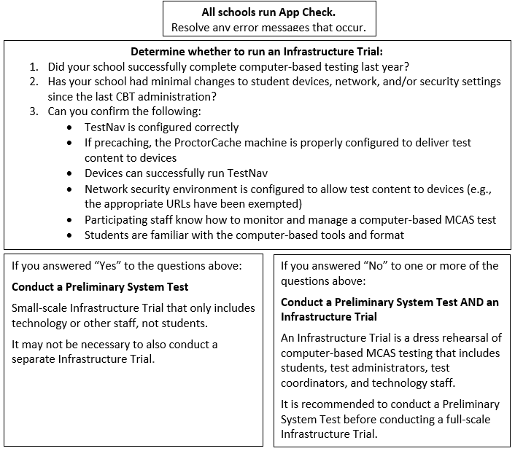
Determine Whether to Run an Infrastructure Trial

Slide 10
Testing Your Network and Devices
App Check: A test run in TestNav by school staff to check connectivity to Pearson servers, the ability of the device to enter “kiosk” mode, and the TestNav configuration (if a configuration identifier is used). See the Infrastructure Trial Guide for further details.
Preliminary System Test: A small-scale Infrastructure Trial during which school staff log in to and click through practice tests instead of students.
Infrastructure Trial: Simulated testing experience during which one or more practice test sessions are administered.

Slide 11
Testing Your Network and Devices
Task | What is it? | Should my school complete this task? | Who participates? | Confirms that:
App Check | App Check is completed in TestNav after configuring the network and downloading TestNav on student devices. | Yes, all schools should complete App Check. | Technology staff | Devices can successfully run TestNav TestNav is configured correctly
Preliminary System Test | Small-scale Infrastructure Trial completed by technology or other school staff, during which staff log in to TestNav on student devices and click through practice tests. | Strongly recommended for schools not conducting Infrastructure Trial. Recommended for schools conducting Infrastructure Trial. | Technology or other school staff | Devices can successfully run TestNav TestNav is configured correctly Network security environment is configured to allow test content to devices (e.g., the appropriate URLs have been exempted)
Infrastructure Trial | Simulated testing experience during which one or more practice test sessions are administered. | Guidance on whether to conduct an Infrastructure Trial is outlined on slide 9. | Students, teachers, technology staff, test coordinators | Devices can successfully run TestNav TestNav is configured correctly Network security environment is configured to allow test content to devices (e.g., the appropriate URLs have been exempted) If precaching, the ProctorCache machine is properly configured to deliver test content to devices Participating staff know how to monitor and manage a computer-based MCAS test Students are familiar with the computer-based tools and format.

Slide 12
Steps for Conducting a Preliminary System Test
Technology staff follow all steps to prepare for Infrastructure Trial, including the following:
Download the TestNav app; confirm that the OS of student devices is supported by TestNav; configure internet firewalls, content filters, and spam filters to exempt the test delivery URLs from filtering and inspection; and download ProctorCache and precache tests, if applicable
Test coordinator creates a small number of sample student records and tests in the PAN training site and puts them into PAN Sessions. Test coordinators prepare and start PAN Sessions.
Technology or other staff logs in to TestNav with student credentials and clicks through practice tests to confirm they can access test content without issues.

Slide 13
Recommended Windows to Conduct Preliminary System Tests/Infrastructure Trials
Grades | Recommended Windows
March Retests | January 29 – February 23
Grades 3–8 | January 29 – March 15
Grade 10 ELA | February 5 – March 18
June High School Science | April 22 – May 24
Note that there is no recommended Infrastructure Trial window for grade 10 Mathematics. If a school successfully completes grade 10 ELA CBT testing, and their technology does not change, they may not need to conduct additional Infrastructure Trials.
Note that there is no recommended Infrastructure Trial window for the Grade 8 Civics Field Test. Test administrators who wish to practice completing tasks in PAN may use the Spring 2024 MCAS Gr. 3–8 administration in the PAN training site
Schools may choose to complete an Infrastructure Trial for high school Science if they have students and staff who have not yet participated in CBT.

Slide 14
2. Introduction to Infrastructure Trials

Slide 15
Main Steps for the Infrastructure Trial
Technology Coordinators:
Set up and configure ProctorCache and/or Secondary Save locations in PAN.
Set up and configure network to make sure the appropriate URLs are exempted.
Ensure that the current version of TestNav is installed on testing devices and that device OS versions are supported by TestNav.
Test Coordinators: Generate sample students, create PAN Sessions, and assign students to Sessions in the PAN training site.
Test Coordinators: Assign any accommodations that students may need to try out in the Trial.
Test Administrators: Administer practice tests to students using TestNav and manage those sessions in PAN during testing.
MCAS Testing Team: Conduct follow-up activities and review lessons learned with the test administration team based on your school’s circumstances.

Slide 16
Practice Tests
 | Infrastructure Trial | TestNav App | MCAS Resource Center
How to Access | Set up through PAN, students will use specific log-ins for TestNav. | Accessed through the “Practice Tests” button in the app. | Links to the CBT practice tests (URLs) and PDFs of the paper-based testing (PBT) practice tests are located under “Practice Tests” on the MCAS Resource Center
Tests included | Same practice tests in the TestNav app as well as Screen Reader (Grade 3 Math) and Compatible Assistive Technology (Grade 3 ELA) practice tests | Same as CBT practice tests on the MCAS Resource Center. | - CBT and PBT practice tests (all grades/subjects) - TTS (all grades/subjects) - ASL (Grade 10 Math, Biology, Intro Physics) - Spanish/English (Grade 10 Math, Biology, and Intro Physics)
Used for | Used as a “dress rehearsal” for test day and should mimic as close as possible test day circumstances (e.g., time of day, number of students, staff involved). | Students can use to practice TestNav functionality and similar content. These can be done at any time. | Students can use to practice TestNav functionality and similar content. Not every TestNav feature is accessible through these practice tests (e.g., Zoom In/Out tool). These can be done at any time.

Slide 17
Poll Question 2
Which practice tests does your school use?
Infrastructure Trial
TestNav App
MCAS Resource Center

Slide 18
Number of Test Sessions in the Practice Tests
 | Infrastructure Trial contains additional test session(s) that students will not take | MCAS Resource Center | TestNav App
ELA | All grades: 2 test sessions (only the first contains test content) | 1 session | Same as CBT practice tests on the MCAS Resource Center
Math | Grades 3, 5-8: two test sessions (students DO take both sessions) Grades 4 & 10: three sessions (the first TWO contain test content) | 2 sessions | Same as CBT practice tests on the MCAS Resource Center
STE | Grades 5 & 8: three test sessions (only the first contains test content) Biology & Intro Physics: two test sessions (only the first contains test content) | 1 session | Same as CBT practice tests on the MCAS Resource Center

Slide 19
Training Site and User Accounts for PearsonAccess Next
Infrastructure Trials are done through the PAN training site: trng-mcas.pearsonaccessnext.com/customer/index.action
Users with accounts from last year may need to reset their passwords to enable their accounts by clicking “Forgot Password” on the login page.
User accounts need to be set up for each site individually (live and training) in order to gain access.
Usernames and passwords are always the same between the live and the training sites. If you reset a password on one site, passwords will be reset on both sites.
If you need access to PAN (either the training or live site), please reach out to your district test coordinator.
Discuss with your team who will be responsible for setting up PAN user accounts for other users in your school – both test coordinators and technology coordinators have this ability in PAN.

Slide 20
Demonstrations
PearsonAccess Next
Live site
Training site

Slide 21
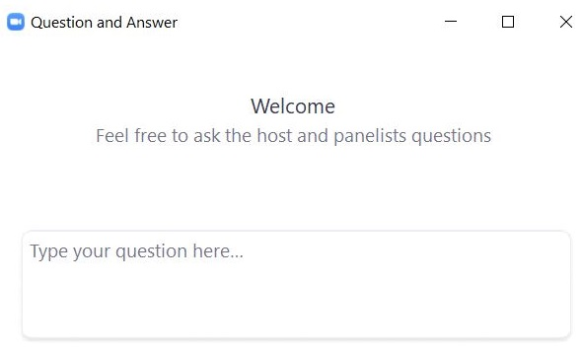
Questions and Answers
Use the “Q&A” feature to ask questions.

Slide 22
3. Tasks for Test Coordinators and Test Administrators

Slide 23
Steps for Test Coordinators
View training modules (mcas.pearsonsupport.com/training/)
Assemble an Infrastructure Trial team to carry out all the required tasks.
Identify students who will participate.
It is recommended that schools select the maximum number of staff and students who will be using network resources at the same time, so that the trial approximates the maximum anticipated network load.
Train all staff involved in the Infrastructure Trial.
Designate appropriate testing schedule, locations, and devices.
Consult with the Technology Coordinator and confirm that all devices meet the technology specifications.

Slide 24
Steps for Test Coordinators (continued)
Generate sample students.
Edit student records (if needed).
Assign student tests.
Create/Edit/Prepare/Start PAN Sessions.
Print student testing tickets, and print proctor testing tickets for students in Human Read-Aloud and Human Signer PAN Sessions.
Mark tests complete.
Stop PAN Sessions.
Convene your team prior to operational testing to resolve any issues you encountered.

Slide 25
Steps for Test Administrators
View training modules (mcas.pearsonsupport.com/training/)
Confirm students have the correct test form assigned by using the Session Student Roster (recommended)
Start, Stop, and Resume student tests in PAN
Lock and Unlock PAN Sessions
Monitor student progress in the PAN Sessions
Close down testing devices

Slide 26
Demonstrations 2
Generate Sample Students
Create PAN Sessions

Slide 27
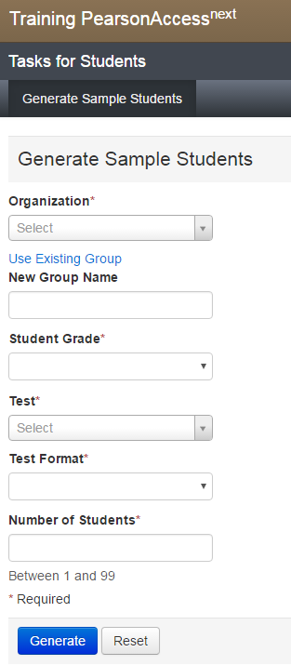
Generate Sample Students
Sample students are created for the Infrastructure Trial instead of using live student data.
Setup > Students > Generate Sample Students
Populate all the fields, including New Group Name, which will be used when adding students to PAN Sessions.
Once complete, click Generate. Repeat until all groups of sample students have been created (e.g., Grade 3 Math, Grade 4 Math)
Note: Groups are ONLY used in the Infrastructure Trial (not actual testing) to help schools assign a large number of sample students to PAN Sessions.
Group Names should include the following, for ease of finding them:
Test administrator name, testing location, grade, subject area test

Slide 28
DESE File of Sample Students
Upon request, DESE can place a pre-populated .CSV file of sample students in schools’ MCAS 2024 Data folder in DropBox Central.
Records are representative of students in each school.
Includes some pre-populated accommodations available in CBT practice tests in the Infrastructure Trial.
After accessing the .CSV file from DropBox, schools can assign appropriate PAN Session names and then import the file into the PAN Training Site prior to conducting an Infrastructure Trial.
Contact DESE to make this request at mcas@doe.mass.edu
Note that it is not recommended to use live student data from your SR/PNP file for Infrastructure Trials.

Slide 29
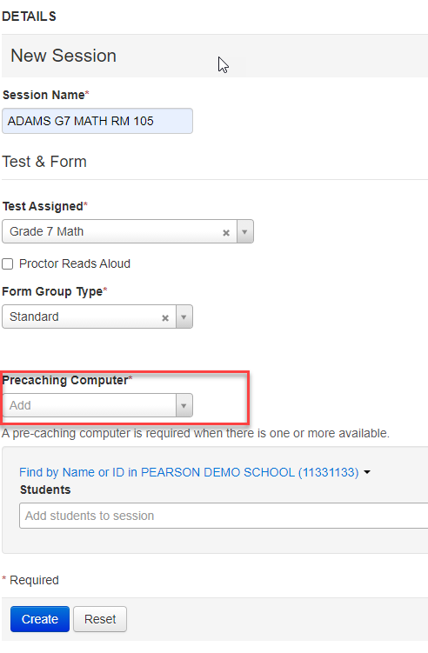
Create PAN Sessions
Sample students must be added to PAN Sessions by completing the following steps.
Testing > Sessions > Create/Edit Sessions
Complete all the required fields, including selecting a precaching computer if one has been configured for your school.
If no configurations have been set, this field will be blank; if one has been set, it will show in this field.
Above Students, change the drop-down to the Find by Group option, select your group, and click Create.

Slide 30
Questions and Answers 2
Use the “Q&A” feature to ask questions.

Slide 31
Demonstrations 3
Updating a Student Record
Add an Accommodation for a Student
Add a Student Using an Accommodation to a PAN Session
Human Reader/Human Signer PAN Sessions
Student Testing Ticket vs. Proctor Testing Ticket
Finding the Session Student Roster

Slide 32
Form-Dependent Accommodations
The following form-dependent accommodations are especially important to verify before testing because they cannot be changed after a student signs in to the test.
Text-to-speech
ASL video edition of the grade 10 Mathematics test and June high school Science tests
Spanish/English edition of the grade 10 Mathematics test/retest and high school Science tests
Screen reader edition
Compatible assistive technology
DESE recommends practicing with these accommodations during the Infrastructure Trial to confirm that the school is ready to administer the accommodations during operational testing.

Slide 33
Add Accommodations to a Student Record
To edit a student record and add accommodations: Setup > Students > select the checkbox next to the student name and choose Create/Edit Students and Manage Student Tests from the Tasks menu.
On the Create/Edit Students page, the sample student’s name can be updated to reflect accommodations (e.g., New Student TTS).
On the Manage Student Tests page, choose the test on the left side, select the accommodations, and click Save.

Slide 34
Add Accommodations to a Student Record 2

Slide 35
Add a Student Using an Accommodation to a PAN Session
Testing > Sessions
Select the Session you are adding a student to
Select Tasks > Add/Remove Students in Sessions > Start
Select the student and Save

Slide 36
Edit PAN Sessions – Human Reader/Human Signer
Students who are assigned a Human Reader or Human Signer accommodation must be placed in a PAN Session designated as Human Reader or Human Signer because these tests require a proctor testing ticket.
Testing > Sessions > find your PAN Session and select the checkbox > Create/Edit Sessions
Select the Proctor Reads Aloud option and choose the Human Read-Aloud or Human Signer option in the Form Group Type drop-down. Click Save.

Slide 37
Human Read-Aloud and Human Signer Sessions
Test administrators who provide these accommodations will use their own computer and print their own proctor testing ticket to access a “test administrator” version of the test.
Students will use their own testing ticket to log in to their test.
Do not confuse the student’s testing ticket with the proctor testing ticket.

Slide 38
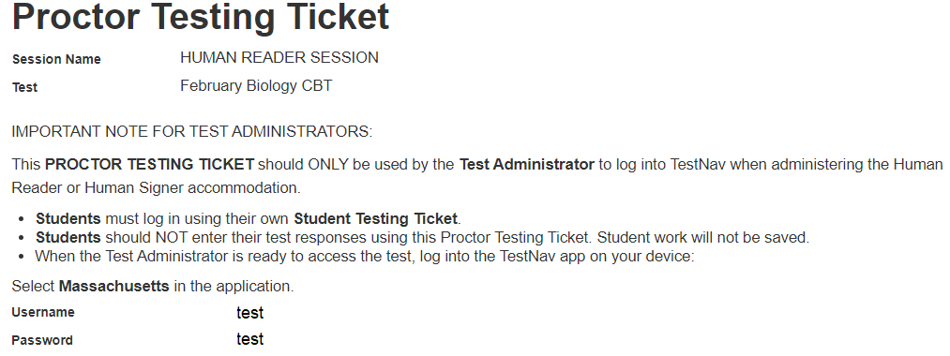
Proctor Testing Tickets
Sample Proctor Testing Ticket for Human Reader/Signer accommodation

Slide 39
Student Testing Tickets for Human Read-Aloud/Human Signer, TTS

Slide 40
Print Testing Tickets
Note: During operational/live testing, schools should print, cut, and sort student testing tickets up to two days before testing.
Steps to prepare student testing tickets can be found at support.assessment.pearson.com/x/HxpgAQ.

Slide 41
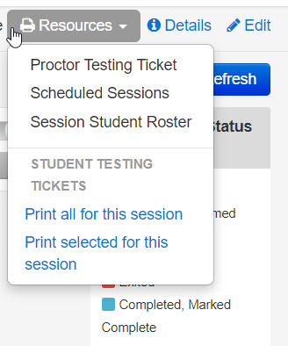
Print Testing Tickets 2
Students require testing tickets to log in to TestNav and access test content.
To print the student testing tickets, go to Testing > Students in Sessions > Add a Session > search for and select your Session, click Add Selected, then select the Resources drop-down.
Note: For live testing, testing tickets are secure and need to be tracked.

Slide 42
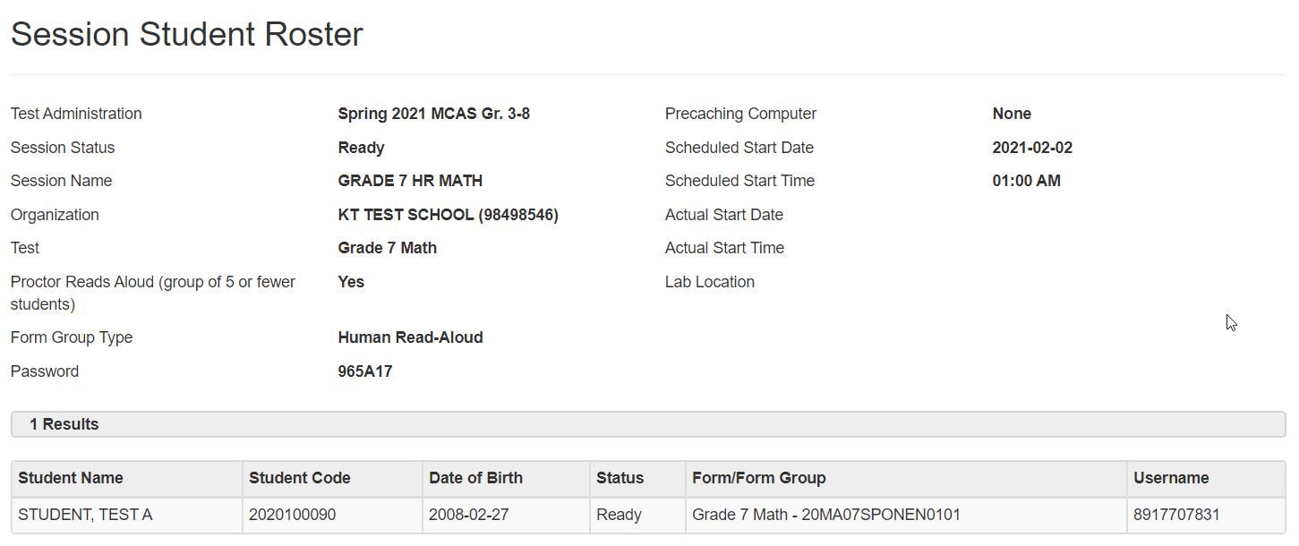
Sample Session Student Roster (Students in Sessions > Resources)

Slide 43
Questions and Answers 3
Use the “Q&A” feature to ask questions.

Slide 44
Demonstrations
Prepare/Start Sessions
Unlock/Lock Sessions

Slide 45
Poll Question 3
During live/operational testing, school should plan to prepare and start PAN Sessions according to the following timeline:
Prepare PAN Sessions up to two days prior to testing, and start PAN Sessions no more than one day prior to testing
Prepare PAN Sessions up to two weeks prior to testing, and start PAN Sessions no more than one day prior to testing
Prepare PAN Sessions up to two weeks prior to testing, and start PAN Sessions no more than two days prior to testing
Prepare PAN Sessions up to one week prior to testing, and start PAN Sessions no more than one day prior to testing

Slide 46
Prepare/Start PAN Sessions
Note: During operational/live testing, schools should plan to prepare and start PAN Sessions according to the following timeline:
Prepare PAN Sessions up to two days prior to testing
Start PAN Sessions no more than one day prior to testing

Slide 47
Prepare PAN Sessions
PAN Sessions must be prepared by the test coordinator before they can be started. This step assigns the test forms to the students.
Testing > Students in Sessions > Find the PAN Session and select the checkbox to see the Session Details screen. Click the blue Prepare Session button.

Slide 48
Start the PAN Session
After you have prepared your PAN Session, you will see a green Start Session button on the Session Details page. Click that to start the PAN Session.
Once started, a Session cannot be stopped until all students are in Complete or Marked Complete status.

Slide 49
Unlock PAN Sessions
On the Students in Sessions screen, while looking at your selected Session, you can unlock each test session by sliding the lock bar to the right.

Slide 50
Unlock Individual Students’ Tests
Students’ tests can also be unlocked one at a time if needed. This is done by selecting the lock icon next to each student’s name.

Slide 51
Questions and Answers 4
Use the “Q&A” feature to ask questions.

Slide 52
4. Administration and Next Steps

Slide 53
Poll Question 4
When your school has conducted Infrastructure Trials previously, how much time did you schedule for the Infrastructure Trial?
One hour or less
1-2 hours
2-3 hours
More than 3 hours

Slide 54
Conducting the Trial
Technology coordinators will be responsible for:
Ensuring ProctorCache software is running, if being used
Monitoring network performance for slowdowns or ISP bandwidth usage
Responding to technology/device issues that may arise
Test coordinators will be responsible for:
Directing test administrators and students to testing locations
Distributing testing tickets
Monitoring administration
Infrastructure Trials should take approximately 60 minutes to administer.

Slide 55
Monitoring PAN Sessions
Test administrators can use the Students in Sessions page to monitor students as they progress through each test session.
The top of the Students in Sessions page contains a status bar for each test session.

Slide 56
Student Status Dashboard and Error Codes
The Students in Sessions page has an additional feature to monitor students’ testing status.
A link will appear next to the status bar for each test session.
(the feature is not available if there are more than 100 students in the session)

Slide 57
Student Status Dashboard and Error Codes 2
A dashboard will open in a separate tab in the browser.
This dashboard will allow users to see all students in that test session and their activity/testing status and any error codes on a student's device, as well as the battery level of each testing device.
Error Codes: https://support.assessment.pearson.com/x/DwACAQ

Slide 58
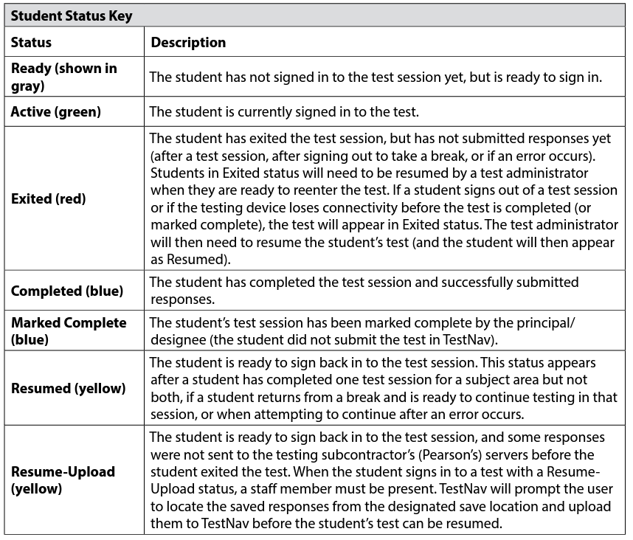
Key to Student Statuses for Students in PAN Sessions (Appendix B of the CBT TAM)

Slide 59
Resuming Student Tests
Sometimes a student will be exited from TestNav after they begin testing and will need to log back in.
Examples: user error, technology issues
Students must be in a “Ready”, “Resumed”, or “Resumed Upload” status in order to log in to TestNav.
If a student is in “Exited” status, and needs to get back in to TestNav, they will need to be Resumed by the Test Administrator.
Refer to the Resuming Student Tests video on the MCAS Resource Center for a demonstration of resuming student tests.

Slide 60
Resume-Upload
If a student is being resumed from an “Active” status in PAN, “Resume Upload” will be the only available option. This is to alert test administrators that there has been an abnormal exit such as the device being powered off.
Select “Resume Upload” in PAN
Select “Resume” in PAN
The student can also log in when in “Resume Upload”, but a message will appear on the student’s screen that gives the option of navigating to a Saved Response File. You can select “Skip Upload” on this message.
If you encounter any issues, call the MCAS Service Center.

Slide 61
Mark Students’ Tests Complete
Students will show in Complete status when they submit their responses in TestNav.
Test coordinators will need to mark complete a student test when a student has not finished testing in the usual manner or has not submitted their responses correctly.
Marking a test complete indicates the student is DONE with testing.
A test session cannot be stopped until all students have a status of Complete or Marked Complete.
On the Mark Student Test Complete page, you must enter a reason.

Slide 62
Stop PAN Sessions
Before a PAN session can be stopped, all students in that Session must either have the status of Complete or Marked Complete.
You may need to remove any students in Ready status from the PAN Session who did not log in to the test.
Once all students are in a Completed or Marked Complete status, select the Stop Session button on the Students in Sessions page.
Refer to the Marking Student Tests Complete video on the MCAS Resource Center for a demonstration of marking student tests complete and stopping a PAN Session.

Slide 63
After the Infrastructure Trial
Meet/debrief with technology coordinators and test administrators.
Collect any notes regarding need for support from the MCAS administration team, and share with the district test coordinator if applicable.
If any issues come up:
Report any issues that cannot be resolved to the MCAS Service Center.
Encourage technology coordinators to schedule a technology support call.

Slide 64
Questions and Answers 5
Use the “Q&A” feature to ask questions.

Slide 65
5. Resources, Support, and Next Steps

Slide 66
Resources in the MCAS Resource Center
Resource | Location
Infrastructure Trial Readiness Guide, including Best Practices for CBT Set-Up, Administration, and Troubleshooting | mcas.pearsonsupport.com/manuals (“PearsonAccess Next Guidance” drop-down)
Infrastructure Trial training modules | mcas.pearsonsupport.com/training
Student tutorial and practice tests | mcas.pearsonsupport.com/student
TestNav8 and PearsonAccess^{next} User Guides | mcas.pearsonsupport.com/technology-setup (“User Guides” drop-down)
Guide to the SR/PNP Process | mcas.pearsonsupport.com/manuals (“PearsonAccess Next Guidance” drop-down)
Technology Specifications | mcas.pearsonsupport.com/technology-setup (“Technology Guidelines” drop-down)
Accessibility and accommodations guidance and modules | mcas.pearsonsupport.com/manuals (“Accessibility and Accommodations Guidance” drop-down)

Slide 67
Additional Resources on the DESE MCAS website
Resource | Description
Home page | Access MCAS headlines and links to MCAS site (e.g., test schedule, test designs, training)
Infrastructure Trial/Preliminary System Test Windows | Contains information on Infrastructure Trial/Preliminary System Test windows for 2023–24
Student Assessment Updates | Biweekly email with important updates about the MCAS program If you do not already receive this email, subscribe at this link: http://eepurl.com/ghSOhH
Sample materials from schools | Review materials developed by Swampscott Public Schools and other schools that can be helpful in preparing for an Infrastructure Trial.

Slide 68
Upcoming Training Sessions
Date | Session | Audience
Wednesday, January 24, 9:30 – 11:00 a.m. | Infrastructure Trials for Technology Coordinators | Technology coordinators
Thursday, January 25, 9:30 – 11:00 a.m. | Infrastructure Trials for Principals and Test Coordinators – New Staff Part I | Principals and test coordinators
Friday, January 26, 9:30 – 11:00 a.m. | Infrastructure Trials for Principals and Test Coordinators – New Staff Part II | Principals and test coordinators
Tuesday, January 30 and Thursday, February 1, 9:30 – 11:00 a.m. | MCAS Accessibility and Accommodations | Principals, test coordinators, special education administrators and supervisors, test administrators
Wednesday, January 31, 9:30 – 11:15 a.m. | MCAS Test Security and Administration Protocols – Returning Staff | Principals, test coordinators, and test administration teams
Friday, February 2, 9:30 – 11:30 a.m. | MCAS Test Security and Administration Protocols – New Staff | Principals, test coordinators, and test administration teams
Registration for training sessions available now: www.doe.mass.edu/mcas/training.html
After each session is delivered, a recording of the session and the slides will be posted at mcas.pearsonsupport.com/training/ approximately one week later.

Slide 69
Upcoming Training Sessions 2
Date | Session | Audience
Monday, February 5, 9:30 – 11:00 a.m. | Pre-Administration Tasks for Technology Staff | Technology coordinators
Tuesday, February 27, 9:30 – 11:00 a.m. | Tasks in PearsonAccess Next Before Testing | Principals and test coordinators
Thursday, February 29, 9:30 – 11:00 a.m. | PAN Tasks for Accessibility Features and Accommodations | Principals, MCAS test coordinators, special education administrators and supervisors, and test administrators administering accessibility features and accommodations
Tuesday, March 12, 9:30 – 11:00 a.m. | Tasks in PAN During Testing | Principals and test coordinators
Thursday, March 14, 9:30 – 10:45 a.m. | Tasks in PAN After Testing | Principals and test coordinators
Registration for training sessions available now: www.doe.mass.edu/mcas/training.html
After each session is delivered, a recording of the session and the slides will be posted at mcas.pearsonsupport.com/training/ approximately one week later.

Slide 70
Next Steps
Today: Complete the evaluation form.
Responses are associated with the name and email address used to log in.
Email your input to mcas@doe.mass.edu if you have problems accessing or completing the form.
Within one week:
Receive an email with the Q&A from this session
Recording will be available

Slide 71
Email and Phone Support
MCAS Service Center
DESE Student Assessment Services
Questions on logistics and technology (e.g., PearsonAccess Next, SR/PNP, TestNav)
Web: mcas.pearsonsupport.com
Email: mcas@cognia.org
Phone: 800-737-5103
Schedule Technology Support Call
Policy questions (e.g., student participation, accommodations, “I have a student who…”)
Web: www.doe.mass.edu/mcas
Email: mcas@doe.mass.edu
Phone: 781-338-3625

Slide 72
THANK YOU
The Office of Student Assessment Services
781-338-3625
mcas@doe.mass.edu
www.doe.mass.edu/mcas
135 Santilli Highway, Everett, MA 02149

