Slide 1
Infrastructure Trial
Technology Coordinators
Notes:
These training slides give an overview of the steps for setting up and configuring the technology needed to conduct an Infrastructure Trial. It is recommended these slides be used in conjunction with the Infrastructure Trial Readiness Guide.

Slide 2
How to use this PowerPoint
Additional information is included in the Notes section of most slides.
Some slides in this PowerPoint have videos. When this occurs, it will be mentioned in the Notes section.
When a video is available, please hover your cursor over the slide and select the Play button to view the video.
For slides with videos, please remember to read the Notes section for additional information.

Slide 3
Topics
Glossary of Terms
Determine Whether to Run an Infrastructure Trial
App Check
Preliminary System Test
Steps to Conduct a Preliminary System Test
Introduction to Infrastructure Trials
Infrastructure Trial Goals
Links for Getting Started
ProctorCache:
ProctorCache Requirements
ProctorCache Setup
Precaching
Precaching Diagnostics
Student Response File Secondary Save Locations
After Testing
Import or Export TestNav Configurations
Frequently Asked Questions
Resources
Notes:
We will cover the topics listed on this slide.
By the end of these slides, you’ll be familiar with the technology setup for the Infrastructure Trial. Some of these slides focus on ProctorCache and precaching test content. Schools that are not using ProctorCache can skip slides 12-16.

Slide 4
Glossary
Infrastructure Trial: An opportunity for districts and schools to prepare for the computer-based tests by ensuring student devices are set up correctly and simulating test day network use.
PearsonAccess^{next} (PAN): The online management system used by principals, test coordinators, technology coordinators, and test administrators to register students, order test materials, and manage activities for computer-based testing.
ProctorCache: Optional software that precaches (i.e., loads) test content onto a designated machine in the school. In schools with lower bandwidth, ProctorCache can reduce test delays and can provide students with a more seamless testing experience in the event of disruptions to Internet connectivity.
Precache: The process of loading or “caching” test content locally to a designated ProctorCache computer at a school.
TestNav: The online testing platform used by students to take the computer-based MCAS tests.
App Check: A test run in TestNav by school staff to check connectivity to Pearson servers, the ability of the device to enter “kiosk” mode, and the TestNav configuration (if a configuration identifier is used).
Preliminary System Test: A small-scale Infrastructure Trial during which school staff log in to and click through practice tests instead of students.
Notes:
Please take a moment to read the definitions of the different components of the technology used to set up an Infrastructure Trial.

Slide 5
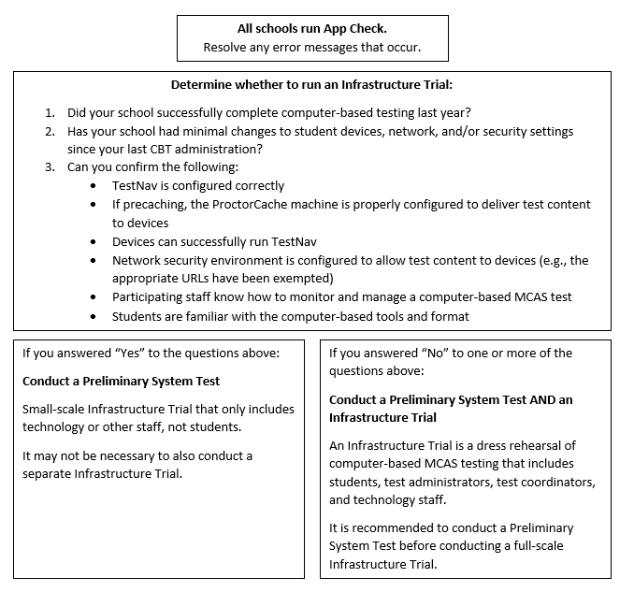
Determine Whether to Run an Infrastructure Trial
Notes:
App Check is completed in TestNav after configuring the network and downloading TestNav on student devices. It confirms that the device can connect to TestNav and that it is able to launch TestNav in kiosk (locked-down) mode. Steps to complete App Check can be found beginning on page 8 of the Infrastructure Trial Readiness Guide, under “Test the “lock down” settings.”

Slide 6
App Check
As a first step to ensuring that devices and networks are set up correctly to use TestNav for computer-based testing, complete App Check in TestNav after configuring the network and downloading TestNav onto student devices.
All schools should complete App Check in TestNav on a small sample of student testing devices to minimize technology issues during administration.
To run App Check:
Open the TestNav app and navigate to the Massachusetts sign in page.
Click the user icon in the top right and choose App Check from the menu.
Enter a Configuration Identifier if one will be used. Then select Run App Check.
A “Success” message should appear. If you encounter an error message, refer to the Set Up TestNav and App Check Error Messages webpages for further information.

Slide 7
Preliminary System Test
All schools, particularly those that do not conduct a full-scale Infrastructure Trial, are strongly recommended to conduct a Preliminary System Test.
A Preliminary System Test is a small-scale Infrastructure Trial conducted without students during which a small number of staff log in to TestNav as students on student devices and click through practice tests.
Follow the graphic on slide 5 (page 2 of the Infrastructure Trial Readiness Guide) to decide whether to conduct an Infrastructure Trial in addition to a Preliminary System Test.
While this module is geared toward preparing and conducting Infrastructure Trials, most of the content covered is also applicable to Preliminary System Tests.

Slide 8
Steps to Conduct a Preliminary System Test
Technology staff follows all steps to prepare for Infrastructure Trial, including the following:
Download the TestNav app; confirm that the OS of student devices is supported by TestNav; configure internet firewalls, content filters, and spam filters to exempt the test delivery URLs from filtering and inspection; and download ProctorCache and precache tests, if applicable
Test coordinator creates a small number of sample student records and tests in the PAN training site and puts them into PAN Sessions.
Technology or other staff logs in to TestNav with student credentials and clicks through practice tests to confirm they can access test content without issues.
See the Infrastructure Trial Readiness Guide for further instructions on conducting Preliminary System Tests.

Slide 9
Introduction to Infrastructure Trials
Purpose of an Infrastructure Trial: an opportunity for districts and schools to prepare for the computer-based tests by ensuring student devices are set up correctly and simulating test day network utilization
Who should participate: test coordinators, technology coordinators, test administrators, and students
Where to conduct the Infrastructure Trial: PearsonAccess^{next} training site: http://trng-mcas.pearsonaccessnext.com
ProctorCache Recommendation: The recommendation on whether to use ProctorCache is based on a school’s bandwidth. Schools should run the Network Check using school network services to determine whether your school needs to use ProctorCache. Instructions are provided in the ProctorCache Recommendation document.
Notes:
The Infrastructure Trial is an opportunity for districts and schools to prepare for the computer-based tests by simulating test day network utilization.
It is recommended that the Infrastructure Trial include everyone who will participate in computer-based testing: test coordinators, test administrators, technology coordinators, and students. It is recommended that students participate so they may practice taking online tests and so that technology coordinators have an approximate idea of the bandwidth needed for online testing.
Schools should plan for the largest number of students who will be concurrently using school network resources so they can “stress test” the network during the trial.
ProctorCache is optional software that allows for precaching of test content on a designated precaching machine located at the school or district and can reduce bandwidth requirements.

Slide 10
Infrastructure Trial Goals
The trial is designed to confirm that:
TestNav is configured correctly
If precaching, the ProctorCache machine is properly configured to deliver test content to devices
Devices can successfully run TestNav
Network security environment is configured to allow test content to devices (e.g., the appropriate URLs have been exempted)
Participating staff know how to monitor and manage a computer-based MCAS test
Students are familiar with the computer-based tools and format.
Notes:
If your organization has successfully administered school-wide CBT, and you are able to confirm the six bulleted items in this list, your organization may not need to conduct an Infrastructure Trial.
If one or more items in the bulleted list cannot be confirmed, or if your technology setup has significantly changed since the last CBT administration (including schools that will be using Bring Your Own Device for the first time), an Infrastructure Trial is recommended.

Slide 11
Getting Started
Review the TestNav System Requirements to verify that all student testing devices meet the minimum specifications.
Download the TestNav App on all student testing devices prior to testing.
For desktop computers, laptops, iPads, Chromebooks, or Androids, download a device-specific TestNav application from the Apple Store, the Google Chrome Web Store, Google Play, or go to http://mcas.pearsonsupport.com/technology-setup/.
Review the Network Requirements and Guidelines.
Add the allow-list URLs to any Content Filters, Firewalls, and Proxy Servers.
Review the ProctorCache Recommendation and run a Network Check to see if your school should use ProctorCache.
For schools that will use ProctorCache, review the ProctorCache System Requirements.
The current ProctorCache version is required if precaching.
If you have an old version of ProctorCache software on your machine, it is recommended you uninstall the old version prior to installing the new version.
Download ProctorCache Software
If students are using assistive technology, refer to the Guidelines for Using Assistive Technology for more information.
Notes:
The information linked above contains all the technology-related information you need to get started with preparing for your Infrastructure Trial. We will demonstrate using ProctorCache software and precaching in the following slides.

Slide 12
ProctorCache Requirements (Optional)
ProctorCache is only recommended for schools that do not pass the Network Check in TestNav as described in the ProctorCache Recommendation.
ProctorCache software is available for Windows caching machines
Does not require an underlying server-based operating system
ProctorCache requires a fixed internal IP address.
Organizations may set up multiple precaching machines.
Whenever possible, it is strongly recommended to minimize the physical distance between precaching machines and student testing devices. It is also strongly recommended to set up precaching machines locally (i.e., at schools), rather than centrally (districts).
See further information on the Set Up and Use ProctorCache page.
Notes:
**Slides 12-16 are only applicable for those schools using ProctorCache.
ProctorCache is the Pearson-supplied software that is used in conjunction with TestNav to reduce bandwidth requirements. ProctorCache is available at http://download.testnav.com/.
ProctorCache software operates on Windows caching machines. It is recommended that schools do not use a MacOS for a ProctorCache machine, but schools that are unable to find another device type should contact the MCAS Service Center for support.
ProctorCache does not require an underlying server-based operating system. It can operate on desktop class hardware and desktop class operating systems, which gives districts flexibility on what machines they use for precaching. ProctorCache cannot be operated on a Chromebook.
ProctorCache uses TCP port 80 for communication between the precaching machine and the Pearson servers and ports 4480 and 4481 for communication between student testing devices and the precaching machine.
Districts that require internet traffic to pass through an upstream proxy server will need to configure ProctorCache to point to their proxy server. For details on setting up an upstream proxy, refer to the “Set Up and Use ProctorCache” page in the TestNav 8 Online Support User Guide (https://support.assessment.pearson.com/x/HAACAQ).

Slide 13
Proctor Cache Setup
Notes:
Please select the play button above to view the video.
To set up ProctorCache, sign in to the PearsonAccess Next training site at http://trng-mcas.pearsonaccessnext.com using the computer that will serve as the precaching machine. Select Setup then TestNav Configurations. Select Create/Edit Configurations and click Start to launch the configuration. The Configuration screen will allow you to access the configuration settings to set secondary save locations for TestNav and, if applicable, set up a connection to your precaching machine. To facilitate the recovery of student responses if connectivity issues interfere with testing and to avoid a situation of missing student responses, the Department strongly recommends setting up a secondary save location. The primary save location should be left blank to default to the student’s device.
Enter a name for your Configuration and fill out the Organization Field. Pearson recommends using only letters and numbers, since other characters may cause problems with test delivery. Organizations may have multiple precaching computers connected to their TestNav configuration.
Next, identify the precaching computer. In the “Default Precaching Computer” section, enter a computer name, the computer’s IP address, and port information. Please note the computer selected for precaching should not be a student testing machine.
All users need to complete the following fields:
Name: The computer name will be the name that displays when selecting a precaching machine during test session creation. Please note that the ProctorCache software must be installed on each machine to be used for precaching.
IP Address: If you will be precaching, provide the internal network IP address of the caching machine.
Port number: 4480 for Pearson-supplied ProctorCache software, unless modified.
Next, specify the student response file secondary save locations and click Create. A “Success” message will appear in green once this is successfully configured. Details for this task can be found on slides 17 and 18.
If you need to modify the configuration or add additional precaching computers to the organization, you may do this on the same Create/Edit Configurations task.

Slide 14
Precaching
If your school needs to use ProctorCache, you may precache by test prior to student records being created in the system as soon as forms are available for the Infrastructure Trial; for operational testing, test content is available approximately one week prior to the opening of the window.
If a school does not have a precaching machine or TestNav Configuration, then the district setup will apply. The Department strongly recommends that precaching machines and TestNav Configurations are set up at the school level. Refer to the Infrastructure Trial Readiness Guide for more information.
An organization can only have one configuration. However, each configuration can have multiple precaching computers set up.
Notes:
Once you have added your configuration, there are some important details to understand about how precaching works inside PearsonAccess Next. Precaching is the process of loading or “caching” test content locally to a designated ProctorCache computer at a school.
You may precache by test as soon as forms are available for the Infrastructure Trial. You do not need to have student records created in the system first. For operational testing, test content is available approximately one week prior to the beginning of the testing window.
If a school does not have a precaching machine or TestNav Configuration, then the district setup will apply. The Department strongly recommends that precaching machines and TestNav Configurations are set up at the school level. Refer to the Infrastructure Trial Readiness Guide for more information.
An organization can only have one configuration. However, each configuration can have multiple precaching computers set up.

Slide 15
Precaching 2
Notes:
Please select the play button above to view the video.
It is recommended that you precache by test rather than at the individual session level since “Precaching by Test” needs to be done only once for the entire organization. If you would like more information on precaching by individual test sessions, please visit the “Precache Test Content” page on the PearsonAccess Next User Guide: https://support.assessment.pearson.com/PAsup
To precache by test, go to Setup then click Precache by Test. Select up to 10 tests to cache, and then select the Precache Server to which the test content should be downloaded. Click Precache. This will bring up a popup window with a Precache button that will allow you to initiate the caching process. The popup window automatically closes after you click the Precache button. If you are setting up multiple precaching machines, precache only the test content that will be assigned to that machine.
A second tab or window will appear shortly. This window will display the Proctor Caching – Tests tab. This window will detail each Test, Form, and Status.
While precaching test content, you may see an additional prompt depending on the Browser that is being used. If you do not confirm, the content will not be cached.
Note: If using Google Chrome, you may need to select the popup window from your task bar, as it may be minimized.

Slide 16
Proctor Cache Diagnostics
Tests Tab:
Clients Tab:
Notes:
We will now review the ProctorCache Diagnostics interface.
Once installed, the ProctorCache software provides technology coordinators access to a web page that shows the status of cached content and monitors caching connections from student testing devices.
Select the Tests tab for information about the test content and caching status. The Tests tab provides status indicators for each item of cached test content.
A green OK status means the content has successfully cached.
The yellow status indicators appear when the content is in the process of being cached. Not Loaded means the content is not cached. Waiting… means the content is in the queue, waiting to be loaded, and Loading… means the content is currently loading.
Red status indicators indicate problems with cached content. Failed to load content means there was a failure to download content. ProctorCache also performs an MD5 data integrity check once an item has been cached to compare the test content on the Pearson servers with the cached item. The MD5 check should show that the items are identical. MD5 Check Invalid means the MD5 comparison could not be completed successfully. MD5 Mismatch means the MD5 comparison was completed but the files did not match. In general, any status in red is a critical problem. Any content with a red status should be checked and reloaded.
Select the Clients tab to monitor client connectivity. The Clients tab offers a quick view into client computer connections. Each computer can be clicked to bring up an individual Client Details screen. It provides visibility to which student testing devices have requested test content from the server.
For more information on the ProctorCache Diagnostics page – including status indicators, Monitoring, Refreshing, Reloading and Purging ProctorCache, visit the “Set Up and Use ProctorCache” page in the TestNav User Guide (https://support.assessment.pearson.com/x/HAACAQ). The default ProctorCache password is t35t1n6 and is also found in the Infrastructure Trial Readiness Guide at mcas.pearsonsupport.com.

Slide 17
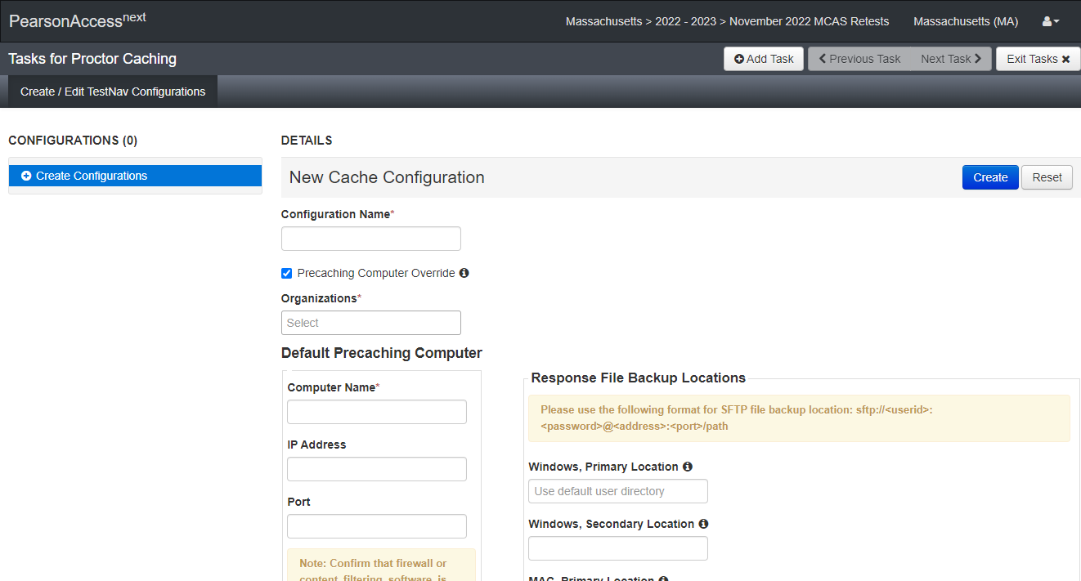
Student Response File Secondary Save Locations (Highly Recommended)
Notes:
To facilitate the recovery of student responses if connectivity issues interfere with testing and to avoid a situation of missing student responses, the Department strongly recommends setting up a secondary save location. The primary save location should be left blank to default to the student’s device.
To configure secondary save locations for your student responses in PAN:
Select Setup then TestNav Configurations.
Select Create/Edit Configurations
Click Start to launch the configuration.
Enter the appropriate information in the fields on the page shown above, and click Create.
Check that the secondary save location is configured correctly by running an App Check in TestNav. Visit https://support.assessment.pearson.com/TN/set-up-testnav-on-windows-20054054.html for step-by-step instructions on ensuring the configured file path is valid, and refer to the App Check Error Messages page (https://support.assessment.pearson.com/TN/app-check-error-messages-23069571.html) if the App Check returns any error messages.

Slide 18
Student Response File Secondary Save Locations (Highly Recommended) 2
Notes:
The Configuration screen will allow you to access the configuration settings to set the secondary save locations for TestNav (expanded view above).
For further details regarding Student Response File setup, please refer to Set up and Use TestNav page in the TestNav User Guide: https://support.assessment.pearson.com/TN/set-up-and-use-testnav-16908318.html

Slide 19
After Testing
Document and report technical Issues
Meet with test coordinators and test administrators for a debrief
Purge Sample Test Content (if using ProctorCache)
After resolving any technical issues, export your TestNav Configuration from the (brown) training site and import it into the (blue) live site.
Notes:
After testing, document any technical issues that were found, and work to resolve them with the test administration team prior to operational testing. Principals, test coordinators, and test administrators should share any concerns students had with connectivity issues or slow loading with the technology coordinator. For example, if the network loading of test content on student testing devices was slow, and the network was busy with other non-testing tasks during that time, any other, non-testing tasks should be suspended during operational testing. Schools will also need to develop a plan to address and resolve any other issues that were encountered.
For those using ProctorCache, after all Infrastructure Trial testing is complete, you will need to purge the practice test content by using the steps in the link on this slide.
After resolving any technical issues, export your TestNav Configuration from the (brown) training site and import it into the (blue) live site.

Slide 20
Import/Export TestNav Configurations
Notes:
Once you have fixed any issues you may have encountered during the Infrastructure Trial, export the TestNav configuration and import it into an operational test administration at mcas.pearsonaccess.next.com.
For more information on how to import or export TestNav Configurations, visit the “Import or Export TestNav Configurations” page of the PearsonAccess^{next} User Guide (https://support.assessment.pearson.com/PAsup).

Slide 21
Frequently Asked Questions
1. How do I verify my content is cached?
2. How do I see if the clients are connecting to the precache computer?
3. When do I purge test content?
Notes:
1. To determine if ProctorCache is working as expected, you may enter the following URL to see if forms have correctly been precached: http://[Precaching Computer’s IP Address]:4480.
2. To see if the clients are connecting to the precaching computer, on the Sign In screen on the TestNav app on the student’s device, there is a User icon on the top, right-hand side of the screen with an App Check option. It will ask for a Config ID which can be found in the TestNav Configuration that was set up in PearsonAccess^{next}. Enter the Config ID into TestNav on the student’s device on the App Check screen to confirm that the client can connect to the precaching computer.
3. For organizations that previously administered computer-based tests: It is strongly recommended to purge test content from any previous years’ test administration and to uninstall existing ProctorCache software before installing updated ProctorCache software. For all organizations administering computer-based tests: After the close of the test administration window, purge test content to reduce the amount of content visible on the ProctorCache Diagnostics screen.

Slide 22
Resources
Infrastructure Trial Readiness Guide
PearsonAccess^{next} User Guide
TestNav8 Online Support User Guide
TestNav and ProctorCache requirements and download links
PAN Training Site
MCAS Test Administration Resources
Guidelines for Using Assistive Technology
Notes:
Here are the resources to help you with the process when you conduct an Infrastructure Trial.

Slide 23
Thank you.

