Slide 1
MCAS 2023 Preliminary Data and Discrepancy Reporting
Office of Student Assessment Services August 8, 2023

Slide 2
Presenters
Scott Kelley, Reporting Specialist
Bob Lee, MCAS Chief Data Analyst
Jodie Zalk, Manager of Test Administration & Publications

Slide 3
Logistics for This Session
Use the Q&A feature to ask a question.
Some questions may be covered during the course of the presentation.
We will answer some questions at the end of this session.
After the session, we will email questions and answers to participants.
Email questions about individual records or specific questions about your school/district to mcas@doe.mass.edu instead of asking here.
Use the thumbs-up icon to “upvote” someone else’s question.
This session is being recorded and will be available in about a week in the MCAS Resource Center, along with the slides.
Slides were also emailed out beforehand and are being posted in the chat.
Click the “CC” to enable closed captioning (if needed).

Slide 4
Today’s Agenda
Data Deliveries
What’s New
Considerations for Using Preliminary Spring 2023 Results
Discrepancy Reporting
Answers to Your Questions
Resources, Support, and Next Steps

Slide 5
1. Data Deliveries

Slide 6
2023 Data Deliveries to Date
Month | Release Date | Delivery
June | June 5 | Grade 10 ELA
 | June 12 | MCAS-Alt Feedback Forms in DropBoxes
 | June 14 | Grade 10 ELA released essays
 |  | Grades 3–8 ELA
 | June 21 | Grades 3–8 ELA released essays
 | June 22 | Grade 10 ELA preliminary results in DropBoxes (scaled scores and achievement levels only)
July | July 10 | Grades 3–8 Math
 |  | Grades 5 & 8 STE
 | July 18 | HS Biology and Intro. Physics
 |  | Grade 10 Math

Slide 7
August 2023 Data Deliveries
August 8 in DropBoxes
Full preliminary results in .CSV files for all grades and subjects except SGP
First-year EL status for students enrolled in March and June SIMS (years in MA verified by historical SIMS)
August 9 in DropBoxes
Preliminary participation data (aggregated by subject/student group)
August 15 in Edwin Analytics
Full preliminary results for all grades and subjects except SGP, which will be available in September

Slide 8
2. What’s New

Slide 9
Graduation Requirements for the Classes of 2024 and 2025
Subject | Option 1 | Option 2
ELA | Earn a score of 472 or higher (EPP* not required) | Earn a score of 455–471 (EPP* required) Note: 455–469
Math | Earn a score of 486 or higher (EPP* not required) | Earn a score of 469–485 (EPP* required) Note: 469
STE | Earn a score of 220 or higher on legacy Chemistry or Technology/Engineering; 470 or higher in Introductory Physics; or 467 or higher in Biology. Note (Biology): 467–469 | Not applicable (only one option for STE)
Not Meeting Expectations
Not Meeting Expectations
Not Meeting Expectations
*Educational Proficiency Plan information is available at www.doe.mass.edu/assessment/epp/.
For detailed information about graduation requirements, refer to www.doe.mass.edu/mcas/graduation.html.

Slide 10
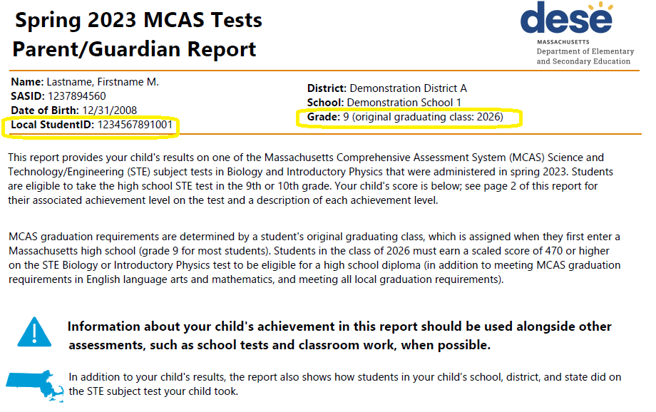
New Information on Parent/Guardian Reports
Local Student ID (LASID from SIMS) on all reports
Original Graduating Class on Grades 9 & 10 reports (calculated from SIMS)

Slide 11
2023 MCAS Released Items and Student Work
Interactive released items in TestNav
Works in a browser; provides selected-response score
Released items for paper-based tests
Legacy tests in Chemistry and Technology/Engineering are not released; only item information provided
Sample student work and scoring guides

Slide 12
3. Considerations for Using Preliminary Spring 2023 Results

Slide 13
Considerations for Using Preliminary Assessment Data
Identify/report potential discrepancies to ensure accurate data for release of official results and Parent/Guardian Reports
View achievement for returning students
Interactive Edwin reports
View achievement for newly enrolled students
Claim students in Edwin to view prior years school enrollment, attendance, course enrollment and marks, assessment results, and CD status.

Slide 14
Claim New Students to Access Their Prior Data
Students with prior enrollment in a Massachusetts public school must be “claimed” for access to that data.
Claiming is done at the district level, generally by individuals with the “SIMS Contact” role in your district.
Find your district’s SIMS contact by using this form
Additional information on the claiming process
Student claiming is almost immediate for most student level reports; it eliminates the need to wait until October 1st for districts to view their students in SIMS.
FAQs on student claiming
Contact Data Collection at data@doe.mass.edu for assistance.

Slide 15
Finding Claimed Students in Edwin
Most student reports have a “Claimed Students” filter:

Slide 16
View Pre-Claimed Student Data in Edwin
The Student Profile (PR600) and Assessment History Summary (PE613) reports contain a “Pre-Claimed Students” drop-down.
District may claim students in advance of official enrollment and view these data.
Step-by-step guidance: November 2, 2022, SAS Update

Slide 17
Student-Level Reports in Edwin Analytics (8/15)
Item Analysis Reports
Growth Analysis Reports
(SGP available in September release)
IT621-626 Student Rosters
Achievement Analysis Reports
Student Profile Reports
Students’ CD status is available only in IT523, IT616, and Student Rosters in August; CD status for all other Edwin reports available in September release.

Slide 18
Security Portal is Migrating to the Cloud!
DESE applications in the Security Portal are migrating to the CLOUD! Anticipated Timeline: Weekend of August 26–27
Changes include:
Logging in to Security Portal has Multi-factor Authentication
Changes to Prompt area (Parameters)
Order of Prompts/names of prompts
ANY CHANGE IN PROMPTS – MUST HIT VIEW REPORT for changes to take effect!
How you download data
Webinars covering new version will be held in September and resources will be posted on www.doe.mass.edu/edwin

Slide 19
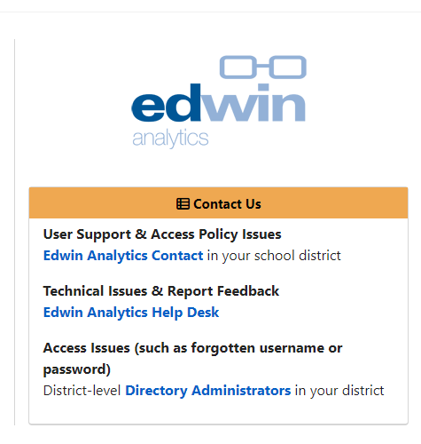
Need support using Edwin?
Resources available at www.doe.mass.edu/edwin/

Slide 20
4. Discrepancy Reporting

Slide 21
MCAS Discrepancy Reporting Overview
August 8−11 at 5:00 p.m.
Discrepancies reported after August 11 will not be included in MCAS Parent/Guardian Reports or in the public release of official school and district MCAS results.
Discrepancy reporting tool is on the MCAS Service Center
MCAS Service Center passwords were placed in MCAS 2023 Data folder in DropBox Central, on the Department’s Security Portal

Slide 22
MCAS Discrepancy Reporting
CSV data files and first-year English learner files are now in DropBoxes
Preliminary participation data (aggregated by subject/student group) in DropBoxes on August 9
MCAS Discrepancy Reporting Guide is posted in DropBoxes as well as the MCAS Service Center website
Call the MCAS Service Center at 800-737-5103 if you need assistance

Slide 23
Updates to DropBox Files from Previous Early Release Files
Regular absence, medical absence, and first-year EL exemptions are noted
Security breach invalidations are included (cell phone use, inappropriate accommodations, and other irregularities that have been resolved)
Most duplicate cases and missing SASIDs resolved

Slide 24
How to Review Your Data for Potential Discrepancies
Review individual student data using data files (now in the MCAS Data Folder in DropBoxes; megafile layout included).
Confirm that each student has a SASID.
Confirm that each student enrolled during the testing windows is listed only once.
Verify that non-participating students have the correct participation status (slide 25 has most common codes; full list in the Discrepancy Reporting Guide).

Slide 25
Most Common Test Participation Codes and Status
Code | Status | Status in CSV file | Description
ABS | Absent | ABS | Not tested or partially tested
ALT | Tested Alternate Assessment | T | Tested MCAS-Alt
INC | Incomplete | NTO | Partial test not scored; repeated CBT tech issues; no accountability reporting
INV | Invalidated | NTO | Invalidated due to security breach
LEP | First-year LEP | NTL | First-year EL: satisfied participation requirement; scaled score and SGP not aggregated
MED | Absent - Medically Documented | NTM | Did not test for medical reasons
PAS | Previously Passed | NTO | Did not test; earned a passing score on a prior high school STE test
PRF | Previously Failed | NTO | Did not test; did not earn a passing score on a prior high school STE test
STD | Tested Standard | T | Fully tested and reported for accountability
TRN | Transferred | NTO | Transferred into or out of your school/district; not tested and not reported for accountability
VAB | Voided Answer Booklet | NTO | Voided Answer Booklet

Slide 26
What Data Are Not Yet Available?
Student Growth Percentiles
SGP will be computed after the discrepancy reporting period and available with official MCAS results in mid-September.

Slide 27
Discrepancies that Schools/Districts Can Change Directly
A missing SASID can be added.
Test participation status can be changed from “Medically documented” to “Absent” or vice-versa.
Incorrectly voided tests can be un-voided.

Slide 28
Discrepancies Requiring Department Approval
Student was not tested at your school (or an affiliated test site) but appears on your roster with test results
Participation status should be changed from “Absent” to “Tested” (student confirmed as present during all test days)
Participation status should be changed to “First-year EL” or “Transferred” (subject to Department validation using SIMS)
Special access accommodation status is incorrect
Note: See the full list of discrepancies in the Discrepancy Reporting Guide, available in DropBox and the Discrepancy Reporting Tool.

Slide 29
Discrepancies Requiring Department Approval (continued)
High schools only:
Student is reported as “Absent” for ELA and/or Math tests but previously participated in a spring grade 10 test
summarize = 1 student was required to test, but school records didn’t show testing was required
A first-time grade 10 student (not repeating) is reported with a test status of “TR” (Tested–Retest)
CD Status is incorrect or missing
New for 2023: student’s original graduating class is incorrect or missing (grade 9 and above)

Slide 30
What Not to Report as a Discrepancy
Students with correct SASID but incorrect name, birth date, gender, race/ethnicity, or any other SIMS data; update next SIMS submission instead
Students involved in a test breach whose results appear as “INV.” These results have been invalidated due to a security breach.
Correctly voided CBT test or PBT answer booklets (listed as “VAB”)
Students reported as enrolled in March and June 2023 SIMS, did not participate in test(s), and therefore assigned a performance level of “Absent”: update enrollment in next SIMS submission

Slide 31
What Not to Report as a Discrepancy (continued)
High schools only:
Student who skipped grade 10 and did not participate in grade 10 spring ELA and Math tests and is reported as “Absent” (retests do not count)

Slide 32
Using Preliminary Results – Embargo Policies
Do
Use early release results for educational planning purposes within the school and district, including
Summer acceleration, IEP meetings, curricular decisions
Don’t
Discuss or share aggregate results outside your organization
Show preliminary aggregate reports at school committee meetings

Slide 33
Additional 2023 Data Deliveries
Date | Delivery | Location
Late August | Preliminary district and school accountability results available in the Security Portal | Accountability Data application in DESE’s Security Portal
Mid-September | Official embargoed MCAS.csv data files posted electronically | DropBox Central in DESE’s Security Portal
 | Official embargoed MCAS & MCAS-Alt student results available in Edwin | Edwin Analytics in DESE’s Security Portal
 | Official embargoed accountability data for all districts & schools available electronically | Accountability Data application in DESE’s Security Portal
Late September | Official district & school-level MCAS & MCAS-Alt results released to the public | DESE’s School and District Profiles
 | Official accountability reports for all districts & schools released to the public | DESE’s School and District Profiles

Slide 34
Additional 2023 Data Deliveries (continued)
Date | Delivery | Location
Late September (cont’d) | Electronic standard MCAS parent/guardian reports available to superintendents, principals & district test coordinators | PearsonAccess Next
 | Printed standard MCAS and MCAS-Alt parent/guardian reports received by superintendents | UPS delivery to district offices
The 2023 Assessment and Accountability Reporting Schedule is now available in the embedded URL above (opens a Word document).

Slide 35
5. Answers to Your Questions

Slide 36
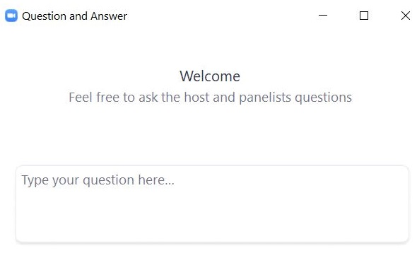
Questions and Answers
Use the “Q&A” feature to ask questions.

Slide 37
6. Resources, Support & Next Steps

Slide 38
Additional Resources
Resource | Location
MCAS Resource Center | mcas.pearsonsupport.com/
Modules and recordings of previous trainings | mcas.pearsonsupport.com/training/
PAN user information | mcas.pearsonsupport.com/pearsonaccessnext/
Student Assessment Updates (Biweekly email with important updates about the MCAS program) | www.doe.mass.edu/mcas/updates.html If you do not already receive this email, subscribe using this link: http://eepurl.com/ghSOhH
Released Items | mcas.pearsonsupport.com/released-items

Slide 39
Email and Phone Support
MCAS Service Center
DESE Student Assessment Services
Questions on logistics
Web: mcas.pearsonsupport.com
Email: mcas@cognia.org
Phone: 800-737-5103
Policy and data questions
Web: www.doe.mass.edu/mcas
Email: mcas@doe.mass.edu
Phone: 781-338-3625

Slide 40
Next Steps
Today: Complete the evaluation form.
Responses are associated with the name and email address used to log in.
Email your input to mcas@doe.mass.edu if you have problems accessing or completing the form.
Within about a week:
Receive an email with the Q&A from this session
Recording will be available

Slide 41
THANK YOU
The Office of Student Assessment Services
781-338-3625
mcas@doe.mass.edu
www.doe.mass.edu/mcas
75 Pleasant Street, Malden, MA 02148

