Slide 1
Using MCAS Early Release Data Files ELA Grades 3–8 & 10 Round 2 Math Grades 3–8 & 10 Round 1 STE Grades 5 & 8 Round 1
The Office of Student Assessment Services June 21, 2023

Slide 2
Presenters
Scott Kelley, Reporting Specialist
Bob Lee, MCAS Chief Data Analyst
Jodie Zalk, Manager of Test Administration & Publications

Slide 3
Logistics for This Session
Use the Q&A feature to ask a question.
Some questions may be covered during the course of the presentation.
We will answer some questions at the end of this session.
After the session, we will email questions and answers to participants.
Email questions about individual records or specific questions about your school/district to mcas@doe.mass.edu instead of asking here.
Use the thumbs-up icon to “upvote” someone else’s question.
This session is being recorded and will be available in about a week in the MCAS Resource Center, along with the slides.
Slides were also emailed out beforehand and are being posted in the chat.
Click the “CC” to enable closed captioning (if needed).

Slide 4
Today’s Agenda
What is (and is not) included in the MCAS Early Release?
Demonstration: Opening Your Data & Using the Item Analysis Templates
Answers to Your Questions
Early Release, Preliminary, Discrepancy Reporting Schedules
Resources, Support, and Next Steps
Graduation Requirements & the Interim CD

Slide 5
1. What is (and is not) included in the MCAS Early Release?

Slide 6
Early Release Data in PearsonAccess Next (PAN)
.CSV file in the “Published Reports” tab
Early release data contains:
constructed and selected response (V2) ELA scores
selected response (V1) Math and grades 5 & 8 STE scores
One row per student per test administration
Points earned for each item:
0 = no points earned or no response
– = item not yet scored (V1)
Accommodations and accessibility features assigned (.CSV)
Student roster of results (school level only) show:
item scores, reporting category percent of possible points, void/medical absence flag (if appropriate)
ELA Released Essays

Slide 7
Released Items
ELA and Math: to be posted soon
Grades 5 and 8 STE: to be posted later this month
High school STE: to follow
CBT released items in the MCAS Resource Center: mcas.pearsonsupport.com/released-items/
PBT released items on the DESE website: www.doe.mass.edu/mcas/testitems.html
Scoring rubric and examples of student work: to be posted this summer www.doe.mass.edu/mcas/student/

Slide 8
Schedule for Early Release Data in PAN
Raw Scores Only; no Scaled Scores, Achievement Levels, SGP *All dates are tentative. Check the Student Assessment Update for changes.
Month | Release Date | Machine-Scored (V1); Hand- and Machine-Scored (V2)
May | May 3 | Grade 10 ELA V1
 | May 22 | Grades 3–8 ELA V1
June | June 5 | Grade 10 ELA V2
 | June 14 | Grade 10 ELA essays
 | June 14 | Grades 3–8 ELA V2
 | June 14 | Grade 10 Math V1
 | June 14 | Grades 3–8 Math V1
 | June 20 | Grades 3–8 ELA Essays
 | June 22 | Grades 5 & 8 STE V1
July | July 10 | Grades 3–8 Math V2
 | July 10 | Grades 5 & 8 STE V2
 | July 18 | HS Biology and Intro. Physics V1
 | July 18 | Grade 10 Math V2
Who has access? Superintendents, principals, district and school test coordinators. Others may be added by assigning the “Published Reports” user role in PAN.

Slide 9
Comparison between Machine-Scored & Hand-Scored Items
Subject/ Grade | Machine-Scored Items Included in Round 1 |  |  |  | Hand-Scored Items Included in Round 2 |  |  |  | Total
ELA grade | One-Point Selected Response | Two-point Selected Response (SR) | Machine- Scored Points | Percent Machine- Scored | Constructed Response (CR) | Essays | Hand-Scored Points | Percent Hand- Scored | Total Raw Score Points
3-4 | 24-28 | 3-5 | 34 | 77% | 1 (3 pts.) | 1 (7 pts.) | 10 | 23% | 44
5 | 24-28 | 3-5 | 34 | 71% | 0 | 2 (7 pts.) | 14 | 29% | 48
6-8 | 24-28 | 3-5 | 34 | 68% | 0 | 2 (8 pts.) | 16 | 32% | 50
10 | 21 | 7 | 35 | 69% | 0 | 2 (8 pts.) | 16 | 31% | 51
Math grade | One-Point SR Short Answer | Two-Point SR SA | Machine- Scored Points | Percent Machine- Scored | CR | N/A | Hand-Scored Points | Percent Hand- Scored | Total Raw Score Points
3 | 36 | 0 | 36 | 75% | 4 (3 pts.) |  | 12 | 25% | 48
4-8 | 34 | 2 | 38 | 70% | 4 (4 pts.) |  | 16 | 30% | 54
10 | 32 | 6 | 44 | 73% | 4 (4 pts.) |  | 16 | 27% | 60
STE grade | One-Point SR | Two-Point SR | Machine- Scored Points | Percent Machine- Scored | Two-Point CR | Three-Point CR | Hand-Scored Points | Percent Hand- Scored | Total Raw Score Points
5 & 8 | 32 | 3 | 38 | 70% | 2 | 4 | 16 | 30% | 54

Slide 10
Poll Question – MCAS Data Embargo
Who is permitted to view MCAS results during the embargo (before official release)? Select more than one, if applicable.
Curriculum director/coordinator
Teachers
Counselors
IEP team (includes parent/guardian)
All the above
None of the above

Slide 11
Using MCAS Preliminary Embargoed Early Release Results
Data are embargoed.
Use early release results for educational planning purposes within the school and district, including
Summer acceleration, IEP meetings, curricular decisions
Do not share aggregate results outside your organization.
Compare school/district scores to state averages.
Differences indicate areas of relative strength/weakness among student groups.
Only students tested at your school/district are included; outplaced and transfer students will be reported to sending districts in Aug. with full preliminary results.
Identify potential discrepancies.
Report missing tests to the MCAS Service Center.
Review not tested reasons (medical or technical) in .CSV and/or roster.
Retain potential discrepancies, such as SASID changes, until discrepancy reporting period (August 8–11).

Slide 12
2. Demonstration: Opening Your Data & Using the Item Analysis Templates

Slide 13
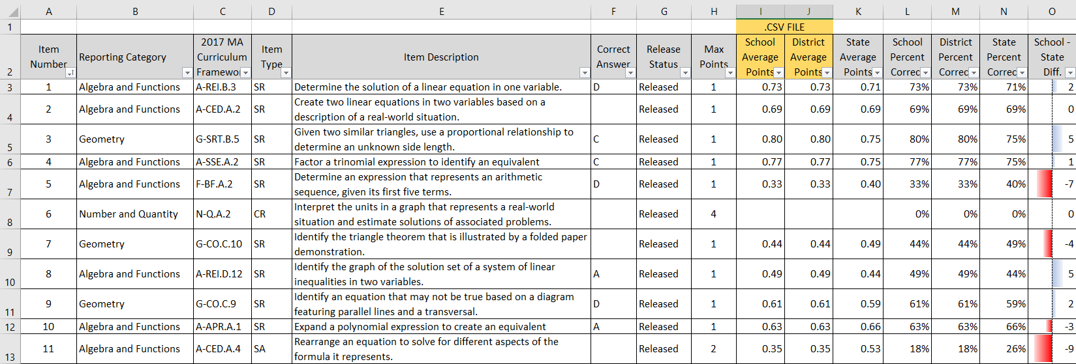
Using the Item Analysis Template (Replicates Edwin Analytics Report IT301)

Slide 14
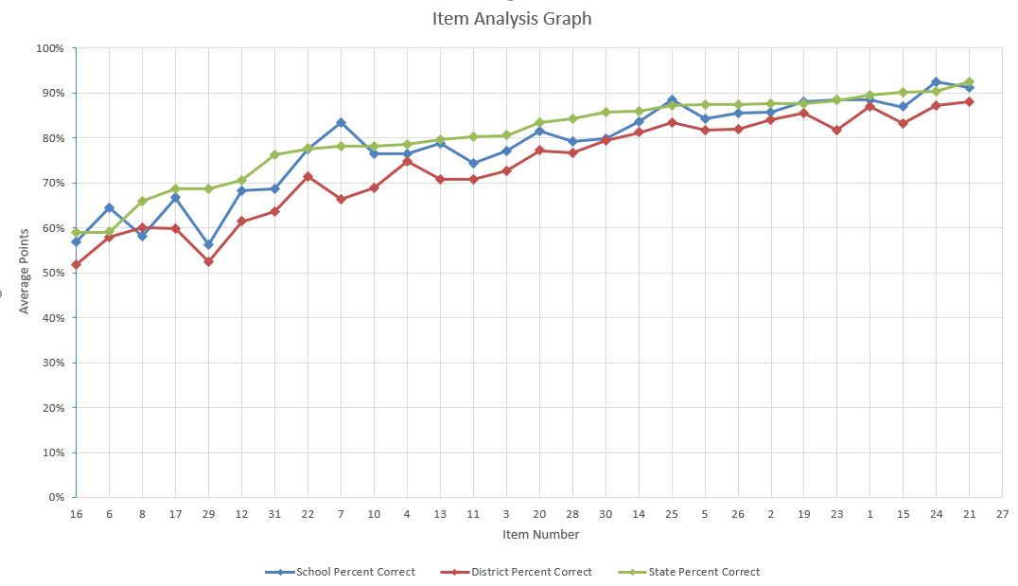
Using the Item Analysis Template (Replicates Edwin Analytics Report IT302)

Slide 15
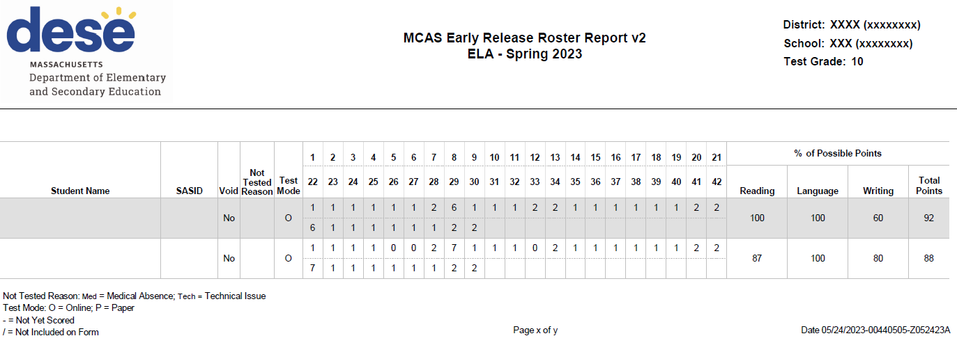
Student Roster in PAN

Slide 16
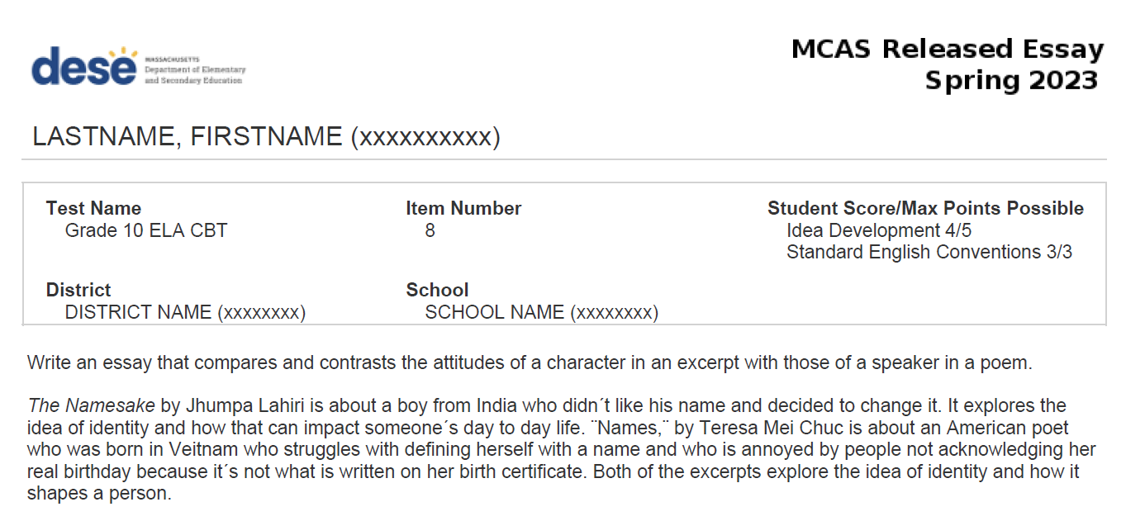
CBT Released Essay in PAN

Slide 17
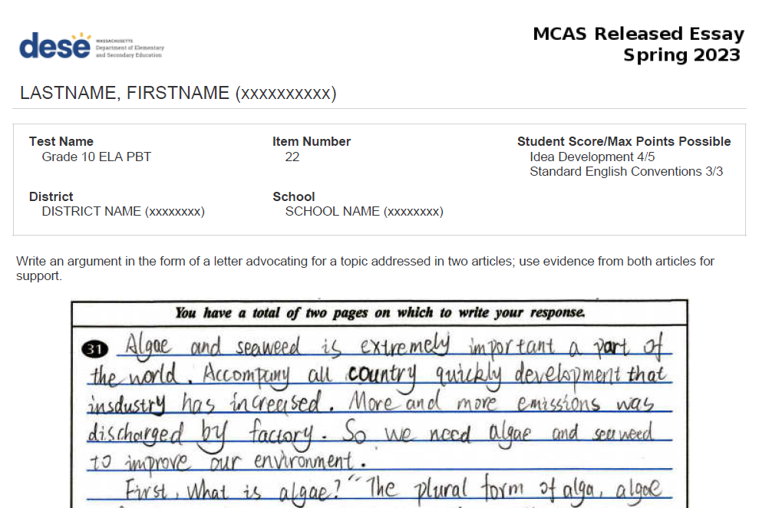
PBT Released Essay in PAN

Slide 18
Supporting Resources for the Item Analysis Templates
Excel template: statewide item information and item level results
Includes state average points and percent correct per item (item difficulty)
DropBox Central in the MCAS 2023 Data folder
Step-by-step Instructions for Using the Item Analysis Templates
DropBox Central in the MCAS 2023 Data folder
Released items (available on a rolling release; check Student Assessment Update)
http://mcas.pearsonsupport.com/released-items
Includes approximately 50% of items for grades 3–8 and 100% for grade 10 ELA, Math, and high school Biology and Intro. Physics

Slide 19
Recap of Steps for Loading Data into Templates
Download your .CSV file from PearsonAccess Next
Insert blank rows at the top; note the last row of data in the file
Enter the subtotal formula in .CSV file: =Subtotal(1, cell range*) in a blank cell above the Item number.
Copy the subtotal formula to the row above the remaining items
For V2, copy the subtotal formula to the RepCat† rows
Set filters to remove void and not tested records; use the school filter if you are a district user; set test code filter.
Copy item subtotals from the .CSV to the template using “Paste Special” with “values” and “transpose” selected.
*Cell Range is all records; †RepCat is Reporting Category

Slide 20
3. Answers to Your Questions

Slide 21
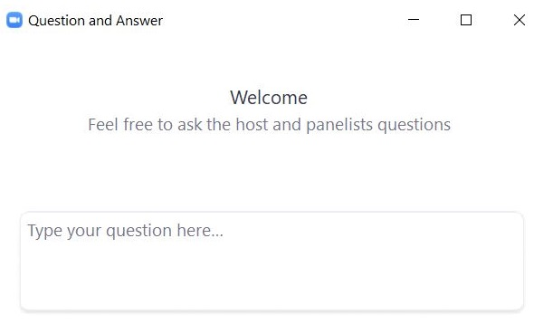
Questions and Answers
Use the “Q&A” feature to ask questions.

Slide 22
4. Early Release, Preliminary, Discrepancy Reporting Schedules

Slide 23
Preliminary Results and Discrepancy Reporting Periods
Preliminary Embargoed Results: Scaled Scores and Achievement Level Data
June 21: Grade 10 ELA in DropBox Central
Aug. 8: Grades 3–8, 10 ELA/Math, 5, 8, high school STE in DropBox Central
Aug. 15: Grades 3–8 10 ELA/Math, 5, 8, high school STE in Edwin Analytics
Mid-September: SGP available, with official embargoed results
Discrepancy Reporting Period
Aug. 8‒11: MCAS Service Center
Examine student rosters and data files for potential discrepancies (missing results; incorrect SASID; incorrect test status).

Slide 24
Early Release Data Considerations
Results have not been filtered; all students who earned at least one point are included.
The following data are included in early release files, but results will not be aggregated with school/district for official reporting:
First-year ELs (file in DropBoxes in early/mid August)
Void/medical absence
Not tested/partially tested (students who did not attempt at least one item in each session
Test status codes (absent, security breach, transfer) will appear in the preliminary file in August.

Slide 25
5. Resources, Support & Next Steps

Slide 26
Additional Resources
Resource | Location
MCAS Resource Center | mcas.pearsonsupport.com/
Modules and recordings of previous trainings | mcas.pearsonsupport.com/training/
PAN user information | mcas.pearsonsupport.com/pearsonaccessnext/
Student Assessment Updates (Biweekly email with important updates about the MCAS program) | www.doe.mass.edu/mcas/updates.html If you do not already receive this email, subscribe using this link: http://eepurl.com/ghSOhH
Released Items | mcas.pearsonsupport.com/released-items

Slide 27
Email and Phone Support
MCAS Service Center
DESE Student Assessment Services
Questions on logistics
Web: mcas.pearsonsupport.com
Email: mcas@cognia.org
Phone: 800-737-5103
Policy and data questions
Web: www.doe.mass.edu/mcas
Email: mcas@doe.mass.edu
Phone: 781-338-3625

Slide 28
Next Steps
Today: Complete the evaluation form.
Responses are associated with the name and email address used to log in.
Email your input to mcas@doe.mass.edu if you have problems accessing or completing the form.
Within about a week:
Receive an email with the Q&A from this session
Recording will be available

Slide 29
6. Graduation Requirements & the Interim CD

Slide 30
Poll Question – Interim Competency Determination
For students in the class of 2025, select the subject or subjects in which a passing score is below 470 (Not Meeting Expectations).
ELA
Mathematics
All the above
None of the above

Slide 31
Interim CD Standard for the Classes of 2021–2025
The Competency Determination standards for the classes of 2021–2025 are set at a level of achievement that has been established as equivalent to Needs Improvement on the legacy MCAS tests.
Some students in the classes of 2021–2025 may score in the Not Meeting Expectations level, but their scaled score is high enough to earn the CD in that subject.
See the September 22, 2022 edition of the Student Assessment Update for a visual representation of this.

Slide 32
Graduation Requirements for the Class of 2023
Subject | Option 1 | Option 2
ELA | Earn a score of 472 or higher (EPP* not required) | Earn a score of 455–471 (EPP* required) Note: 455–469
Math | Earn a score of 486 or higher (EPP* not required) | Earn a score of 469–485 (EPP* required) Note: 469
STE | Earn a score of 220 or higher on legacy Chemistry or Technology/Engineering; 470 or higher in Introductory Physics; or 467 or higher in Biology. Note (Biology): 467–469 | Successful completion of a relevant high school course. Modified CD requirements and a list of accepted courses are available in the link below.
Not Meeting Expectations
Not Meeting Expectations
Not Meeting Expectations
*Educational Proficiency Plan information is available at www.doe.mass.edu/assessment/epp/.
For detailed information, refer to www.doe.mass.edu/mcas/graduation.html.

Slide 33
Graduation Requirements for the Classes of 2024 and 2025
Subject | Option 1 | Option 2
ELA | Earn a score of 472 or higher (EPP* not required) | Earn a score of 455–471 (EPP* required) Note: 455–469
Math | Earn a score of 486 or higher (EPP* not required) | Earn a score of 469–485 (EPP* required) Note: 469
STE | Earn a score of 220 or higher on legacy Chemistry or Technology/Engineering; 470 or higher in Introductory Physics; or 467 or higher in Biology. Note (Biology): 467–469 | Not applicable (only one option for STE)
Not Meeting Expectations
Not Meeting Expectations
Not Meeting Expectations
*Educational Proficiency Plan information is available at www.doe.mass.edu/assessment/epp/.
For detailed information, refer to www.doe.mass.edu/mcas/graduation.html.

Slide 34
Graduation Requirements for the Classes of 2026–2030
Subject | Option 1 | Option 2
ELA | Earn a score of 486 or higher (*EPP not required) | Earn a score of 470–485 (*EPP required)
Math | Earn a score of 486 or higher (*EPP not required) | Earn a score of 470–485 (*EPP required)
STE | Earn a score of 470 or higher in Biology or Introductory Physics Beginning in 2024, Chemistry and Tech./Eng. tests will no longer be offered. | Not applicable (only one option for STE)
*Educational Proficiency Plan information available at www.doe.mass.edu/assessment/epp/
For detailed information, refer to www.doe.mass.edu/mcas/graduation.html.

Slide 35
THANK YOU
The Office of Student Assessment Services
781-338-3625
mcas@doe.mass.edu
www.doe.mass.edu/mcas
75 Pleasant Street, Malden, MA 02148

