Slide 1
Accessibility and Accommodations
For Next-Generation MCAS Tests
Notes:
This module presents an overview of the Accessibility and Accommodations policies for the next-generation MCAS tests. We will describe accessibility features that are available to all students, some of which were previously available only to students with disabilities. We will also describe accommodations only available for students with disabilities and English learners. These policies are intended to help all students participate fairly and show their knowledge, skills, and abilities on the next-generation MCAS tests.

Slide 2
Overview of Accessibility and Accommodations for MCAS Next-Generation Tests
See the publication Accessibility and Accommodations Manual available at www.doe.mass.edu/mcas/accessibility/.
Some previous MCAS accommodations are now called:
  Universal Accessibility Features
    available to all students on computer- and paper-based tests
  Designated Accessibility Features
    can be given to any student at the discretion of the principal
Accommodations are available to students with disabilities and English learners.
“Nonstandard” accommodations are now called Special Access accommodations.
Notes:
In addition to viewing this module, please review the updated version of the MCAS Accessibility and Accommodations Manual available at the web address shown on your screen.
Accessibility features are available to all students. Some are called Universal Accessibility Features that are either built into the computer-based system or provided by a test administrator. Others are called Designated Accessibility Features which allow a principal to determine whether a student should have flexibility in their test setting, group size, or scheduling of the test. Some accommodations are available only to students with disabilities, while others are available to English learners. Special access accommodations, previously called “nonstandard accommodations,” are available to a very small number of students with disabilities who meet certain guidelines to receive them. These will all be described in this presentation.

Slide 3
Overview of Accessibility and Accommodations for MCAS Next-Generation Tests (Continued)
The following are available to all students:
  Untimed test sessions
  Blank scratch paper (including lined or graph paper)
  Assistance from a test administrator, as needed, to use the computer-based test platform
The following have changed for next-generation MCAS tests:
  New categories and numbering system for accessibility features and accommodations
  Many former accommodations now available to all students
  Some features and accommodations differ on computer- vs. paper-based tests.
  Expanded list of accommodations now available to EL students.
  High School tests will transition to next-generation computer-based tests
Notes:
There are several changes in the next-generation MCAS policies from the previous “legacy” MCAS tests: First, the list of accommodations and the accommodations numbering system have changed. Second, many accommodations that were available on the legacy MCAS tests are available to all students on the next-generation tests, and are now called “accessibility features.” Third, accessibility features may differ depending on whether a student is taking a computer- or paper-based test. Fourth, an expanded set of accommodations is now available for students who are English learners; and fifth, the grade 10 ELA and mathematics MCAS tests are now included in the next-generation system. Those tests will now be administered on a computer-based testing platform for the first time, beginning in spring 2019, with science and technology/engineering to follow in subsequent years.

Slide 4
Universal Accessibility Features for all students
Computer | Paper
Alternative background/font color (SR/PNP) | Colored overlays
Screen magnification/ Zoom tool | Magnification device
Line reader tool | Tracking device/straight edge
Answer Eliminator | Use pencil to eliminate answer choices
Answer Masking (SR/PNP) | Masking using blank card
Item flag/Bookmark | Place marker
Highlighter
Audio aids
Human read-aloud (or sign) selected words on Math or STE, as requested by student
Test administrator repeats/clarifies test directions
Test administrator redirects student’s attention to test
Notes:
The Universal Accessibility Features shown on this screen are available to any student who needs them, depending on whether they are taking the computer- or paper-based test. There are two column headers on this table: Computer and Paper. On the left side, “Computer” is used to show the features that are available to students taking the computer-based tests using the TestNav platform. The “Paper” column on the right shows the equivalent accessibility feature for students taking the paper-based test.
Each of these universal accessibility features is described in the Accessibility and Accommodations policy manual. We will describe a few of them to you now.
“Answer Eliminator,” allows students to cross out answer options they think are incorrect on the computer-based test. “Answer Masking” allows a student to read a line of text or an answer option while blocking out the rest of the question or the other answer options.
“Human read-aloud (or sign) selected words” allows a test administrator to read aloud or sign a selected word or phrase to any student on the Mathematics or Science and Technology/Engineering tests, as requested by the student. For example, a student taking the Mathematics MCAS test is allowed to raise his or her hand and ask the test administrator to read aloud an unfamiliar word. The test administrator would then quietly read the word to the student without disturbing the other students taking the test. No definitions can be given; only the pronunciation is allowed. Test administrators may also redirect the student’s attention back to the test, if he or she has lost their focus or is engaging in an unrelated activity. Take a moment to review this list of Universal Accessibility Features and determine if you’d like to review any of these more closely in the Accessibility and Accommodations Manual.
Please also be aware that certain selected features and accommodations marked with the letters “SR/PNP” mean that this must be documented in the student’s Personal Needs Profile (PNP), which we’ll discuss later in this module.

Slide 5
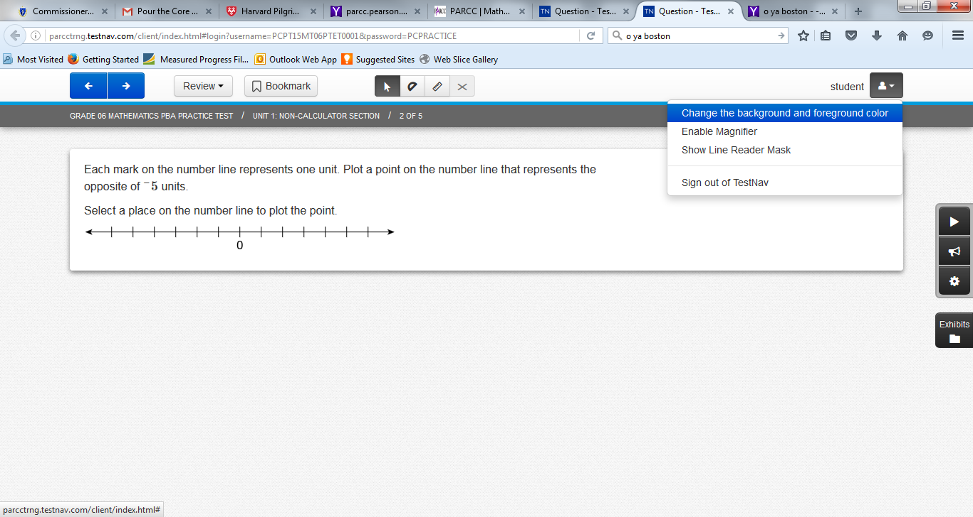
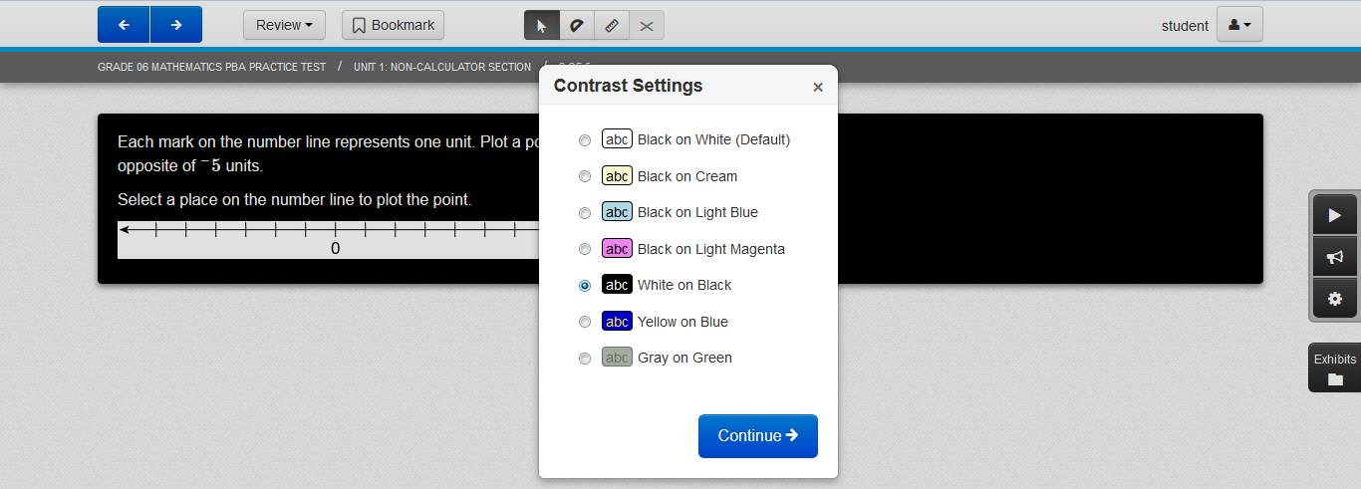
Alternative Background/Font Color (Color Contrast)
Notes:
Here is an example of how the “Alternative background and font color” accessibility feature is used. The student can change the colors on the computer screen to match any of the combinations shown in the dropdown menu. There are seven color settings that can be set or reset by the student. This feature can benefit students with visual disabilities, and must be designated in the student’s Personal Needs Profile so it will be available to the student when he or she takes the computer-based test.

Slide 6
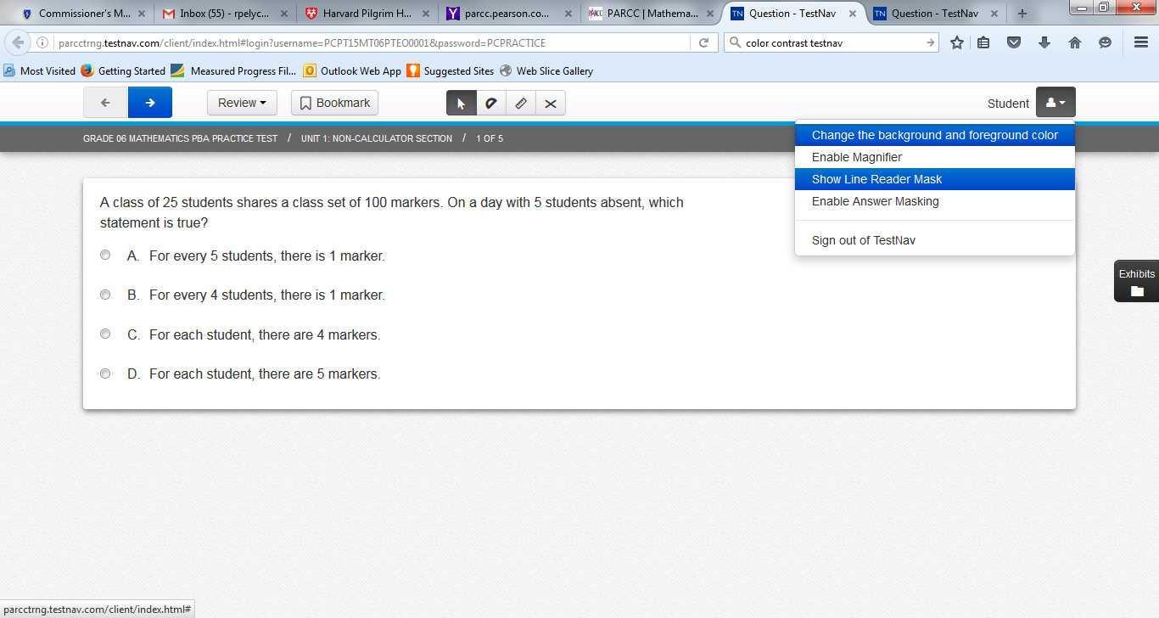
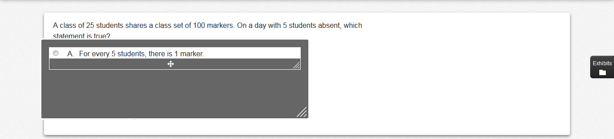
Line Reader
Notes:
The “Line Reader Tool” looks like a gray box with a clear window that allows the student to focus on one line of text at a time and limits the distractions from surrounding text. A student may turn it on and off by selecting the icon shown on the screen. The student can adjust the size of the box and the width and height of the reading line, and can move the line reader to different areas of the screen.

Slide 7
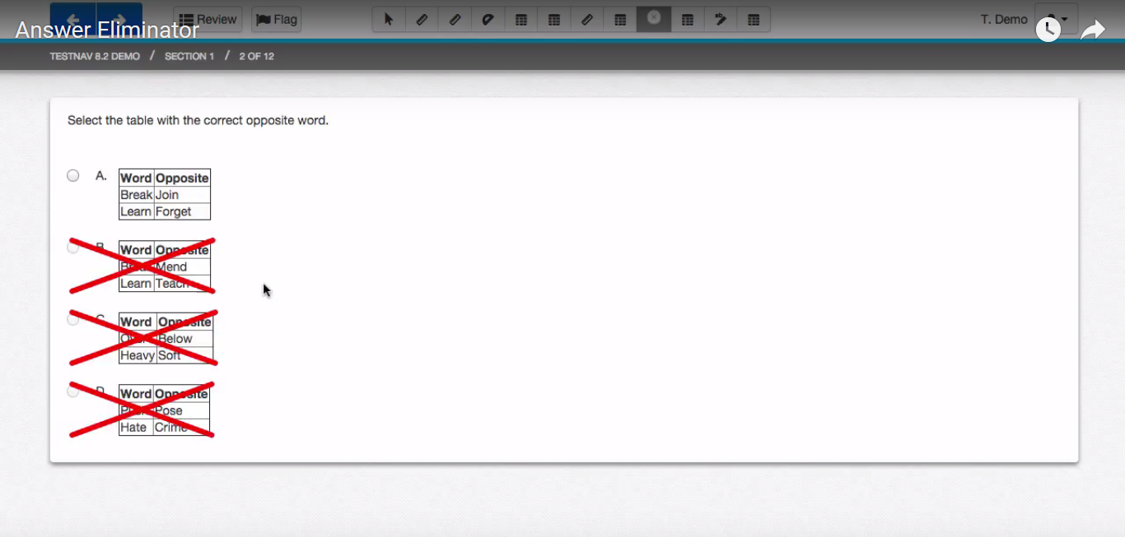
Answer Eliminator
Notes:
The Answer Eliminator looks like this. Students can use the icon on the screen to turn the answer eliminator on and off. Students can “X” out the answer options they believe are incorrect. This tool helps students keep track of which answers they thought were wrong and narrow down the list of reasonable responses. This allows students taking the computer-based test to parallel students who take the paper-based test who can use their pencil to cross out answer options in the test booklet.

Slide 8
Designated Accessibility Features for any student at principal’s discretion
Designated Accessibility Features
Small group test administration (up to 10 students)
Individual (one-to-one) test administration
Frequent supervised breaks
Test in a separate location
Familiar test administrator
Seating in a specified area of room, including study carrel
Adaptive or specialized furniture or lighting
Noise buffer/noise-cancelling earmuffs/headphones (no music)
Student reads test aloud to self
Specific time of day
“Stop Testing” policy: If student is not responding to test questions after 15−20 minutes, test administrator may ask if student is finished. If so, collect the student’s test materials. Student may sit quietly or be excused.
Notes:
Next, we’ll briefly review the list of Designated Accessibility Features. These features were available previously only as accommodations for students with disabilities. Now, these features are available to any student, if the principal or his or her designee gives their approval. Most of these features determine where, with whom, and when students will be tested, as well as some other considerations. Please note the state’s “Stop Testing Policy,” which may be especially helpful when testing first-year English learners and some special education students.

Slide 9
Accommodations for Students with Disabilities
Test Presentation Accommodations
Computer | Paper
Paper-based test, if unable to use a computer (SR/PNP) | N/A
N/A | Large print test (SR/PNP)
Screen reader for student who is blind (SR/PNP) | Braille test (SR/PNP)
Text-to-speech for Math, or Human read-aloud for Math and/or STE (SR/PNP) | Human read-aloud for Math or STE (SR/PNP) Kurzweil for STE legacy and Math legacy retests only (SR/PNP)
Human signer for Math, STE, or test questions only for ELA (SR/PNP)
Test administrator helps student track test items
Notes:
The accommodations listed here are available only to students with disabilities. This slide describes some different ways in which the MCAS test can be presented to the student. The left-hand column shows accommodations for students with disabilities who are taking the computer-based tests; the column on the right shows the equivalent accommodation on the paper-based test. Accommodations that include the “PNP” designation are those that must be listed in the student’s Personal Needs Profile (or PNP). These accommodations must also be listed in the student’s IEP or 504 plan before they can be provided on the MCAS test.
Students who are unable to take a computer-based test due to the effects of their disability may take a paper-based test instead, as an accommodation, if this is listed in their IEP or 504 plan.
The “text-to-speech” accommodation will allow a student to listen with headphones to a computer-based version of the test read aloud. The “human read-aloud” is the comparable accommodation for a student taking the paper-based test who needs the test read aloud. Be aware that reading aloud the ELA test is a “special access” accommodation that will be discussed later.
A “screen reader” is intended ONLY for students who are blind or have visual impairments and use a screen reader program such as JAWS or NVDA. The Braille test is an equivalent accommodation for a student who is blind and cannot take the computer-based test.

Slide 10
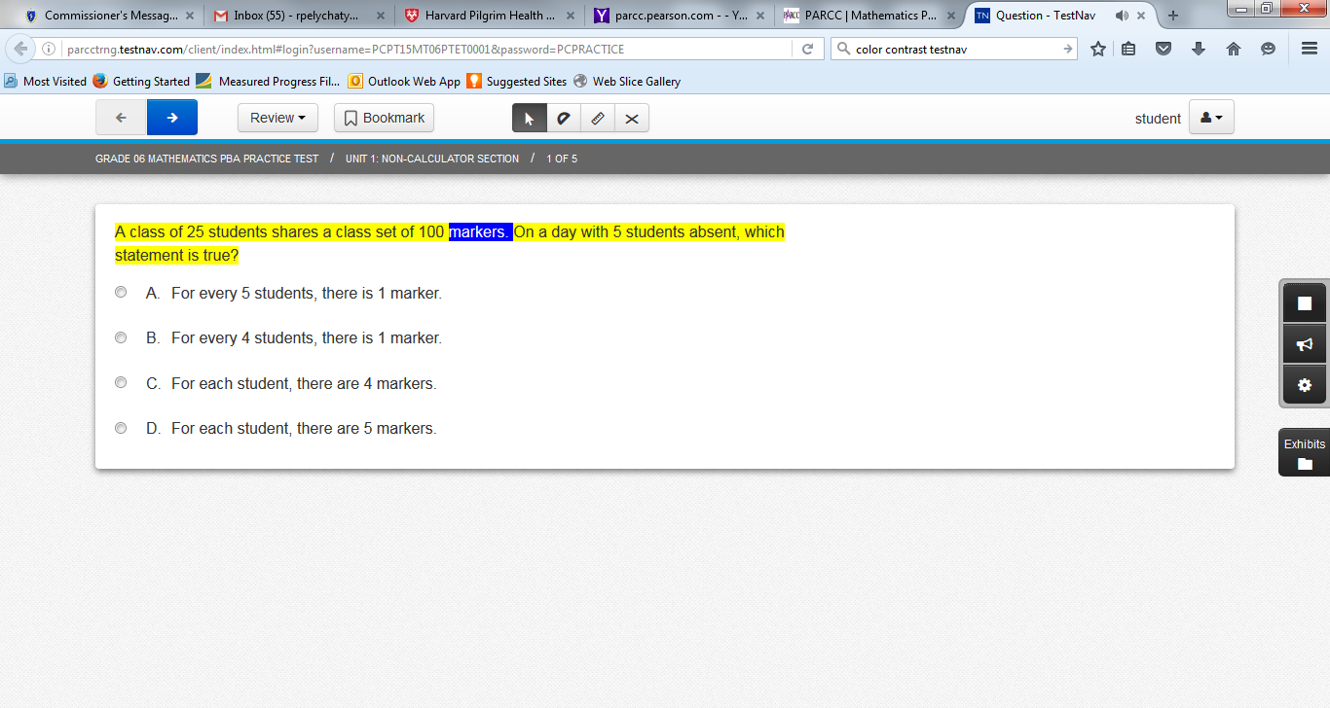
Text-to-Speech
Control Icons
Notes:
Here is what the text-to-speech feature looks like on the computer-based test. The sentence being read aloud is highlighted in yellow; the word being read aloud at the moment is highlighted in blue. The student can control the speed and the volume of the speaking voice using the control icons shown in the display. Another icon controls whether the read-aloud picks up where it left off when it was stopped, or goes back to the beginning. Students who plan to use text-to-speech on the test should become familiar with the look and feel of this accommodation before testing begins. The Department strongly encourages students who need this accommodation to take practice tests using the text-to-speech accommodation so they will be familiar with how the text-to-speech accommodation operates.

Slide 11
Accommodations for Students with Disabilities (Continued)
Response Accommodations
Computer | Paper
ELA graphic organizer or Math/STE supplemental reference sheet (only those developed by DESE, available at www.doe.mass.edu/mcas/accessibility/organizers/) (SR/PNP)
Human scribe or external speech-to-text device for Math/STE (Note: 504 plan needed for fractured writing arm) (SR/PNP)
N/A | Answers recorded in test booklet
N/A | Typed responses (SR/PNP) (No transcription necessary)
Test administrator monitors placement of test responses
Responses recorded (audio or video), then transcribed by student during playback
Braille writer, Braille note-taker, or refreshable Braille display
Notes:
Response Accommodations change the way in which a student with a disability responds to test questions. For example, typed responses are allowed on the paper-based test; and a scribe can write down the answers dictated by the student.
Another response accommodation is to allow a student with a disability to use a specific approved graphic organizer for the ELA test; or an approved supplemental mathematics reference sheet to answer questions on the mathematics test. Only graphic organizers and reference sheets that include text and have been developed by the Massachusetts Department of Elementary and Secondary Education may be used, and only by a student with a disability who has this accommodation listed in their IEP or 504 plan. Graphic organizers and reference sheets may be downloaded from the site shown on this table, and have been designed especially to assist students in responding to questions on the next-generation MCAS tests. Schools may no longer submit their own individualized supplemental reference sheets or graphic organizers for Department approval for next generation Mathematics or ELA tests. However, it is possible to request the use of a customized STE reference sheet, which must be submitted to the Department prior to testing. The use of a specific approved graphic organizer or approved supplemental mathematics reference sheet must be documented in the student’s PNP.

Slide 12
Special Access Accommodations for Students with Disabilities (formerly called Nonstandard Accommodations)
Special Access Accommodations
Computer and Paper
Text-to-speech/Human reader for ELA (SR/PNP)
Signing the ELA reading passages (SR/PNP)
Scribe responses (or speech-to-text device) for ELA (SR/PNP)
Calculator or mathematics manipulatives on non-calculator session of Math (SR/PNP)
Spell check for ELA (SR/PNP) (Note: automatic feature on Next Generation STE CBT tests)
Word prediction for ELA (SR/PNP)
Notes:
Special Access Accommodations, formerly known as “nonstandard accommodations,” are used by a small number of students with disabilities on specific MCAS tests. They are called “special access” because they change part of what the test is designed to measure, and should be used only by a very small number of students who meet certain guidelines. Eligibility to receive these accommodations is limited to students who are severely limited or prevented from performing the skill in question; such as a student who is virtually unable to calculate, write, read, or spell. Teams must carefully review the criteria described for each special access accommodation listed in the Accessibility and Accommodations Manual before designating these for students, and may consult with Department staff beforehand.
All Special Access Accommodations must be requested in the student’s Personal Needs Profile, or PNP.

Slide 13
Accommodations for English Learners (EL)
EL Accommodations
Paper-based test (SR/PNP) (for a first-year EL who is unfamiliar with technology)
Approved Bilingual Word-to-Word Dictionary or Glossary
Text-to-speech/human reader for Math and STE (in English) (SR/PNP)
Scribe for Math and STE (SR/PNP)
Grade 10 English/Spanish Mathematics Test or Retest, if enrolled fewer than 3 years (SR/PNP)
Read aloud/repeat/clarify test directions in student’s native language, if native language speaker is available
Notes:
The accommodations listed in this table are intended for students who were reported as English learners in the Student Information Management System (or SIMS). First-year ELs with low levels of English proficiency may take a paper-test, instead of a computer-based test, if they are unfamiliar with the use of technology. English learners are entitled to use all of the Accessibility Features that were previously mentioned. The use of approved bilingual word-to-word dictionaries is also allowed for former ELs. Please also remember that English learners in their first year in a Massachusetts school may, at the principal’s discretion, be exempted from participation in the MCAS ELA test.
Please take a minute to review this list of accommodations available to ELs, whether they have a disability or not.

Slide 14
Special (Accommodated) Test Forms
The following special test forms are available as accommodations for next- generation tests and must be requested in the student’s Personal Needs Profile (PNP):
  Computer-based special test forms:
    Text-to-Speech (digital read-aloud, requiring headphones)
    Screen reader (for a student who is blind or visually impaired; used in conjunction with a hard-copy Braille test)
    Compatible Assistive Technology (for student using an AT program that is compatible with the computer-based test)
      See Guide to Using Assistive Technology at www.doe.mass.edu/mcas/accessibility/
  Paper-based special test forms:
    Large print
    Braille
    Kurzweil – for retests and high school STE tests only
Notes:
The special test forms listed on this slide are available as accommodations for students with disabilities. Please take a minute to review the list of accommodated forms.
For computer-based tests, in grades three through eight, text-to-speech screen reader, and Assistive Technology forms are available.
For paper-based tests, large print and Braille forms are available. The Kurzweil format is a read-only CD version of the legacy high school Science and Technology/Engineering tests and legacy retests only.
Also note that Unified English Braille tests will replace European Braille American Edition tests in grades 3 through 8. Beginning in spring 2020, all Braille MCAS tests will be in UEB format.

Slide 15
Assistive Technology (AT)
Students may use assistive technology (AT) when it is listed in their IEP or 504 plan; for example:
  Word prediction software
  Speech-to-text programs
  Adapted keyboard, mouse, screen magnifier
There are two categories of assistive technology:
  Compatible technology that interacts directly with TestNav, the computer-based MCAS testing platform (see Guidelines at www.doe.mass.edu/mcas/accessibility/)
  External technology that does not interact with TestNav
    Requires a second computer device that is not directly connected to TestNav
    May require test administrator to facilitate transfer of information from external device to computer used for assessment
    Internet access must be disabled or monitored closely during testing.
Notes:
Students with disabilities may use their familiar assistive technology to participate in next-generation MCAS tests if the specific technology is listed in the student’s IEP or 504 plan. Assistive technology might include word prediction, speech-to-text programs, adaptive keyboards or mouse; or a screen magnifier.
There are two kinds of assistive technology that can be used to take the test. One is an assistive technology program that is compatible with TestNav, the computer-based testing platform. Compatible programs are those that function within TestNav during the computer-based test. In that case, “Compatible Assistive Technology” must be requested in the PNP to ensure that the correct form of the test is provided to the student. A list of compatible assistive technology programs is listed on the “Guidelines for Using Assistive Technology as an MCAS Test Accommodation” available on the Department’s website.
Other assistive technology programs may not be compatible with TestNav and are therefore considered “external” technology that does not interact with TestNav. These will require another nearby computer that includes the assistive technology program or device that is not connected to the computer that uses TestNav. A test administrator may need to help the student transfer the information from the additional computer to the actual computer-based test. Schools should plan in advance for test administrations that will use assistive technology, and try these out beforehand using practice tests. It will also be important to make sure the student using assistive technology cannot access the Internet during testing.

Slide 16
Test Preparation
Before testing begins, students should be familiar with features and basic functionality of TestNav, the computer-based testing platform.
View the Tutorial at mcas.pearsonsupport.com
Take an Online Practice Test on TestNav.
Test coordinator should review IEPs, 504 plans, and any forms used to document MCAS accommodations for EL students (sample found in the Accessibility and Accommodations Manual).
  Schedule testing for these students accordingly.
Notes:
Test preparation is an important part of performing well on the next-generation MCAS tests, particularly on the computer-based test. Educators should plan time to allow students to become familiar with the basic operation of the computer-based testing platform, called “TestNav.”
One way to prepare students, is to view the Student Tutorial on the mcas.pearsonsupport.com web page. The Student Tutorial provides students with an interactive experience on how to use the various tools, screens, and commands in TestNav.
Another way to prepare students for the test is to have them take practice tests. The online practice tests will expose students to the types of test questions that will be asked on the next-generation MCAS tests.
Be sure that students’ accommodations are documented in their IEPs and 504 plans, and that the test coordinator is aware of which students will receive which accommodations on the day of the test. Tests results may be invalidated if students receive the incorrect accommodation, or if they do not receive the accommodations listed in their plan.
Schools should document accommodations for English learners, using the sample “Documentation of MCAS Accommodations for an EL Student” form found in the appendix of the Accessibility and Accommodations Manual.

Slide 17
Student Registration/Personal Needs Profile (SR/PNP)
The function of the SR/PNP is to:
  enroll students for each test, regardless of computer- or paper-based testing
  order special test forms, and
  collect information on several selected accommodations.
Consult the Guide to the Student Registration/Personal Needs Profile (SR/PNP) and the Student Registration/ Personal Needs Profile module for directions for importing the SR/PNP file.
Notes:
The SR/PNP is used to register students for the test; order special accommodated test forms; and for the Department to collect information on a small number of test accommodations.
For more information on the current process for loading students as well as the PNP system, please refer to the Guide to the Student Registration/Personal Needs Profile (SR/PNP) found at mcas.pearsonsupport.com/manuals/ under the “PearsonAccess^{next}” drop-down, or the Student Registration/Personal Needs Profile training module found at mcas.pearsonsupport.com/training/.

Slide 18

The SR/PNP is Used to Request Special Test Forms and Report the Use of Selected Accommodations by the Student
Sample “Manage Student Test” Screen in the SR/PNP
Special Test Forms
Text-to-Speech
Large Print
Braille
Screen Reader Edition (for student with a visual disability; request hard-copy Braille test for graphics)
Compatible Assistive Technology (see list of compatible software in PAN)
Selected Accommodations
Typed Response (paper-based only)
Calculation Device on non-calculator Math session
Human Scribe or Speech-to-text
Spell Checker (computer-based ELA only)
Word Prediction (application provided by school)
Any other accommodation
Accessibility Features
Answer Masking
v
Human Read-Aloud or Human Signer
Human Scribe or
Speech-to-Text
Alternative Background
and Font Color
Accommodations listed in SR/PNP may vary, according to each test.
Notes:
Here is an example of the Manage Student Test screen which is part of the Student Registration/Personal Needs Profile, or SR/PNP. Schools can use the Manage Student Test screen to change or add an accommodation, request a special test form, or activate an accessibility feature for a student. The Manage Student Test screen may vary depending on the test. For example, the Calculation Device accommodation would only appear on the screen for the Mathematics test.
Refer to the document entitled Guide to the Student Registration/Personal Needs Profile (SR/PNP) on the MCAS Resource Center web page for information on how to access and complete the Manage Student Test screen.

Slide 19
Resources and Support
  Support and Assistance:
  Web: mcas.pearsonsupport.com
  Phone: 1-800-737-5103
  Office of Student Assessment - Accessibility and Accommodations
  Web: www.doe.mass.edu/mcas/accessibility/
Phone: 781-338-3625
  Email: mcas@doe.mass.edu
Notes:
Thank you for taking the time to view this module.
Please use the available resources at mcas.pearsonsupport.com and on the Department’s MCAS Accessibility and Accommodations web page for additional information and assistance.

