Slide 1
Infrastructure Trial
Test Coordinators and Test Administrators
Notes:
Welcome to the Infrastructure Trial training module for school staff with the Test Coordinator and Test Administrator roles. This training module gives an overview of the steps to prepare for the Infrastructure Trial.

Slide 2
Topics
Glossary
Introduction
Test Coordinator and Test Administrator Roles
Schedule and Staffing
Capacity Planning
PearsonAccess^{next} Tasks
PearsonAccess^{next} Setup
During and After Trial
Tools and Accessibility Features in TestNav
TestNav Tools Demonstration
Resources
Notes:
In this training, we will provide an overview of the steps to prepare and administer an Infrastructure Trial. We will cover the roles of test coordinators and test administrators, scheduling the trial and the staff who may need to be involved, planning for device capacity, and PearsonAccess^{next} (PAN) setup. We will also provide demonstration of the TestNav tools.

Slide 3
Glossary
Infrastructure Trial: an opportunity for districts and schools to prepare for the computer-based tests by ensuring student devices are set up correctly and simulating test day network utilization.
TestNav: The online testing platform that students use to take the computer-based MCAS assessments
PearsonAccess^{next}: the online management system. All schools will use PAN to register students and order test materials. Schools doing computer-based testing will also use PAN to manage online testing activities.
PAN Session: separate groupings of the students who will take a test at the same time and in the same testing location
ProctorCache: Software supplied by Pearson that is used in conjunction with TestNav to reduce bandwidth requirements and accelerate the delivery of test content. The software allows schools and districts to precache test content to their local network before a test.
Notes:
Please take a moment to pause the module so that you can read the definitions of the different components of the Infrastructure Trial process. The pause button is located on the bottom, left-hand side of the screen.

Slide 4
Introduction
The Infrastructure Trial is a dress rehearsal to confirm whether:
ProctorCache software is configured correctly
Devices can successfully operate TestNav
The local network can bear the full load
Participating staff know how to manage and monitor computer-based assessments
Students are familiar with the computer-based tools and format
Notes:
The Infrastructure Trial is a dress rehearsal for operational testing. By conducting an Infrastructure Trial you can confirm whether ProctorCache software is configured correctly and whether the student testing devices are prepared to run TestNav. It’s also a way for staff and students to practice test-day activities so that everyone knows what to expect the day of testing. The Infrastructure Trial is especially important for students who will use compatible assistive technology, as it allows the school and students to try specific assistive technology programs to determine how the programs will function in TestNav. For more information on setting up and using assistive technology -- including screen readers -- in TestNav, refer to the Assistive Technology Guide.
In this module we will discuss the practice tests that are found in the MCAS PearsonAccess^{next} training site. These are the same practice tests that are found at the MCAS Resource Center (mcas.pearsonsupport.com) or through the TestNav app. Using the practice tests that are set up through PearsonAccess^{next} allows the test administrator or test coordinator to practice test-day activities in PearsonAccess^{next}, as well as allows for students to practice with the computer-based functionality they will use during operational testing.

Slide 5
Test Coordinator and Test Administrator Role
Test coordinators:
Locate documentation outlined on the Resources slide
Plan, schedule, and oversee Infrastructure Trial activities
Train staff who will be participating in the trial
Report any technical issues to the technology coordinator
Resolve issues prior to operational testing
Test administrators:
Oversee students taking practice tests
Start, manage, stop testing sessions in PearsonAccess^{next}
Help students understand how to use the computer-based functionality (e.g., where to find the calculator, how to respond to drag-and-drop questions)
Notes:
Test coordinators should be prepared to plan, schedule, and oversee the Infrastructure Trial activities, along with their technology coordinator. It’s also expected that test coordinators will ensure that test administrators and technology coordinators are trained, have access to PearsonAccess^{next}, and know where to find supporting documentation outlined on the Resources slide.
Test administrators will oversee students taking the practice test during the Infrastructure Trial and need to receive training in how to start, manage, and stop testing sessions. They should also be prepared to answer any questions the students have about the computer-based functionality.

Slide 6
Schedule and Staffing
To ensure a successful Infrastructure Trial:
Assemble an Infrastructure Trial team to carry out all the required tasks.
Involve test administrators from different grade and/or subject area teams.
Identify students who will participate.
It is recommended that schools select the maximum number of students you expect will be testing at the same time, so that the trial approximates the maximum anticipated load on your network.
Train all staff involved in the Infrastructure Trial.
Designate appropriate testing schedule, test locations, and student testing devices.
Consult with the technology coordinator and confirm that all the devices meet the technology specifications.
Confirm that assistive technology programs meet requirements.
Plan for 60 minutes for the trial.
Convene the team after the trial to resolve issues prior to operational testing.
Notes:
To ensure a successful Infrastructure Trial, there are several things you can do ahead of time to make sure that it goes smoothly and that it is a sufficient rehearsal for the operational assessment.
You will want to involve test administrators from different grade and/or subject area teams.
If you’re including students in your Infrastructure Trial activities, identify students who will participate. It is recommended that you select the maximum number of students you expect will be testing at the same time so the trial approximates the maximum anticipated load on your network.
Train all staff involved in the Infrastructure Trial and ensure they’re aware of the testing schedule, locations and devices that will be used.
Before the trial, consult with the technology coordinator and confirm that all the student testing devices and assistive technology programs, if used, meet the requirements needed to participate in the Infrastructure Trial.
Once all technology and setup tasks are complete, schools should plan for approximately 60 minutes to administer the Infrastructure Trial per class/group of students.
After the Infrastructure Trial, convene with your team to resolve any issues you encountered prior to operational testing.

Slide 7
Capacity Planning
What is our testing schedule?
Where are our testing locations?
How many devices are needed?
Does my school have the capacity to support the schedule?
number of devices
testing locations
bandwidth
Notes:
Here are some additional considerations prior to conducting an Infrastructure Trial.
You will first want to establish a schedule for the students to do the practice tests as well as other activities for the Infrastructure Trial. This plan will ensure that all participating personnel know what to expect leading up to the Infrastructure Trial as well as actual day-of-testing activities.
When determining the schedule, you will want to consider the number of available testing locations and devices in order to simulate the maximum anticipated load on the network during operational testing.

Slide 8
PearsonAccess^{next} Tasks
PAN Setup
Generate sample student records
Create Sessions in PAN
Print student testing tickets
During and After the Trial
Administer practice tests to students
Manage student tests in PAN Sessions
Exit the practice test
Stop PAN Sessions
Notes:
Here is an overview of the tasks that a test coordinator and test administrator should be prepared to do in PearsonAccess^{next}. The next few slides will discuss how to perform those tasks.

Slide 9
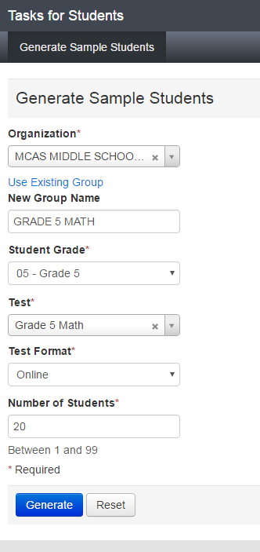
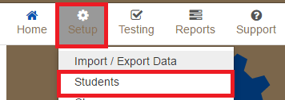
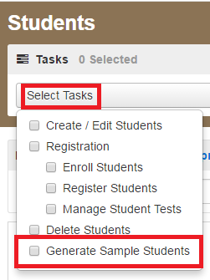
PAN Setup – Create Sample Students and Sessions
1.
3.
2.
Notes:
Create Sample Student Records and Groups: For the purpose of the Infrastructure Trial, it is recommended that you generate sample student records for the number of students who will be participating in the trial. To create sample student records in PearsonAccess^{next}, go to Setup and select Students. Then go to Select Tasks and Generate Sample Students, then click Start.
On the “Generate Sample Students” page, select the Organization, and then click Create a New Group and fill out the New Group Name. A Group is simply a grouping of sample students that can easily be pulled into a session. Create a descriptive group name (e.g., “Grade3ELA") that will be easy to identify when you create Sessions in PAN.
Fill out the remainder of the fields on the “Generate Sample Students” page with the following considerations:
To ensure the participation of test administrators across your school, create sample student records in the grades and subject areas to be tested.
Create at least as many students who will be concurrently testing on any given day, in order to approximate the maximum load on the network.
Set the Test Format to Online.
When finished, click Generate, and then click Exit Tasks.

Slide 10
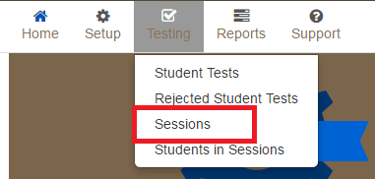
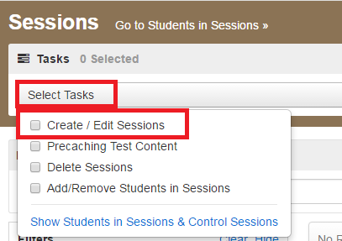
PAN Setup – Create Sessions
1.
2.
Notes:
Create Sessions via User Interface: Once the sample students and groups are created, it’s time to pull those groups into Sessions. Go to Testing, and then Sessions. Click Select Tasks and Create/Edit Sessions, and then click Start. Fill out all the required fields at the top of the screen. Note the following:
It is a good idea to choose a naming convention for the Sessions in PAN that's easy for your test administrators to find and manage. You could use administrator name, room number of the testing location, grade, subject, or any combination. A session can only be populated with students who are assigned the same test code (i.e., taking the same grade and subject area test).
The Form Group Type will default to Standard, unless the Proctor Read Aloud box is checked, in which case you must select the Human Read Aloud or Human Signer Form Group Type.
If your technology coordinator has set up ProctorCache, you can choose your precaching computer here. You may do this step later as well, if needed.

Slide 11
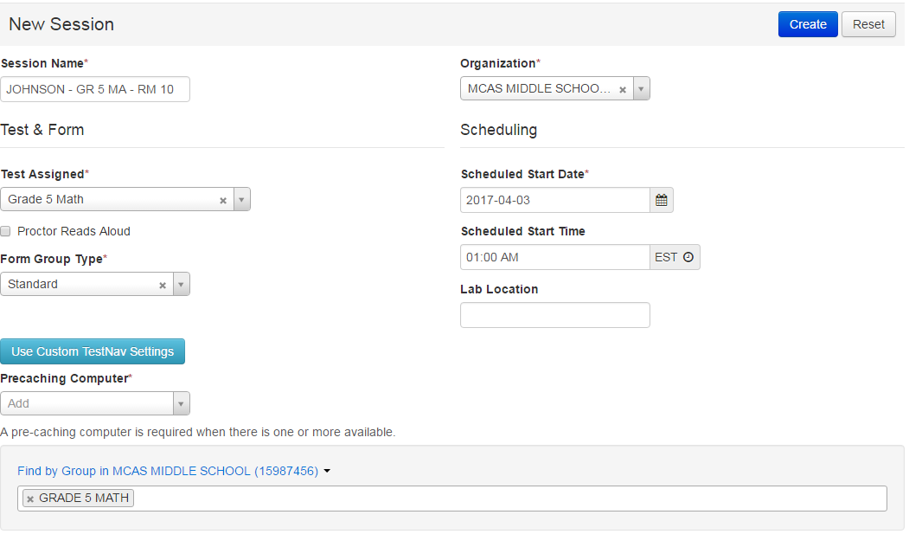
PAN Setup – Create Sessions
Notes:
When you get to the bottom of the screen where it says Add students to session, change the dropdown to Find by Group. When you click in the text box, the groups of students that are assigned to the same test as your sessions will appear. You may add one or all groups that populate to this session. Click Create. Then, click Exit Tasks.

Slide 12
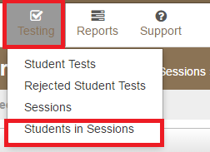
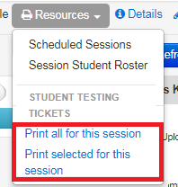
PAN Setup – Print Student Testing Tickets and Seal Codes
1.
2.
Notes:
Print Student Testing Tickets: Testing tickets are needed for students to log into TestNav. Go to Testing then Students in Sessions. Click the Add a Session button on the left-hand side of the screen and search for your session, or use one of the available filters at the top of the dialog box. Click on your PAN Session name on the left-hand side of the screen. Click Resources. Select Student Testing Tickets, and then print the tickets using your browser’s print menu. There are options to print one per page, four per page, or a grid. Students will use the Username and Password on the tickets to log into TestNav on their devices. You can also find the Proctor Testing Tickets in this menu if your students are in a Human Read Aloud or Human Signer test session. Do not pass out the proctor testing tickets to students for testing as the responses are not captured.
On the “Students in Sessions” screen, you should now be able to see any special test forms that are assigned by an indicator next to the students’ name. This will include Text-to-Speech (TTS), Screen Reader (SR), and Assistive Technology (AT). If you do not see the indicators as expected, you can still update the student record in the Manage Student Tests task. An Assistive Technology form is available for Grade 3 ELA and a Screen Reader form is available for Grade 3 Math and can be used to test the assistive technology or screen reader with the student device running TestNav. Consult the Guidelines for Using Compatible Assistive Technology for more information.

Slide 13
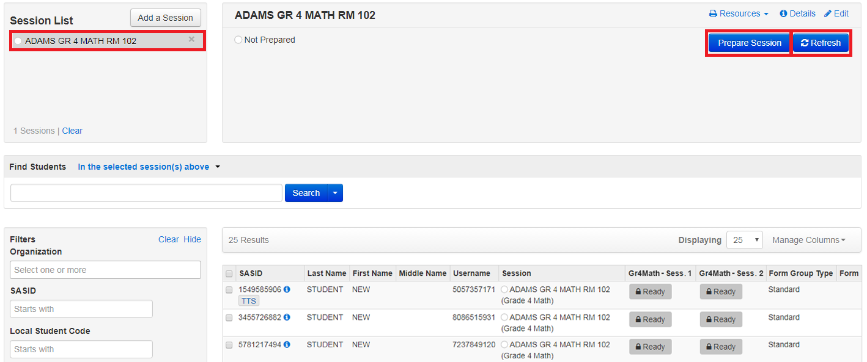
During and After Testing – Prepare sessions
Notes:
Session Management:
Prepare: Before students can login, the PAN Session must be prepared by a test coordinator or test administrator. Preparing a PAN Session will assign the proper test forms to the students. You can prepare a PAN Session in two ways:
To prepare a single PAN Session: Go to Testing > Students in Sessions, select a Session from the Session List and click Prepare Session.
To prepare multiple PAN Sessions: Go to Testing > Students in Sessions, use Combined View to select multiple sessions. Click Prepare All Sessions.
After you click Prepare, click the blue Refresh button until you see the green Start Session button.

Slide 14
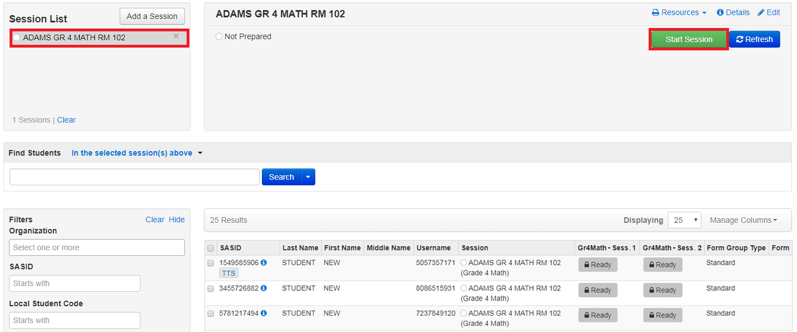
During and After Testing - Start Session
Notes:
Now that the sessions have been prepared, you may start the session. Click the session name from the Sessions List. The Session Details screen will appear for the test session selected. If multiple sessions are selected, the option to Combine View appears. Click the green Start button in the Session Details screen. If multiple sessions are selected and are combined, there is an option to start all sessions. Once the session has started, the start button will change to a Stop Session button which will allow you to stop the session after all students are in Completed or Marked Complete status. Stopping sessions will be explained in a future slide.

Slide 15
During and After Testing - Unlock Test
Unlock for all students:
Unlock for single student:
Notes:
You will now need to unlock the first PAN Session. You can unlock it from two places on the screen – up at the top to unlock a session for all students, or you can unlock a session by clicking the arrow next to each student’s Ready status. Typically you will unlock the whole session for a live class of students who will be testing. If you have a student taking a make-up test, it is suggested only to unlock the test for the one student who will be testing.

Slide 16
During and After Testing - Monitor Progress
Notes:
Once students log into TestNav using their testing ticket, you can monitor their progress. The Student Test Status will change for each student individually. The test status for each student is displayed in the Session window.
After the first session in ELA and Science, there is no need to continue moving through the test. If students move on to the next session, they will encounter items with a Stop Sign encouraging students to exit TestNav. There are items in both test sessions for math in both the calculator and non-calculator test sessions.

Slide 17
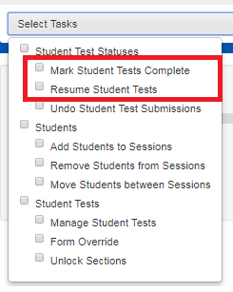
During and After Testing - Mark Test Complete / Resume Test
1.
2.
Notes:
To mark a test complete or resume student tests, go to Testing, then Students in Sessions. Be sure the PAN Session name is selected on the Session List. At the bottom of the screen, check the box next to the student(‘s) name. Then go to Select Tasks and select from the menu the action you would like to complete.
Please note, student tests are marked complete when a student has not finished testing in the usual manner and is not going to return to the test. For more information on these tasks, visit the During Online Testing page on the PearsonAccess^{next} User Guide.

Slide 18
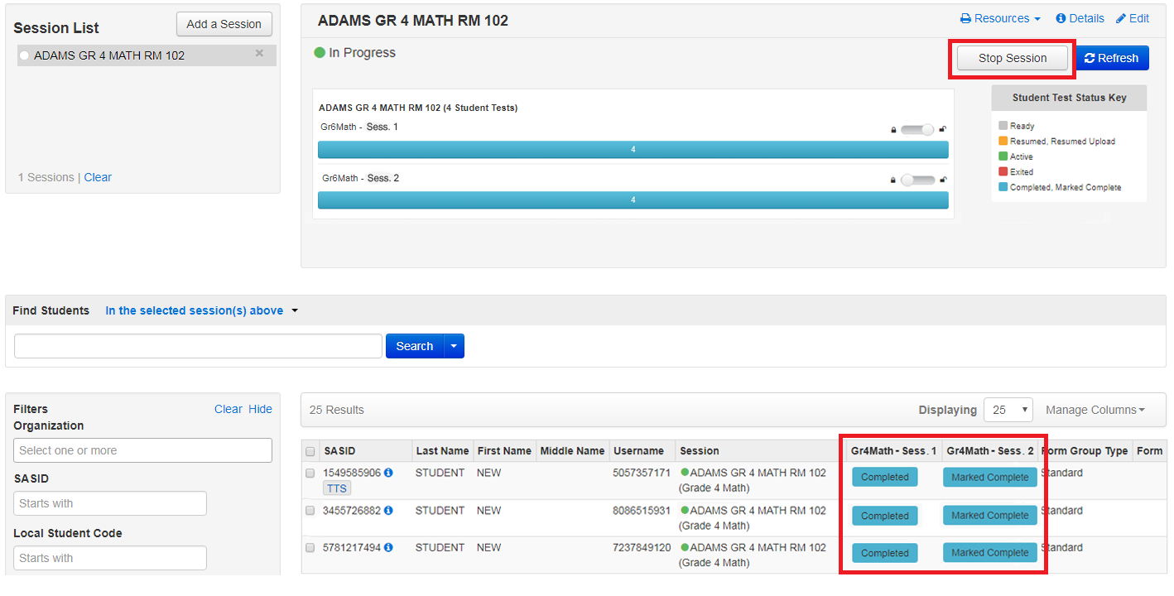
During and After Testing - Sign out of TestNav Stop Sessions
Notes:
Sign Out of TestNav: Students should be answering practice test questions in ELA and Science Session 1 only and in both Mathematics Session 1 and 2. When students finish testing, they should click on the green “Submit Section” button, and then sign out of TestNav.
Stop Sessions: During operational testing, test administrators may need to stop a session, but this is not needed for the Infrastructure Trial. However, test administrators may want to try this out during the Infrastructure Trial; they can do so once all students’ sessions are in the “Marked Complete” status.
After the Infrastructure Trial, it is advised to set aside some time with technology coordinators, test coordinators, and test administrators to discuss how the trial worked and if there could be improvements made prior to the operational testing.

Slide 19
Tools and Accessibility Features in TestNav
Highlighter
Magnifier
Line Reader
Bookmark
Review
Notepad
Answer Eliminator
Item Types
Notes:
There are a number of tools that are available for every student in TestNav. Students should be encouraged to try all the tools while participating in the Infrastructure Trial. We will demonstrate the tools in the next slide.

Slide 20
TestNav Tools Demonstration
Notes:
Highlighter: Click and drag over text on the screen, then choose a color. Highlight the text again and choose the option with the red slash to remove the highlighter.
Magnifier: At the top of the screen, click the User Dropdown Menu. Choose the Enable Magnifier option to turn the Magnifier on and the Disable Magnifier option to turn the Magnifier off.
Line Reader: At the top of the screen, click the User Dropdown Menu. Choose the Show Line Reader Mask option to turn the Line Reader on. There are multiple places in the line reader tool where it can be adjusted. Choose Hide Line Reader Mask to hide the tool.
Bookmark: At the top of the screen, click the Bookmark button to bookmark the test question for later.
Review: Click the Review button at the top of the screen to show all test questions that were answered, not answered, and bookmarked. You may skip to any test question directly from this menu.
Answer Eliminator: At the top of the screen, click the Answer Eliminator button, which looks like an X. On multiple choice or multiple select test questions, this tool may be used to mark an “x” on the options that the student thinks are incorrect.
Item Types: As students move through the practice test, encourage them to practice with all of the different item types and ask questions.

Slide 21
Resources
TestNav and ProctorCache requirements and download links
MCAS Infrastructure Trial Readiness Guide
PearsonAccess^{next} Training Site
PearsonAccess^{next} User Guide
Tutorial and Practice Tests
Spring MCAS Test Administration Resources for Grades 3–8
Guidelines for Using Compatible Assistive Technology
Notes:
Here are the resources to help you with the Infrastructure Trial.

Slide 22
Thank you.
Notes:
This concludes the “Infrastructure Trial for Test Coordinators and Test Administrators” training module. Thank you.

