Slide 1
Accessibility and Accommodations
Notes:
This module presents an overview of the accessibility and accommodations policies for MCAS testing. We will describe accessibility features that are available to all students, and we will also describe accommodations that are only available for students with disabilities and English learners. These policies are intended to help all students participate fairly and show their knowledge, skills, and abilities on the MCAS tests.

Slide 2
Topics
Overview
Universal Accessibility Features
Designated Accessibility Features
Accommodations for Students with Disabilities
Special Access Accommodations for Students with Disabilities
Accommodations for EL Students
Form-Dependent Accommodations
Assistive Technology
Test Preparation
Student Registration/Personal Needs Profile
Resources
Notes:
We will cover the topics listed on this slide.

Slide 3
Overview of Accessibility and Accommodations for MCAS Tests
See the publication Accessibility and Accommodations Manual available at www.doe.mass.edu/mcas/accessibility/.
All students may use accessibility features
  Universal Accessibility Features
    available to all students on computer- and paper-based tests
  Designated Accessibility Features
    can be given to any student at the discretion of the principal
Accommodations are available to students with disabilities and English learners.
Special Access accommodations are only for students with severe deficits in specific areas and who are receiving intensive support services.
Notes:
In addition to viewing these slides, please review the annually updated version of the MCAS Accessibility and Accommodations Manual available at the web address above.
Accessibility features are available to all students. Some are called Universal Accessibility Features that are either built into the computer-based system or provided by a test administrator. Others are called Designated Accessibility Features which allow a principal to determine whether a student should have flexibility in their test setting, group size, or scheduling of the test. Some accommodations are available only to students with disabilities, while others are available to English learners. Special access accommodations, are available to a very small number of students with disabilities who meet certain guidelines to receive them. These will all be described in these slides.

Slide 4
Universal Accessibility Features for All Students
Computer | Paper
Color Contrast | Colored overlays
Screen magnification/ Zoom tool | Magnification device
Notepad | Scratch paper
Line reader tool | Tracking device/straight edge
Answer Eliminator | Use pencil to eliminate answer choices
Answer Masking | Masking using blank card
Item flag/Bookmark | Place marker
Enlarged Cursor/Pointer (SR/PNP) | Enlarged pencil/writing instrument
Highlighter
Audio aids
Human read-aloud (or sign) selected words on Math or STE, as requested by student
Test administrator repeats/clarifies test directions
Test administrator redirects student’s attention to test
Notes:
The Universal Accessibility Features shown on this screen are available to any student who needs them, depending on whether they are taking the computer- or paper-based test. On the left side of the table above, the “Computer” column shows the features that are available to students taking the computer-based tests using the TestNav platform. The “Paper” column on the right shows the equivalent accessibility feature for students taking the paper-based test.
Each of these universal accessibility features is described in the MCAS Accessibility and Accommodations Manual.
New for 2023–24: As in the past, students can magnify material on their computer-based test by using the zoom in/out tool (i.e., the “Ctrl +” and “Ctrl –” key commands). However, the magnifier tool formerly embedded in TestNav has been removed.
The “Answer Eliminator” allows students to cross out answer options they think are incorrect on the computer-based test.
“Answer Masking” allows a student to read a line of text or an answer option while blocking out the rest of the question or the other answer options.
“Human read-aloud (or sign) selected words” allows a test administrator to read aloud or sign a selected word or phrase to any student on the Mathematics or Science and Technology/Engineering tests, as requested by the student. For example, a student taking the Mathematics test is allowed to raise their hand and ask the test administrator to read aloud an unfamiliar word. The test administrator would then quietly read the word to the student without disturbing the other students taking the test. No definitions can be given; only the pronunciation is allowed.
Test administrators may also redirect the student’s attention back to the test, if they lost focus or are engaging in an unrelated activity.
Take a moment to review this list of Universal Accessibility Features and review the details more closely in the Accessibility and Accommodations Manual. Please also be aware that certain selected features and accommodations marked with the letters “SR/PNP” mean that it must be documented in the student’s Student Registration/Personal Needs Profile (SR/PNP) (see slide 17). New for 2023–24: Color contrast and answer masking are now automatically available for all students to turn on and off at will during test administration, except for those students using the screen reader edition. There is no longer a need to select these Universal Accessibility Features (UFs) in the SR/PNP. Selected Universal Accessibility Features are described in detail on the next few slides.

Slide 5
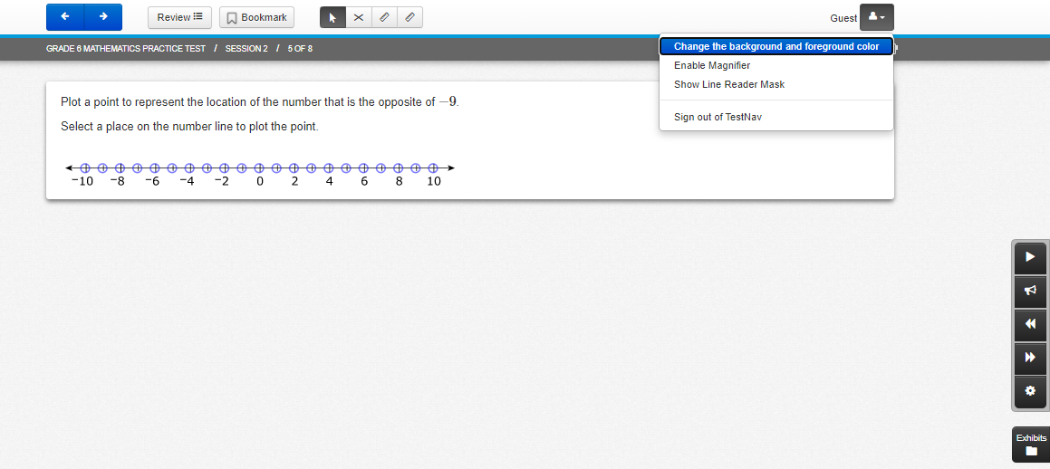
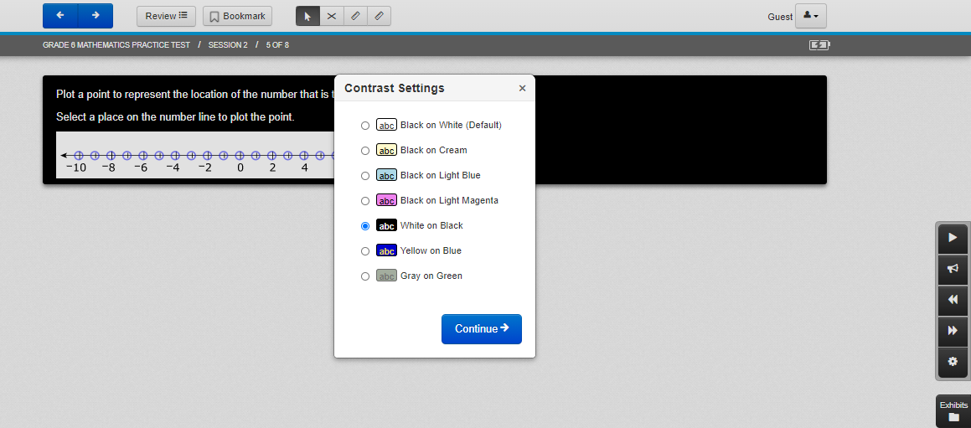
Color Contrast
Notes:
Here is an example of how the “Color contrast” accessibility feature is used. The student can change the colors on the computer screen to match any of the combinations shown in the drop-down menu. There are seven color settings that can be set or reset by the student. This feature can benefit students with visual disabilities. This feature is now available to all students within TestNav without requesting it in the SR/PNP.

Slide 6
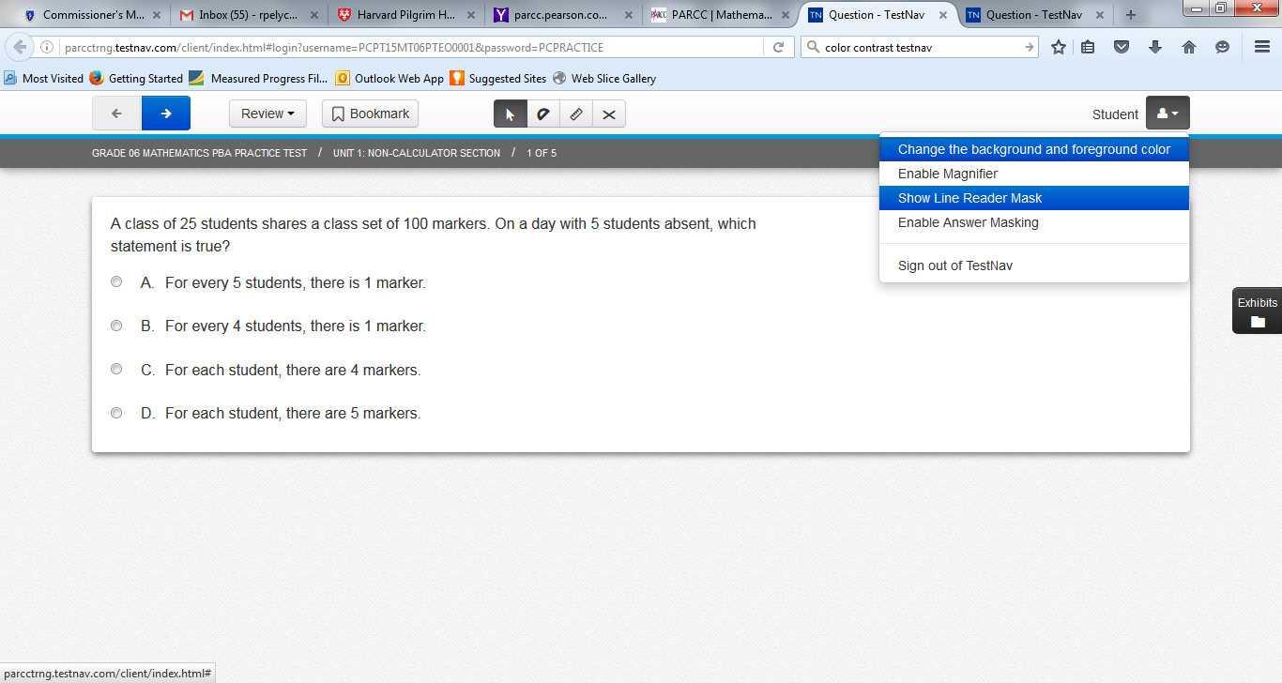
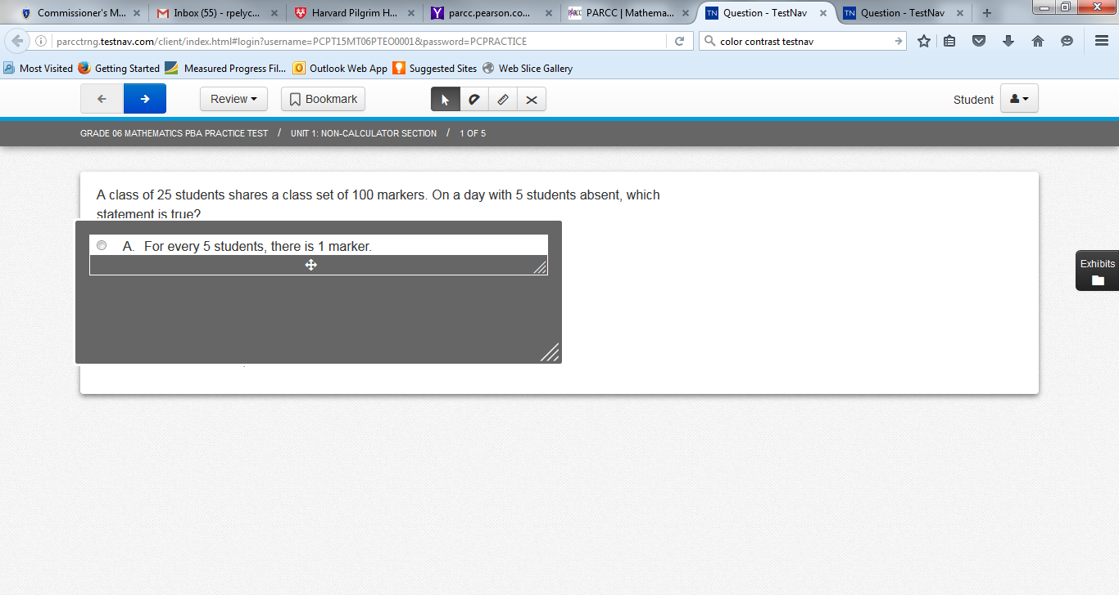
Line Reader
Notes:
The “Line Reader Mask” looks like a gray box with a clear window that allows the student to focus on one line of text at a time and limits distractions from the surrounding text. A student may turn it on and off by selecting the option from the user drop-down menu shown on the screen. The student can adjust the size of the box and the width and height of the reading line, and can move the line reader to different areas of the screen.

Slide 7
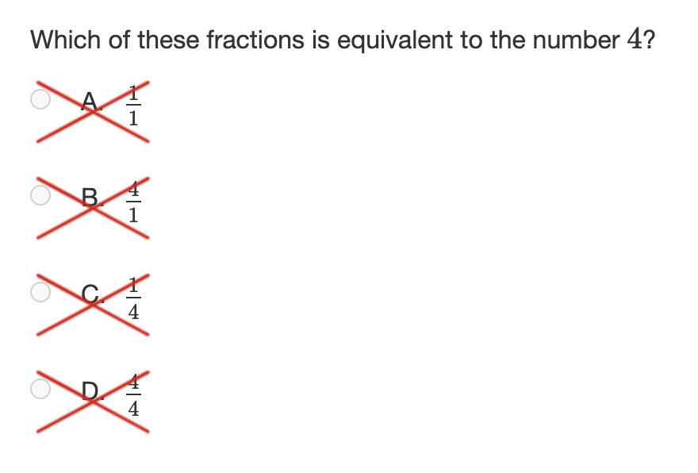
Answer Eliminator
Notes:
Students can use the “X” icon on the top of screen to turn the answer eliminator on and off. Students can then “X” out the answer options they believe are incorrect. This tool helps students keep track of which answers they thought were wrong and narrow down the list of reasonable responses. This allows students taking the computer-based test a parallel experience to students who take the paper-based test who can use their pencil to cross out answer options in the test booklet.

Slide 8
Designated Accessibility Features for Any Student at the Principal’s Discretion
Designated Accessibility Features
Small group test administration (up to 10 students)
Individual (one-to-one) test administration
Frequent supervised breaks
Test in a separate location
Familiar test administrator
Seating in a specified area of room, including study carrel
Adaptive or specialized furniture or lighting
Noise buffer/noise-cancelling earmuffs/headphones (no music)
Student reads test aloud to self
Specific time of day
“Stop Testing” policy: If student is not responding to test questions after 15−20 minutes, test administrator may ask if student is finished. If so, collect the student’s test materials. Student may sit quietly or be excused.
Notes:
On this slide is the list of Designated Accessibility Features. These features are available to any student, if the principal or their designee gives their approval. Most of these features determine where, with whom, and when students will be tested, as well as some other considerations. Please note the state’s “Stop Testing Policy,” which may be especially helpful when testing first-year English learners and some students with disabilities.

Slide 9
Accommodations for Students with Disabilities
Test Presentation Accommodations
Computer | Paper
Paper-based test, if unable to use a computer (SR/PNP) | N/A
N/A | Large print test (SR/PNP)
Screen reader for student who is visually impaired (SR/PNP) | Braille test (SR/PNP)
Text-to-speech for Math and STE, or Human read-aloud for Math and/or STE (SR/PNP) | Human read-aloud for Math and/or STE (SR/PNP)
Human signer for Math, STE, or test questions only for ELA (SR/PNP)
Test administrator helps student track test items
ASL Video Test Editions: Grade 10 Math, High School Science (SR/PNP) | N/A
Notes:
The accommodations listed here are available only to students with disabilities. This slide describes some different ways in which the MCAS test can be presented to the student. The left-hand column shows accommodations for students with disabilities who are taking the computer-based tests; the column on the right shows the equivalent accommodation on the paper-based test. Accommodations that include the “SR/PNP” designation must be listed in the student’s Student Registration/Personal Needs Profile (or SR/PNP). Accommodations must be listed in the student’s IEP or 504 plan to ensure that they receive the accommodations to which they are entitled.
Students who are unable to take a computer-based test due to the effects of their disability may take a paper-based test instead as an accommodation if this is listed in their IEP or 504 plan.
The “text-to-speech” accommodation will allow a student to listen with headphones to a computer-based version of the test being read aloud. The “human read-aloud” is the comparable accommodation for a student taking the paper-based test who needs the test read aloud. Please be aware that reading aloud the ELA test is a “special access” accommodation that will be discussed later.
A “screen reader” is intended for use only by students who are blind or have visual impairments and already use a screen reader program such as JAWS or NVDA. The Braille test is an equivalent accommodation for a student who is blind and cannot take the computer-based test.

Slide 10
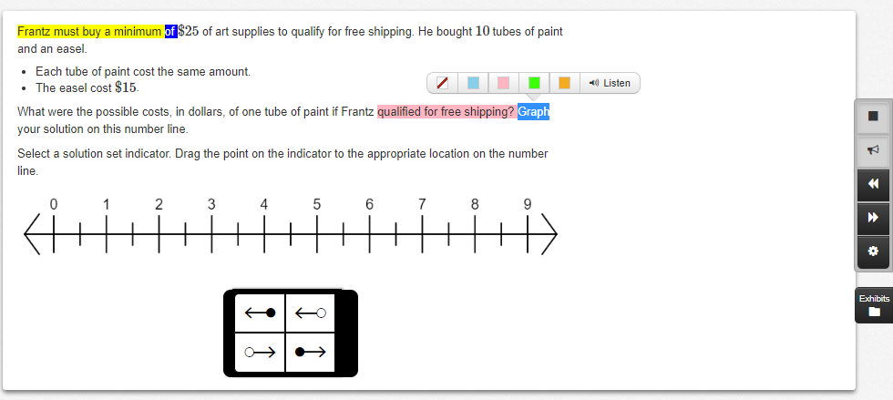
Text-to-Speech
Highlight-to-Hear Feature
Control Icons
Notes:
Here is what the text-to-speech feature looks like on the computer-based test. The sentence being read aloud is highlighted in yellow; the word being read aloud at the moment is highlighted in blue. The student can control the speed and the volume of the speaking voice using the control icons shown in the display. Another icon controls whether the read-aloud picks up where it left off when it was stopped, or goes back to the beginning. Students who plan to use text-to-speech on the test should become familiar with the look and feel of this accommodation before testing begins. The Department strongly encourages students who need this accommodation to take practice tests using the text-to-speech accommodation so they will be familiar with how the text-to-speech accommodation operates.
Additionally, indicated above is the “Highlight-to-Hear Feature.” Students can highlight text for the option to “Listen” to the selection. With this feature, TTS will not continue reading past the end of this sentence.

Slide 11
Accommodations for Students with Disabilities (Continued)
Response Accommodations
Computer | Paper
ELA graphic organizer or Math/STE supplemental reference sheet available at www.doe.mass.edu/mcas/accessibility/organizers/) (SR/PNP)
Human scribe or external speech-to-text device for Math/STE (SR/PNP)
N/A | Answers recorded on special paper
N/A | Typed responses (SR/PNP) (No transcription necessary)
Test administrator monitors placement of test responses
Responses recorded (audio or video), then transcribed by student during playback
Braille writer, Braille note-taker, or refreshable Braille display
Notes:
Response Accommodations change the way in which a student with a disability responds to test questions. For example, typed responses are allowed on the paper-based test, and a scribe can write down the answers dictated by the student.
Another response accommodation is to allow a student with a disability to use a specific approved graphic organizer for the ELA test or an approved supplemental mathematics reference sheet to answer questions on the Mathematics test. Only ELA graphic organizers and mathematics reference sheets that include text and have been developed by DESE may be used, and only by a student with a disability who has this accommodation listed in their IEP or 504 plan. Graphic organizers and reference sheets may be downloaded from the site shown on this table, and they have been designed especially to assist students in responding to questions on the MCAS tests. Schools may no longer submit their own individualized supplemental reference sheets or graphic organizers for Department approval for Mathematics or ELA tests. However, it is possible to request the use of a customized STE reference sheet, which must be submitted to the Department prior to testing. The use of a specific approved graphic organizer or approved supplemental mathematics reference sheet must be documented in the student’s SR/PNP.

Slide 12
Special Access Accommodations for Students with Disabilities
Special Access Accommodations
Computer and Paper
Text-to-Speech/Human reader for ELA (SR/PNP)
Signing the ELA reading passages (SR/PNP)
Scribe or Speech-to-Text responses for ELA (SR/PNP)
Calculator or mathematics manipulatives on non-calculator session of Math (SR/PNP)
Spell check for ELA (SR/PNP) (Note: automatic feature on STE CBT tests)
Word prediction for ELA (SR/PNP)
Notes:
Special Access Accommodations are used by a small number of students with disabilities on specific MCAS tests. They are called “special access” because they change part of what the test is designed to measure, and they should be used only by a very small number of students who meet certain guidelines. Eligibility to receive these accommodations is limited to students who are severely limited or prevented from performing the skill in question, such as a student who is virtually unable to calculate, write, read, or spell. Teams must carefully review the criteria described for each special access accommodation listed in the Accessibility and Accommodations Manual before designating these for students, and may consult with Department staff beforehand by emailing mcas@doe.mass.edu.
All Special Access Accommodations must be requested in the student’s SR/PNP.

Slide 13
Accommodations for English Learners (EL)
EL Accommodations
Paper-based test (SR/PNP) (for a first-year EL who is unfamiliar with technology)
Approved Bilingual Word-to-Word Dictionary or Glossary
Text-to-speech/human reader for Math and STE (in English) (SR/PNP)
Scribe for Math and STE (SR/PNP)
Grade 10 Spanish/English Mathematics Test/Retest and High School Science if enrolled fewer than 3 years (SR/PNP)
Read aloud/repeat/clarify test directions in student’s native language, if native language speaker is available
Notes:
The accommodations listed in this table are intended for students who were reported as English learners in the Department’s Student Information Management System (or SIMS). First-year ELs with low levels of English proficiency may take a paper-based test, instead of a computer-based test, if they are unfamiliar with the use of technology. English learners are entitled to use all of the Accessibility Features that were previously described. The use of approved bilingual word-to-word dictionaries is also allowed for students who were ever reported as EL.
Please also remember that English learners in their first year in a Massachusetts school may, at the principal’s discretion, be exempted from participation in the MCAS ELA test.
Please take a minute to review this list of accommodations available to ELs, whether or not they have a disability.

Slide 14
Form-Dependent Accommodations
The following form-dependent accommodations are available and must be requested in the student’s SR/PNP:
  Computer-based special test forms:
    Text-to-Speech
    ASL
    Spanish/English
    Screen reader (only for a student who is visually impaired; used in conjunction with a hard-copy Braille test)
    Compatible Assistive Technology (for student using an AT program that is compatible with the computer-based test)
      See Guidelines for Using Assistive Technology as an MCAS Test Accommodation at www.doe.mass.edu/mcas/accessibility/
    Human read-aloud/human signer
  Paper-based special test forms:
    Large print
    Braille
Notes:
The special test forms listed on this slide are available as accommodations for students with disabilities. Please take a minute to review the list of accommodated forms.
For computer-based tests, text-to-speech, ASL, Spanish/English, screen reader, and compatible assistive technology forms are available. It is necessary to review the Guidelines for Using Assistive Technology as an MCAS Test Accommodation prior to assigning a student a web extension or compatible assistive technology form.
For paper-based tests, large print and Braille forms are available.
See Appendix A of the Guide to the SR/PNP for additional information about assigning these accommodations: mcas.pearsonsupport.com/manuals/

Slide 15
Assistive Technology (AT)
Students may use assistive technology (AT) when it is listed in their IEP or 504 plan; for example:
  Word prediction software
  Speech-to-text programs
  Adapted keyboard, mouse, screen magnifier, enlarged screen
There are two categories of assistive technology:
  Compatible technology that interacts directly with TestNav, the computer-based MCAS testing platform (see the Guidelines for Using AT at www.doe.mass.edu/mcas/accessibility/)
  External technology that does not interact with TestNav
    Requires a second computer device that is not directly connected to TestNav
    May require test administrator to facilitate transfer of information from external device to computer used for assessment
    Internet access must be disabled or monitored closely during testing.
Notes:
Students with disabilities may use their familiar assistive technology to participate in MCAS tests if the specific technology is allowable and is listed in the student’s IEP or 504 plan. Assistive technology might include word prediction, speech-to-text programs, adaptive keyboards or mouse, or a screen magnifier.
There are two kinds of assistive technology that can be used for MCAS testing. One is an assistive technology program that is compatible with TestNav, the computer-based testing platform. Compatible programs are those that function within TestNav during the computer-based test. In that case, the “Web Extension” form or the “Compatible Assistive Technology” form must be requested in the SR/PNP to ensure that the correct form of the test is provided to the student. Schools should review an annually updated description of assistive technology programs in the Guidelines for Using Assistive Technology as an MCAS Test Accommodation that is available on DESE’s website.
Other assistive technology programs may not be compatible with TestNav and are therefore considered “external” technology that does not interact with TestNav. These will require another nearby computer that includes the assistive technology program or device that is not connected to the computer that uses TestNav. A test administrator may need to help the student transfer the information from the additional computer to the actual computer-based test. Schools should plan in advance for students that will use assistive technology, and try these out beforehand using practice tests. It will also be important to make sure the student using assistive technology cannot access the Internet during testing.

Slide 16
Test Preparation
Before testing begins, students should be familiar with features and basic functionality of TestNav, the computer-based testing platform.
View the Student Tutorial at http://mcas.pearsonsupport.com/student
Take an online practice test using TestNav.
Test coordinators should review IEPs, 504 plans, and any forms used to document MCAS accommodations for EL students (sample found on the DESE website). (http://www.doe.mass.edu/mcas/accessibility/)
Notes:
Test preparation is important, particularly for students who are not familiar with computer-based testing for MCAS. Educators should plan time to allow students to become familiar with the basic functionality of TestNav, the computer-based testing platform.
One way to prepare students is to view the Student Tutorial on the mcas.pearsonsupport.com webpage. The Student Tutorial provides students with an interactive experience on how to use the various tools, screens, and commands in TestNav.
Another way to prepare students for the test is to have them take practice tests. The online practice tests will expose students to the types of test questions that will be asked on the MCAS tests.
Be sure that students’ accommodations are documented in their IEPs and 504 plans, and that the test coordinator is aware of which students will receive which accommodations on the day of the test. Tests results may be invalidated if students receive the incorrect accommodation, or if they do not receive the accommodations listed in their plan.
Schools should document accommodations for English learners, using the sample “Documentation of MCAS Accommodations for an EL Student” form found at https://www.doe.mass.edu/mcas/testadmin/forms/

Slide 17
Student Registration/Personal Needs Profile (SR/PNP)
The function of the SR/PNP is to:
  enroll students for each test, regardless of computer- or paper-based testing
  order special test forms, and
  collect information on several selected accommodations.
Consult the Guide to the Student Registration/Personal Needs Profile (SR/PNP) and the Student Registration/ Personal Needs Profile module for directions for importing the SR/PNP file.
Resource Link URLs:
Test Administration Guidance: URL: http://mcas.pearsonsupport.com/manuals/
Pearson Access Next Training Page: URL: http://mcas.pearsonsupport.com/training
Slide /
Notes:
For more information on the process for registering students, please refer to the Guide to the Student Registration/Personal Needs Profile (SR/PNP) Process found at mcas.pearsonsupport.com/manuals/ under the “PearsonAccess^{next}” drop-down, or the Student Registration/Personal Needs Profile training module found at mcas.pearsonsupport.com/training/.

Slide 18
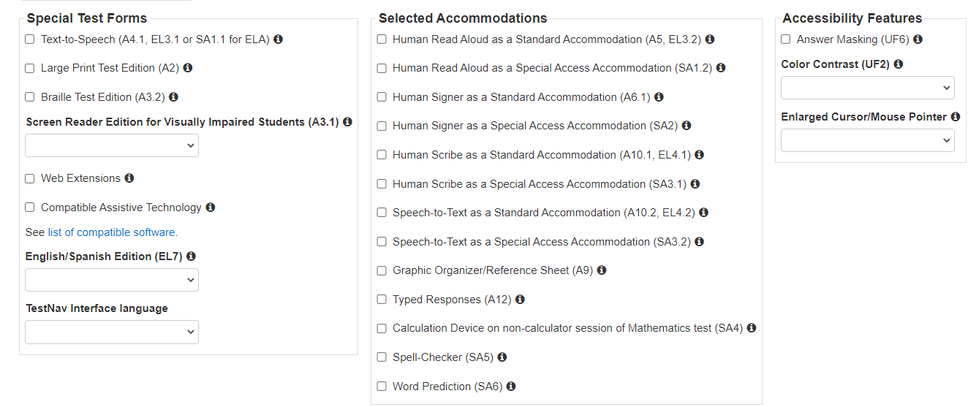
Sample Manage Student Tests Screen (SR/PNP)
Notes:
Here is an example of the Manage Student Tests screen which is part of the Student Registration/Personal Needs Profile, or SR/PNP. Schools can use the Manage Student Tests screen in PAN to change or add an accommodation, request a special test form, or activate an accessibility feature for a student. The Manage Student Tests screen may vary depending on the test. For example, the Calculation Device accommodation only appears among the options for the Mathematics test.
Refer to the document entitled Guide to the Student Registration/Personal Needs Profile (SR/PNP) on the MCAS Resource Center for information on how to access and complete the Manage Student Tests screen. Refer to Appendix E of the Accessibility and Accommodations Manual for a crosswalk of all accessibility features and accommodations and their corresponding column in the SR/PNP file.

Slide 19
Resources and Support
  MCAS Service Center Support and Assistance:
  Web: mcas.pearsonsupport.com
  Phone: 1-800-737-5103
  Office of Student Assessment - Accessibility and Accommodations
  Web: www.doe.mass.edu/mcas/accessibility/
Phone: 781-338-3625
  Email: mcas@doe.mass.edu
Notes:
Thank you for taking the time to view this module.
Please use the available resources at mcas.pearsonsupport.com and on DESE’s MCAS Accessibility and Accommodations webpage for additional information and assistance.

