Slide 1
MCAS Accessibility and Accommodations
For All Grades, with a Focus on High School Tests/Retests
January 2019

Slide 2
Presenters
Dan Wiener, Administrator of Inclusive Assessment
Robert Pelychaty, Accommodations and Appeals Coordinator
Jodie Zalk, Test Administration Coordinator
Liz Pennington, Pearson Project Manager

Slide 3
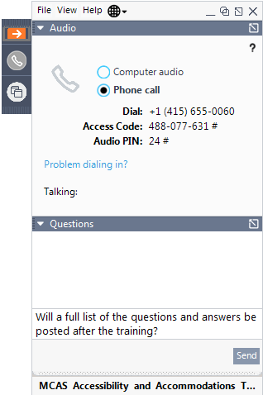
Logistics for This Session
Questions may be asked at any time using the Questions feature on the GoToWebinar screen.
  Questions about a specific student should be sent by email to mcas@doe.mass.edu.
  We will attempt to answer all questions asked during the session; after the session, all questions will be answered and emailed out to participants.
This session is being recorded and will be available online in about one week at:
  MCAS Resource Center ― mcas.pearsonsupport.com/training
    In the section entitled “Training Sessions Previously Offered This School Year”

Slide 4
01
Participation Requirements
02
What’s New and Notable?
Student Registration/Personal Needs Profile (SR/PNP)
CONTENTS
03
04
Accessibility and Accommodations
05
Preparing for Test Administration

Slide 5
Participation Requirements
01

Slide 6
MCAS Participation Requirements
All publicly-funded students must participate in the MCAS assessments required for their grade.
  All eligible students have the right to participate in high school retests (March 4–8)
MCAS participation includes students with disabilities (SWDs) and English learners (ELs).
Participation ensures that all students receive instruction based on the MA Curriculum Frameworks.

Slide 7
Decision-Making Guidelines for Students with Disabilities
IEP teams determine how, not whether, SWDs will participate in MCAS.
  IEPs and 504 plans must list assessment decisions, including accommodations and alternate assessments.
See the publication Accessibility and Accommodations Manual available at www.doe.mass.edu/mcas/accessibility/.

Slide 8
What’s New and Notable?
02

Slide 9
What’s New and Notable?
Virtually all students in grades 3–8 and 10 are expected to take computer-based tests in Spring 2019.
In spring 2019, computer-based MCAS tests will be administered to students in grade 10 for the first time in ELA and Mathematics.
  Next-generation tests measure the 2017 curriculum frameworks.
Paper-based tests are available as an accommodation for students with disabilities who are unable to test on a computer (if listed in IEP/504 plan)
  This year, high school STE and all retests offered only on paper.

Slide 10
What’s New and Notable? (Continued…)
Individualized graphic organizers (that contain text) and customized reference sheets may no longer be used on next-generation ELA and mathematics tests.
  Instead, only supplemental mathematics reference sheets and ELA graphic organizers pre-approved by DESE may be used for next-gen tests, available at: www.doe.mass.edu/mcas/accessibility/organizers/.
  Students taking legacy retests and high school STE tests may continue to use individualized reference sheets and organizers, if approved by DESE.
Transition to Unified English Braille (UEB) from English Braille American Edition (EBAE) and Nemeth Code will continue for 2018–19.
  All MCAS tests in grades 3–8 will be given in UEB.
  High school tests will continue to be administered in EBAE with Nemeth Code until spring 2020, when they will transition to UEB.

Slide 11
What’s New and Notable? (Continued…)
Accessibility and Accommodations Manual for the 2018‒2019 MCAS Tests/Retests contains policy information for MCAS testing in all grades.
Next-generation accessibility and accommodations policies now include:
  High school tests and retests
  English learners who are now eligible to receive certain accommodations
  Accessibility features for all students.

Slide 12
Team Decisions Needed Before Testing in Spring 2019
Team members should review MCAS accessibility and accommodations policies (www.doe.mass.edu/mcas/accessibility).
Important decisions needed for each student with a disability:
  Does student need a paper-based test (PBT) as an accommodation?
    If “unable to take computer-based test due to a disability,” list PBT as an accommodation in IEP or 504 Plan.
    Students who previously needed accommodations for typed response, large print, answers written in test booklet, or assistance tracking placement of responses may be better-suited for computer-based tests.
  If taking a computer-based test (CBT), which features and accommodations are needed? Determine whether previous MCAS accommodations are still needed?
  For read-aloud, can student use text-to-speech (TTS) with headphones, or needs a human reader?

Slide 13
English Learner (EL) Accommodations – Guidelines
ELs are required to participate in all MCAS tests scheduled for their grade, with one exception:
  First-year ELs are not required to take the MCAS ELA test, but may participate.
  First-year EL students are those who enrolled in U.S. schools after March 1, 2018, and who are reported for the first time in June 2018 SIMS or later.
EL Accommodations are available to all ELs
Adults familiar with the student should meet to:
  consider EL students’ language needs, learning characteristics, and preferences.
  review available accessibility features and accommodations for ELs.
  select and document the accessibility features and accommodations that will be provided to the student on MCAS tests.
    Sample form provided in Appendix B of Accessibility and Accommodations Manual.

Slide 14
Student Registration/Personal Needs Profile (SR/PNP)
03

Slide 15
What is the Student Registration/Personal Needs Profile (SR/PNP)?
A collection system for student-level test data, including
  student demographic information
  registration for specific tests
  information on selected accommodations that a student used during testing (Note: Information can be changed until the end of testing)
Used as the basis for initial shipment of test materials to schools, including
  Student ID Labels
  Test Administration Manuals
  Paper-based test materials (if needed) and special test editions
Accurate SR/PNP reporting is important! It will determine initial order shipment to your school, provide a record of students tested, and the accommodations they used.

Slide 16
Student Registration/Personal Needs Profile (SR/PNP) Process
DESE will upload student demographic information to school and district DropBoxes on January 28, including selected accommodations used by students in grades 4–10.
Schools will verify/update this information, and register students for upcoming tests:
  Add students enrolled after October SIMS.
  Update selected accommodations.
  Add accommodations for grade 3 and high school students,
  Request paper-based tests, large-print, text-to-speech, Braille, etc.
  Import file to Pearson Access Next (PAN)
Additional SR/PNP training will be offered on Jan. 24, 10-11:30 a.m.
Notes:
PNP intended to: order special test forms (paper), order computer-based forms with certain built-in tools and supports, and to document use of selected accommodations

Slide 17
Accessibility and Accommodations
(Including New Policies for Students in High School)
04

Slide 18
Accessibility Features and Accommodations
See Accessibility and Accommodations Manual for list of:
Universal Accessibility Features (UF): Available to all students, for computer-based tests or paper-based equivalent (pp. 3−5).
Designated Accessibility Features (DF): Flexible test administration procedures available to any student, at the discretion of principal (p. 5).
  Includes changes in test setting, group size, seating, scheduling
Accommodations (A): Specific supports available only to students with disabilities and English learners
Special Access Accommodations (SAs): Formerly called nonstandard accommodations, these may be provided to students who meet certain guidelines and criteria (see pp. 20−24).

Slide 19
Universal Accessibility Features (UF) for all students
Computer | Paper
Highlighter
Change background/font color (SR/PNP) | Colored overlays
Screen magnification/ Zoom tool | Magnification device
Line reader tool | Tracking device/straight edge
Answer Eliminator | Use pencil to eliminate answer choices
Answer Masking (SR/PNP) | Mask using blank card
Item flag/bookmark | Place marker
Audio aids
Human read-aloud (or sign) selected words on Math or STE, as requested by student
Repeat/clarify test directions
Test admin redirects student’s attention to test

Slide 20
Demonstration

Slide 21
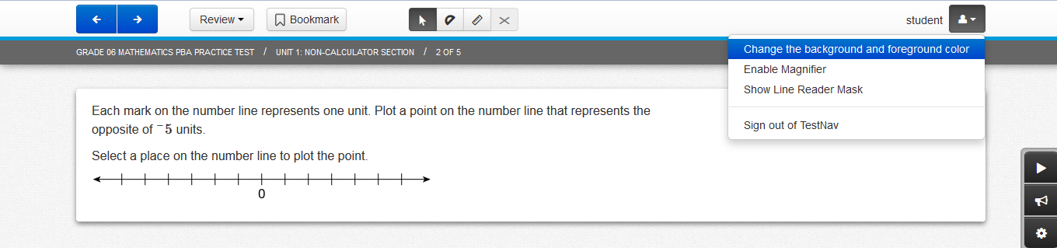
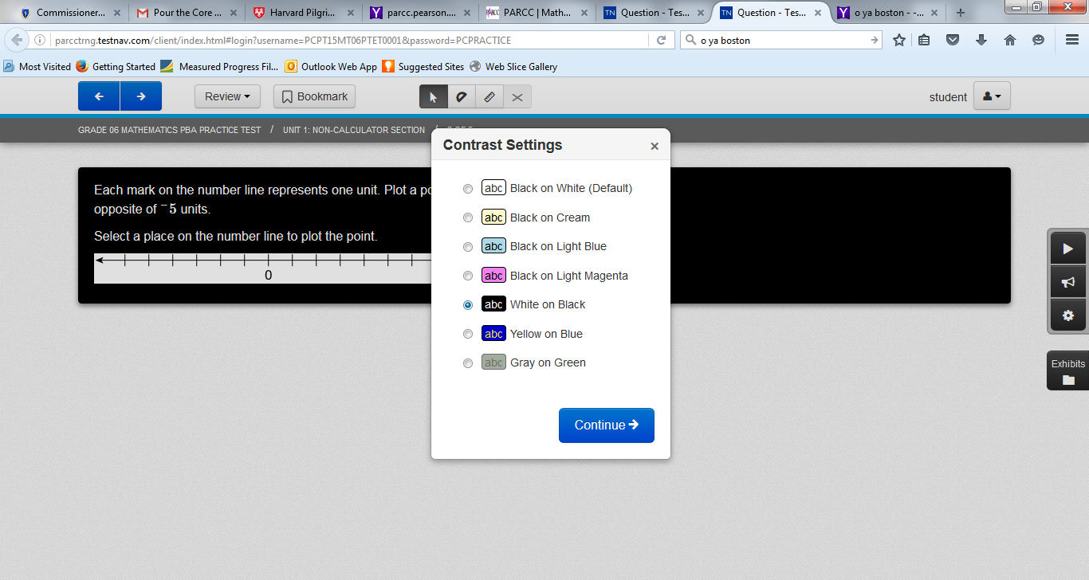
Change background/font color
Notes:
Click top box.

Slide 22
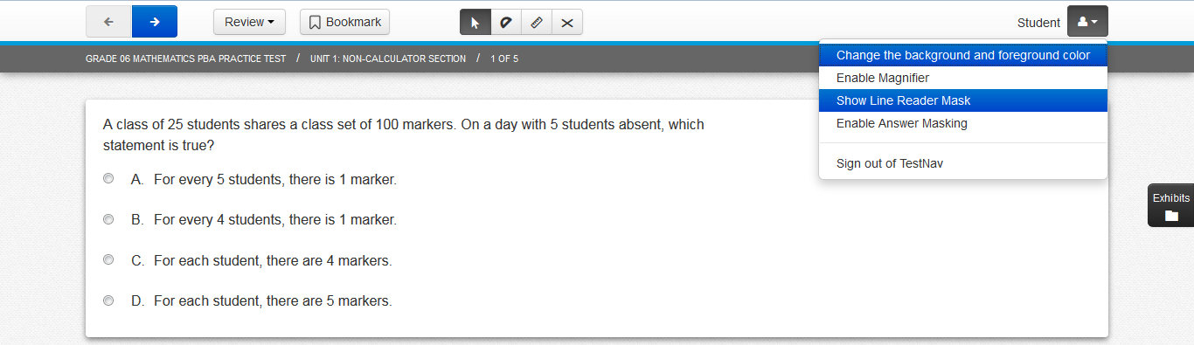
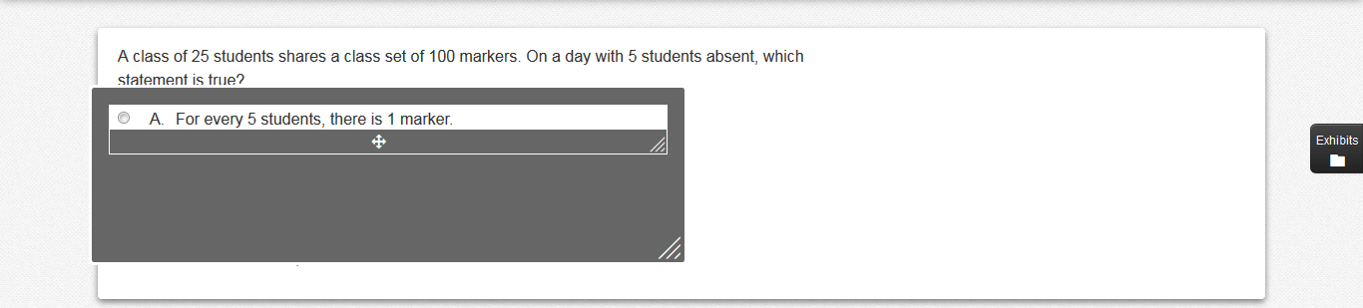
Line Reader

Slide 23
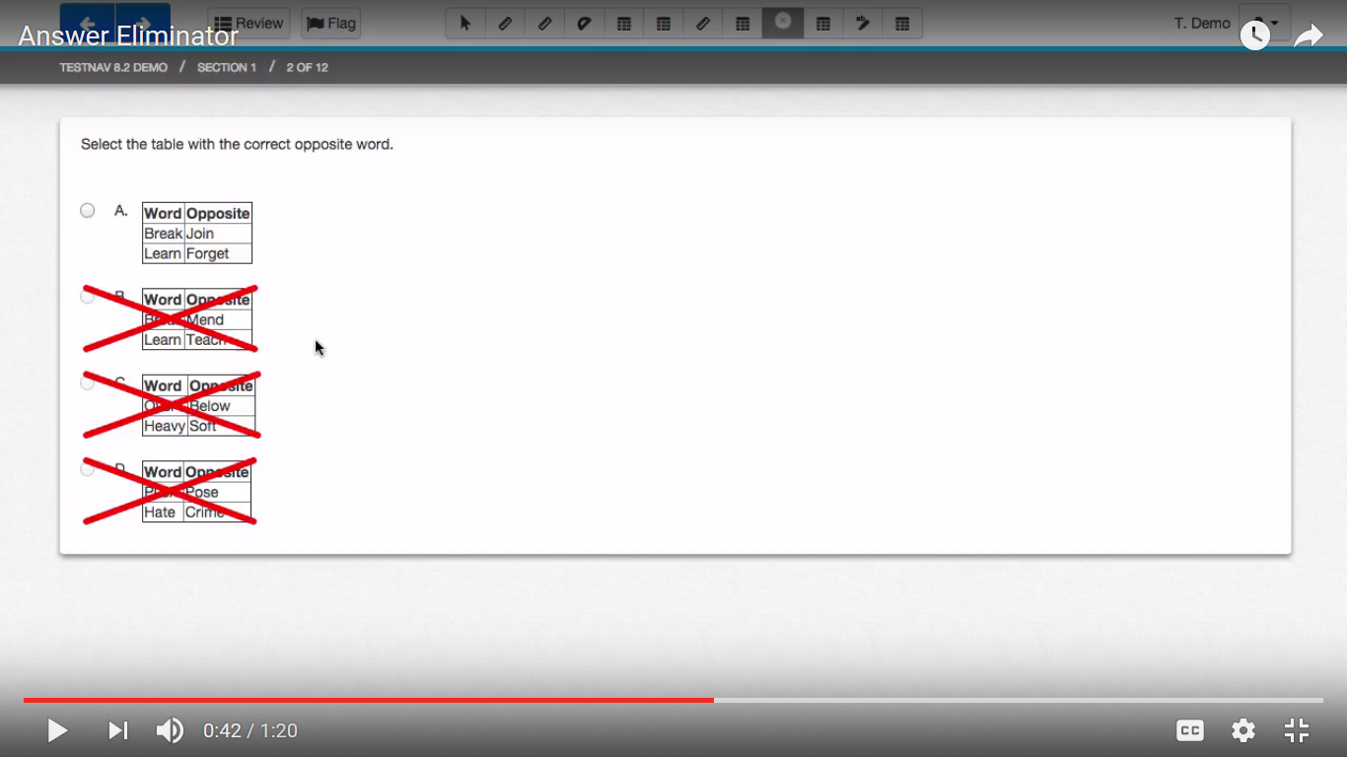
Answer Eliminator

Slide 24
Designated Accessibility Features (DF) for any student, at principal’s discretion
Computer or Paper
Small group test administration (up to 10 students)
Individual (one-to-one) test administration
Frequent supervised breaks
Test in separate location
Seating in a specified area of room, including study carrel
Adaptive or specialized furniture or lighting
Noise buffer/noise-cancelling earmuffs/headphones (no music)
Familiar test administrator
Student reads test aloud to self
Specific time of day
“Stop Testing” policy: If student is not responding to test questions after 15−20 minutes, test administrator may ask if student is finished. If so, collect the student’s test materials. Student may sit quietly or be excused.

Slide 25
Accommodations for Students with Disabilities
Presentation Accommodations
Computer-Based | Paper-Based
Paper test, if unable to use computer (SR/PNP) | N/A
N/A | Large print test (SR/PNP)
Screen reader for student who is blind (SR/PNP) | Braille test (NEW: UEB in grades 3-8; EBAE and Nemeth Code in high school) (SR/PNP)
Text-to-speech/Human read-aloud for Math, STE (SR/PNP) | Human read-aloud for Math, STE (SR/PNP)
Human signer for Math, STE, and test questions only for ELA (SR/PNP)
Test administrator helps student track test items

Slide 26
Demonstration

Slide 27
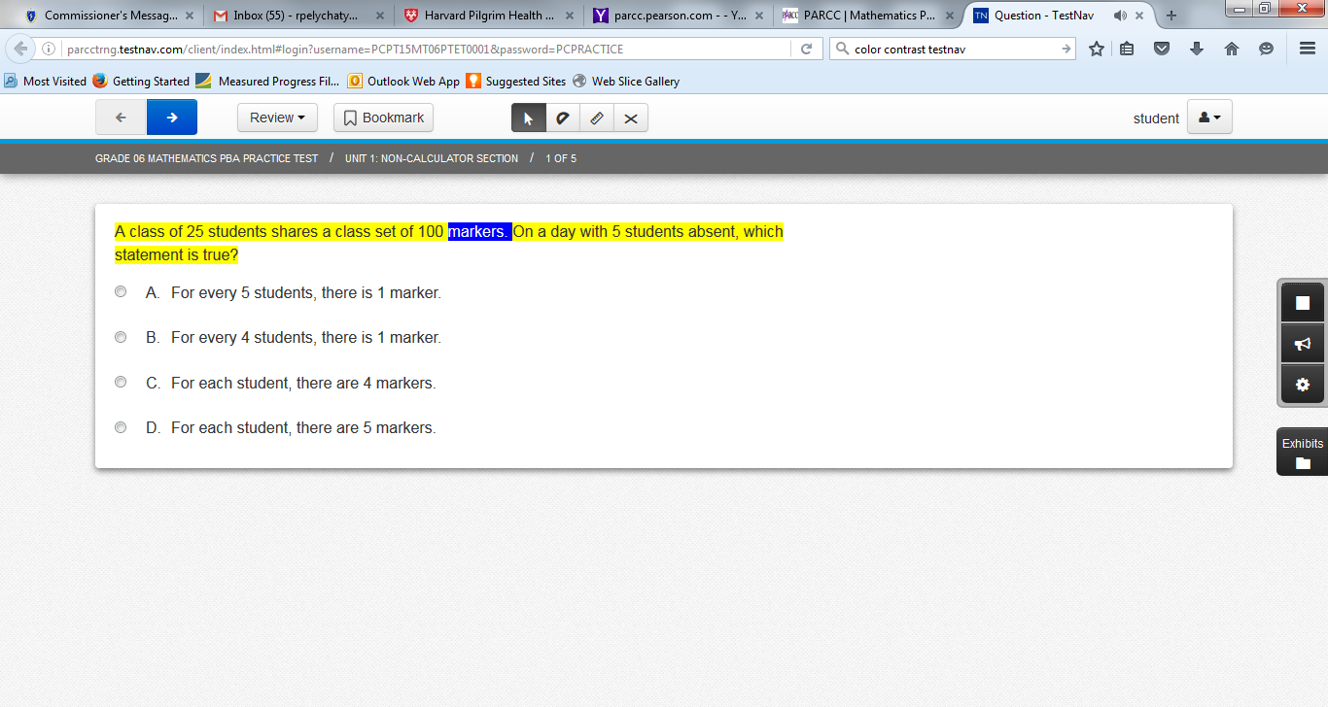
Text-to-Speech
Play and Stop
“Click-to-Hear”
(starts reading
at specified point)
Read-aloud Speed
Notes:
Sentence being read is highlighted in yellow. Word read aloud is highlighted in blue.

Slide 28
Accommodations for Students with Disabilities (Continued)
Response Accommodations
Computer-Based | Paper-Based
Pre-Approved ELA graphic organizer or Math/STE reference sheet for next-gen Math and ELA tests (only those created by DESE or individualized for STE or legacy retests) (SR/PNP)
Human scribe or external speech-to-text device for Math/STE (Note: 504 plan needed for fractured writing arm)
N/A | Answers recorded in test booklet
N/A | Typed responses (No transcription necessary)
Responses recorded (audio or video), then transcribed by student during playback
Monitor placement of test responses
Braille writer, note-taker, or refreshable Braille display

Slide 29
Special Access Accommodations for Students with Disabilities (formerly called Nonstandard Accommodations)
Computer and Paper
Text-to-speech/Human reader for ELA (SR/PNP)
Signing the ELA reading passages (SR/PNP)
Scribe responses (or speech-to-text device) for ELA (SR/PNP)
Calculator or other mathematics tool, device, or manipulatives on non-calculator session of Math (SR/PNP)
Spell-checker for ELA (SR/PNP) (Note: Spell-checker is available to all students for STE)
Word prediction for ELA (SR/PNP)

Slide 30
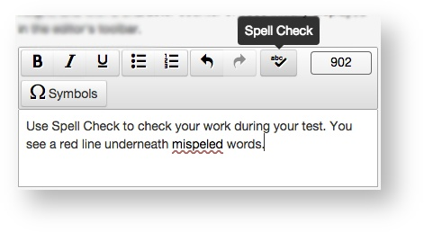
Spell-checker

Slide 31
Criteria for Providing Special Access Accommodations (SAs)
SAs may be provided only to a limited number of students who:
  are virtually unable to decode, calculate, write, or spell; AND
  receive ongoing intervention for these skills.
SAs may not be provided if student is simply performing “below grade level.”
Scores may be invalidated if ineligible students are provided SAs.
Use of SAs will be reported with a notation on
  Parent/Guardian Reports
  School and District Rosters

Slide 32
Accommodations Available for English Learners (ELs)
Computer and Paper
Approved Bilingual Word-to-Word Dictionary or Glossary
Paper-based Test (SR/PNP)
Text-to-speech/human reader for Math and STE (in English) (SR/PNP)
Scribe for Math and STE (SR/PNP)
Grade 10 English/Spanish Mathematics Test or Retest, if enrolled fewer than 3 years (SR/PNP)
Read aloud/repeat/clarify test directions in student’s native language, if native language speaker is available
“Stop testing” policy

Slide 33
Accommodated Test Forms
Accommodated computer-based test forms available:
  text-to-speech (read aloud digitally)
  screen reader (for students with visual impairments only, requires software e.g., JAWS or NVDA)
  compatible assistive technology editions
  ASL video (embedded onscreen―grade 10 mathematics only).
Accommodated paper-based test forms available:
  Large-print
  Braille
  Kurzweil (retests and high school STE tests only).

Slide 34
Assistive Technology (AT)
Students may use assistive technology (AT) if listed in their IEP or 504 plan:
  Word prediction software
  Speech-to-text programs
  Adapted keyboard, mouse, large-format screen monitor, etc.
There are two categories of assistive technology for MCAS testing:
  Compatible technology that interacts directly with TestNav, the computer-based MCAS testing platform
  External technology that does not interact with TestNav
    Requires use of a second computer that is not directly connected to TestNav
    May require test administrator to facilitate transfer of responses from external device to device used for assessment
    Internet access must be disabled or restricted (e.g., kiosk mode) and student must be monitored closely during testing.

Slide 35
Preparing for Test Administration
05

Slide 36
Preparing for Test Administration
Review IEPs, 504 plans, and PAM Appendix B.
Prepare a list/spreadsheet for test scheduling (strongly encouraged):
Order additional accommodated test editions, as needed.
For legacy March retest and STE tests: submit individualized graphic organizers and reference sheets to DESE for approval, if previously approved before 2018.
Student Name | Grade | Subject | TA Name | Room # | Accommodation(s)
Buster Scruggs | 10 | Math | Mr. Rogers | 208 | Human Read-aloud Scribe Reference sheet

Slide 37
Preparing for Test Administration (continued…)
Document accommodations for English Learners (ELs).
  Use Documentation of MCAS Accommodations for an EL Student Appendix B of Accessibility and Accommodation Manual; OR
  Use a locally developed form for this purpose.
Provide training to those who will provide accommodations.
  Test administrators
  Paraprofessionals and substitutes, as needed
  Develop plan to monitor testing accommodations for students who require 1:1 test administration (human read-aloud, scribe).

Slide 38
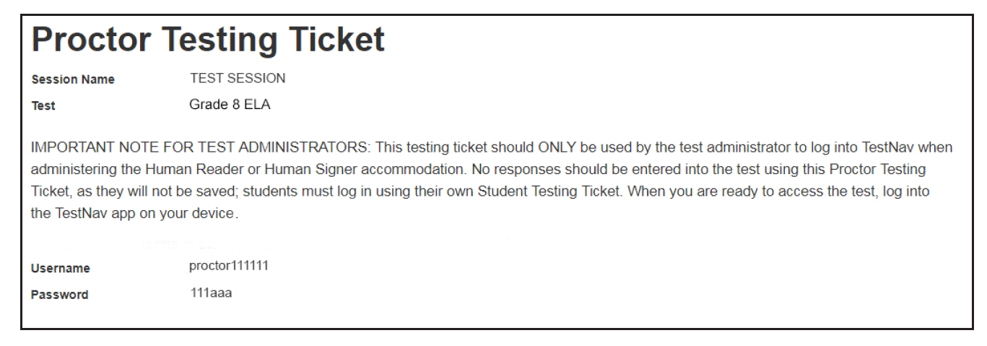
Important Reminder for Computer-Based Testing
Test administrators who provide Human Read-Aloud and Human Signer accommodations will use their own computer and print their own proctor testing ticket to access a “test administrator” edition of the test.
  A separate PAN Session must be created.
  Students will use their own student testing ticket to log into their test.
  Do not confuse student’s testing ticket with proctor testing ticket.

Slide 39
Important Reminders for Paper-Based Testing
Review and follow Special Instructions included with special test forms (e.g., Braille, large-print) to avoid scoring and other problems.
Large-print, Braille, and other responses on special paper must be transcribed into standard booklet, and included with original in Special Handling Envelope.
Typed responses:
  Only 1 item response per page.
  Each response must consist of no more than 1 page.
  Each page must include all parts of each item (i.e., a., b., c., d…etc.).

Slide 40
Reminder to provide these to all students during testing…
Provide all students with the following during testing:
  Untimed test sessions
  Blank scratch paper (including blank, lined, or graph paper)
  Assistance from test administrator, as needed, to navigate the computer-based testing platform
Plus, the appropriate accommodations materials to students who have these listed in their IEP or 504 plan:
  Special (accommodated) test edition, either for CBT or PBT
  Calculator
  Graphic organizer/Mathematics or Science reference sheet

Slide 41
Testing Irregularities – Use of Prohibited Materials
Please report use of the following to the Department as soon as possible:
Cell phones or other unauthorized devices in the testing room
English-language dictionary or thesaurus on any next-gen MCAS test
  Dictionaries are allowed only for the legacy ELA Composition retest.
  Bilingual word-to-word dictionaries are allowed for all ELs/former ELs.
Unapproved Math reference sheet or ELA graphic organizer, including
  Modifications to a DESE-approved supplemental reference sheets/ELA organizer for next-generation MCAS tests.
Use of a calculator on the non-calculator session of Mathematics test, or read-aloud or spell-checker on the ELA test, for student who does not have this accommodation listed in an IEP or 504 plan

Slide 42
If a Student Refuses an Accommodation
Document the student’s refusal in writing; keep in student’s file.
  Sample refusal form — available in Accessibility and Accommodations Manual appendix, at www.doe.mass.edu/mcas/accessibility/
  Do not ask student to sign any forms.
Continue to make accommodation available, if needed, for remainder of test administration.
Update information in student’s SR/PNP, if an accommodation was entered incorrectly or was not used.
Notify parent/guardian of student’s refusal.
Amend IEP/504 plan for future testing.
  If appropriate, list the accommodation in the IEP/504 plan “as requested by student,” or remove it.

Slide 43
Upcoming Training Sessions
Training sessions are listed at www.doe.mass.edu/mcas/training.html.
  Links to register will be posted on this page approximately one month before each session.
After each session is delivered, it will be posted at mcas.pearsonsupport.com/training/ in approximately one week.

Slide 44
Email and Phone Support
MCAS Service Center
DESE Office of Student Assessment Services
Questions on logistics and technology (e.g., PearsonAccess Next, SR/PNP, TestNav)
  Web: mcas.pearsonsupport.com
  Email: mcas@measuredprogress.org
  Phone: 800-737-5103
Policy questions (e.g., student participation, accommodations)
  Web: www.doe.mass.edu/mcas
  Email: mcas@doe.mass.edu
  Phone: 781-338-3625

Slide 45
Questions & Answers
(Use the “Questions” feature
to ask questions.)

Slide 46




THANK YOU
The Office of Student Assessment Services
781-338-3625
mcas@doe.mass.edu
www.doe.mass.edu
75 Pleasant Street, Malden, MA 02148

