Slide 1
MCAS Accessibility and Accommodations for Students in Grades 3−8
Notes:
This module presents an overview of the Accessibility and Accommodations policies for the next generation MCAS tests for students in grades 3 through 8. Please listen carefully to this information, since there are important features that are available to all students. We will also discuss accommodations that are available only to certain students, like students with disabilities or English learners. These policies are intended to help all students participate fairly and effectively in the Next Generation MCAS tests.

Slide 2
Overview of MCAS Accessibility and Accommodations for Grades 3−8
See the publication Accessibility and Accommodations Manual available at www.doe.mass.edu/mcas/accessibility/.
Some previous MCAS accommodations are now called:
Universal Accessibility Features
available to all students on computer- and paper-based tests
Designated Accessibility Features
can be given to any student at the discretion of the principal
Accommodations are available to students with disabilities and English language learners.
“Nonstandard” accommodations are now called Special Access accommodations
Notes:
In addition to viewing this module, please review the updated version of the MCAS Accessibility and Accommodations policy manual available at the URL shown on your screen.
Many accessibility features are available to all students. Some of these are Universal Accessibility Features that are either built into the computer-based system or provided by a test administrator. Others are called Designated Accessibility Features which allow the principal to determine whether a student should have flexibility in their test setting, group size, or scheduling of the test. Some accommodations are available only to students with disabilities, while others are available only to English learners. Special Access Accommodations, previously called “nonstandard accommodations,” are available only to a small number of students with disabilities who meet certain guidelines to receive them. All of these will be described shortly.

Slide 3
Grades 3−8 MCAS
The following are available to all students:
Untimed test sessions
Blank scratch paper (including blank lined or graph paper)
Assistance from a test administrator, as needed, to use the computer-based test platform
The following have changed for grades 3−8:
New categories and numbering system for accessibility features and accommodations
Many former accommodations now available to all students
Some features and accommodations differ on computer- vs. paper-based tests.
Expanded list of accommodations now available to ELL students.
Grades 5 & 8 Science Technology and Engineering available as computer-based tests.
Notes:
There are four notable accessibility policies to be aware of: First, the list of accommodations and accommodation numbers for grades 3-8 MCAS tests are different from the previous MCAS; Second, many accommodations on previous MCAS tests are now called “accessibility features” and are available to all students. Accessibility features may differ depending on whether a student is taking a computer- or paper-based test; third, an expanded set of accommodations is now available for students who are English learners; and fourth, the grades 5 and 8 Science Technology and Engineering tests are now available on the computer-based testing platform, with new accessibility features and accommodations such as text-to-speech. Please note that the Kurzweil test editions will no longer be available for grades 5 and 8 Science Technology and Engineering.

Slide 4
Universal Accessibility Features for all students
Computer | Paper
Alternative background/font color (PNP) | Colored overlays
Screen magnification/ Zoom tool | Magnification device
Line reader tool | Tracking device/straight edge
Answer Eliminator | Use pencil to eliminate answer choices
Answer Masking (PNP) | Masking using blank card
Item flag/bookmark | Place marker
Highlighter
Audio aids
Human read-aloud (or sign) selected words on Math or STE, as requested by student
Test administrator repeats/clarifies test directions
Test administrator redirects student’s attention to test
Notes:
The Universal Accessibility Features shown on this screen are available to any student who needs them, depending on whether they are taking the computer- or paper-based test. There are two column headers on this table: Computer and Paper. On the left side, “Computer” is used to show the features that are available to students taking the computer-based tests using the TestNav platform. The “Paper” column on the right shows the equivalent accessibility feature for students taking the paper-based test.
Each of these universal accessibility features is described in the Accessibility and Accommodations policy manual. We will describe a few of them to you now.
“Answer Eliminator,” allows students to cross out answer options they think are incorrect on the computer-based test. “Answer Masking” allows a student to read a line of text or an answer option while blocking out the rest of the question or the other answer options.
“Human read-aloud (or sign) selected words” allows a test administrator to read aloud or sign a selected word or phrase to any student on the Mathematics or Science and Technology/Engineering tests, as requested by the student. For example, a student taking the Mathematics MCAS test is allowed to raise his or her hand and ask the test administrator to read aloud an unfamiliar word. The test administrator would then quietly read the word to the student without disturbing the other students taking the test. No definitions can be given; only the pronunciation is allowed. Test administrators may also redirect the student’s attention back to the test, if he or she has lost their focus or is engaging in an unrelated activity. Take a moment to review this list of Universal Accessibility Features and determine if you’d like to review any of these more closely in the Accessibility and Accommodations Manual.
Please also be aware that certain selected features and accommodations marked with the letters “PNP” mean that this must be documented in the student’s Personal Needs Profile (PNP), which we’ll discuss later in this module.

Slide 5
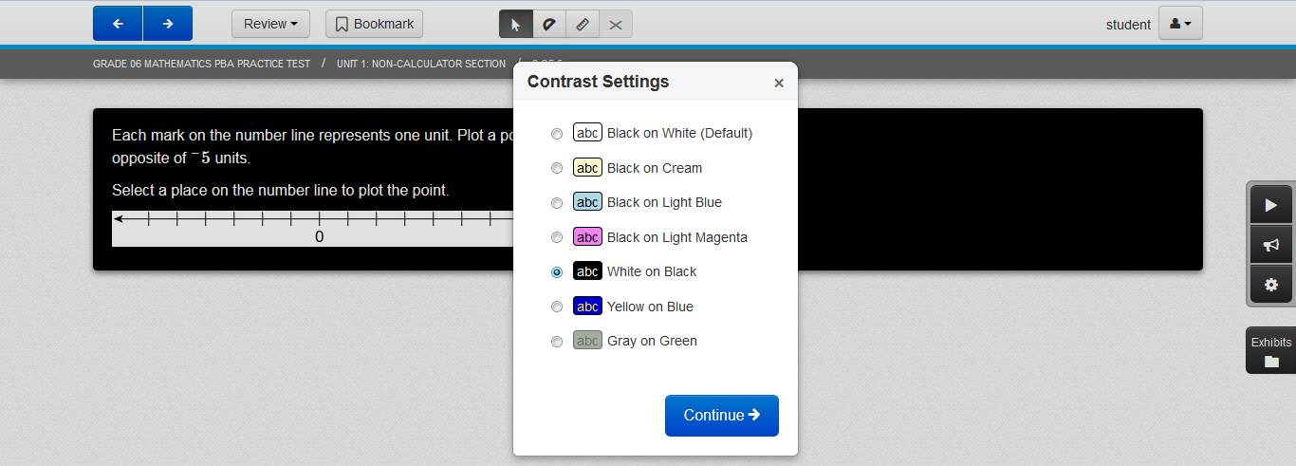
Alternative background/font color
Notes:
Here is an example of how the “Alternative background and font color” accessibility feature is used. The student can change the color of the computer screen to match any of the combinations shown in the dropdown menu. There are seven color settings that can be set or reset by the student. This feature can benefit students with visual disabilities, but must be designated in the student’s Personal Needs Profile so it will be available to the student when he or she takes the computer-based test.

Slide 6
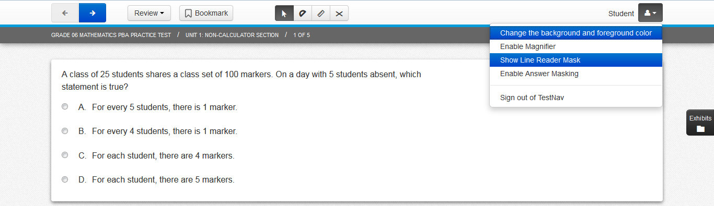
Line Reader
Notes:
The “Line Reader Tool” looks like this. It’s a gray box with a clear window that allows the student to focus on one line of text at a time and limit distractions from surrounding text. A student may turn it on and off by selecting the icon shown on the screen. The student can adjust the size of the box and the width and height of the reading line, and can move the line reader to different parts of the screen.

Slide 7
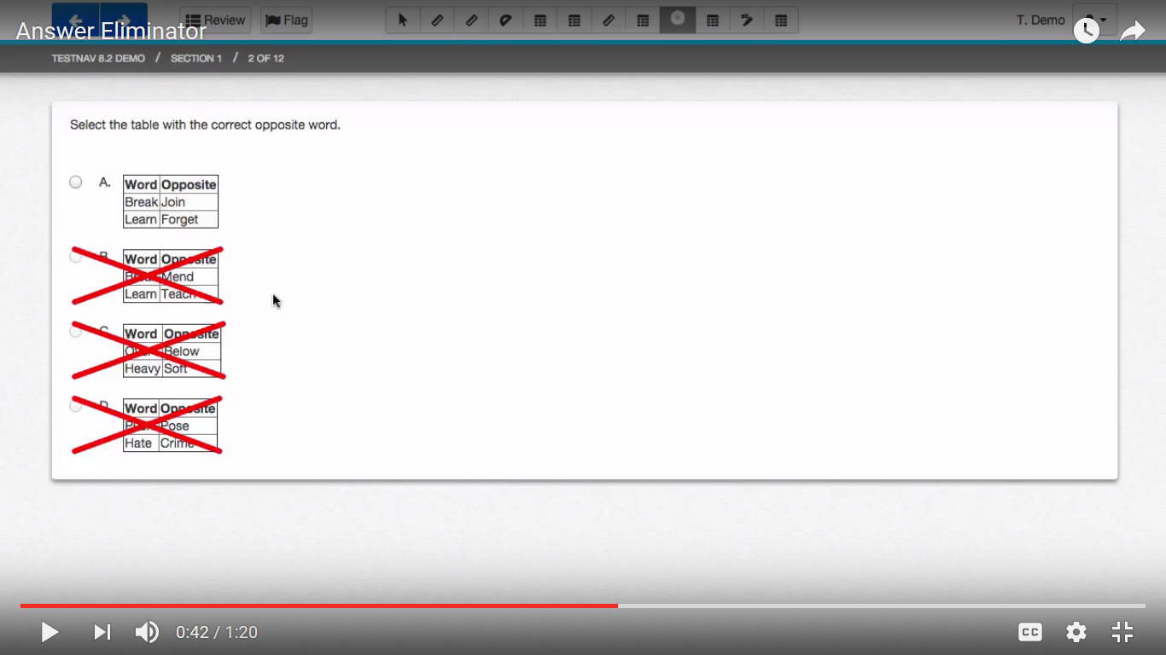
Answer Eliminator
Notes:
The Answer Eliminator looks like this. Students can use the icon on the screen to turn the answer eliminator on and off. Students can “X” out the answer options they believe are incorrect. This tool helps students keep track of which answers they thought were wrong and to narrow down the list of reasonable responses. Students taking the paper-based test can also use an “X” to cross out answer options in the test booklet that they believe are incorrect.

Slide 8
Designated Accessibility Features for any student, at principal’s discretion
Designated Accessibility Features
Small group test administration (up to 10 students)
Individual (one-to-one) test administration
Frequent supervised breaks
Test in a separate location
Familiar test administrator
Seating in a specified area of room, including study carrel
Adaptive or specialized furniture or lighting
Noise buffer/noise-cancelling earmuffs/headphones (no music)
Student reads test aloud to self
Specific time of day
“Stop Testing” policy: If student is not responding to test questions after 15−20 minutes, test administrator may ask if student is finished. If so, collect the student’s test materials. Student may sit quietly or be excused.
8
Notes:
Next, we’ll briefly review the list of Designated Accessibility Features. These features were available in the past only as accommodations for students with disabilities. Now, these features are available to any student, if the principal or his or her designee gives their approval. Most of these features determine where, with whom, and when students will be tested, as well as some other considerations. Please note the state’s “Stop Testing Policy,” which may be especially helpful when testing first-year English learners and some special education students.

Slide 9
Accommodations for Students with Disabilities
Test Presentation Accommodations
Computer-Based | Paper-Based
Paper test, if unable to use computer (PNP) | N/A
N/A | Large print test (PNP)
Screen reader, only for student who is blind or visually impaired (PNP) | Braille test (PNP) (NEW: UEB in grades 3-5; EBAE all other grades)
Text-to-speech for Math and STE or Human read-aloud for Math and/or STE (PNP) | Human read-aloud for Math or STE (PNP)
Human signer for Math, STE, or test questions only for ELA (PNP)
Test administrator helps student track test items
Notes:
The Accommodations listed here are available only to students with disabilities. This slide describes some different ways in which the MCAS test can be presented to the student. The left-hand column shows accommodations for students with disabilities who are taking the computer-based tests; the column on the right shows the equivalent accommodation on the paper-based test. Accommodations that include the “PNP” designation must be listed in the student’s Personal Needs Profile (or PNP). Accommodations must be listed in the student’s IEP or 504 plan to ensure that he or she receives the accommodations to which they are entitled.
Students who are unable to take a computer-based test due to the effects of their disability may take a paper-based test instead, as an accommodation, if this is listed in their IEP or 504 plan.
The “text-to-speech” accommodation will allow a student to listen with headphones to a computer-based version of the test read aloud. The “human read-aloud” is the comparable accommodation for a student taking the paper-based test who needs the test read aloud. Be aware that reading aloud the ELA test is a “special access” accommodation that will be discussed later.
A “screen reader” is intended for use only by students who are blind or have visual impairments and already use a screen reader program such as JAWS or NVDA. The Braille test is an equivalent accommodation for a student who is blind and cannot take the computer-based test.

Slide 10
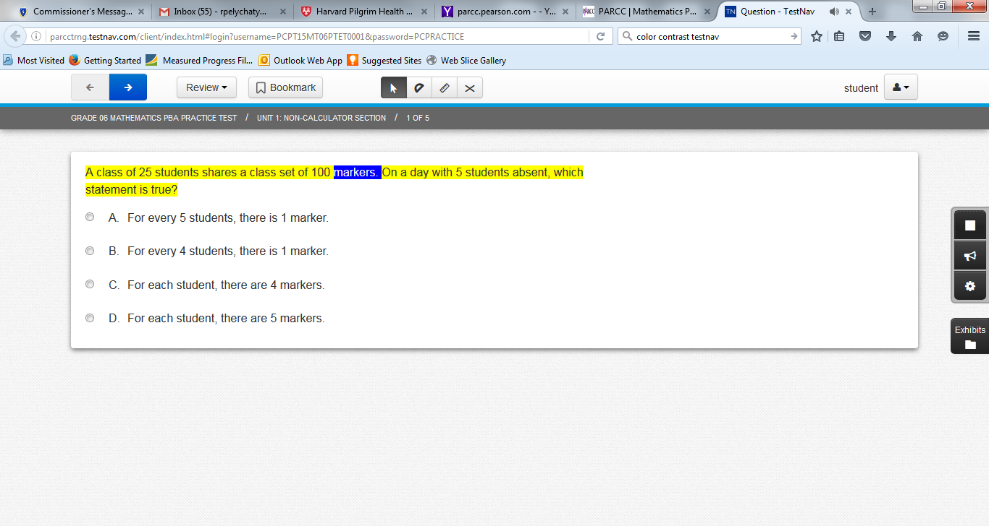
Text-to-Speech
Control Icons
Notes:
Here is what the text-to-speech feature looks like on the computer-based test. The sentence being read aloud is highlighted in yellow; the word being read aloud at the moment is highlighted in blue. The student can control the speed and the volume of the speaking voice using the control icons shown on the display. It is important for students to become familiar with the look and feel of this accommodation before testing begins, if they plan to use it on the test. We strongly encourage students who need this accommodation to take practice tests using the text-to-speech accommodation so they will be familiar with how the text-to-speech accommodation works.

Slide 11
Accommodations for Students with Disabilities (Continued)
Response Accommodations
Computer-Based | Paper-Based
Approved ELA graphic organizer or Math/STE reference sheet (only those developed by ESE for Math and ELA) www.doe.mass.edu/mcas/accessibility/organizers/) (PNP)
Human scribe or external speech-to-text device for Math/STE (Note: 504 plan needed for fractured writing arm) (PNP)
N/A | Answers recorded in test booklet
N/A | Typed responses (PNP) (No transcription necessary)
Monitor placement of test responses
Responses recorded (audio or video), then transcribed by student during playback
Braille writer, note-taker, or refreshable Braille display
Notes:
Response Accommodations change the way in which a student with a disability responds to test questions. For example, typed responses are allowed on the paper-based test; and a scribe can write down the answers dictated by the student.
Another response accommodation is to allow a student with a disability to use a specific approved graphic organizer for the ELA test; or an approved supplemental mathematics reference sheet to answer questions on the mathematics test. Only graphic organizers and reference sheets that have been developed by the Massachusetts Department of Elementary and Secondary Education may be used, and only by a student with a disability who has this accommodation listed in their IEP or 504 plan. It is not permissible to add any text or graphics to these approved ELA graphic organizers or supplemental mathematics reference sheets, but schools are permitted to remove any graphics or text from the existing sheets; or they can use an ELA graphic organizer of their choosing as long as it does not contain any text. Department-approved graphic organizers and reference sheets may be downloaded from the site shown on this table, and have been designed especially to assist students in responding to questions on the next-generation MCAS tests. Schools may no longer submit their own individualized mathematics reference sheets or ELA graphic organizers for Department approval. However, it is possible for a school to request approval for the use of a customized STE reference sheet, which must be submitted for approval prior to testing. The use of this accommodation is collected in each student’s PNP.

Slide 12
Special Access Accommodations for Students with Disabilities (formerly called Nonstandard)
Special Access Accommodations
Computer and Paper
Text-to-speech/Human reader for ELA (PNP)
Signing the ELA reading passages (PNP)
Scribe responses (or speech-to-text device) for ELA (PNP)
Calculator or mathematics manipulatives on non-calculator session of Math or grades 5 and 8 STE tests(PNP)
Spell-checker for ELA (PNP) (Note: automatic accessibility feature for grades 5 & 8 STE tests, but not Math, in 2018)
Word prediction for ELA (PNP)
12
Notes:
Special Access Accommodations, formerly known as “nonstandard accommodations,” are used by a small number of students with disabilities on specific MCAS tests. They are called “special access” because they change part of what the test is designed to measure, and therefore should be used only by a very small number of students who meet certain guidelines. Eligibility to receive these accommodations is limited to students who are severely limited or prevented from performing the skill in question; such as a student who is virtually unable to calculate, write, read, or spell. Teams must carefully review the criteria described for each special access accommodation listed in the Accessibility and Accommodations Manual before designating these for students, and may consult with Department staff beforehand.
All Special Access Accommodations must be included in the student’s Personal Needs Profile, or PNP.

Slide 13
Accommodations for ELLs (EL)
ELL Accommodations
Paper-based test (PNP) (only for a first-year ELL who is unfamiliar with technology)
Approved Bilingual Word-to-Word Dictionary or Glossary
Text-to-speech/human reader for Math and STE (in English) (PNP)
Scribe for Math and STE (PNP)
Read aloud/repeat/clarify test directions in student’s native language, if native language speaker is available
Notes:
The accommodations listed in this table are intended for students who were reported as English language learners in the Student Information Management System (or SIMS). First-year ELLs with low levels of English proficiency may take a paper-test, instead of a computer-based test, if they are unfamiliar with the use of technology. Several other accommodations are allowed for English learners, and the use of approved bilingual word-to-word dictionaries is also allowed for former ELLs.
Please take a minute to review this list of accommodations available to ELLs, whether they have a disability or not.

Slide 14
Special (Accommodated) Test Forms
The following test forms are available as an accommodation for grades 3−8 and must be requested in the student’s Personal Needs Profile (PNP):
Computer-based test
Text-to-Speech (digital read-aloud, requiring headphones)
Screen reader (for a student who is blind or visually impaired; used in conjunction with a hard-copy Braille test)
Compatible Assistive Technology (see Guidelines for Using Assistive Technology as an MCAS Test Accommodation)
Paper-based test
Large print
Braille (UEB in grades 3−5; EBAE in all other grades)
Notes:
The special test forms listed on this slide are available as accommodations for students with disabilities. Please take a minute to review the list of accommodated forms.
For computer-based tests, in grades three through eight, text-to-speech screen reader, and Assistive Technology forms are available.
For paper-based tests, in grades three through eight, large print and Braille forms are available. Please note that Unified English Braille tests will replace European Braille American Edition tests in grades 3 through 5.

Slide 15
Assistive Technology (AT)
Students may use assistive technology (AT), when it is listed in their IEP or 504 plan; for example:
Word prediction software
Speech-to-text programs
Adapted keyboard, mouse, screen enlargement
There are two categories of assistive technology:
Compatible technology that interacts directly with TestNav, the computer-based MCAS testing platform.
External technology that does not interact with TestNav
Requires a second computer station not directly connected to TestNav
May require test administrator to facilitate transfer of information from external station to computer used for assessment.
Internet access should be disabled or restricted during testing.
Notes:
Students with disabilities may use their familiar assistive technology to participate in next-generation MCAS tests if the specific technology is already listed in the student’s IEP or 504 plan. Assistive technology can include word prediction or speech-to-text programs; adaptive keyboards or mouse; and screen enlargement devices.
There are two kinds of assistive technology that can be used to take the test. One is an assistive technology program that is compatible with TestNav, the computer testing platform. Compatible programs are those that function within TestNav during the computer-based test. In that case, “Assistive Technology” must be requested in the PNP to ensure that the correct form of the test is provided to the student. A list of compatible assistive technology programs is listed on the “Guidelines for Using Assistive Technology as an MCAS Test Accommodation” available on the Department’s website.
Other assistive technology programs may not be compatible with TestNav and are therefore considered external technology that does not interact with TestNav. These will require another nearby computer station that includes the assistive technology program or device that is not connected to the computer that uses TestNav. A test administrator may need to help the student transfer the information from the additional computer to the actual computer-based test. Schools should plan in advance for test administrations that will use assistive technology, and try these out beforehand using practice tests. It will also be important to make sure the student using assistive technology cannot access the Internet during testing.

Slide 16
Test Preparation
Students should become familiar with features and basic functionality of TestNav, the computer-based testing platform.
View student tutorials at mcas.pearsonsupport.com
Take online practice tests prior to test administration on TestNav.
Test coordinator should review IEPs, 504 plans, and any forms used to document MCAS accommodations for ELL students (sample found in the Accessibility and Accommodations Manual).
Schedule testing for these students accordingly.
Notes:
Test preparation is an important part of performing well on the next-generation MCAS tests, particularly on the computer-based test. Educators should plan time to allow students to become familiar with the basic operation of the computer-based testing platform, called “TestNav.”
One way to prepare students, is to view the Student Tutorial on the mcas.pearsonsupport.com web page. The Student Tutorial provides students with an interactive experience on how to use the various tools, screens, and commands in TestNav.
Another way to prepare students for the test is to have them take practice tests. The online practice tests will expose students to the types of test questions that will be asked on the next-generation MCAS tests.
Be sure that students’ accommodations are documented in their IEPs and 504 plans, and that the test coordinator is aware of which students will receive which accommodations on the day of the test. Tests results may be invalidated if students receive the incorrect accommodation, or if they do not receive the accommodations listed in their plan.
It is also important to document accommodations for English language learners. You can use the sample “Documentation of MCAS Accommodations for an ELL Student” found in the appendix of the Accessibility and Accommodations Manual.

Slide 17
Student Registration/ Personal Needs Profile (SR/PNP)
The function of the SR/PNP is to:
enroll students for each test, regardless of computer- or paper-based testing
order special test forms, and
collect information on selected accommodations.
Consult the Guide to the Student Registration/Personal Needs Profile (SR/PNP) and the Student Registration/Personal Needs Profile module for this year’s process and directions for importing the SR/PNP file.
Notes:
An online student registration system is used to register students for the next-generation MCAS, including an accommodation tracking system called the Personal Needs Profile, or PNP. This system is used for enrolling students for computer- and paper-based tests, for requesting accommodated test forms, and for reporting the use of certain selected accommodations.
More information on the process for reviewing and revising student information in the PNP is found in the Guide to the Student Registration/Personal Needs Profile (SR/PNP) at mcas.pearsonsupport.com/manuals/ under the “Test Admin Guidance” drop-down or the Student Registration/Personal Needs Profile training module found at mcas.pearsonsupport.com/training/.

Slide 18
SR/PNP: Request Special Forms and Report Selected Accommodations
Special Test Forms
Text-to-Speech
Large Print Test Edition
Braille Test Edition
Screen Reader Edition
Compatible Assistive Technology
Selected Accommodations
Human Read Aloud as a Standard Accommodation
Human Read Aloud as a Special Access/Non-Standard Accommodation
Human Signer as a Standard Accommodation
Human Signer as a Special Access/Non-Standard Accommodation
Human Scribe as a Standard Accommodation
Human Scribe as a Special Access/Non-Standard Accommodation
Speech-to-Text as a Standard Accommodation
Speech-to-Text as a Special Access/Non-Standard Accommodation
Graphic Organizer/Reference Sheet
Typed Responses
Calculation Device on Non-Calculator test Session(s)
Spell-Checker (ELA only)
Word Prediction
Any Other Accommodation Not Listed Above
Accessibility Features
Answer Masking
Alternative
Background
and Font Color
Notes:
Shown here is an example of the Manage Student Test screen which is part of the Student Registration/Personal Needs Profile, or SR/PNP. Schools can use the Manage Student Test screen to change or add an accommodation, request a special test form, or activate an accessibility feature for a student. The Manage Student Test screen may vary depending on the test. For example, the Calculation Device accommodation would only appear on the screen for the Mathematics test.
Check the list of features and accommodations carefully, and refer to the document entitled Guide to the Student Registration/Personal Needs Profile (SR/PNP) for information on how to access and complete the Manage Student Test screen.

Slide 19
Resources
Resources
Support and Assistance
mcas.pearsonsupport.com
MA Department of Elementary and Secondary Education – MCAS Accessibility and Accommodations
www.doe.mass.edu/mcas/accessibility/
Office of Student Assessment
mcas@doe.mass.edu
Notes:
Thank you for taking the time to view this module.
Please use the available resources at mcas.pearsonsupport.com and on the Department’s MCAS Accessibility and Accommodations web page for additional information and assistance.

