Slide 1
MCAS Grade 10 ELA
Early Release Conference Call
Office of Student Assessment Services
April 29, 2019

Slide 2
Presenters
Bob Lee, MCAS Chief Data Analyst
Scott Kelley, Reporting Specialist
Jodie Zalk, MCAS Test Coordinator

Slide 3
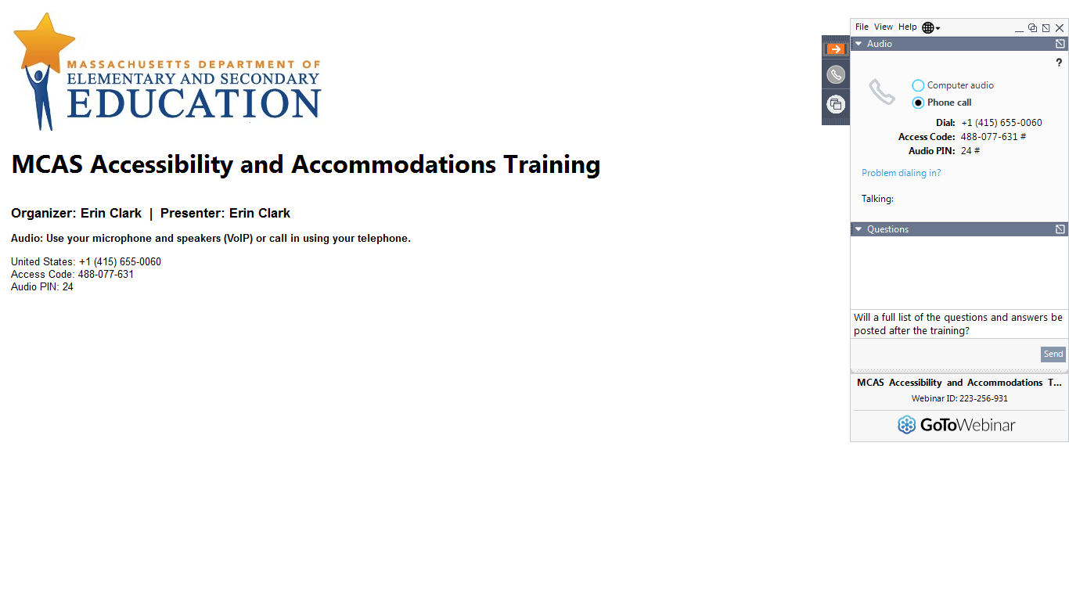
Logistics for This Session
Questions may be asked at any time using the Questions feature on the GoToWebinar screen.
  Questions about a specific student should be sent by email to mcas@doe.mass.edu.
  We will take breaks to answer questions during the session.
  After the session, we will email questions and answers to participants.
This session is being recorded and will be available online in about one week at the MCAS Resource Center.
  In the section entitled “Training Sessions Previously Offered This School Year”

Slide 4
01
What is (and is not) included in the MCAS Early Release?
02
Demonstration: Opening your data
CONTENTS
03
Preliminary Reporting Schedule
04
Resources and support
05
Questions

Slide 5
What is (and is not) included in the MCAS Early Release?
01

Slide 6
What is available in this file
Included
Not Included
Machine-scored results: 21 selected-response and multiple select items; 7 two-point items
Results for 68,900 students taking Grade 10 ELA online
Raw scores (0-35 points)
Essay results: 2 prompts; 16 points
Results from paper-based tests, alternate assessments and records for absent students
Scaled scores, achievement levels, pass/fail determinations, growth scores

Slide 7
Grade 10 ELA Early Preliminary Reporting in PearsonAccess^{next}
Who has access? Superintendents, principals, and district and school test coordinators. Others may be added by assigning the “Published Reports” user role in PAN.
What is available?
CSV file of machine-scored results for students who took the Spring 2019 ELA MCAS online.
Student roster of machine-scored results showing item scores, reporting category earned points, total points, percent possible points, not tested reason and void flag (if appropriate).
Where is it posted? Only available in PearsonAccess^{next} in Reports>Published Reports until August. Preliminary results for all tests except high school STE are scheduled for release to dropboxes on July 24. No scaled scores or student growth.

Slide 8
Grade 10 ELA: Essay Prompt for The Underground Railroad
Essay Prompt–FAQs
What happened?
The essay prompt was voided on March 30th after some students reported their concerns about the question. Students participating in make-up testing after March 30 were instructed to skip this question.
What were students asked to do on the prompt?
http://www.doe.mass.edu/mcas/2019/release/g10ela-voidedessay.pdf
Will scores from the essay be available?
No. Students will receive scores from the remaining two essays next month along with the 35 points worth of test questions released today.
Does this affect the rest of the test?
The Department is working with independent researchers to establish whether the essay prompt impacted student performance on other questions and passages. These studies will be completed this summer.

Slide 9
Early Reporting Dates and Items Available in PAN*
Round 1: Machine-Scored CBT Items Only
  Grade 10 ELA: April 29
  Grades 3–8 ELA: May 20
  Grades 3–8 Mathematics: June 6
  Grades 5 & 8 STE: June 6
  Grade 10 Mathematics: June 20
Round 2: Hand- and Machine-Scored Items (CBT & PBT Items)
  Grade 10 ELA: May 29
    Includes released essays in PAN
  Grades 3–8 ELA: July 1
    Includes released essays in PAN
  Grades 3–8 Mathematics: July 1
  Grades 5 & 8 STE: July 1
  Grade 10 Mathematics: July 8
* All dates tentative

Slide 10
Round 1 CBT Machine-Scored Items in the .CSV File in PAN
Item-level results for Grade 10 ELA
  One row per student
  Points earned for each machine-scored item
  Student’s total raw score; possible raw score; raw score percent correct
  Blanks: no response on machine-scored item; essays not yet scored
Reporting Category results
  RepCat1: Reading raw score for machine-scored items
  RepCat2: Language raw score for machine-scored items (essay Conventions not yet scored)
  RepCat3: Writing (Idea Development) raw score‒not yet scored

Slide 11
What proportion of the MCAS is available through early release?
Subject/Grade | Machine Scored Items Round 1 |  |  |  | Hand Scored Items Included in Round 2
ELA grade | One-Point Selected Response | Two-point Selected Response | Machine Scored Points | Percent Machine Scored | Constructed Responses | Essays | Hand Scored Points | Percent Hand Scored | Total Raw Score Points
3-4 | 15-21 | 3-6 | 27 | 61% | 1 (3 pts.) | 2 (7 pts.) | 17 | 39% | 44
5 | 15-21 | 3-6 | 27 | 56% | 0 | 3 (7 pts.) | 21 | 44% | 48
6-8 | 15-21 | 3-6 | 27 | 53% | 0 | 3 (8 pts.) | 24 | 47% | 51
10 | 21-27 | 4-7 | 35 | 69% | 0 | 2 (8 pts.) | 16 | 31% | 51
Math grade | One-Point Items | Two-Point Items | Machine Scored Points | Percent Machine Scored | Constructed Response | N/A | Hand Scored Points | Percent Hand Scored | Total Raw Score Points
3 | 36 | 0 | 36 | 75% | 4 (3 pts.) |  | 12 | 25% | 48
4-8 | 34 | 2 | 38 | 70% | 4 (4 pts.) |  | 16 | 30% | 54
10 | 32 | 6 | 44 | 73% | 4 (4 pts.) |  | 16 | 27% | 60
STE grade | One-Point Items | Two-Point Items | Machine Scored Points | Percent Machine Scored | Two-Point Constructed Response | Three-Point Constructed Response | Hand Scored Points | Percent Hand Scored | Total Raw Score Points
5 & 8 | 32 | 3 | 38 | 70% | 2 | 4 | 16 | 30% | 54

Slide 12
Legacy vs. Next-Generation Grade 10 ELA Test Design
Legacy Grade 10 ELA Test Design
Next-Generation Grade 10 ELA Test Design
Item Type | Number of questions | Points Possible | Composition Points Breakdown |  | Percent of Total Points
 |  |  | Topic Development | Composition Conventions
One-Point Multiple Choice | 36 | 36 | n/a |  | 50%
Four-Point Open Response | 4 | 16 | n/a |  | 22%
Composition | 1 | 20 | 12 | 8 | 28%
Total | 41 | 72 |  |  | 100%
Item Type | Number of questions | Points Possible | Essay Points Breakdown |  |  | Percent of Total Points
 |  |  | Idea Development | Standard English Conventions
One-Point Selected Response | 21-27 | 21-27 | n/a |  |  | 41%–53%
Two-Point Multiple Select/Tech. Enhanced | 4-7 | 8-14 | n/a |  |  | 8%–14%
Essay | 2 | 16 | 10 |  | 6 | 31%
Total | 31 | 51 |  |  |  | 100%

Slide 13
Equipercentile linking model for establishing the interim CD standards for the Classes of 2021 & 2022 (ELA example)
%

Slide 14
2019 Grade 10 Early Release: Quick stats
Students averaged 79% correct on the 28 items
  Item averages ranged from 59-93% correct statewide
Raw Score | Percentile | % correct
11 | 3rd | 31%
18 | 10th | 51%
25 | 26th | 71%
30 | 52nd | 86%
33 | 81st | 94%
34 | 91st | 97%
35 | 97th | 100%
Grade 8 2017 ELA Achievement Level (including essays) | Grade 8 Scaled Score Range | Grade 10 Prelim. Raw Score Avg. | Range (68% raw score range)
Exceeding Expectations | 530-560 | 32.9 | 31-35
Meeting Expectations | 500-529 | 31.1 | 29-34
Partially Meeting Expectations | 470-499 | 26.4 | 21-31
Not Meeting Expectations | 440-469 | 17.8 | 12-24

Slide 15
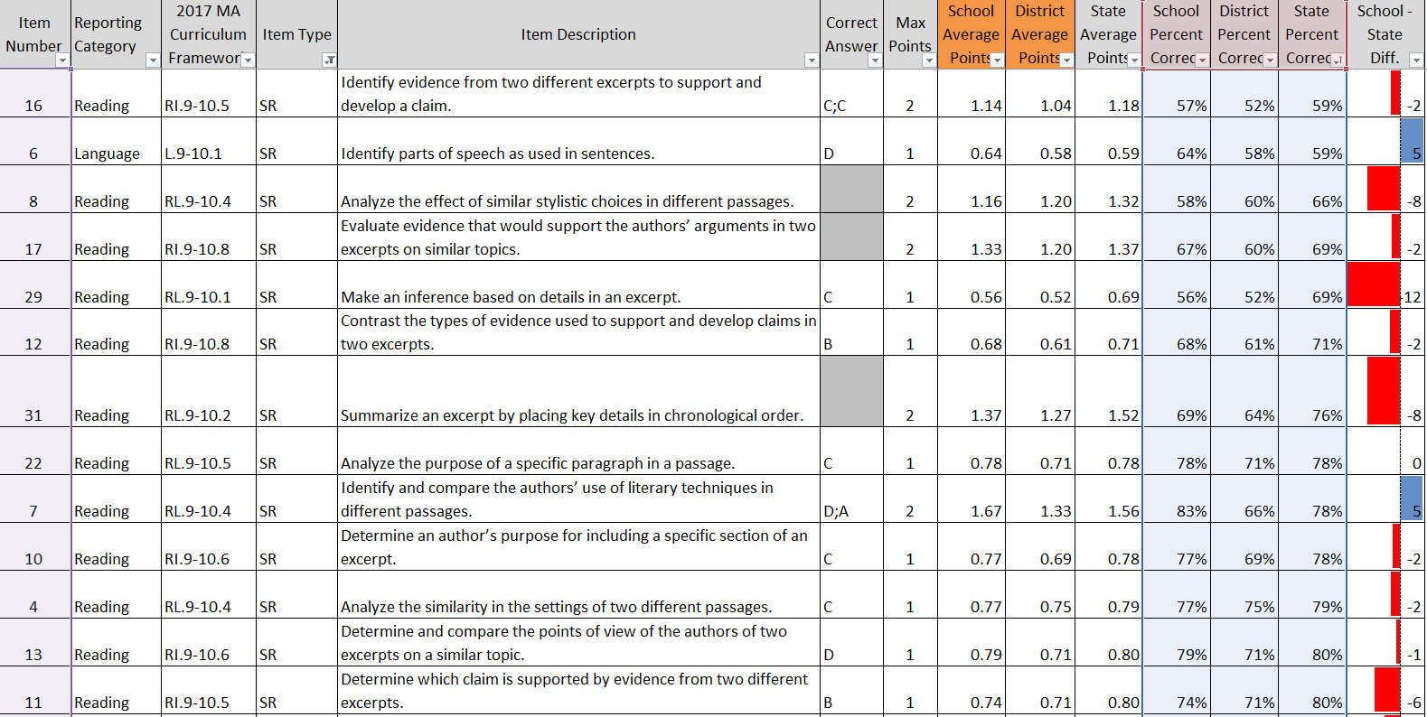
Using the item analysis template (from PAN)

Slide 16
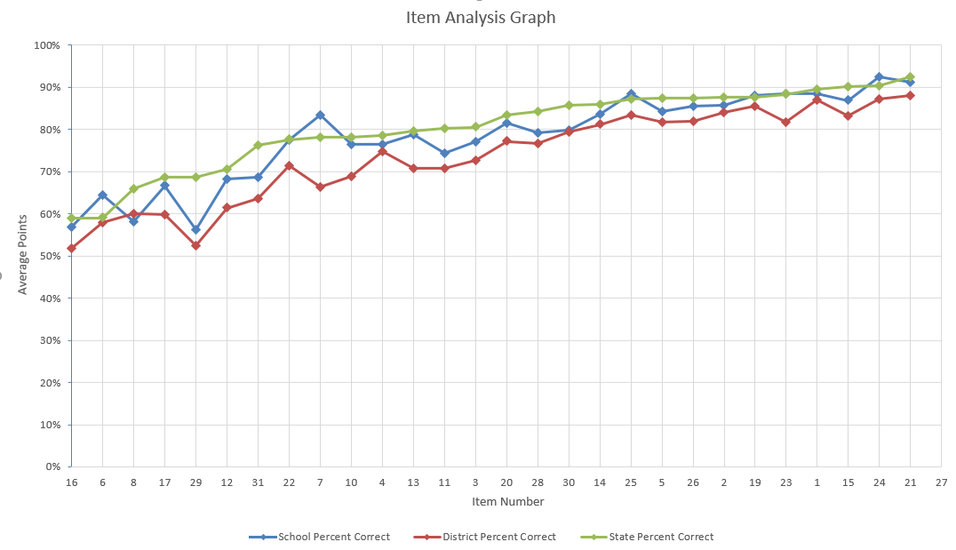
Using the item analysis template: pre-formatted graph

Slide 17
Demonstration:
Opening your data &
using the Item Analysis Templates
02

Slide 18
Supporting Resources
Excel Template: Statewide item information and item level results State average points and percent correct per item (item difficulty) available:
    PearsonAccess^{next} in Support>Documentation (available 4/30)
Grade 10 ELA released items are available on the MCAS Resource Center.
    http://mcas.pearsonsupport.com/released-items/
    Includes all items and item descriptions for grade 10 ELA operational items

Slide 19
Recap of steps for loading data into templates
1. Download your CSV file from PANext
  Insert blank rows at the top; note the last row of data in the file
Enter the subtotal formula: =Subtotal(1, cell range) in one of the blank cells above RawScore (cell range is all records)
  Copy the subtotal formula to the row above the reporting categories and items
Set filters to remove void and not tested records; filter by school if you are a district user
Copy item subtotals from the CSV to the template using “Paste Special” with “values” and “transpose” selected.

Slide 20
Preliminary Data Considerations
Results have not been filtered; all students who earned at least one point have been included
  The following results will not be included in official results:
  1. First year ELs
  2. Students who participated in one session
  3. Void, security breach, students who moved during testing

Slide 21
Preliminary Reporting Schedule
03

Slide 22
Using Preliminary Results
Data Are Embargoed
Use preliminary results for educational planning purposes only
Don’t share aggregate results outside your organization
Compare School/District Scores to State Averages
Differences indicate areas of relative strength & weakness among student groups
Only students tested at your school/district are included; outplaced & transfer students will be correctly reported in August with full preliminary results
Identify Potential Discrepancies
Report missing tests to the MCAS Service Center
Retain potential discrepancies such as SASID changes until discrepancy reporting period (late July)

Slide 23
Other Tentative Reporting Dates
Late July-Early August: Preliminary Results, Discrepancy Reporting–all Grades & Subjects (no scaled scores or growth)
  .csv files and rosters in DropBox; Edwin Analytics approximately 1 week later
  Discrepancy review and reporting period July 24–August 6
Late September:
  Parent/Guardian Reports delivered to districts
  Official results posted

Slide 24
Resources and Support
04

Slide 25
Resources Available
MCAS Resource Center (http://mcas.pearsonsupport.com/)
  Training page (modules and sessions previously offered):
  http://mcas.pearsonsupport.com/training-modules/
Manage Online Tests in PAN (https://support.assessment.pearson.com/display/PAsup/Manage+Online+Tests)
PAN User Guide (https://support.assessment.pearson.com/display/PAsup/PearsonAccess+Next+Online+User+Guide)

Slide 26
Email and Phone Support
MCAS Service Center
DESE Office of Student Assessment Services
All questions on logistics and technology (e.g., PearsonAccess Next, SR/PNP, TestNav)
  Web: mcas.pearsonsupport.com/
  Email: mcas@measuredprogress.org
  Phone: 800-737-5103
All policy questions (e.g., student participation, accommodations)
  Web: www.doe.mass.edu/mcas
  Email: mcas@doe.mass.edu
  Phone: 781-338-3625

Slide 27
Next Steps
Today: Complete the evaluation form.
  Responses associated with the name and email address used to log in
  Email your input to mcas@doe.mass.edu if you have problems accessing or completing the form.
Later this week/early next week:
  Receive an email with the Q&A from this session
  Recording will be available

Slide 28
Answers to Your Questions
05

Slide 29
Questions & Answers
(Use the “Questions” feature
to ask questions or to request any demonstrations in
PearsonAccess Next.)

Slide 30




THANK YOU
The Office of Student Assessment Services
781-338-3625
mcas@doe.mass.edu
www.doe.mass.edu/mcas
75 Pleasant Street, Malden, MA 02148

